Slide 1
Service Provider “Status” Extensions for Dynatrace
Developed by RFD & Associates, Inc.

Slide 2
Status Extensions
Intended to integrate incident identification by your service providers into your Dynatrace environment
Will impact either your application (AWS & Okta) OR a custom device (Salesforce)
Status extensions aid in causation analysis between data captured through OneAgent and what is reported by the service providers

Slide 3
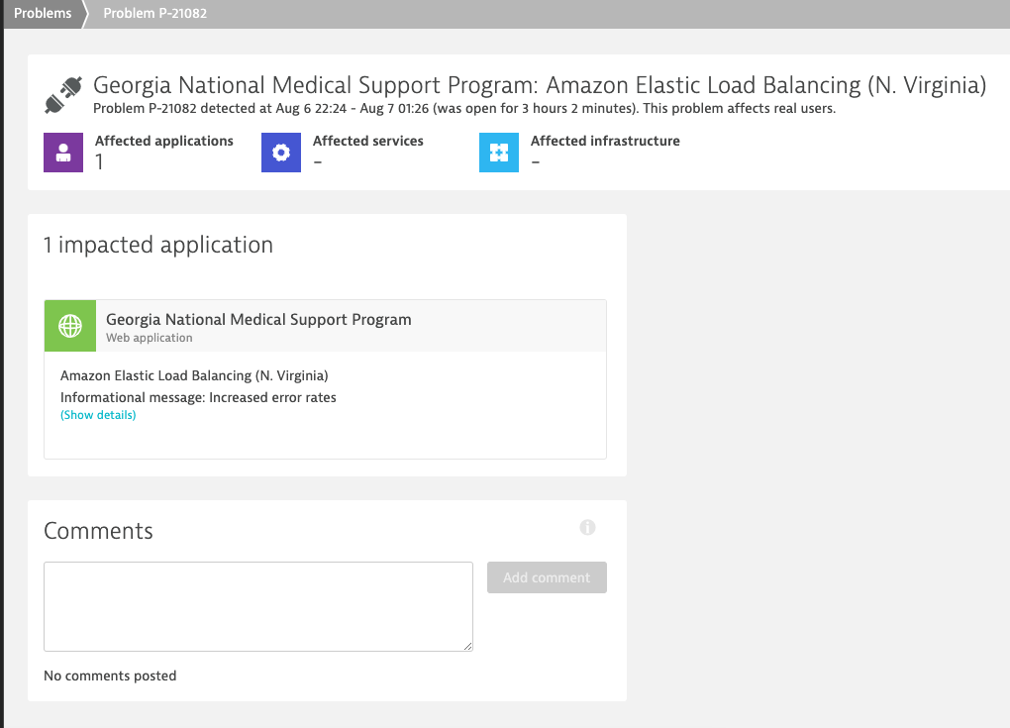
AWS
Uses AWS RSS Status feeds
Problem associated with a defined application
Service and region configurable
Source Code
Service and message reported

Slide 4
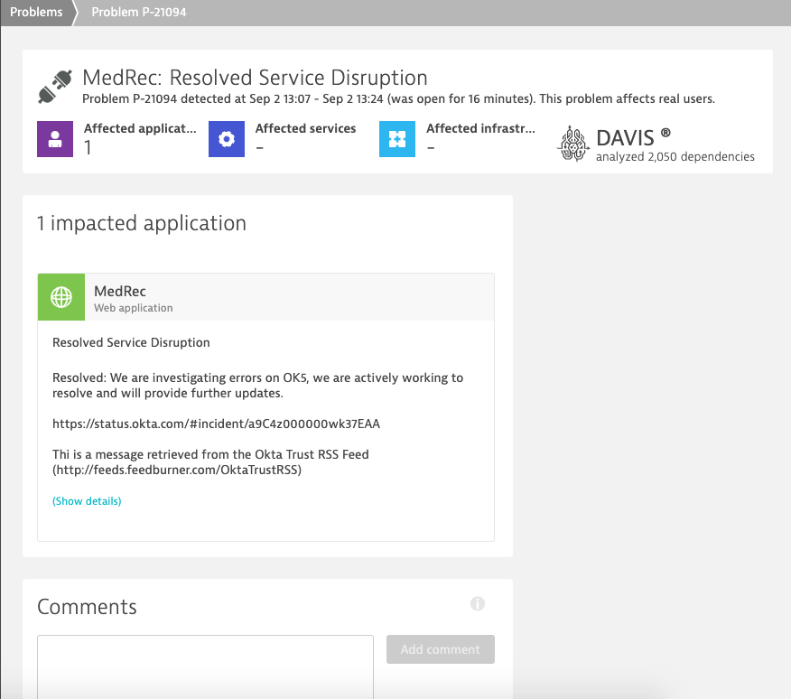
OKTA
Uses Okta RSS Status feeds
Uses tag value on Dynatrace Application for impacted entity
Creates problem card associated with tagged application in Dynatrace when issues detected
Source Code
Message with link back to identified issue

Slide 5
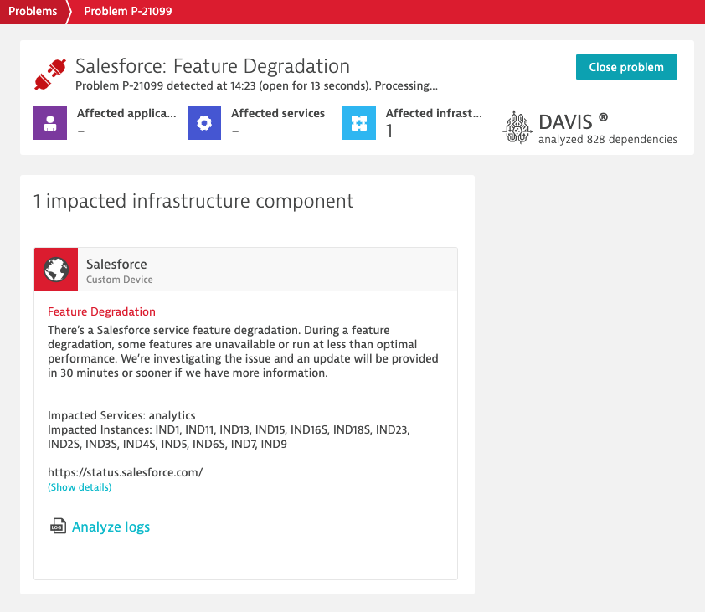
Salesforce
Uses Salesforce Trust API
Creates custom “Salesforce” device in Dynatrace
Problem card created in Dynatrace when issues reported by Salesforce
Allows you to filter by Salesforce instances.
Source Code
Issue identified and message
Service and instances impacted

