Slide 1
dSim: An MR Diffusion Weighted Imaging Simulator
Bob Dougherty
Shyamsundar Gopalakrishnan
Stanford University
June 13, 2008

Slide 2
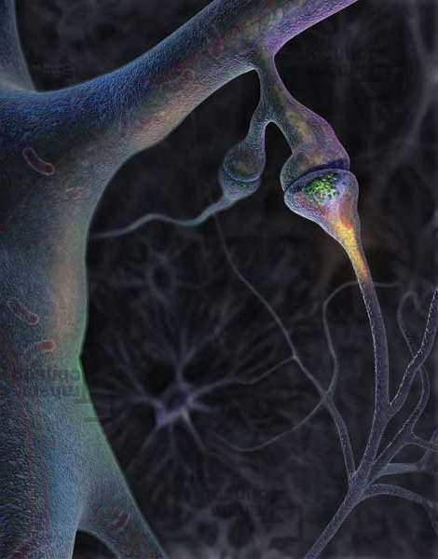
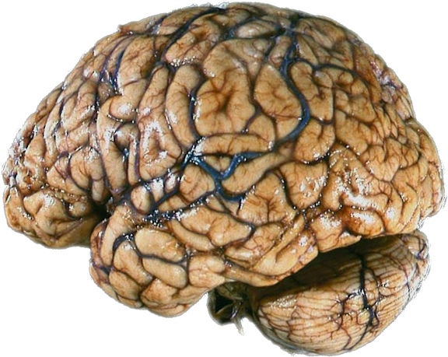
The Brain
Neurons are computational elements
White matter connects the neurons
The connection is called the synapse
Neurons: 10¹¹
Synapses: 10¹⁴
Synapses/neuron: 1000
Surface area of each hemisphere: 25 x 30 cm²
Most connections are local (10-100 um); some span many centimeters
Neurons/mm³: 104-106
Axon length/mm³: 3 km
Francis Crick; Braitenberg and Schutz
Synapse image from Grahm Johnson
Notes:
Image is mine.

Slide 3
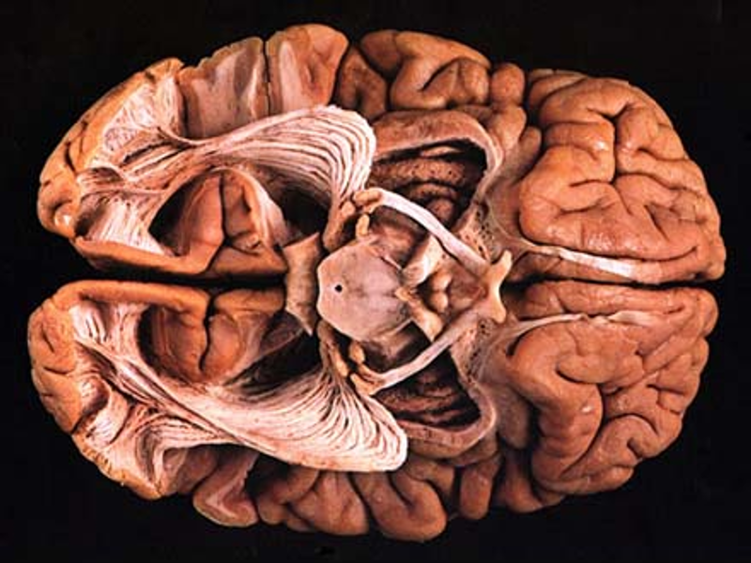
Why You See with the
Back of Your Brain
Brain dissection image from the Virtual Hospital (http://www.vh.org)‏

Slide 4
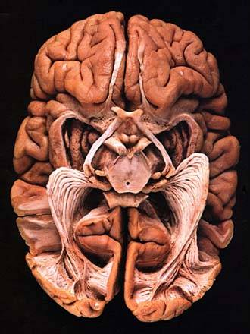
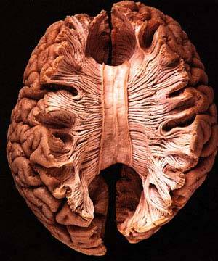
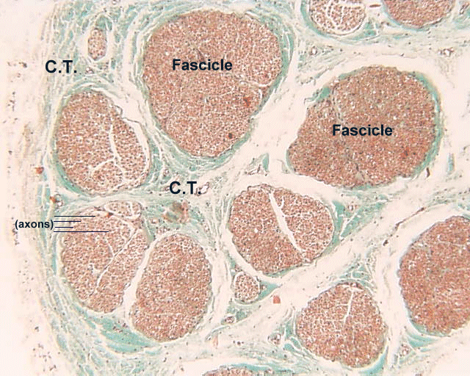
Human Fiber Tracts
From: The Virtual Hospital (www.vh.org); TH Williams, N Gluhbegovic, JY Jew

Slide 5
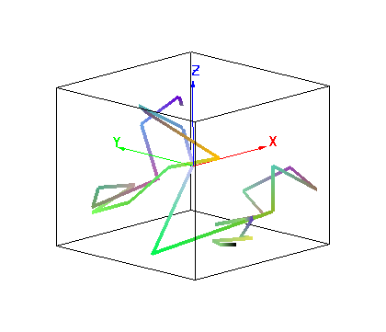
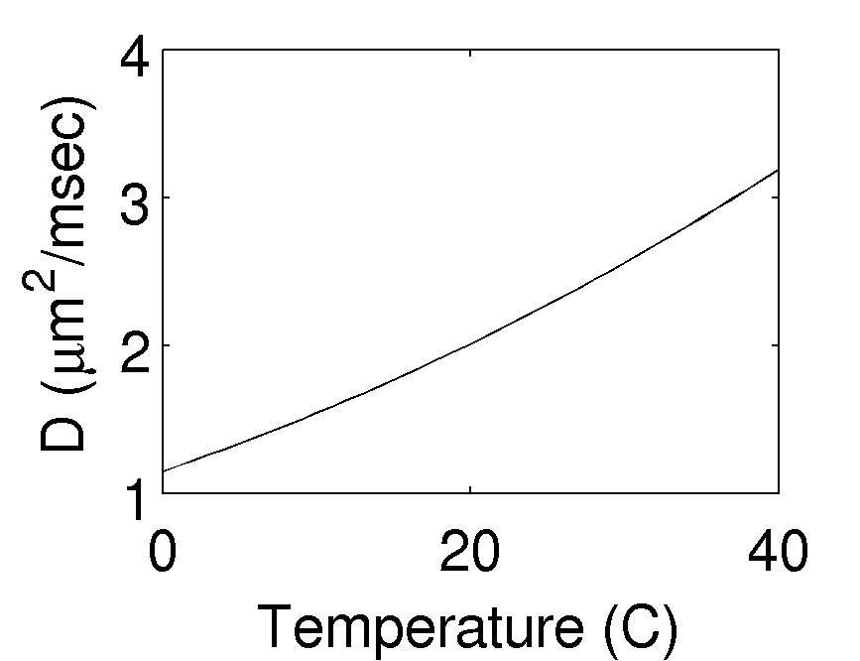
Self-diffusion of Water
Mean-square displacement = 6*D*t
Self-diffusion of water: ~3μm²/msec at 37°C
Described by a random-walk (assuming t is longer than picosecond-range)‏

Slide 6
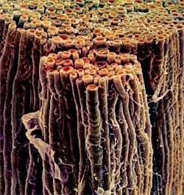
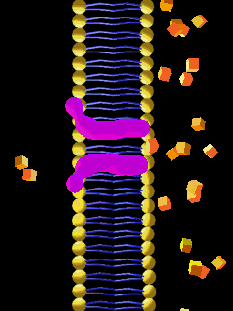
H₂O Diffusion Probes Membrane Properties in the Brain
Axial diffusivity
In regions of high axial coherence, the cytoplasm within the axon limits diffusion and there is a large Apparent Diffusion Coefficient (ADC)‏
Optic nerve fibres
George Bartzokis
Notes:
http://ebiomedia.com/prod/LC/LCenvelope.html

Slide 7
H₂O Diffusion Probes Membrane Properties in the Brain
Radial diffusivity
In all other directions the bi-lipid cell membranes and myelin limit diffusion; perpendicular to the axon the ADC is smaller
Optic nerve fibres
George Bartzokis
Notes:
http://ebiomedia.com/prod/LC/LCenvelope.html

Slide 8
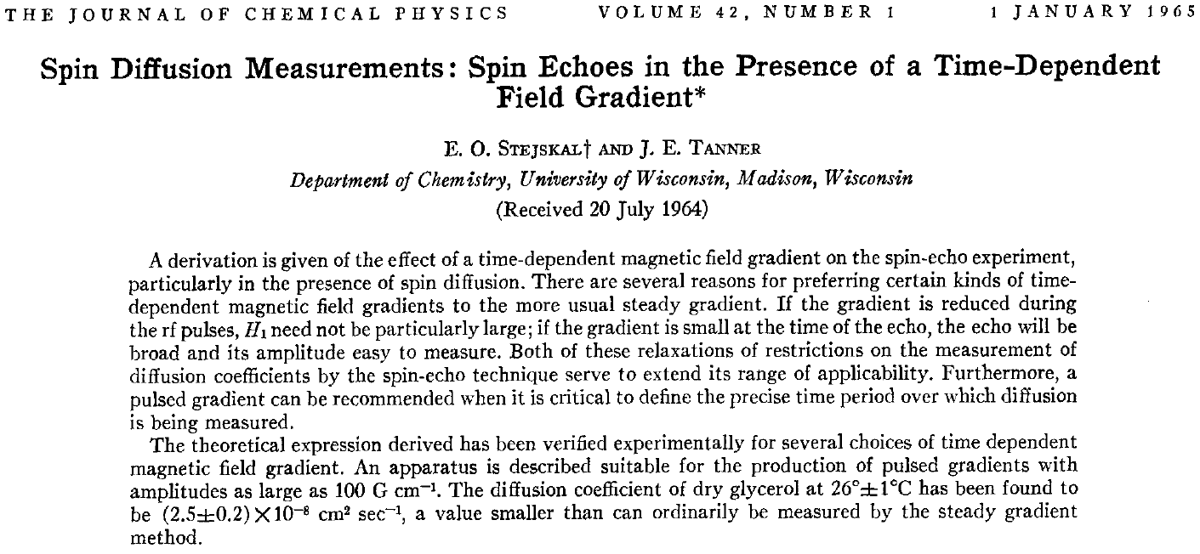
Stejskal-Tanner Equation (NMR)‏
Signal attenuation = exp(-b * ADC)‏

Slide 9
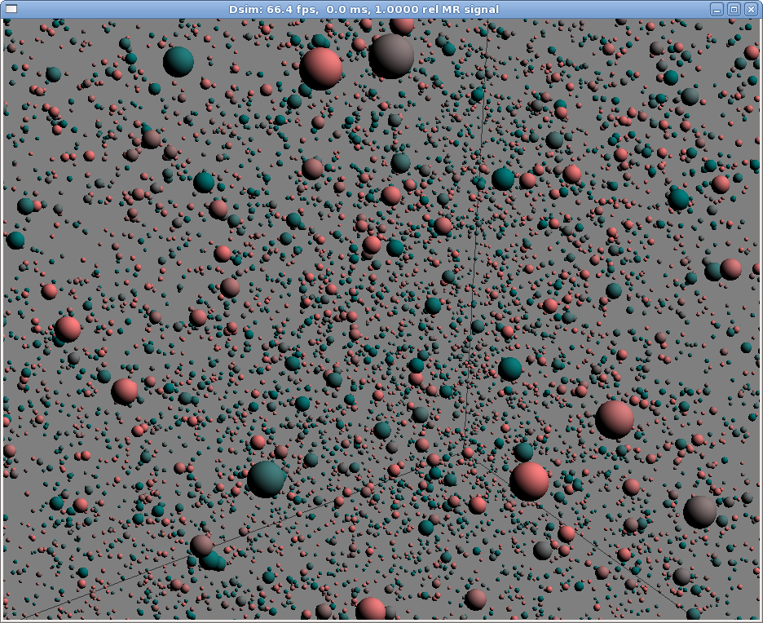
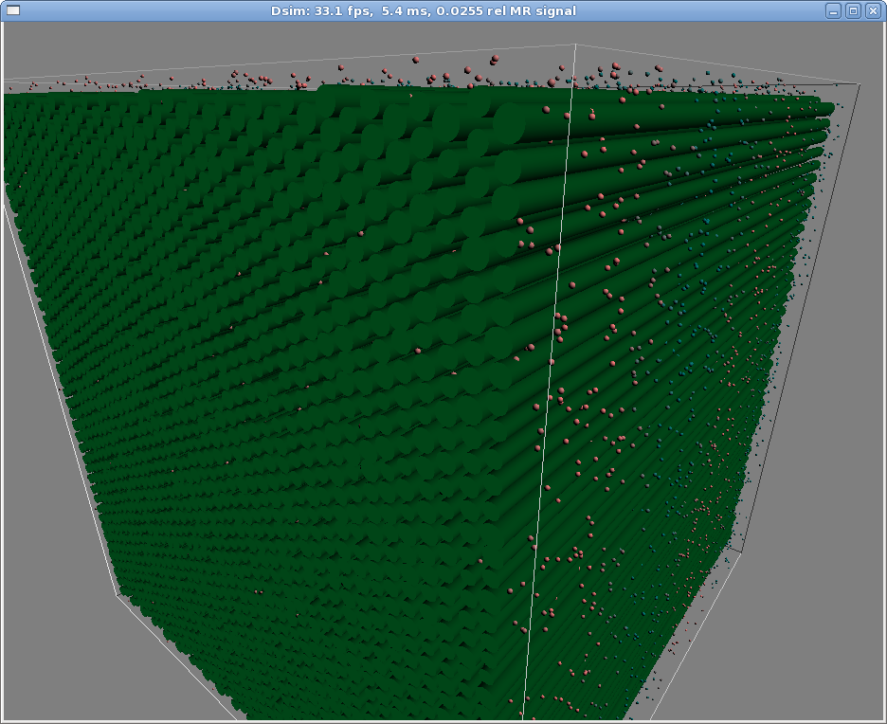
Simulating MR Diffusion Imaging
Simulate diffusion of spins as random walk
Spins interact with axon membranes
Apply DW gradients & measure MR signal

Slide 10
Number of Simulated Spins
A 2mm³ voxel contains ~5.3e+20 spins (Hydrogen nuclei)‏
Of these, only 1.3e+15 produce an MR signal at 1.5T (2x for 3T)‏
We can efficiently model ~1e+5 spins
  But- don't need to model them all
  For simulated tissue structures on the order of 1um, 50k particles is enough

Slide 11
Simulating Diffusion
Spins diffuse with Brownian motion
  Approximated by a random walk with a mean squared displacement of 6*ADC*timestep
    http://en.wikipedia.org/wiki/Random_walk
  x,y & z of displacement vector are drawn from a normal distribution with mean 0 and standard deviation sqrt(2*ADC*timestep)‏
Timestep should be small so displacements probe simulated tissue structures
  0.001 msec -> mean step size = 0.1 μm
Notes:
Why is mean(sqrt(sum( (randn(3,100000)*sqrt(2)) .^2))) <= sqrt(6)?

Slide 12
Pseudo-Random Number Generator
4 PRNGs for each particle at each timestep
  Box-Muller transform- uniform to normal dist.
  3 normal for random walk, 1 uniform for permeation probability
Multiply-with-carry algorithm using 2 32-bit seeds- period >2^60
  From George Marsaglia (1994, sci stat math bb)‏
  Also characterized in Couture & L’Ecuyer (1994, Math. Comput. 62, 799–808)‏
  To do: see Goresky & Klapper (2003, ACM-TMCS) for a simple modification to improve long-period stats

Slide 13
Membrane Interactions
Simulation includes simple tubes arranged with hex-packing
Parameters:
  Tube radius mean and variance
  Tube spacing mean and variance

Slide 14
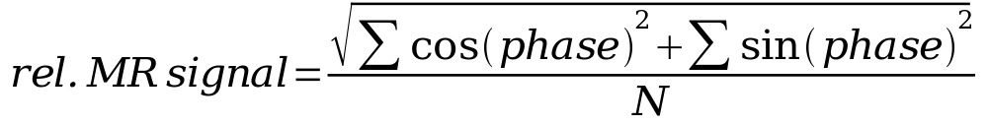
Predicting the MR Signal
Phase shift accumulates on each time step
  G is DW gradient strength
  g is gyromagnetic ratio (42.576 MHz/T)‏
Estimate relative MR signal by summing phases (assume magnitude is 1)‏

Slide 15

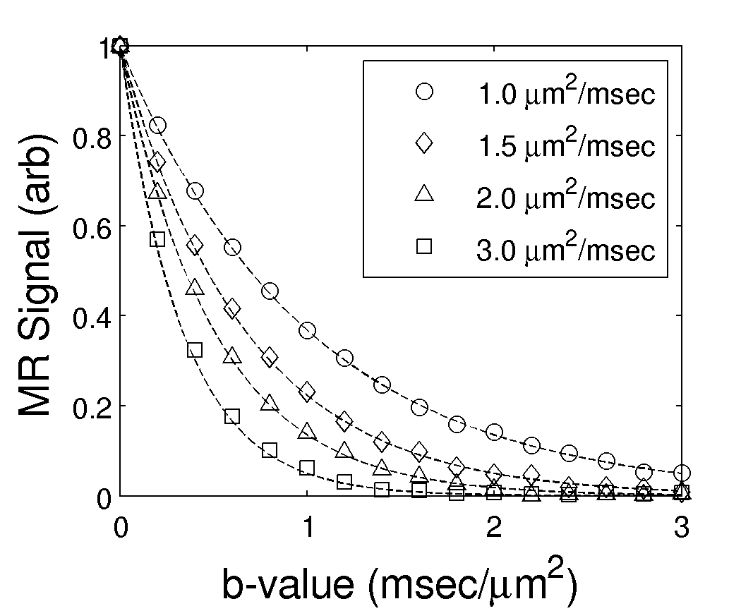
Sanity Check- Signal vs. b-value:
Data match theoretical curves

Slide 16
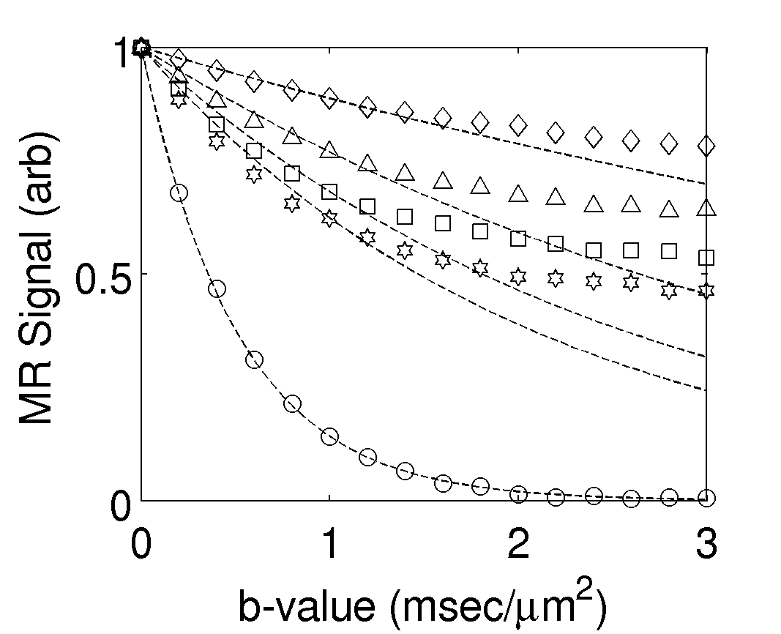
Membrane Interactions:
Bi-exponential pattern for radial diffusion & ADC increases with fiber spacing
0.1μm spacing
0.2μm spacing
0.3μm spacing
0.4μm spacing
to fibers (ADC = 1.96)‏
1um diameter fibers
Particle ADC = 2.0
Constant ADC curves fit to b=1.0
Radial ADCs @ b=1 are 0.12,0.26,0.38,0.47

Slide 17
Uses of the Simulator
What axon properties would cause radial diffusivity differences that we observed in reading development?
Can q-space methods really resolve crossing fibers?
Given fascicle estimates from tractography (e.g. FascTrack), what is the predicted diffusion measurement for each voxel?

