Slide 1
Web API 2 Easy to extend, easy to maintain, easy to implement, flexible, open source.
Damien Bowden,
Ernest Durelle,
Adrian Spycher,
Raphael Felber,
Michael Glaus

Slide 2
Content
What is Web API?
OWIN Middleware
Hosting
Attribute Routing
Media Formatters / e.g. File Up-/Download
OData
Other Features
Advantages/Disadvantages
Demo

Slide 3
What is Web API?
(ASP.NET) Web API is a framework that makes it easy to build HTTP services that reach a broad range of clients, including browsers and mobile devices. Web API is an ideal platform for building RESTful applications on the .NET Framework.

Slide 4
OWIN Middleware
OWIN = Open web interface for .Net
Web API 2 is an OWIN Middleware component.
Can be chained with any other OWIN middleware, for example SignalR or your own…

Slide 5
Hosting
Self-Hosted (OWIN with Katana)
Azure
MVC, IIS Hosting (Update NuGet packages!)
IIS (System.Web, Helios, OWIN Adaptor)
In-Memory (Unit-Testing)

Slide 6

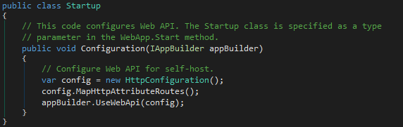


Attribute Routing
Global Routing Configuration
Controller / Action Level
Attribute Routing

Slide 7
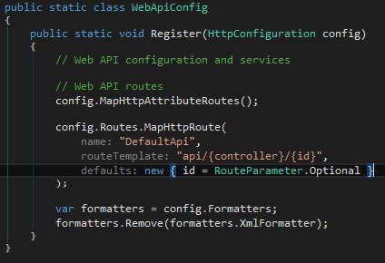
Attribute Routing
Alternative

Slide 8
Media Formatters / e.g. File Up-/Download
Xml
Json
Xlsx
Csv
Protobuf-Net
Custom

Slide 9
OData
Open Data Protocol based on http and using REST methodology
Allows for very flexible client queries
Exposes the IQueryable interface
$stop, $skip, $expand, $select, $orderby, $filter (OData V3)
OData V4 standard also supported (much more functionality)
Can inherit from the ODataController or ApiController

Slide 10
Other Features
IoC / DI / Lifecycle
Filters (Action, Authorisation, Exception…) -> per Attributes, Aspect Oriented
Message Handlers
Batching / e.g. Data Synchronization works, for Web API or Web API OData, single transaction possible for all batch requests, or each request.
Security; uses OWIN security model

Slide 11
Advantages
KISS, flexible
Extensions to the framework are easy
Can reach all clients
Fast, no legacy components
Can be hosted anywhere in .NET
OData V4
Support for any serializations
Open source, very large community
Regular updates, free from .NET release cycle
vNext MVC and Web API come together
WebAPiContrib
Lots of cool NuGet packages for Web API

Slide 12
Disadvantages
Multi-Process transactions missing
No UDP
No full-duplex

Slide 13
Live Self-Hosted Web API ODATA Demo

Slide 14
Questions?

Slide 15
NOSER ENGINEERING AG www.noser.com

