Slide 1
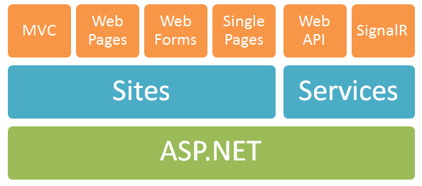
Web API 2
Damien Bowden
Michael Glaus
Raphael Felber

Slide 2
Content
Introduction / Web API != Web
Group Targets
Hosting
IoC / Lifecycle
Filters
Attribute Routing
Media Formatters / e.g. File Up-/Download
ODATA
Message Handlers
Batching / e.g. Data Synchronization
Security
Advantages/Disadvantages

Slide 3
Introduction / Web API != Web
ASP.NET Web API is a framework that makes it easy to build HTTP services that reach a broad range of clients, including browsers and mobile devices. ASP.NET Web API is an ideal platform for building RESTful applications on the .NET Framework.

Slide 4
Group Targets
Workshop in Bern (by Damien)
Workshop E-Days
Technology Input @ Swissqual
Example Application on GitHub
Example Application Server running in Cloud (Azure)

Slide 5
Hosting
IIS
Self-Hosted
Azure
Self-Hosted Example
Azure Example

Slide 6
IoC / Lifecycle
Dependency Resolver
Filter Provider
Unity IIS Example
Unity Self-Hosted Example

Slide 7
Filters
MVC Filters != Web API Filters
Action Filters
Exception Filters
Authorisation Filters
Overriding Filter Groups
Web API 2 RC1 Asynchronous Filters

Slide 8
Attribute Routing
Controller / Action Level
Data Dependent Attribute Routing
How to set default Attribute Routing

Slide 9
Media Formatters / e.g. File Up-/Download
Protobuf-Net
How to configure default Media Formatter (Client/Server)
Example Custom Media Formatter
Example File Up-/Download with HTML5 Web API 2

Slide 10
ODATA
Query Interceptors

Slide 11
Message Handlers
Example

Slide 12
Batching / e.g. Data Synchronization
Later

Slide 13
Security
Later

Slide 14
Advantages/Disadvantages
Later

Slide 15
Ändern über:
Einfügen – Kopf- und Fusszeile
Vorname Nachname, Datum editieren Seitenzahl (#x) belassen
„Für alle übernehmen“ anklicken

Slide 16
NOSER ENGINEERING AG www.noser.com

