Slide 1


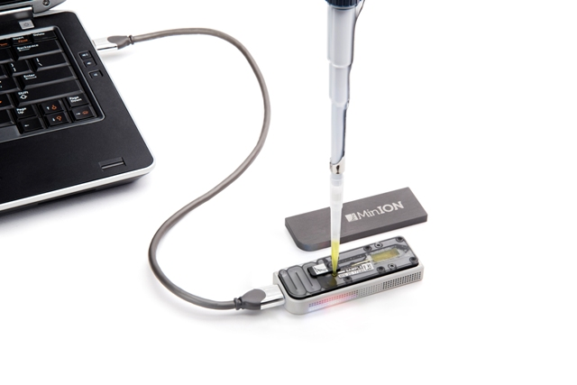
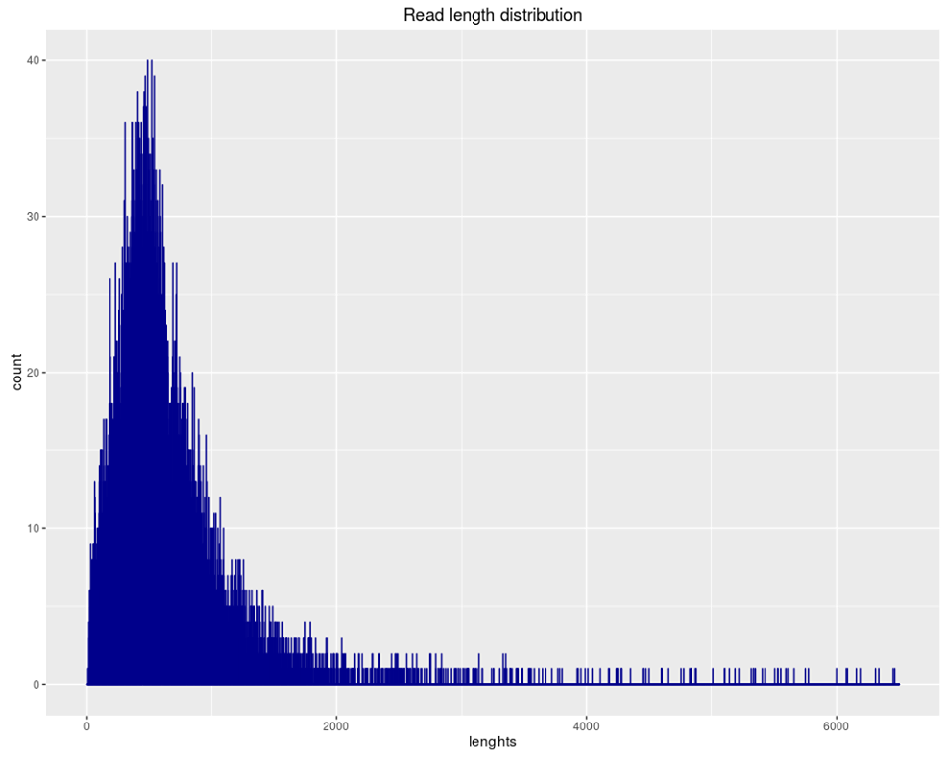
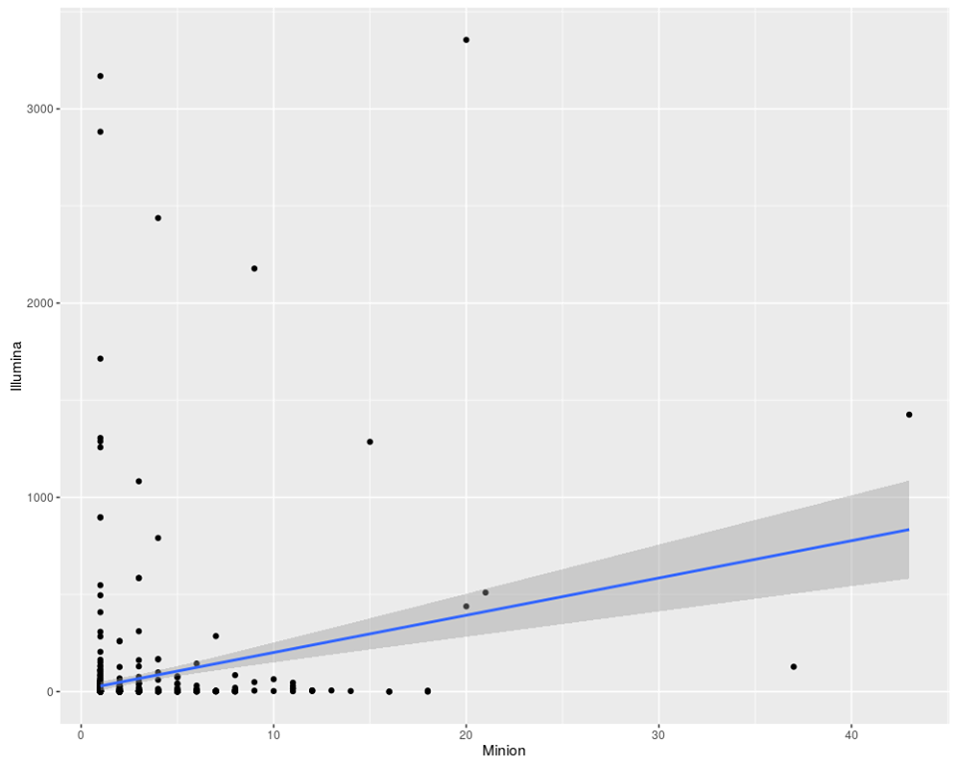
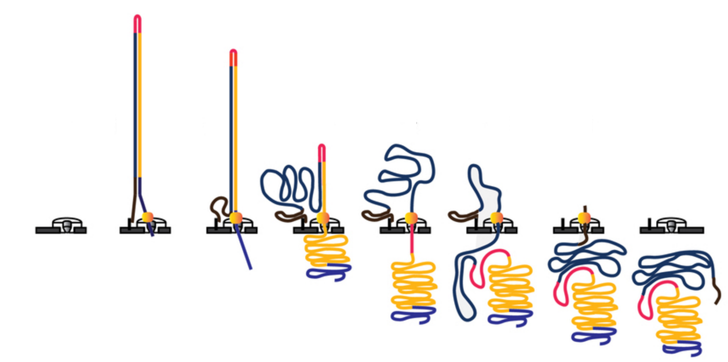
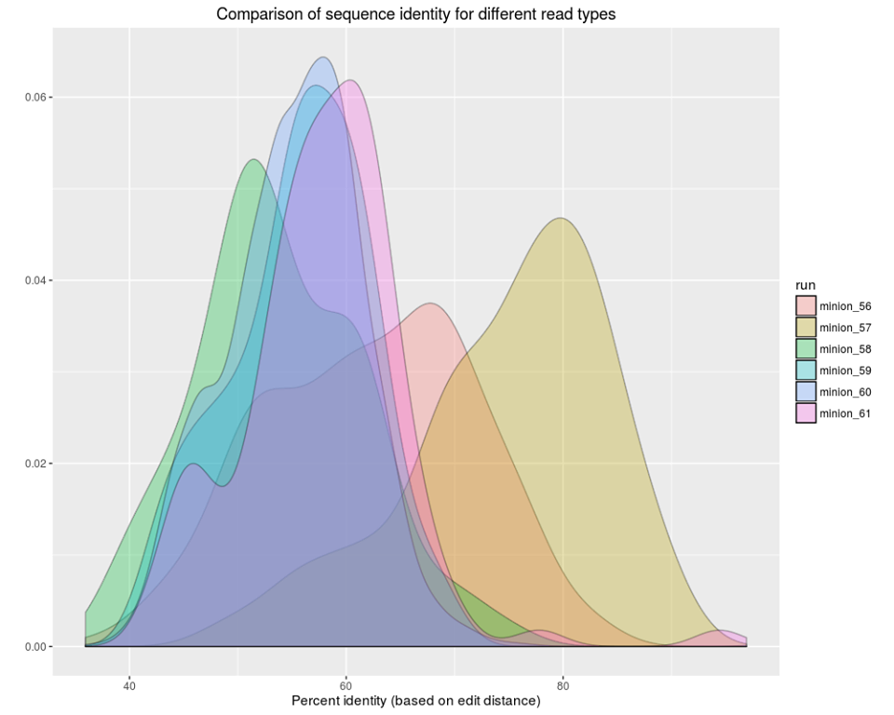
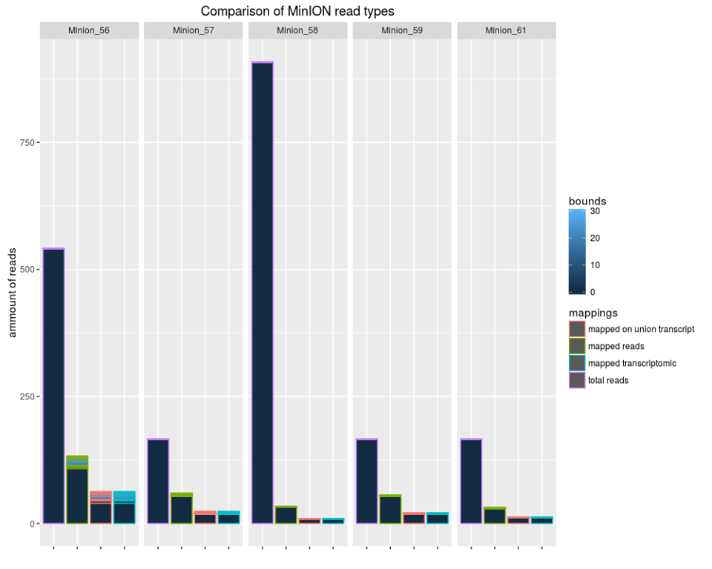
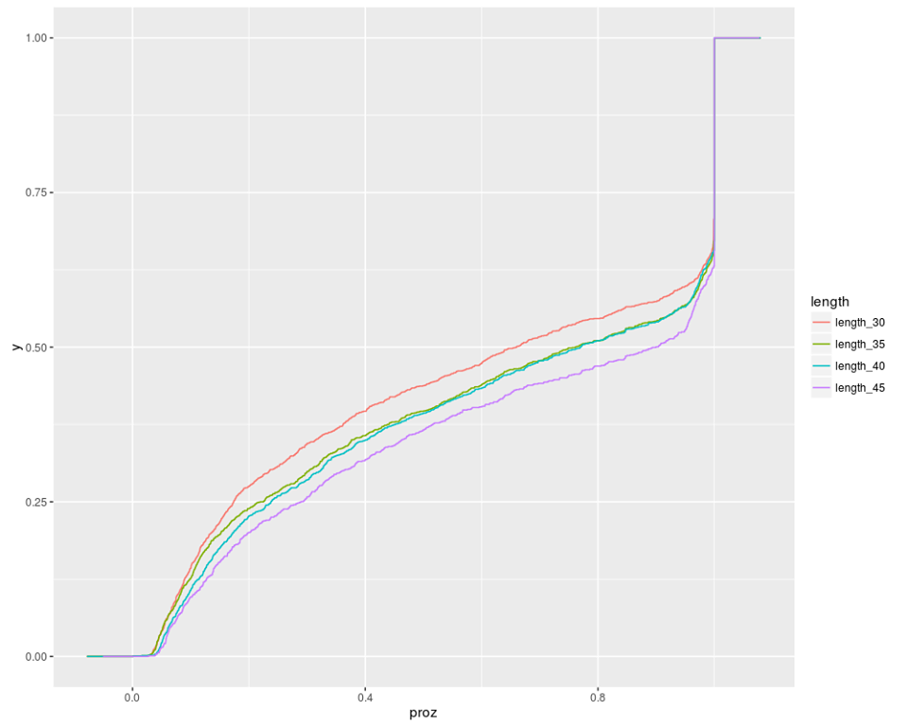
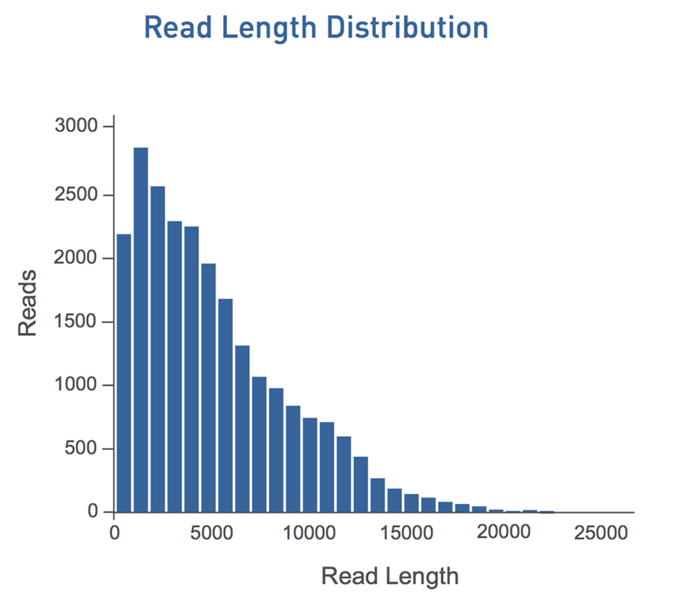
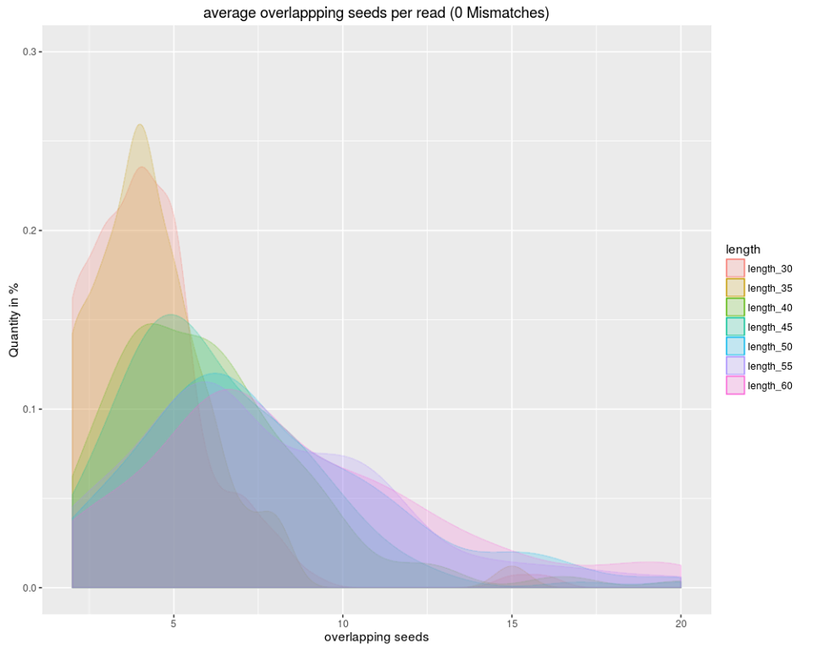
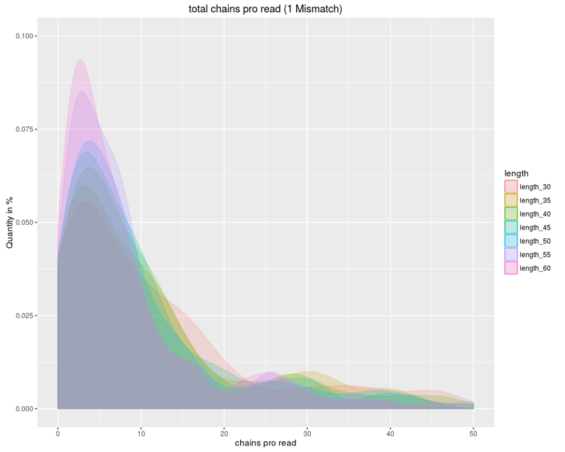
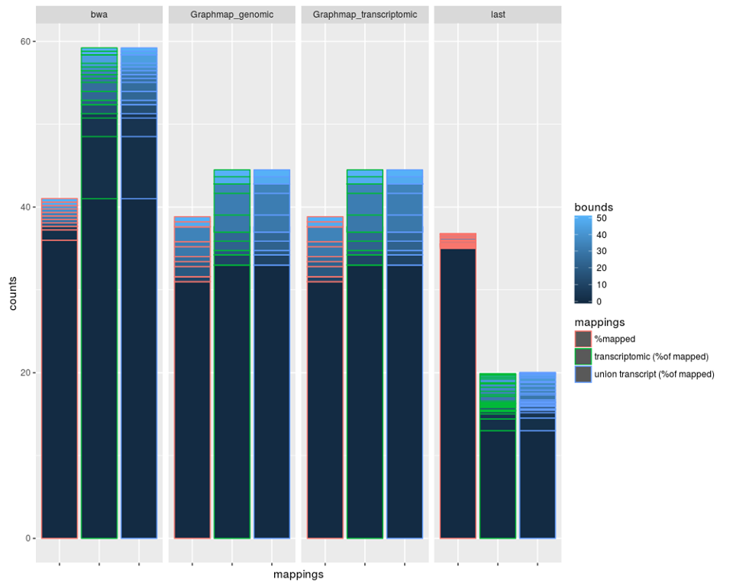
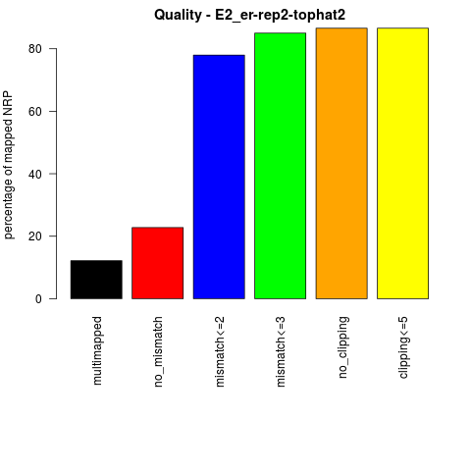
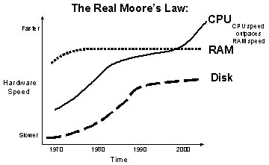
Lehr- und Forschungseinheit Bioinformatik
Institut für Informatik
Ludwig-Maximilians-Universität München
Bioinformatik
Lehre
MinION-BowTie
New Bowtie-based Mapper for long reads with high error rate
Florian Tichawa, Jonas Galli, Ron Fechtner, Felix Offensperger
Praktikum Genomorientierte Bioinformatik Ws 2016-2017
Introduction in MinION reads and goal of the project
In February of 2012, the ONT (Oxford Nanopore Technologies) launched a new device with the size of a USB memory stick. This device should be the future of DNA sequencing, the so-called MinION. Through low cost, portability and quickness, MinION should make sequencing universally accessible.
The basis of this technology is the protein nanopore. This protein is inserted into a membrane. Due to the high electrical resistance of the membrane an electric current can be generated through the nanopore when applying a potential across the membrane. If a single molecule passes through the pore, this event creates a characteristic disruption in current, called the nanopore signal. By measuring this interruption, the molecule can be identified. For the sequencing of DNA, a strand is passed through a nanopore. The current is changed as the bases G, A, T and C pass through the pore in different combinations. Highly scalable arrays of these nanopores are placed on microchips for real time sensing of biological molecules.
Each molecule of DNA is double stranded, one end contains a loading adaptor and the second one a hairpin adaptor. Firstly, one strand of DNA (called template) is passed through the pore, followed by the hairpin adaptor and then by the second strand (called complement). Then, the information from both strands is used for higher accuracy base calling - and the consensus sequence (2D read) is created. In fact, in most cases, no consensus sequence could be created.
The resulting reads are much longer then commons Illumina reads and with a much higher error rate. Because of this, the mapping of these read to a genome must be modified taking care of these factors.
Here we compare mappings of three available mappers (LAST, BWA and GraphMap) on a real and a simulated data set. In fact that differential expression and alternative splicing analysis are nowadays common it became important to work on RNAseq data. Since only GraphMap has published an option for a transcriptomic mapping, the goal of our project is to create a specific mapper for MinION Reads of the transcriptome.
Translocation of the template strand of DNA (gold), the ligated loading (blue and brown), the hairpin adaptors (red) and the complement strand (blue) through the nanopore
Methods
Detection of the right parameters
1.Step: Creation of seeds
In fact that a long MinION read can‘t be aligned to the genome because of the high error rate, the read must be seeded. A fixed seed length was identified. With this length and with a fixed shift of 5 bases all reads are seeded.
After this the seeds are mapped with Bowtie2 against the genome, allowing 1 Mismatch.
2.Step: Creation of overlapping seed-chains
Since not all seeds can be mapped and the order may could be wrong, we created seed-chains. They are the unification of overlapping seeds if they are in the right order. At this point we create a file with all correct seeds and seed-chains pro chromosome for each read, a so called fastm file.
3.Step: Alignment of missing read parts
~
~
~
~
Results
Notes:
B4 Schober, endothelial cells, miRNA soll bestimmte lncRNA regulieren
dicer knockout -> alle miRNA prozessierung ausgeschaltet
Custom Microarray -> lncRNA gemessen
Let-7b and miR103 regulate the expression of the majority of the lncRNAs in atherosclerotic endothelial cells
Für jede probe ein eintrag
Sequenziert die kontroll
From genes to
Was ist Z2, AtheroNetwork (bj modules), AtheroIndex (bj/merkin)
OL STAGE, mouse data, cross tissue/cross species
Ifit3
Rbp4
Söhnlein csaba resolving lipid mediators … -> supplement -> profil ->

