Slide 1


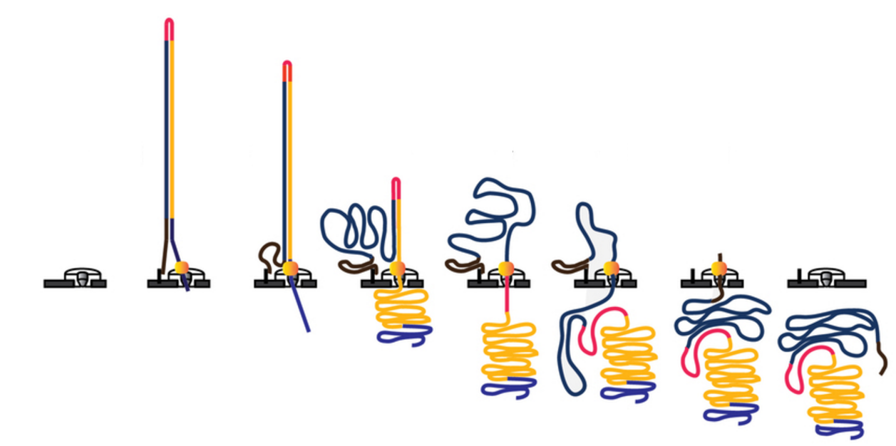
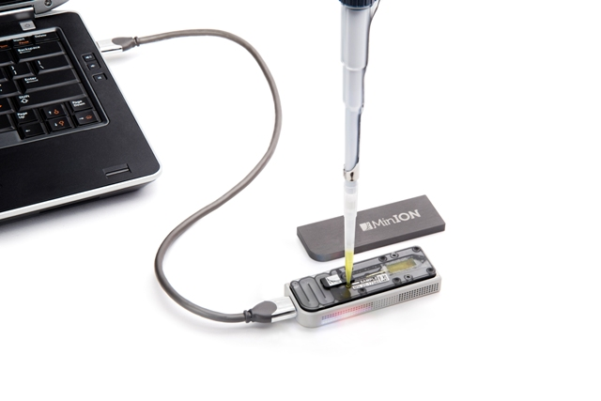
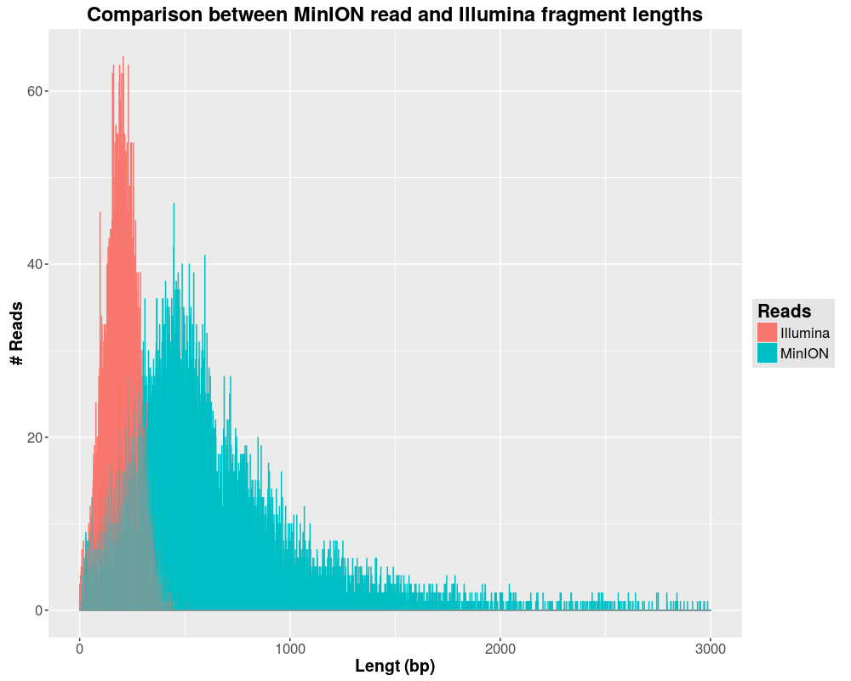
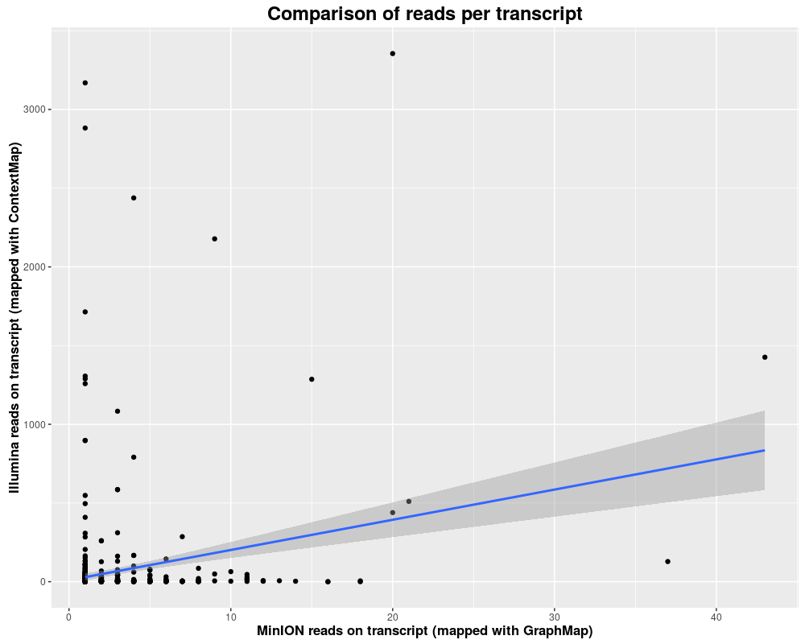
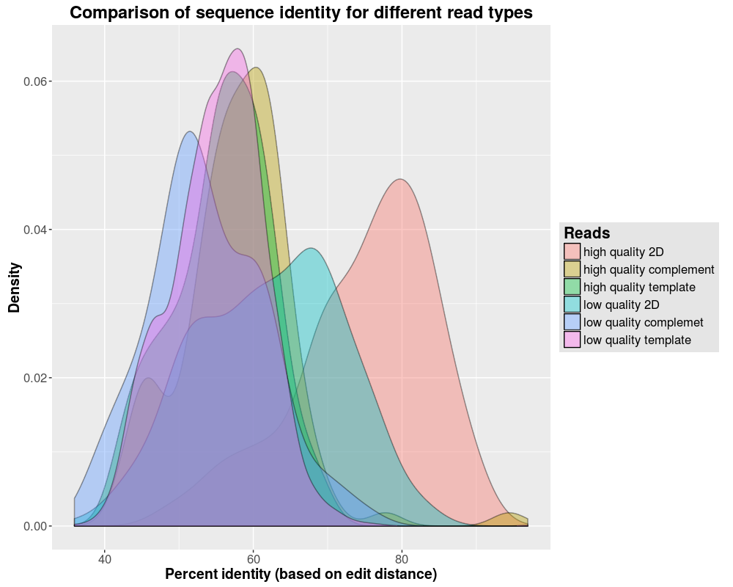
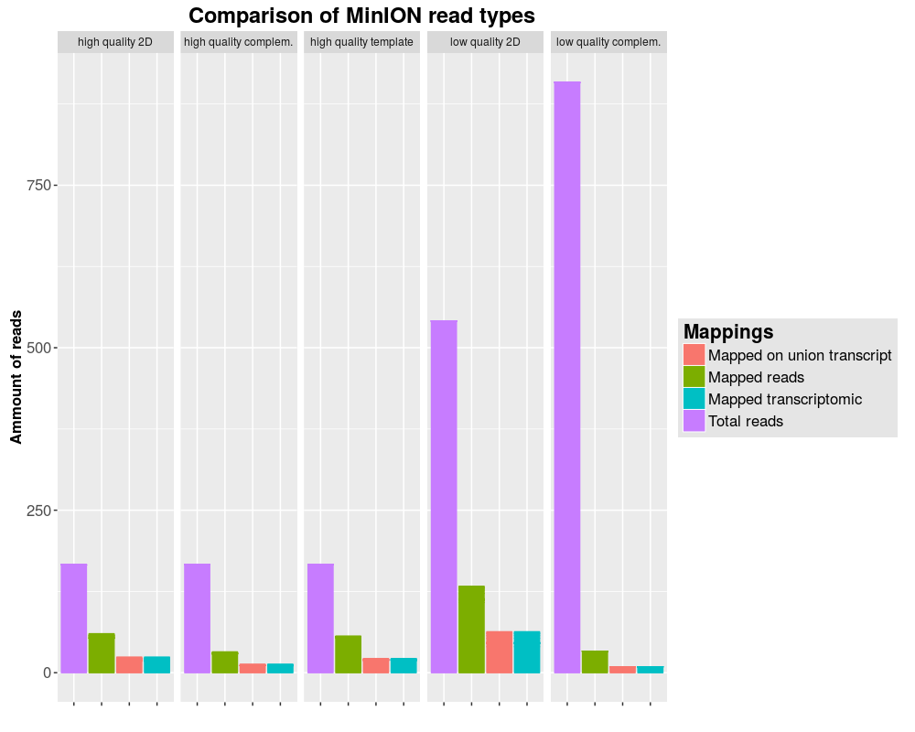
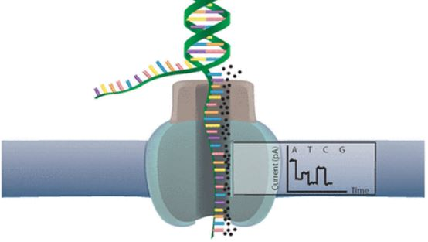
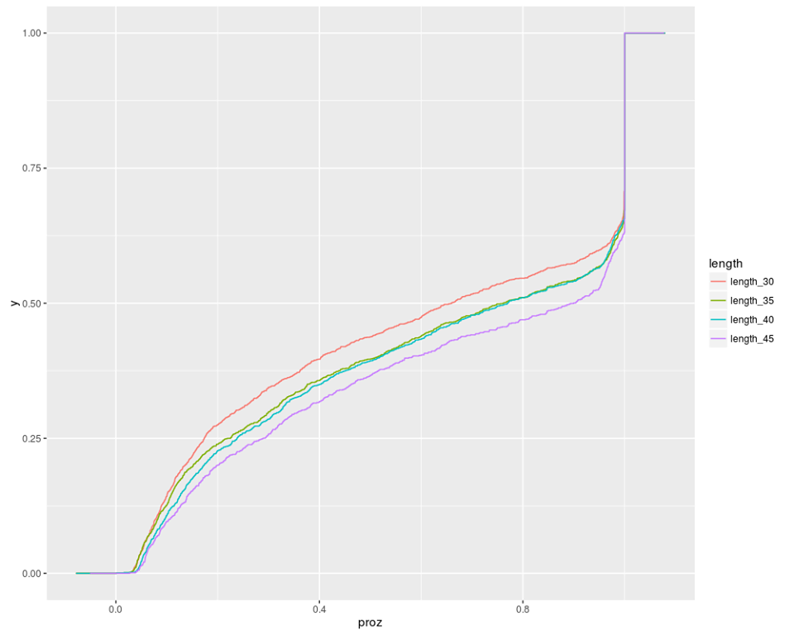
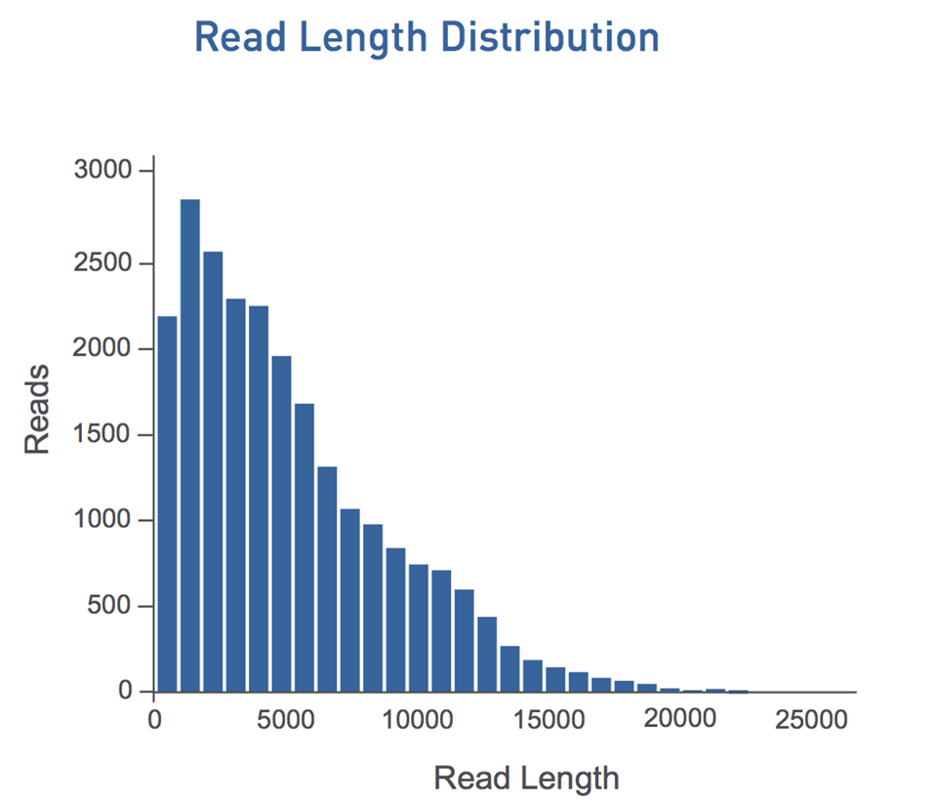
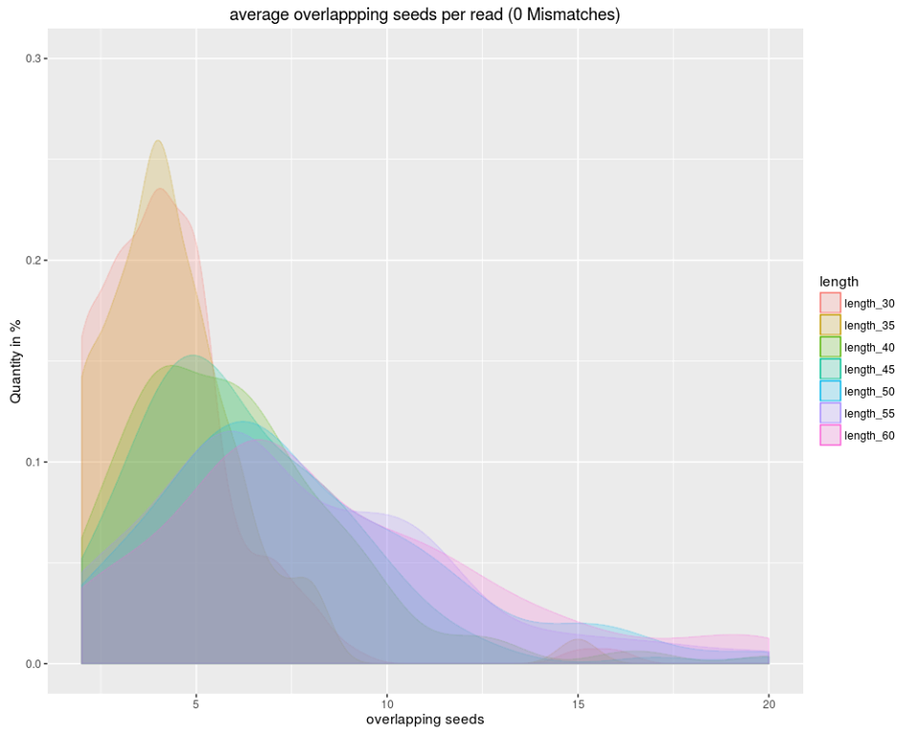
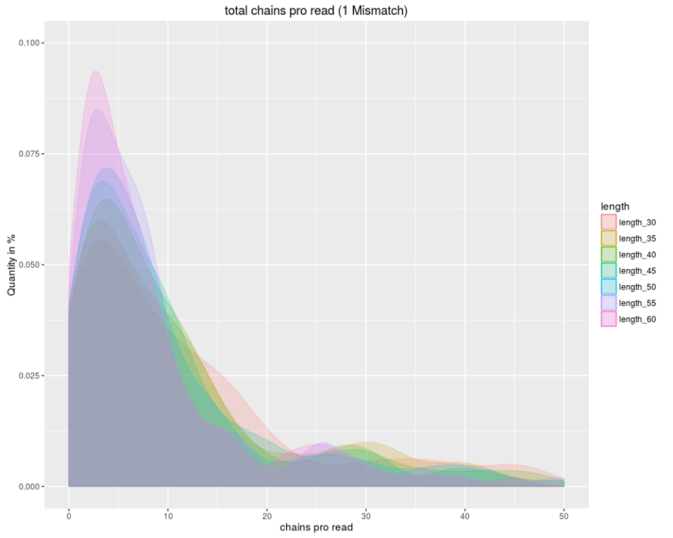
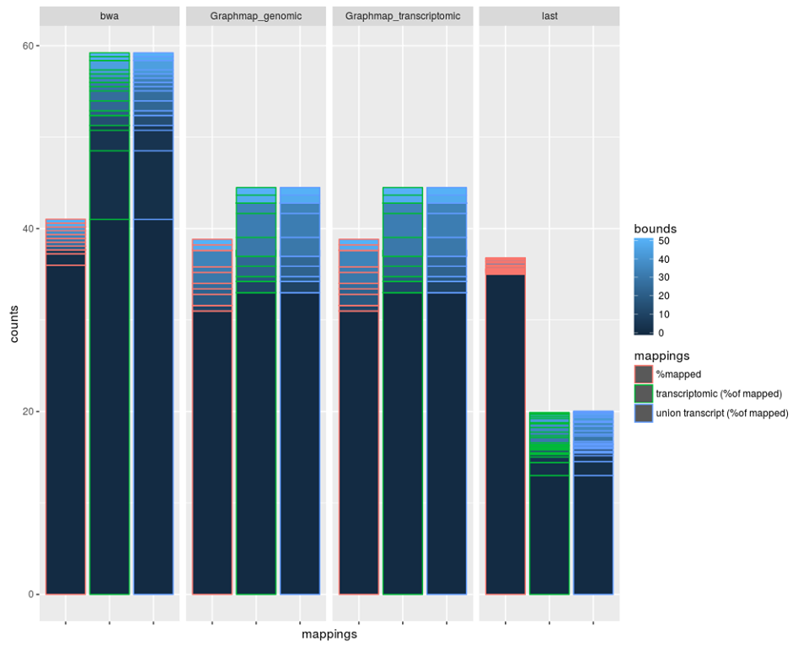
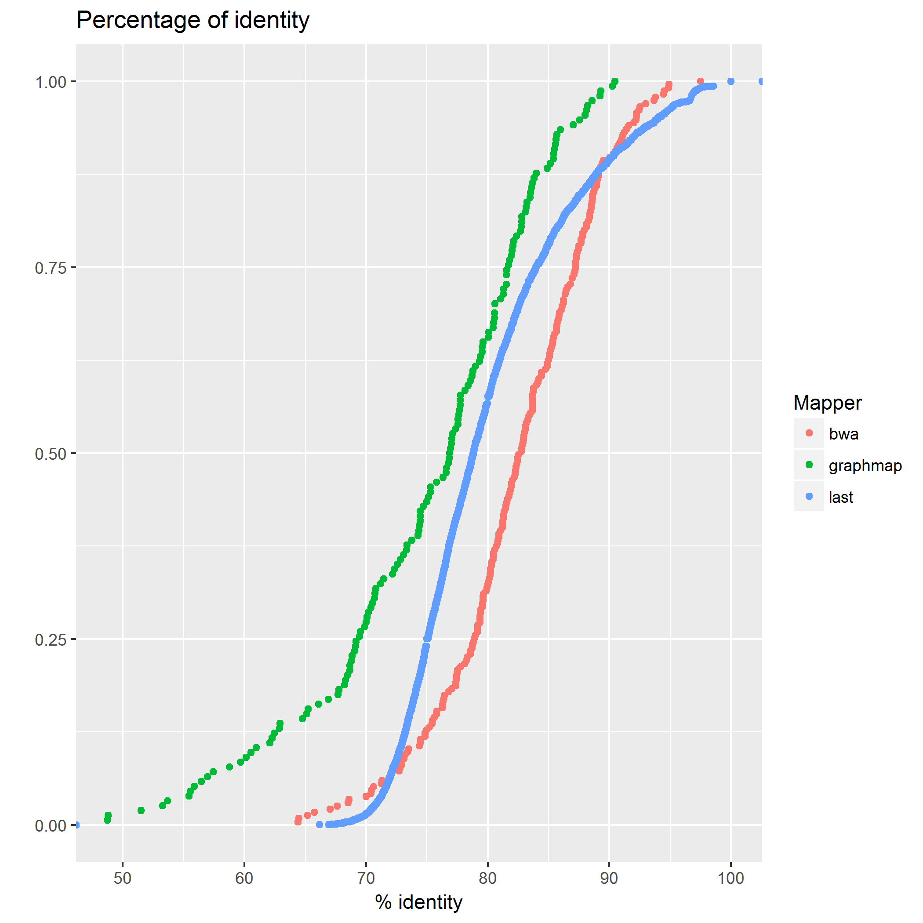
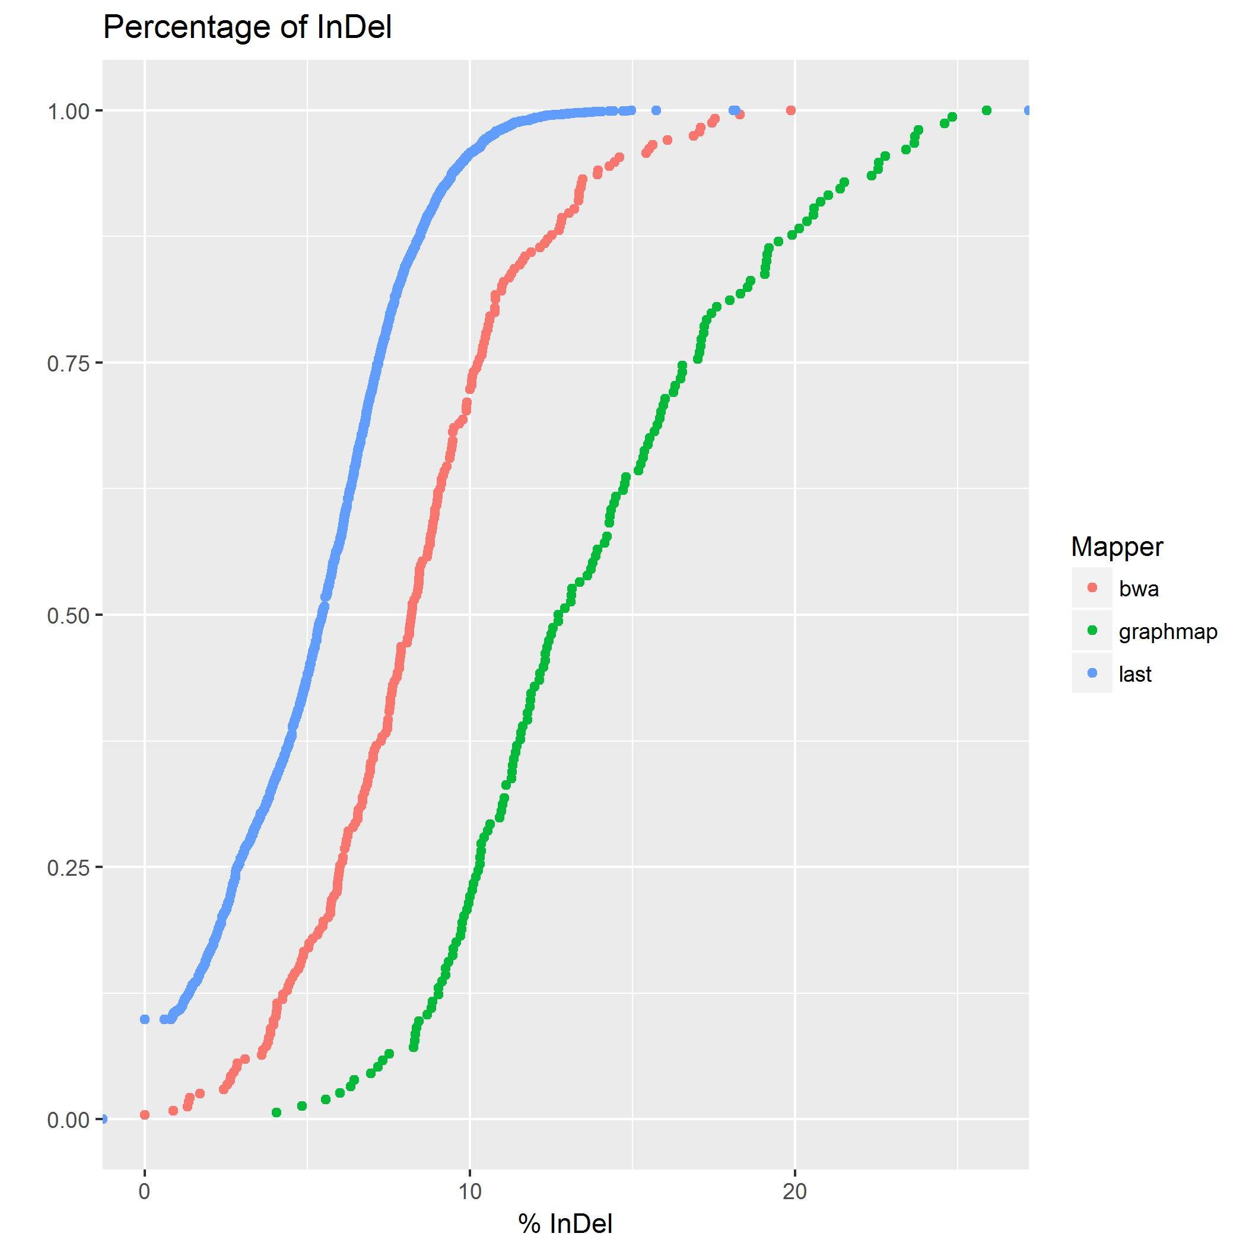
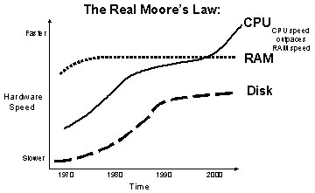
Lehr- und Forschungseinheit Bioinformatik
Institut für Informatik
Ludwig-Maximilians-Universität München
Bioinformatik
Lehre
MinION-BowTie
New Bowtie-based Mapper for long reads with high error rate
Florian Tichawa, Jonas Galli, Ron Fechtner, Felix Offensperger
Praktikum Genomorientierte Bioinformatik Ws 2016-2017
Introduction in MinION reads and goal of the project
Each molecule of DNA is double stranded, one end contains a loading adaptor and the second one a hairpin adaptor. Firstly, one strand of DNA (called template) is passed through the pore, followed by the hairpin adaptor and then by the second strand (called complement). Then, the information from both strands is used for the consensus sequence (2D read).
Long reads
High error rate
Different mapping
In February of 2012, the ONT (Oxford Nanopore Technologies) launched a new device with the size of a USB memory stick. This device should be the future of DNA sequencing, the so-called MinION. Through low cost, portability and quickness, MinION should make sequencing universally accessible.
The basis of this technology is the protein nanopore. Due to the high electrical resistance of the membrane an electric current can be generated through the nanopore when applying a potential across the membrane. If a single molecule passes through the pore, this event creates a characteristic disruption in current, called the nanopore signal.
Here we compare mappings of three available mappers (LAST, BWA and GraphMap) on a real and a simulated data set. In fact that differential expression and alternative splicing analysis are nowadays common it became important to work on RNAseq data. Since only GraphMap has published an option for a transcriptomic mapping, the goal of our project is to create a specific mapper for MinION Reads of the transcriptome.
Methods
Detection of the right parameters
1.Step: Creation of seeds
Read is too long for single mapping
Detection of seedlength with best results
Seeding with fix shift and fix length (5 and **)
Template and Complement
End-to-end mapping with Bowtie allowing one Mismatch
2.Step: Creation of overlapping seed-chains
Order of mapping could be wrong
Unification of overlapping seeds when in shift range
All seed-chains one the same chromosome were collected and written in a fastm file
3.Step: Alignment of missing read parts
~bla blabla
~
~
~
Results
 | GraphMap | Last | BWA | Our mapper
Annotated Alignments | 5529 | 172520 | 12881
Mapped Reads | 3949 | 172520 | 11807
Wrong Chromosome | 72 | 143888 | 174
Right Cromosome | 1107 | 18358 | 3737
Partial | 2170 | 9727 | 7260
Ok | 600 | 547 | 636
Notes:
B4 Schober, endothelial cells, miRNA soll bestimmte lncRNA regulieren
dicer knockout -> alle miRNA prozessierung ausgeschaltet
Custom Microarray -> lncRNA gemessen
Let-7b and miR103 regulate the expression of the majority of the lncRNAs in atherosclerotic endothelial cells
Für jede probe ein eintrag
Sequenziert die kontroll
From genes to
Was ist Z2, AtheroNetwork (bj modules), AtheroIndex (bj/merkin)
OL STAGE, mouse data, cross tissue/cross species
Ifit3
Rbp4
Söhnlein csaba resolving lipid mediators … -> supplement -> profil ->

