Slide 1
MGMM - Nanopore Sequencing Mapper A new Bowtie-based Mapper for long reads with high error rate
Ron Fechtner / Jonas Galli / Felix Offensperger / Florian Tichawa
Genomorientierte Bioinformatik
Praktikumsleitung: Prof. Dr. Ralf Zimmer,
Betreuer: Dr. Gergely Csaba, Markus Gruber
Datum des Vortrags: 28.04.2017

Slide 2

Overview
Nanopore sequencing
How it works
Structure of reads
Defining the problem
Currently available mappers
BWA, Last, GraphMap
Constructing a new mapper
Seeding
Chaining
Pathing
Aligning
Results and comparisons

Slide 3
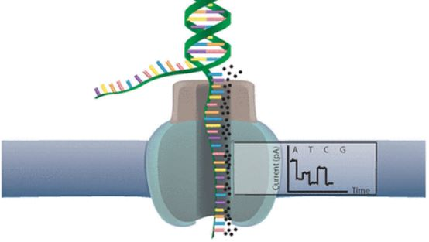
Nanopore sequencing [Ron]
Nanopore sequencing
How it works
Structure of reads
Defining the problem
Currently available mappers
BWA, Last, GraphMap
Constructing a new mapper
Seeding
Chaining
Pathing
Aligning
Results and comparisons

Slide 4
Nanopore Sequencing – How it works
Nanopore Sequencing
Introduced 2012 by Oxford Nanopore Technology
Utilizes electrical

Slide 5
Nanopore Sequencing – How it works
Library preparation
Nanopore sequencing
Analysis

Slide 6
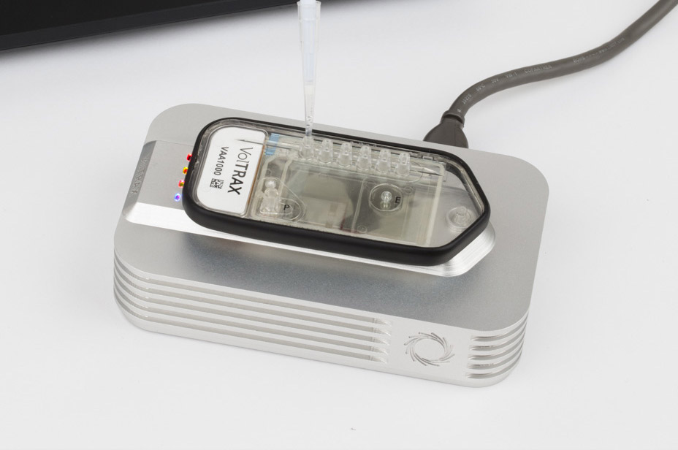
Nanopore Sequencing – How it works
Library preparation
Analysis
Nanopore sequencing
Library preparation Workflow depending on application and input data
Prepare the DNA / RNA compound for nanopore sequencing (NPS)
Manual or Automated
With or without PCR amplification
Various protocol duration lengths
For different input qualities (i.e. low input)
Resulting in different library qualities (1D vs. 2D)

Slide 7
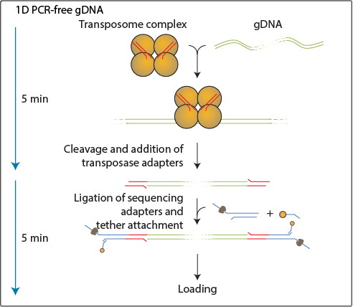
Nanopore Sequencing – How it works
Library preparation
Analysis
Nanopore sequencing
Rapid library preperation
Fast prep in under 10 min
DNA is fragmented using a transposase, which simultaneously attaches adapters to the free ends.
The NPS Y-adapters are then added that allow the DNA to enter the pore
One strand of the duplex is sequenced at a time
Produces lower quality 1D reads

Slide 8
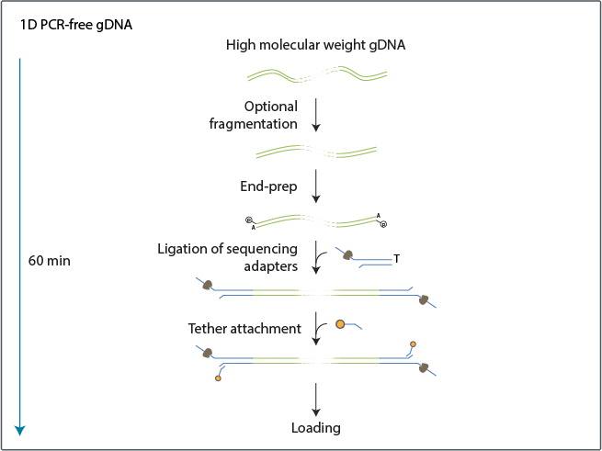
Nanopore Sequencing – How it works
Library preparation
Analysis
Nanopore sequencing
Ligation library preperation (1D)
Genomic DNA may be fragmented, to generate fragments of predefined lengths
Adapters are added to the free ends
NPS Y-Adapters are added
It prepares the sample for '1D' sequencing
Takes up to an hour

Slide 9
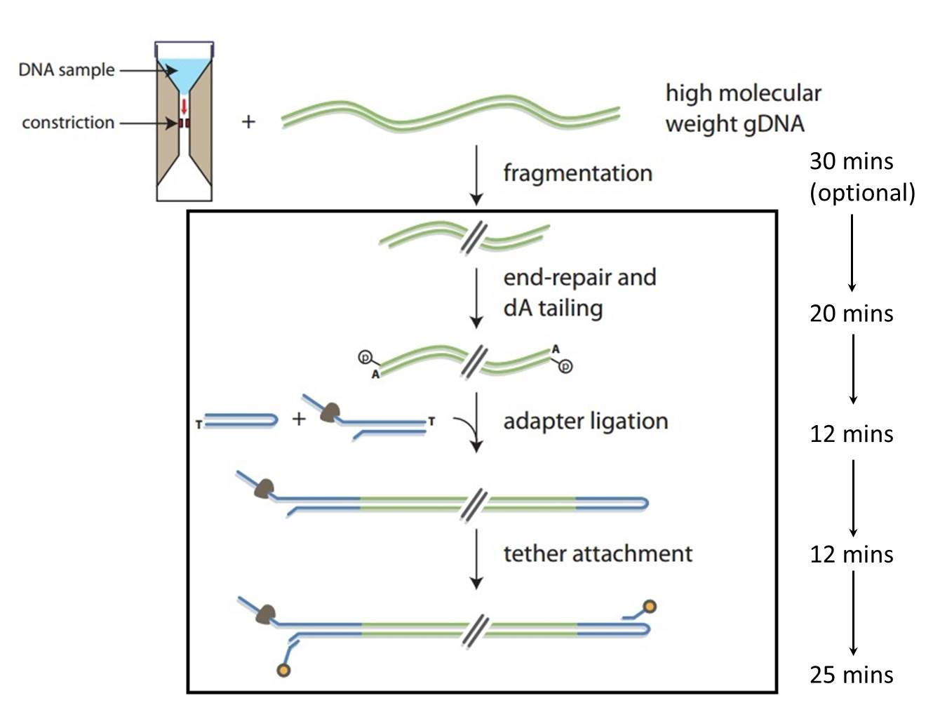
Nanopore Sequencing – How it works
Library preparation
Analysis
Nanopore sequencing
Ligation library preperation (2D)
DNA may be fragmented, to generate fragments of predefined lengths
Optional DNA repair step
Allows barcoding for multiple samples
Adapted protocols for ultra long reads (>100 kb)
Allows low input
Prepares for 2D Sequencing

Slide 10
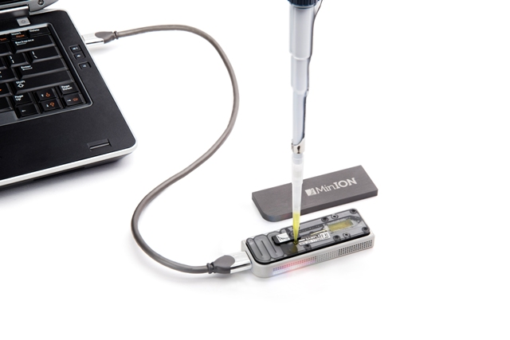
Nanopore Sequencing – How it works
Library preparation
Analysis
Nanopore sequencing
Library is loaded into NPS Device (i.e. portable MinION)

Slide 11
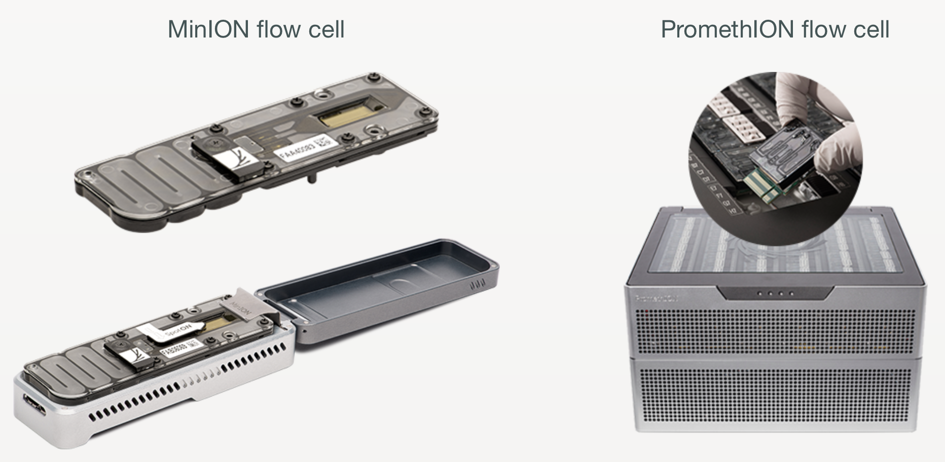
Nanopore Sequencing – How it works
Library preparation
Analysis
Nanopore sequencing
Library is loaded into NPS Device (i.e. portable MinION)
Sequencer contains a replaceable flow cell that contains:

Slide 12
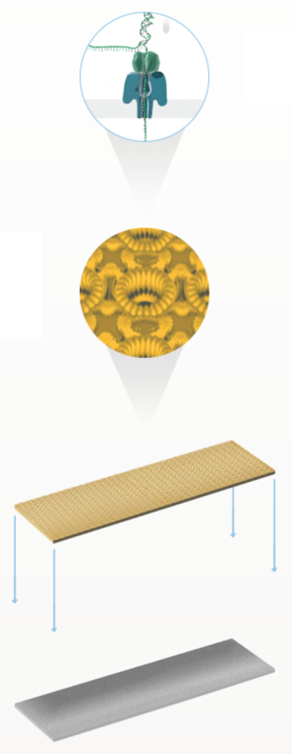
Nanopore Sequencing – How it works
Library preparation
Analysis
Nanopore sequencing
Library is loaded into NPS Device (i.e. portable MinION)
Sequencer contains a replaceable flow cell that contains:
Multiple protein nanopores set in an electrically-resistant polymer membrane
Array of arranged nanopores in microscaffolds
Sensor chip for each microscaffold
Application-Specific Integrated Circuit (ASIC) that measures each nanopore individually

Slide 13
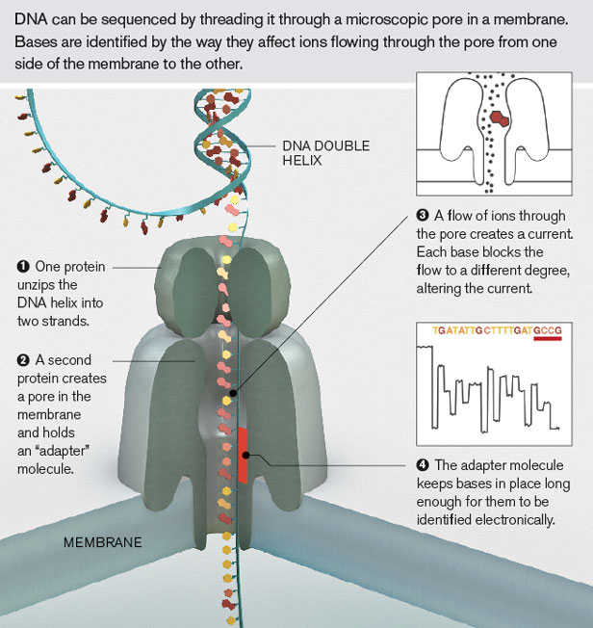
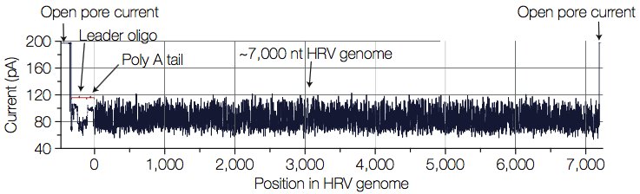
Nanopore Sequencing – How it works
Library preparation
Analysis
Nanopore sequencing

Slide 14
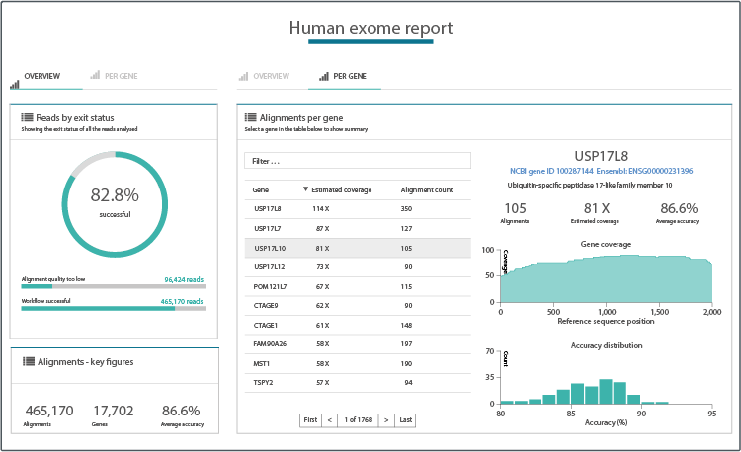
Nanopore Sequencing – How it works
Library preparation
Analysis
Nanopore sequencing

Slide 15
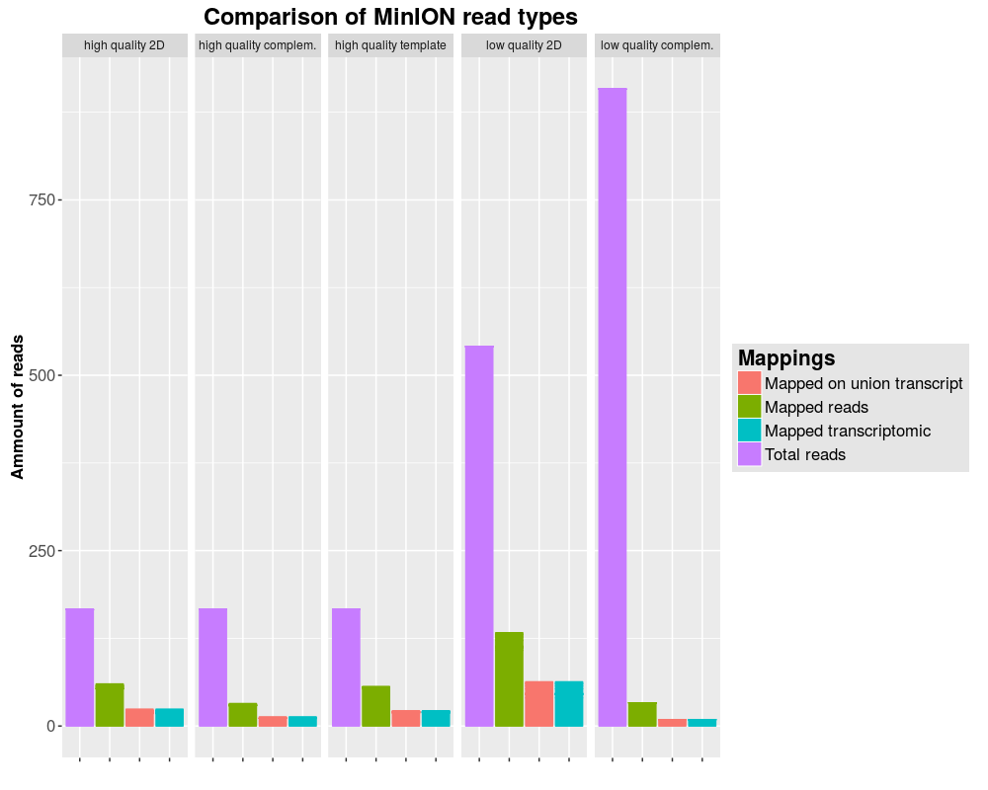
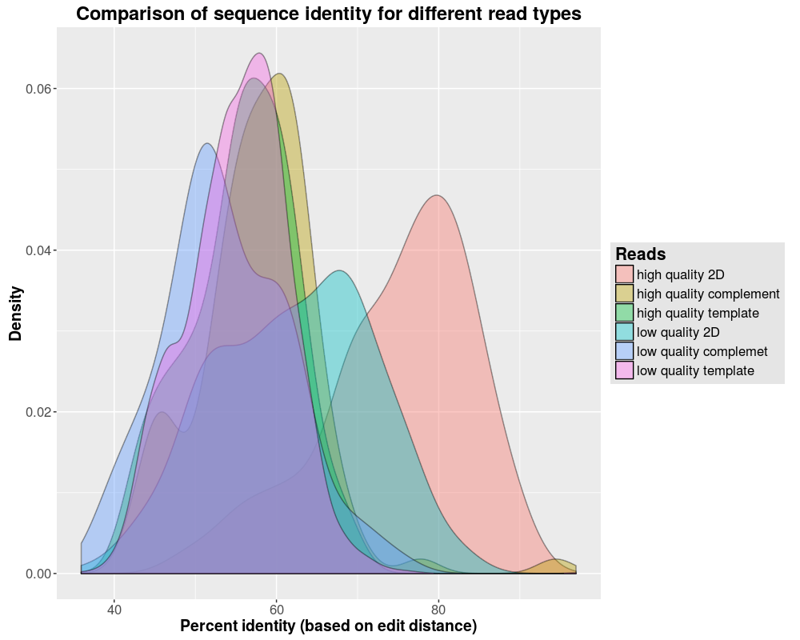
Nanopore Sequencing – Structure of reads

Slide 16
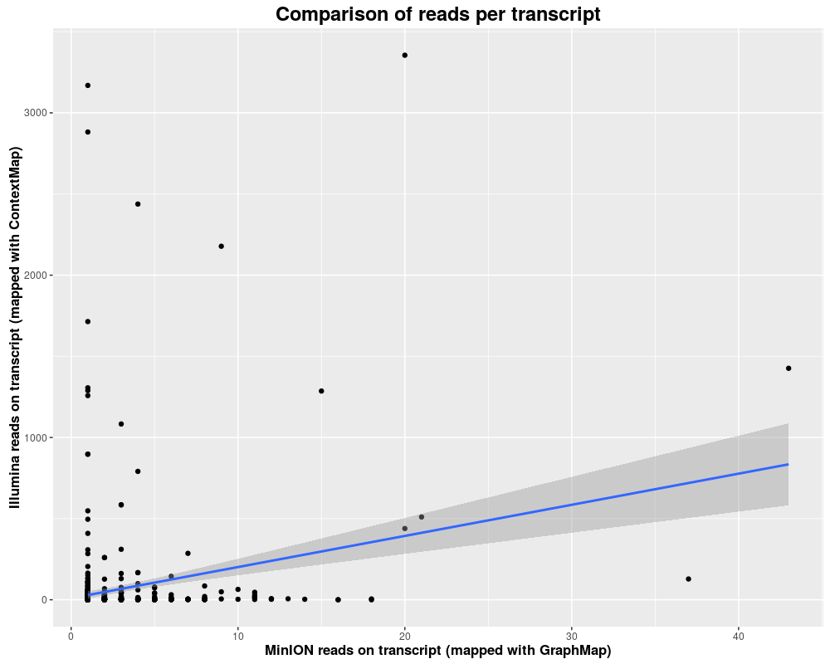
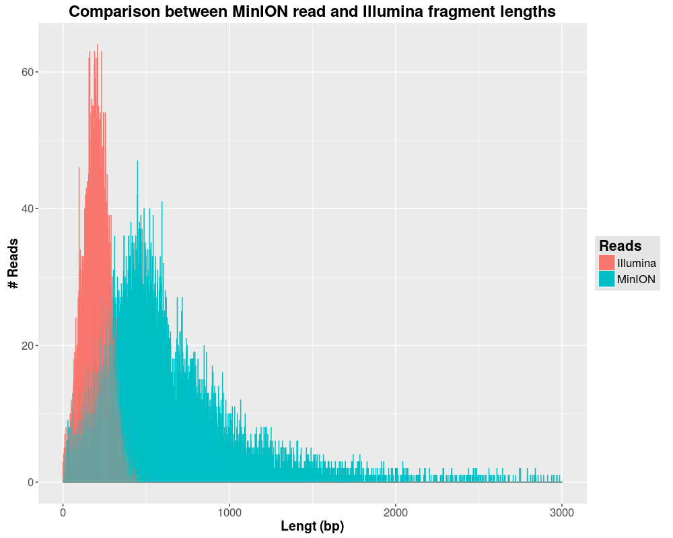
Nanopore Sequencing – Structure of reads

Slide 17
Currently available mappers
Nanopore sequencing
How it works
Structure of reads
Currently available mappers
BWA, Last, GraphMap
Constructing a new mapper
Seeding
Chaining
Pathing
Aligning
Results and comparisons

Slide 18
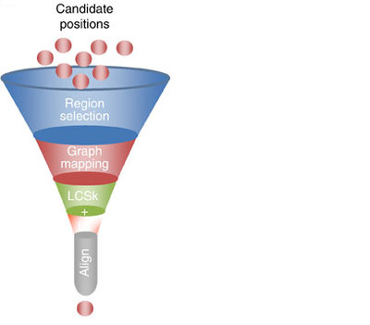
Currently available mappers
Finding candidate positions /seeds:
BWA-MEM: maximal exact matches (MEM)
or supermaximal exact matches (SMEM)
with canonical seed-and-extend paradigm and re-seeding
LAST: Hamming distance based spaced seeds
GraphMap: gapped spaced seeds
similar to gappes q-gram filters for Levenshtein distance
MGMM – A long read Mapper
18
Notes:
18

Slide 19
Currently available mappers
First selection of seeds:
GraphMap: clustering into candidate regions:
- into anchors under graph-based vertex-centrix construction
BWA-MEM: Chaining:
-seeds that are colinear and close to each other are a chain
-chainfiltering short chains that are largely contained in a
long chain and are much worse than the long chain
MGMM – A long read Mapper
19
Notes:
19

Slide 20
Currently available mappers
Chaining, scoring and filtering:
GraphMap: Extending anchors into alignments using LCSk
-variable lengths of corresponding anchors
-a list of consecutive anchors in the target and the query sequence
-filtering with L1 regression
the number of exact kmers covered by the anchor
the length of the query sequence which matched the target
the number of bases covered by anchors
the read length
BWA-MEM: Seed extension:
-ranking seeds by length of the chain it belongs to and
then by the seed length
-dropping seeds that are contained in an alignment found before
-extending seeds with a banded affine-gap-penalty dynamicprogramming
-heurisitcs to avoid the extension of poorly aligned regions
-chooses between local and end-to-end alignments
MGMM – A long read Mapper
20
Notes:
20

Slide 21
Constructing a new mapper
Nanopore sequencing
How it works
Structure of reads
Currently available mappers
BWA, Last, GraphMap
Constructing a new mapper
Seeding
Chaining
Pathing
Aligning
Results and comparisons

Slide 22
Constructing – Seeding [Jonas]
Seeding
Theory
Reads are too long to be aligned in one run
Splitting into many small seeds
Mapping of seeds with close to no mismatches
Implementation
Seed of length (35 bp)
MM max 1
Mapping with Bowtie (End to End MM = 1)
[PLOTS] Fancy plot with seed lengths

Slide 23
Constructing – Chaining [Jonas]
Chaining
Theory
Mapping of single seeds don’t have much meaning (random)
Seed-groups indicate mapped regions
Filtering of misplaced seeds
Implementation
Detection of overlapping seeds
Stitching to larger seed-chains
Grouping of seeds with fitting transcriptomic and genomic coordinates
[PLOTS] Length of seed-chains

Slide 24
Constructing – Pathing [Flo]
Pathing
Theory
Alignments between seeds are still too large -> need to reduce alignment size
Difference between transcriptomic and genomic length = sum of introns -> find intron combinations filling this gap
Implementation
Pathing creates all exon / intron combinations in area between seeds fitting into the gaps with a tolerance of 5 percent
[PLOTS] Transcriptomic length of chained reads vs genomic length

Slide 25
Constructing – Aligning [Flo]
Aligning
Theory
High mismatch rate / low inDel rate
Aligning all possible paths
Picking the best solution for each seed gap
Stitching partial alignments
Implementation
GOTOH approach with optimized parameters
[PLOTS] Heatmap of parameter tuning

Slide 26
Results & comparisons
Nanopore sequencing
How it works
Structure of reads
Currently available mappers
BWA, Last, GraphMap
Constructing a new mapper
Seeding
Chaining
Pathing
Aligning
Results & comparisons

