Slide 1
MGMM – A long read mapper
Florian Tichawa / Felix Offensperger / Jonas Galli / Ron Fechtner
Genomorientierte Bioinformatik
Praktikumsleitung: Prof. Dr. Ralf Zimmer,
Betreuer: Dr. Gergely Csaba, Markus Gruber
Datum des Vortrags: 28.04.2017

Slide 2

Nanopore sequencing
Nanopore sequencing
How it works
Structure of reads
Defining the problem
Currently available mappers
BWA, Last, GraphMap
Constructing a new mapper
Seeding
Chaining
Pathing
Aligning
Results and comparisons

Slide 3
Overview
Nanopore sequencing
How it works
Structure of reads
Defining the problem
Currently available mappers
BWA, Last, GraphMap
Constructing a new mapper
Seeding
Chaining
Pathing
Aligning
Results and comparisons

Slide 4
Currently available mappers
Nanopore sequencing
How it works
Structure of reads
Defining the problem
Currently available mappers
BWA, Last, GraphMap
Constructing a new mapper
Seeding
Chaining
Pathing
Aligning
Results and comparisons

Slide 5
Constructing a new mapper
Nanopore sequencing
How it works
Structure of reads
Defining the problem
Currently available mappers
BWA, Last, GraphMap
Constructing a new mapper
Seeding
Chaining
Pathing
Aligning
Results and comparisons

Slide 6
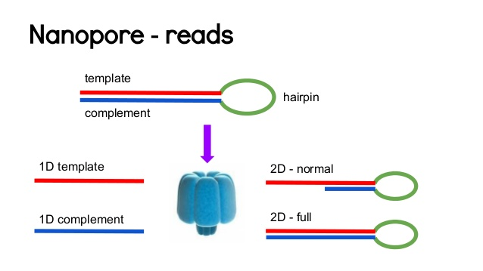
Structure of reads
Two groups: Fail and Pass (low and high quality)
High quality → 2D with complement and template
Low quality → All other reads

Slide 7
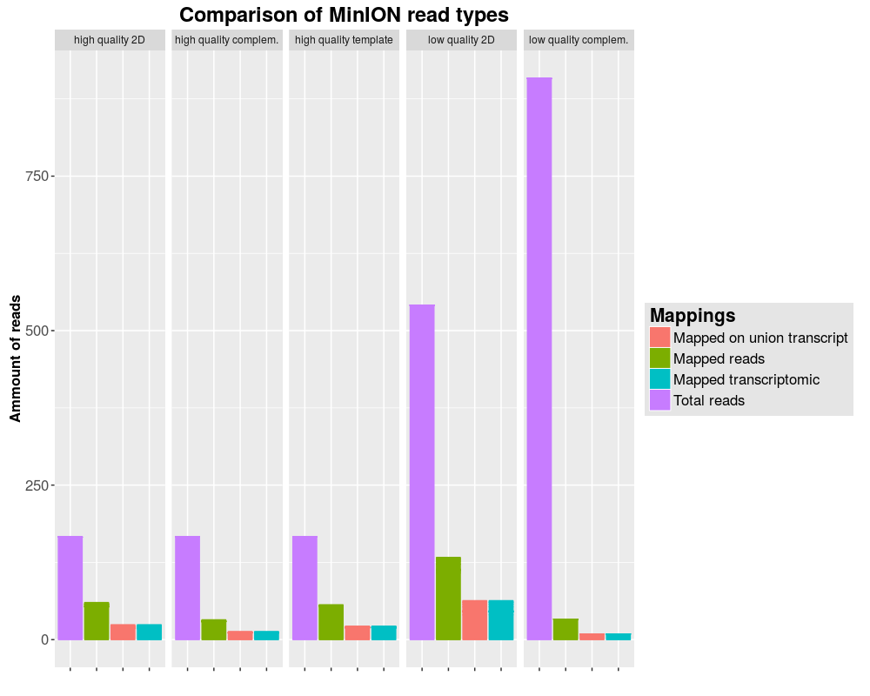
Properties of MinION reads

Slide 8
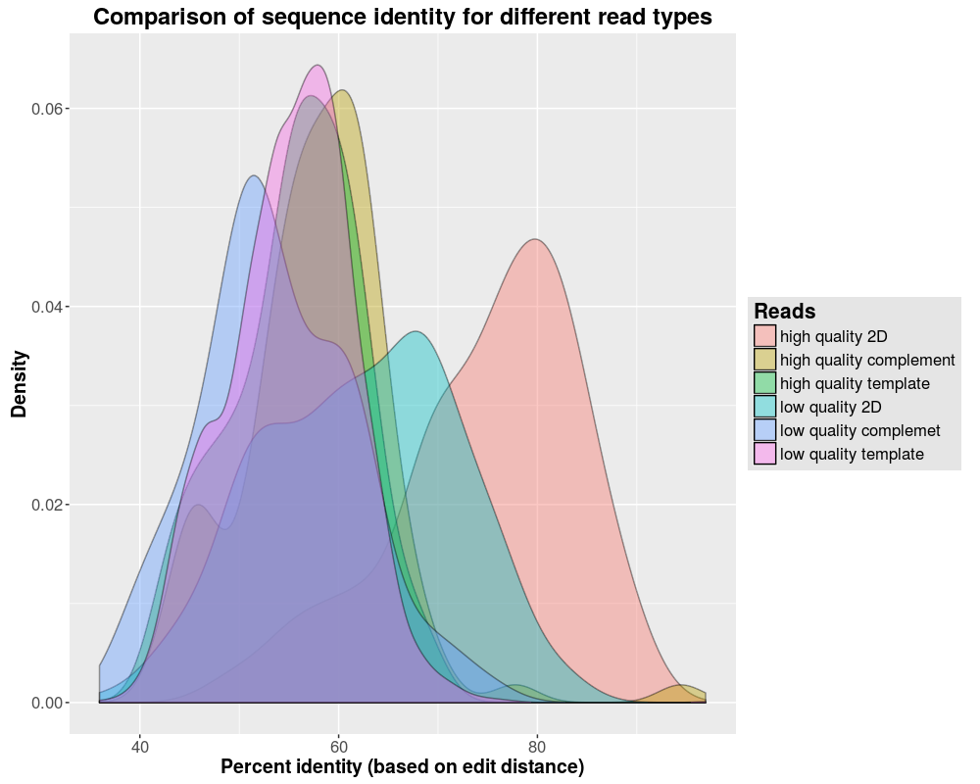
Properties of the reads
Quality comparison between MinION read types

Slide 9
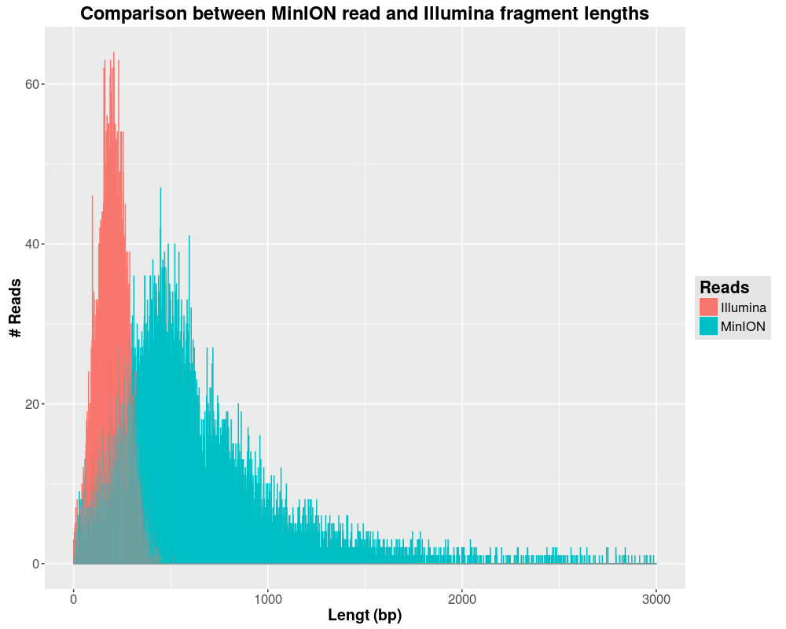
Comparison with Illumina
Read length distribution
Mean length: ~1000
Mean sd: 100
Error rate: 0,3
InDel rate: 0,01

Slide 10
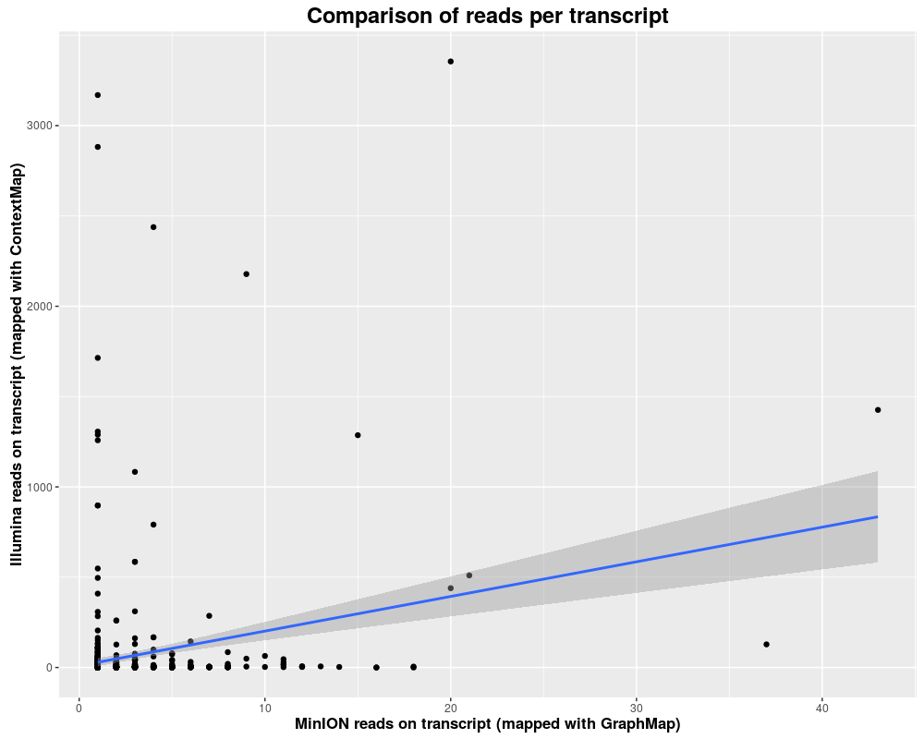
Comparison with Illumina
Read types per transcript (comparison Illumina vs. MinION)
Illumina reads:
Mapping on 148.322 transcripts
MinION reads
Mapping on 679 transcprits
→not enough reads for detection of alternative splicing

Slide 11
Construction – Pathing
Seeding
Reads are too long to be aligned as one
Short reads can be aligned with close to zero mismatches and String search
Splitting the read into small seeds
Plot(length)

Slide 12
Construction – Seeding
Seeding
Fixed seed length of 35 bp with 5 bp shift
Up to 7 seeds per bp
Mapping with Bowtie
End-to-End alignment
Allowing 1 mismatch
No mapping on reverse strand

Slide 13
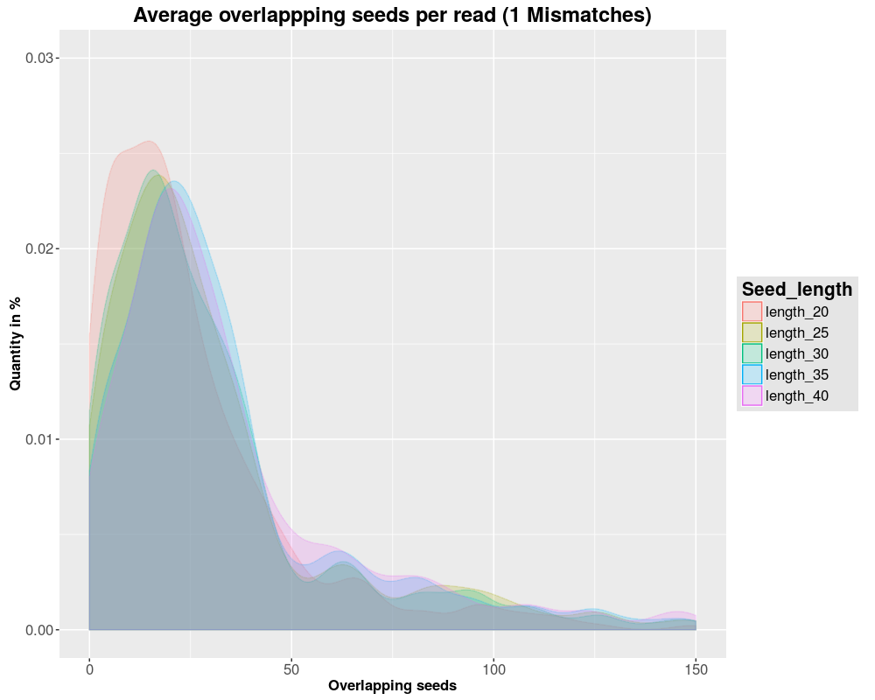
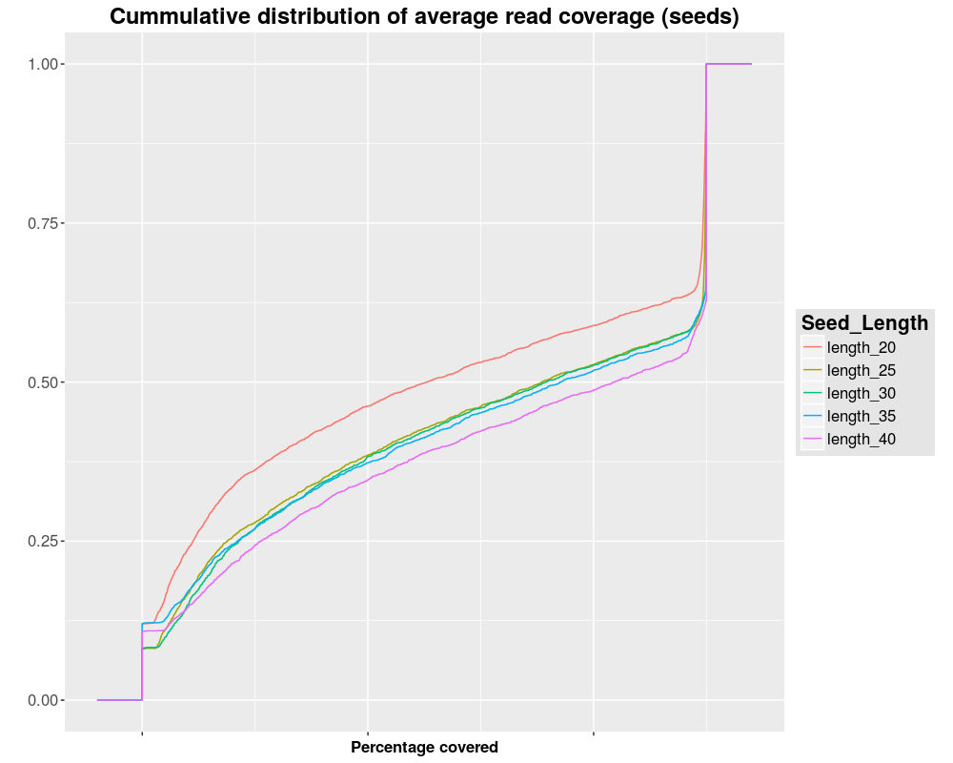
Construction – Seeding
Distribution of overlapping seeds per read and coverage

Slide 14
Construction – Chaining
Chaining
Mapping of single seeds is possibly random
Seed groups in same genomic region indicate a possible mapping
Filtering of misplaced seeds

Slide 15
Construction – Chaining
Chaining
Detection of overlapping seeds in correct order
Stitching to longer seed chains
Grouping of seeds with fitting genomic and transcriptomic coordinates
Filtering of reverse and forward chains
Seed chains are written to fastM files for alignment

Slide 16
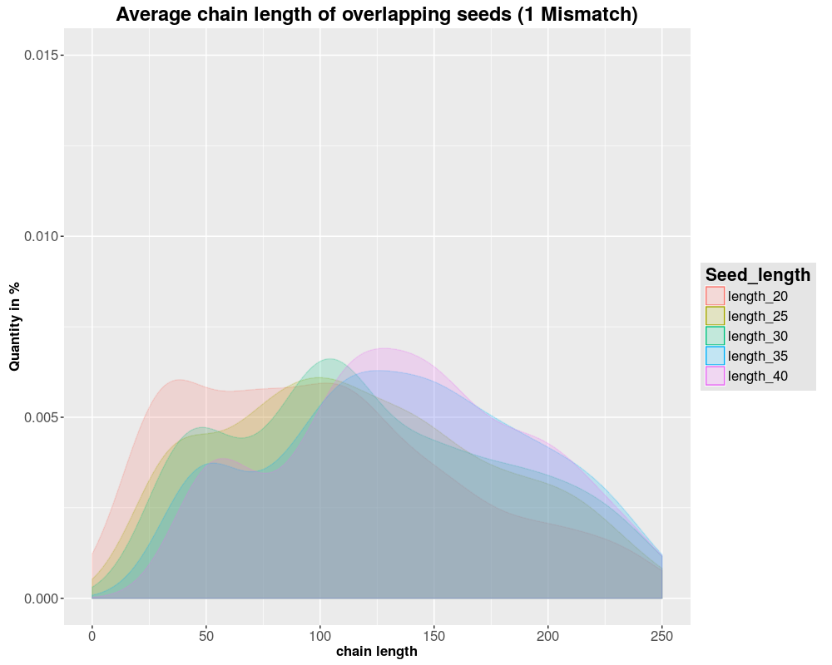
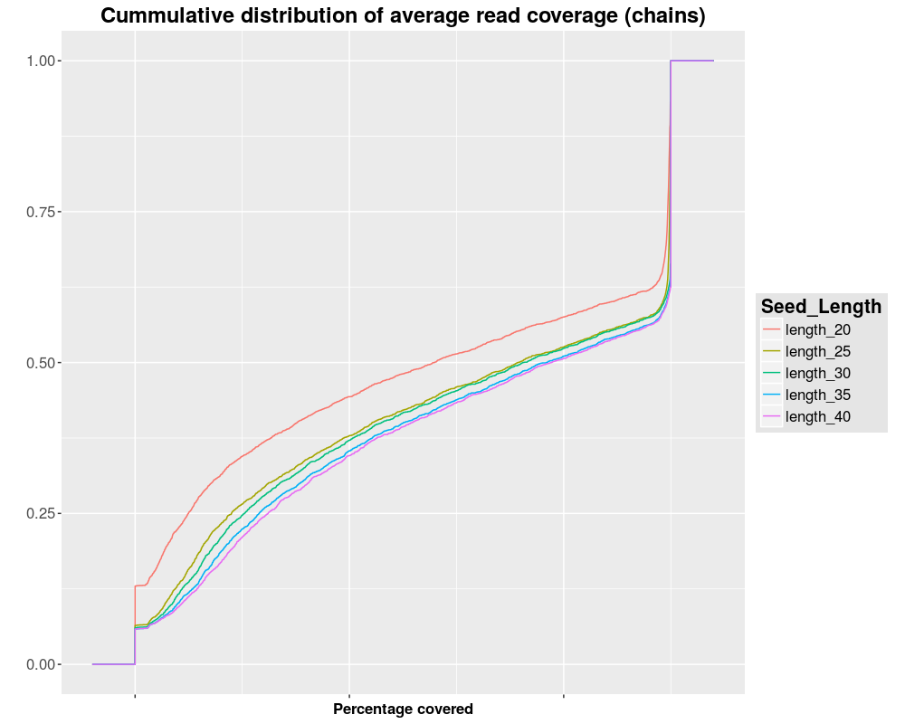
Construction – Seeding
Distribution of overlapping seeds per read and coverage

Slide 17
Construction – Pathing
Exon / Intron Pathing
Gaps between Seed Chains are too large to be aligned
Genomic Length = Transcriptomic Length + Introns
Identified Introns can be skipped during alignment
[BOXPLOT]

Slide 18
Construction – Pathing
Exon / Intron Pathing
Step 1: Generate all possible read start and stop positions from known transcripts
Step 2: Find all solutions to fill seed gaps with a tolerance of 5% to allow InDels
[BOXPLOT]

Slide 19
Construction – Alignment
Alignment
Goal: Compare Pathing solutions to pick most likely variant
Near-linear alignment inside of exons (Close to O(n^2), n = transcript size per Pathing variant)

Slide 20
Construction – Alignment
Alignment
Step 1: Gotoh alignment of all Paths
Step 2: Retain maximum Path for every seed gap
Step 3: Stitch retained Paths for every seed chain

Slide 21
Construction – Alignment
Alignment – Parameter Tuning
Low InDel rate (~1%) -> High gap costs
Short InDels (Avg. 1) -> Low GO and high GE costs
High mismatch rate (~30%) -> Low Mismatch costs
Complex interaction of mapping parameters makes systematic tuning hard
[Heatmaps]

Slide 22
Results & comparisons
Nanopore sequencing
How it works
Structure of reads
Defining the problem
Currently available mappers
BWA, Last, GraphMap
Constructing a new mapper
Seeding
Chaining
Pathing
Aligning
Results & comparisons

