Slide 1


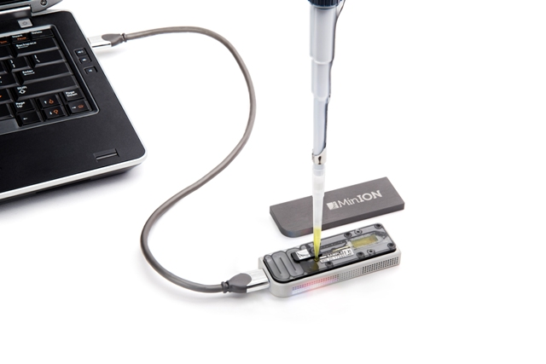
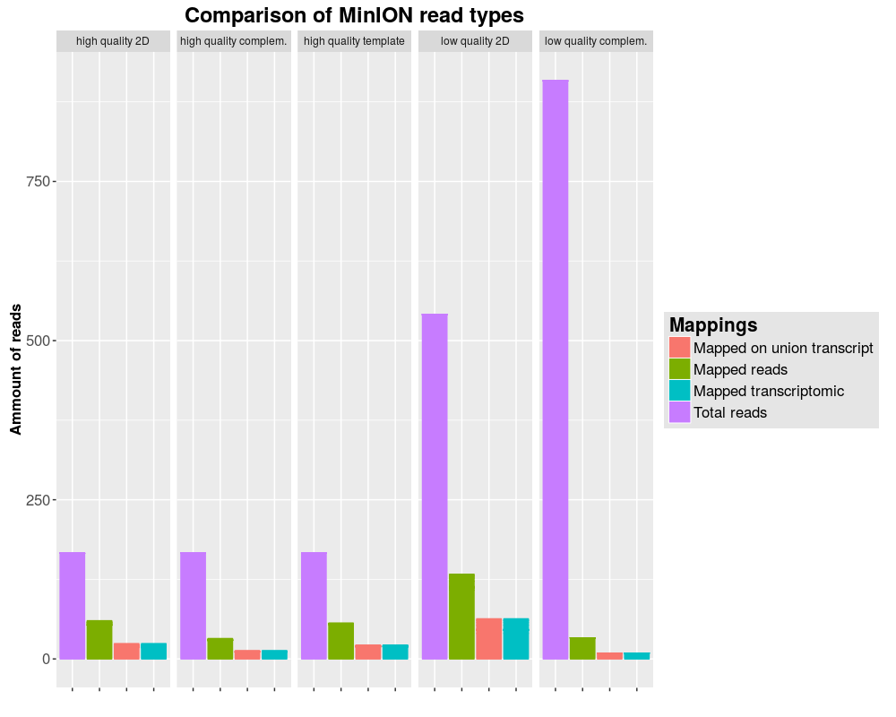
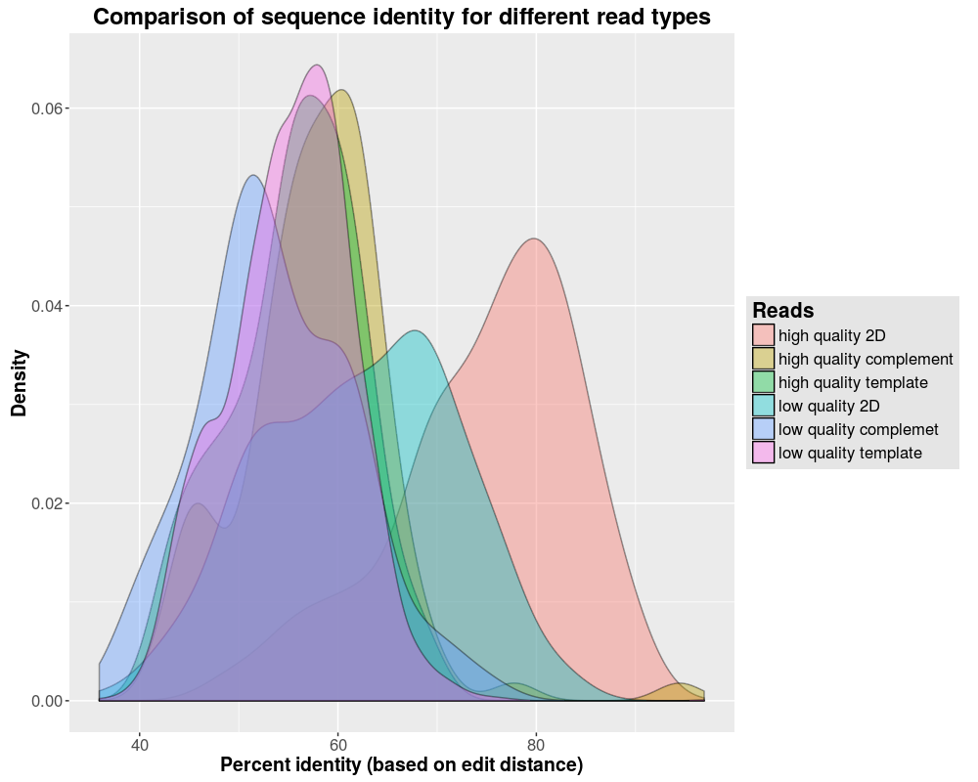
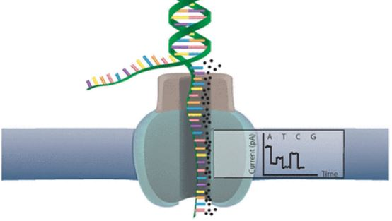
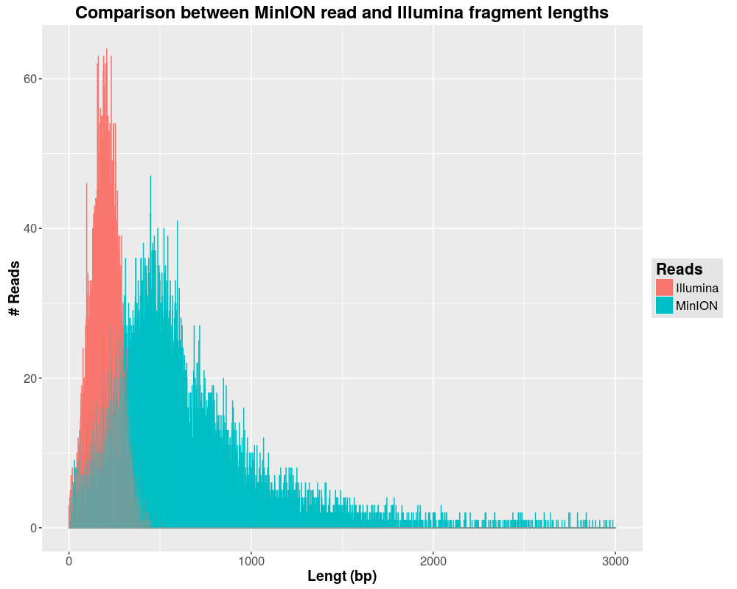
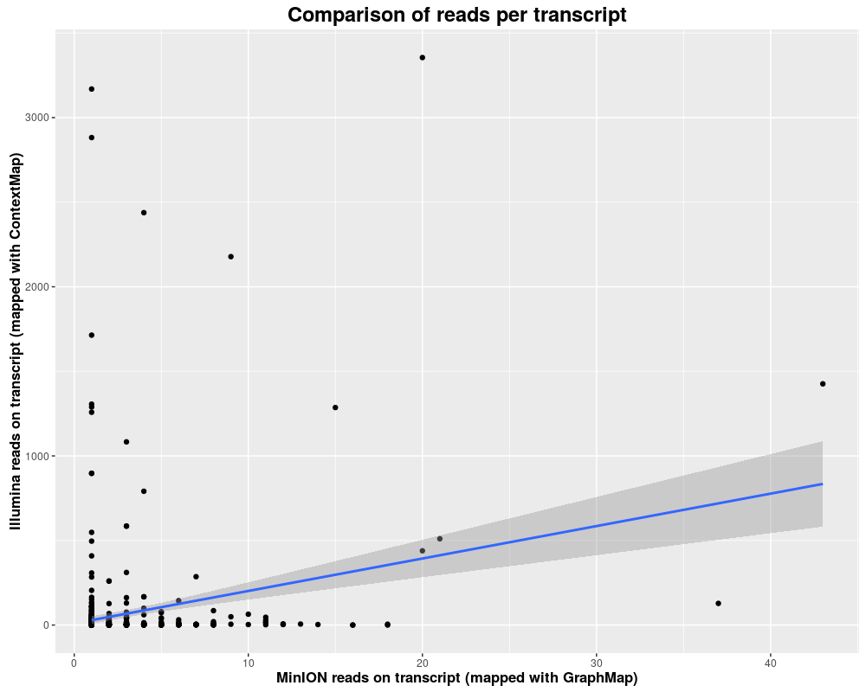
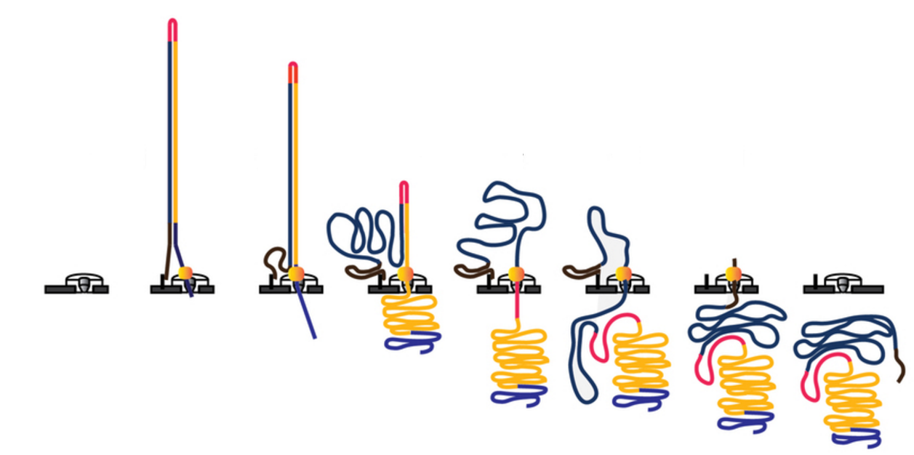
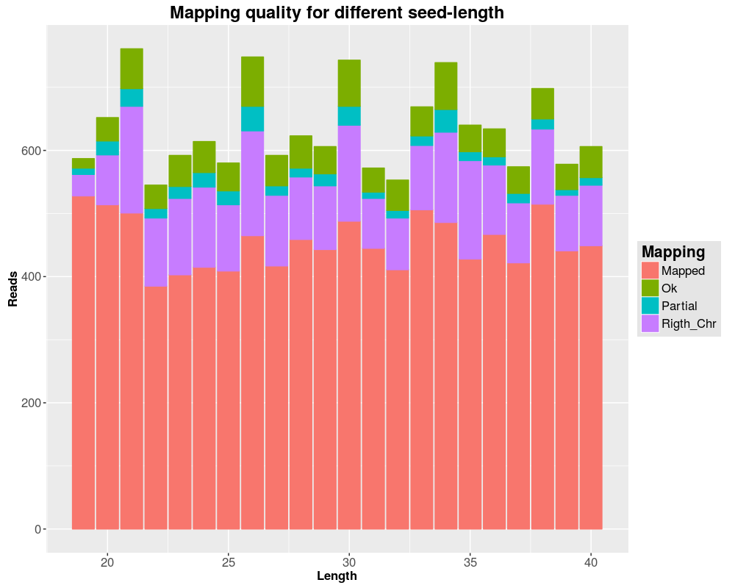
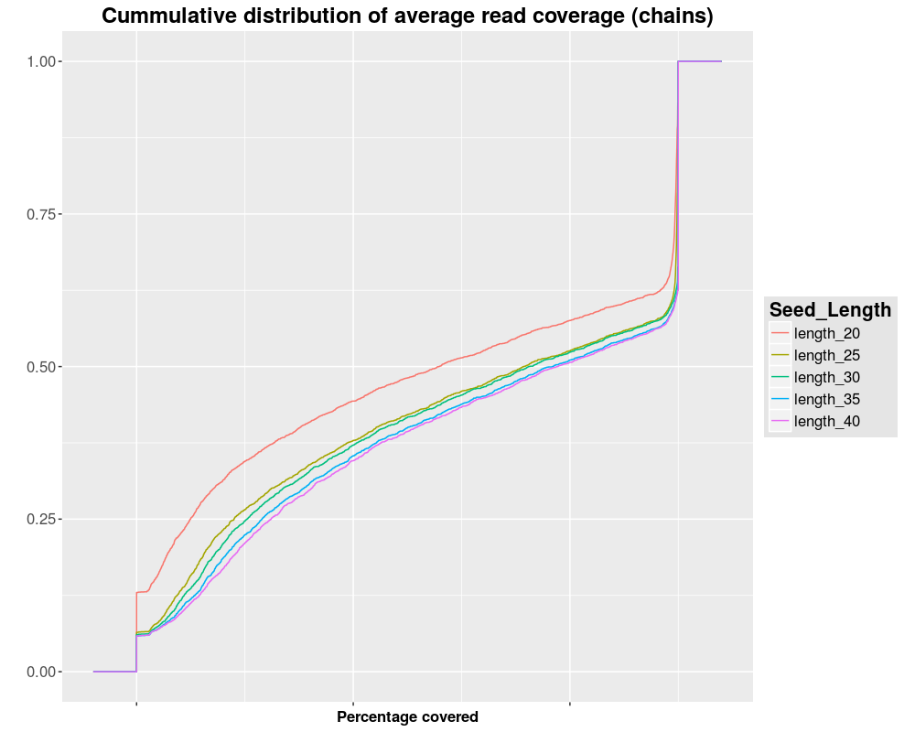
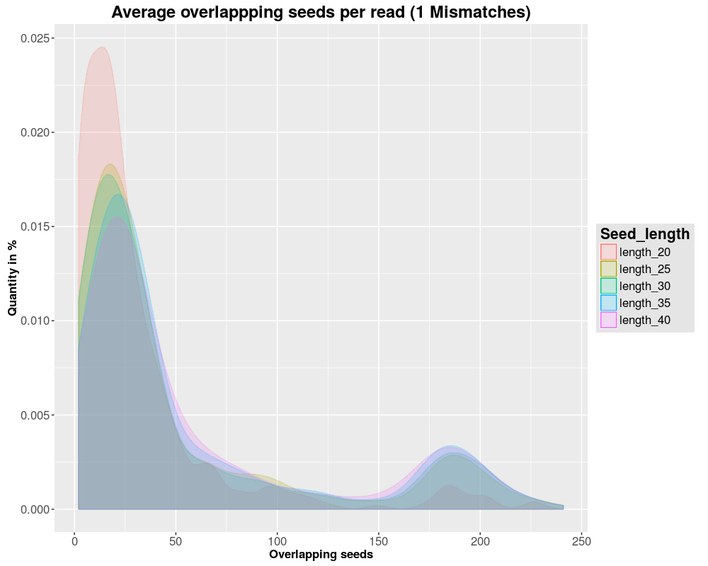
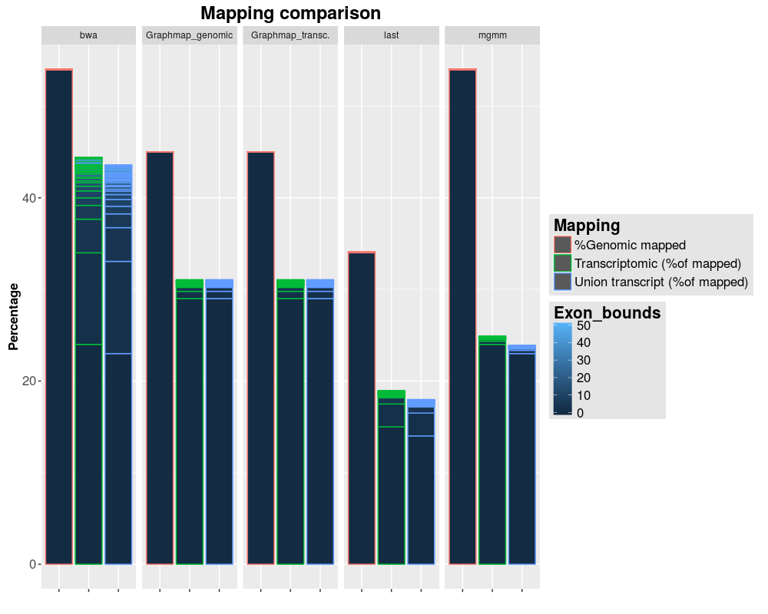
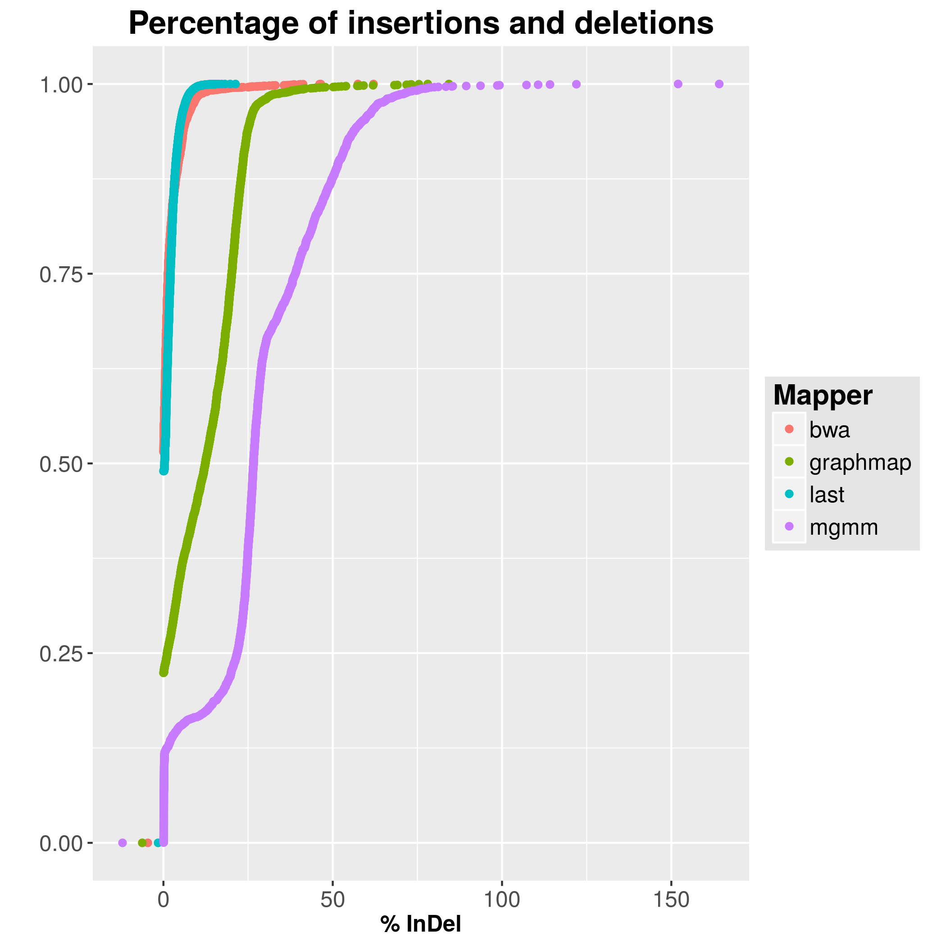
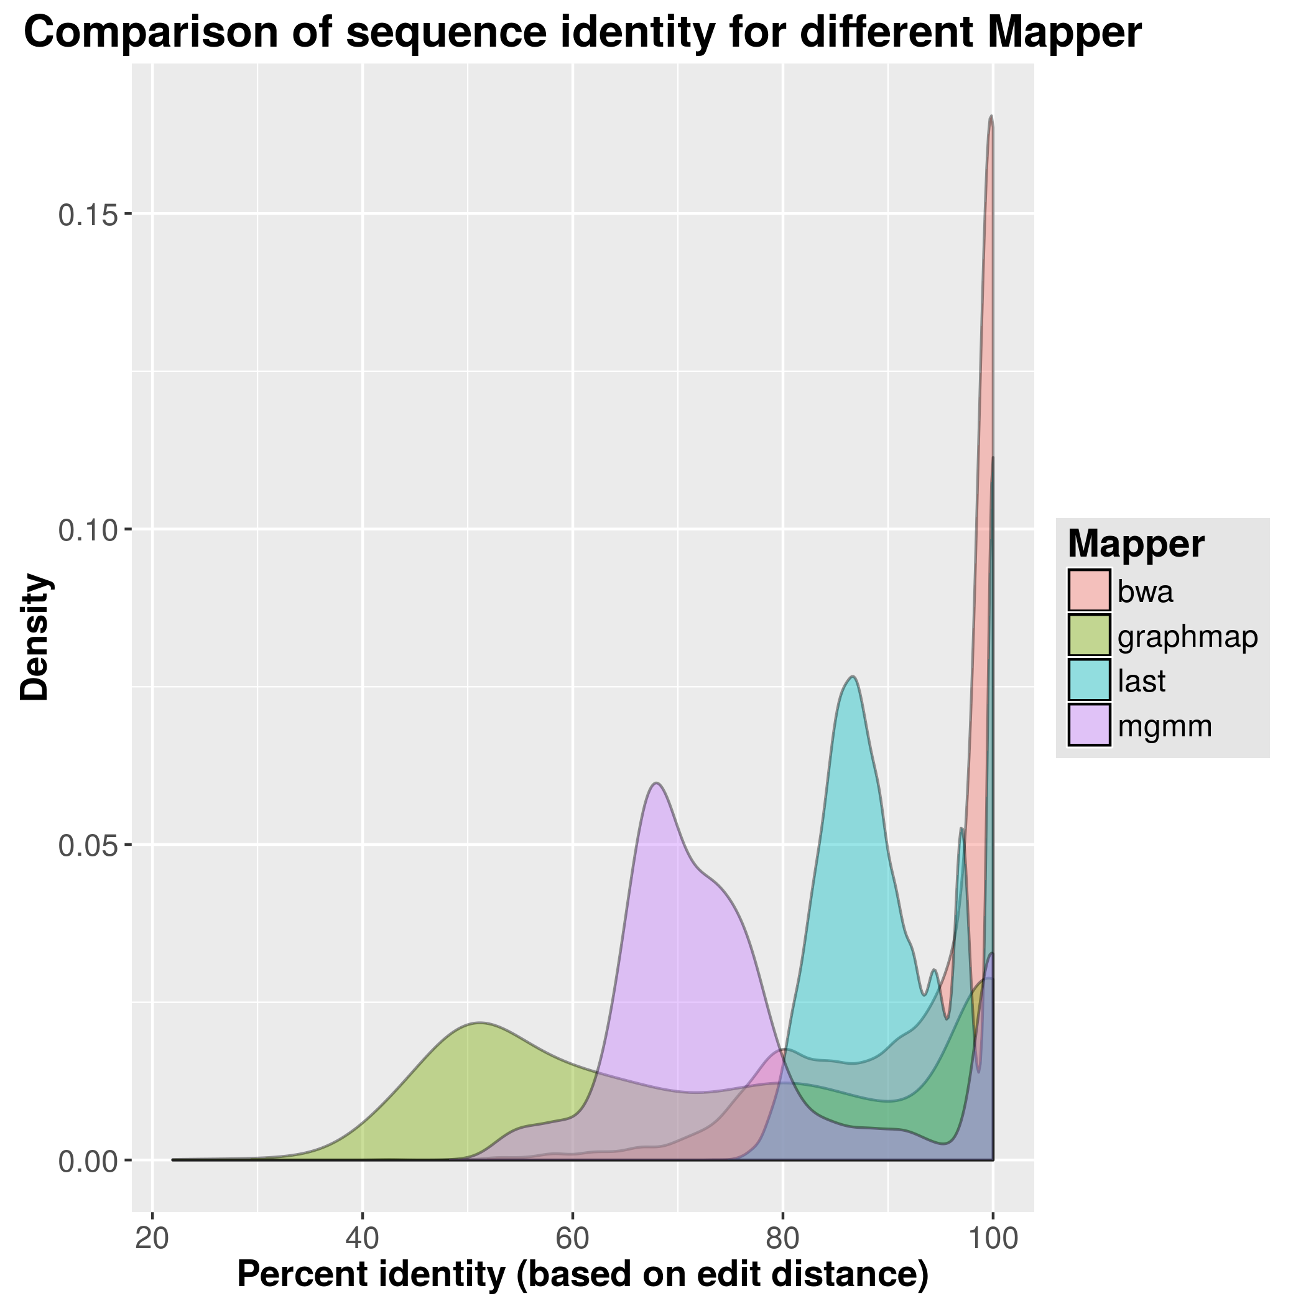
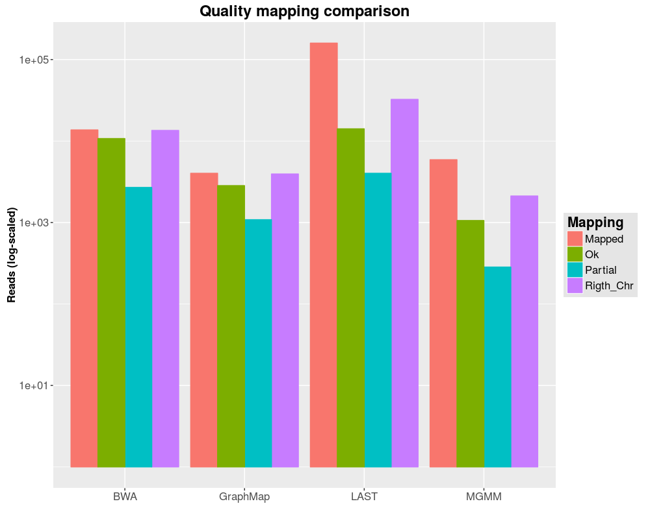
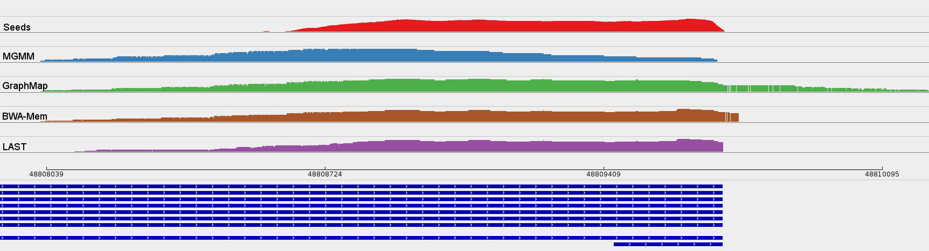
Lehr- und Forschungseinheit Bioinformatik
Institut für Informatik
Ludwig-Maximilians-Universität München
Bioinformatik – GoBi Praktikum
MGMM - Nanopore Sequencing Mapper
A new Bowtie-based Mapper for long reads with high error rate
Ron Fechtner, Jonas Galli, Felix Offensperger, Florian Tichawa
Praktikum Genomorientierte Bioinformatik Ws 2016-2017
Introduction in MinION reads and goal of the project
Introduced Feb 2012 by Oxford Nanopore Technology (ONT)
Real-time DNA, RNA / miRNA and Protein Sequencing
Compact USB-Stick Format
Low cost
Fast library preparation
Few, long reads
High error rate
A protein nanopore is set in an electrically-resistant polymer membrane
Electric current generated through the nanopore when applying a potential across the membrane
Passing molecule create characteristic disruption in current, called the nanopore signal
Demand for new mapping approach
Enable transcriptomic mapping
A passing molecule is composed of
Loading adaptor (Eases flow through pore)
Template strand
Hairpin adaptor (Connects strands)
Complement strand
Loading adaptor
The information from both strands is used for the consensus sequence (2D read)
Methods
Detection of the right parameters
1.Step: Creation of seeds
Read is too long for single mapping
Detection of seed length with best results
Seeding with fix shift and fix length (5 and **)
Template and Complement
End-to-end mapping with “Bowtie” allowing one Mismatch
2.Step: Creation of overlapping seed-chains
Order of mapping could be wrong
Unification of overlapping seeds when in shift range
All seed-chains one the same chromosome were collected and written in a fastM file
3.Step: Pathing of missing read parts
Gaps between seed-chains are too big for alignment
Calculation of all possible exon / intron paths
4.Step: Alignment
Alignment of all previously detected paths
Comparison of alignment scores and stitching of the best path combinations
Conclusion
Seeding worked well, but filtering seemed too restrictive
Parts without seeds could not be mapped
Complex interaction between different parameters
Writing runtime and memory efficient code is challenging
Notes:
B4 Schober, endothelial cells, miRNA soll bestimmte lncRNA regulieren
dicer knockout -> alle miRNA prozessierung ausgeschaltet
Custom Microarray -> lncRNA gemessen
Let-7b and miR103 regulate the expression of the majority of the lncRNAs in atherosclerotic endothelial cells
Für jede probe ein eintrag
Sequenziert die kontroll
From genes to
Was ist Z2, AtheroNetwork (bj modules), AtheroIndex (bj/merkin)
OL STAGE, mouse data, cross tissue/cross species
Ifit3
Rbp4
Söhnlein csaba resolving lipid mediators … -> supplement -> profil ->

