Slide 1
MGMM - Nanopore Sequencing Mapper A new Bowtie-based Mapper for long reads with high error rate
Ron Fechtner / Jonas Galli / Felix Offensperger / Florian Tichawa
Genomorientierte Bioinformatik
Praktikumsleitung: Prof. Dr. Ralf Zimmer,
Betreuer: Dr. Gergely Csaba, Markus Gruber
Datum des Vortrags: 28.04.2017

Slide 2

Overview
Nanopore sequencing
How it works
Structure of reads
Defining the problem
Currently available mappers
BWA, Last, GraphMap
Constructing a new mapper
Seeding
Chaining
Pathing
Aligning
Results and comparisons

Slide 3
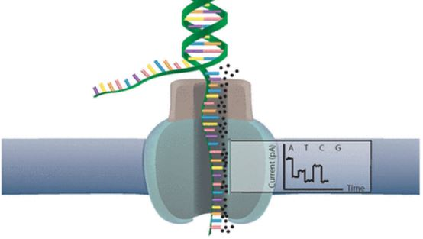
Nanopore sequencing [Ron]
Nanopore sequencing
How it works
Structure of reads
Defining the problem
Currently available mappers
BWA, Last, GraphMap
Constructing a new mapper
Seeding
Chaining
Pathing
Aligning
Results and comparisons

Slide 4
Nanopore Sequencing – How it works
Nanopore Sequencing
Introduced 2012 by Oxford Nanopore Technology
Utilizes electrical

Slide 5
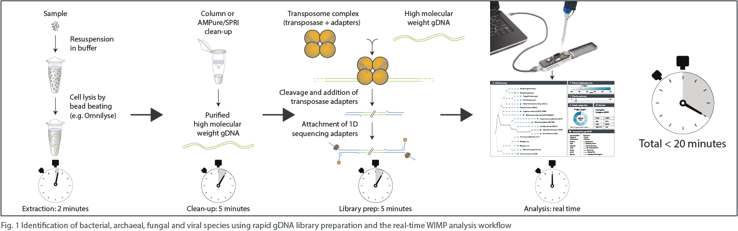
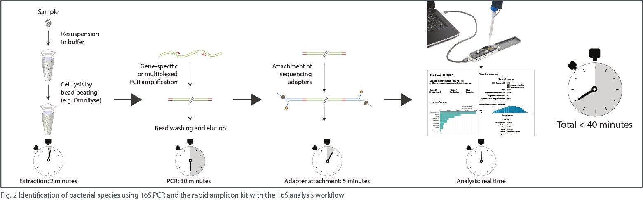
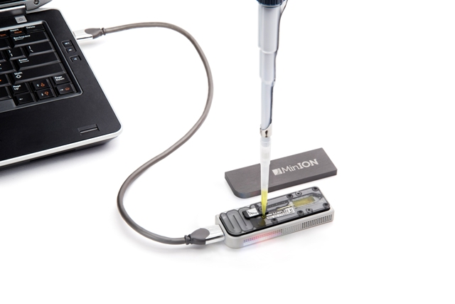
Nanopore Sequencing – How it works

Slide 6
Nanopore Sequencing – How it works

Slide 7
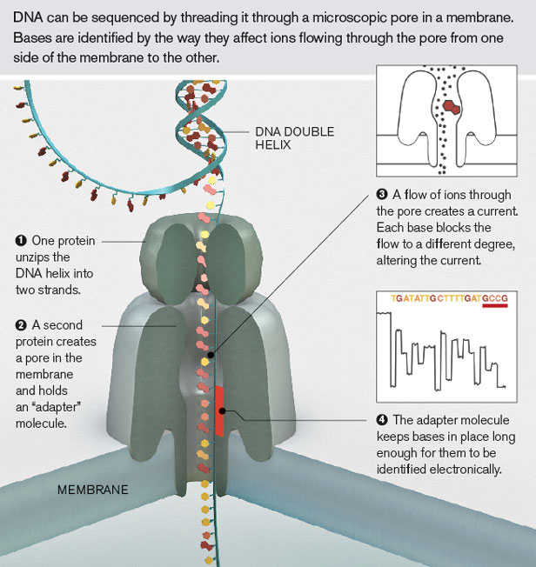
Nanopore Sequencing – How it works

Slide 8
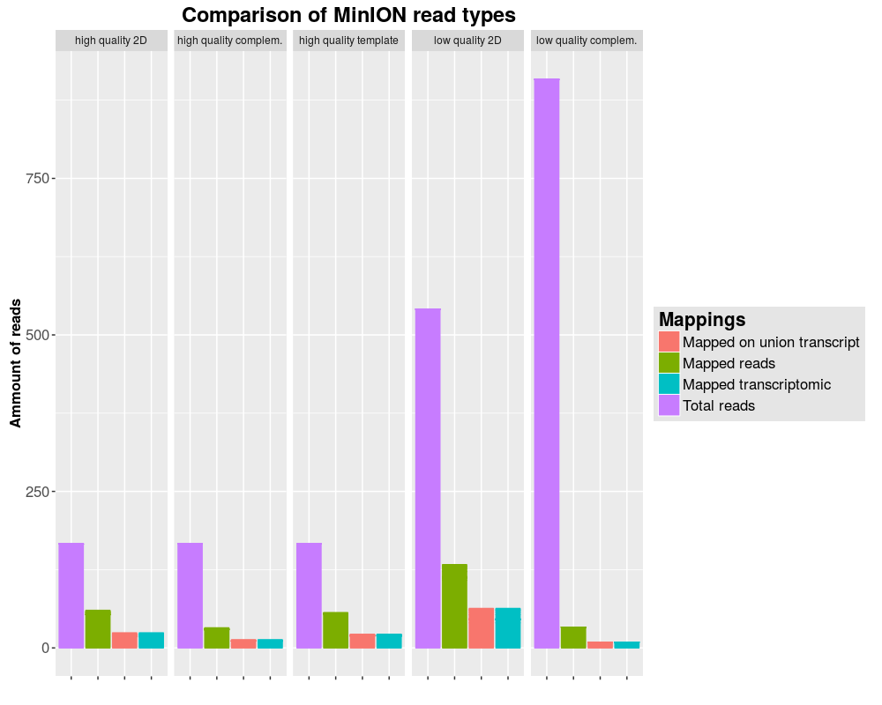
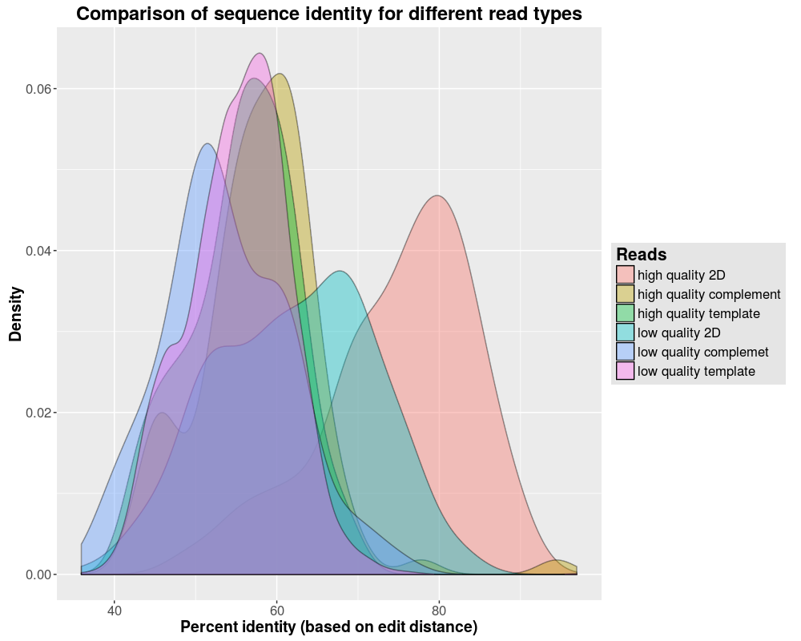
Nanopore Sequencing – Structure of reads

Slide 9
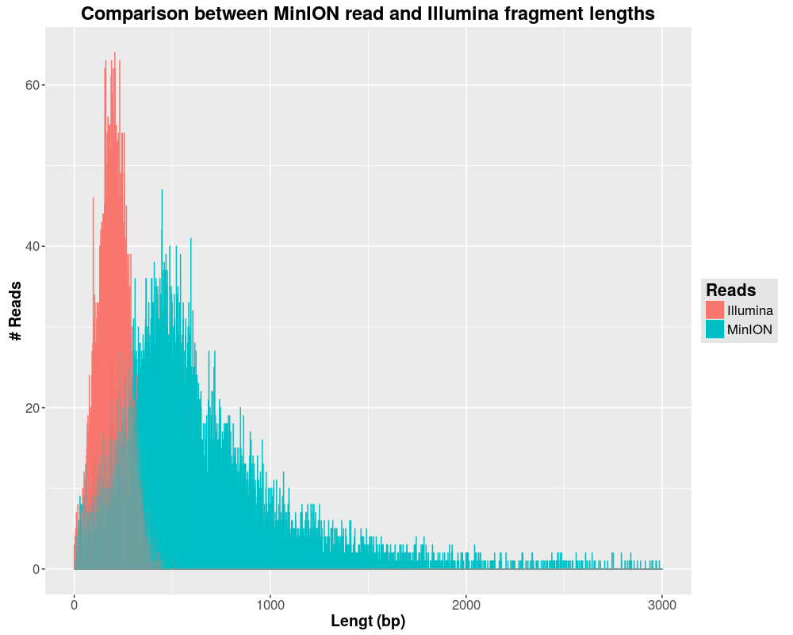
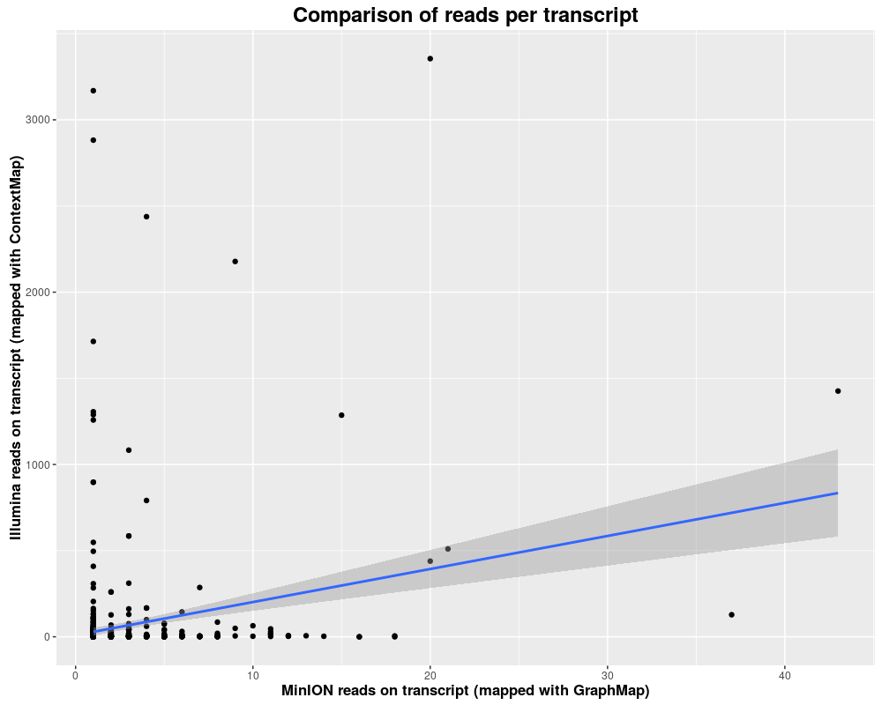
Nanopore Sequencing – Structure of reads

Slide 10
Nanopore Sequencing – Defining the Problem

Slide 11
Currently available mappers
Nanopore sequencing
How it works
Structure of reads
Defining the problem
Currently available mappers
BWA, Last, GraphMap
Constructing a new mapper
Seeding
Chaining
Pathing
Aligning
Results and comparisons

Slide 12
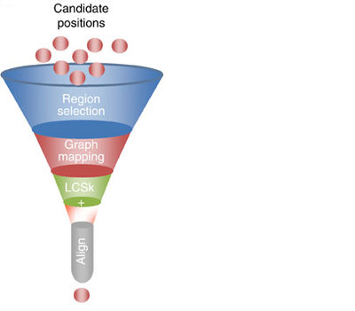
Currently available mappers
Finding candidate positions /seeds:
BWA-MEM: maximal exact matches (MEM)
or supermaximal exact matches (SMEM)
with canonical seed-and-extend paradigm and re-seeding
LAST: Hamming distance based spaced seeds
GraphMap: gapped spaced seeds
similar to gappes q-gram filters for Levenshtein distance
MGMM – A long read Mapper
12
Notes:
12

Slide 13
Currently available mappers
First selection of seeds:
GraphMap: clustering into candidate regions:
- into anchors under graph-based vertex-centrix construction
BWA-MEM: Chaining:
-seeds that are colinear and close to each other are a chain
-chainfiltering short chains that are largely contained in a
long chain and are much worse than the long chain
MGMM – A long read Mapper
13
Notes:
13

Slide 14
Currently available mappers
Chaining, scoring and filtering:
GraphMap: Extending anchors into alignments using LCSk
-variable lengths of corresponding anchors
-a list of consecutive anchors in the target and the query sequence
-filtering with L1 regression
the number of exact kmers covered by the anchor
the length of the query sequence which matched the target
the number of bases covered by anchors
the read length
BWA-MEM: Seed extension:
-ranking seeds by length of the chain it belongs to and
then by the seed length
-dropping seeds that are contained in an alignment found before
-extending seeds with a banded affine-gap-penalty dynamicprogramming
-heurisitcs to avoid the extension of poorly aligned regions
-chooses between local and end-to-end alignments
MGMM – A long read Mapper
14
Notes:
14

Slide 15
Constructing a new mapper
Nanopore sequencing
How it works
Structure of reads
Defining the problem
Currently available mappers
BWA, Last, GraphMap
Constructing a new mapper
Seeding
Chaining
Pathing
Aligning
Results and comparisons

Slide 16
Constructing – Seeding [Jonas]
Seeding
Theory
Reads are too long to be aligned in one run
Splitting into many small seeds
Mapping of seeds with close to no mismatches
Implementation
Seed of length (35 bp)
MM max 1
Mapping with Bowtie (End to End MM = 1)
[PLOTS] Fancy plot with seed lengths

Slide 17
Constructing – Chaining [Jonas]
Chaining
Theory
Mapping of single seeds don’t have much meaning (random)
Seed-groups indicate mapped regions
Filtering of misplaced seeds
Implementation
Detection of overlapping seeds
Stitching to larger seed-chains
Grouping of seeds with fitting transcriptomic and genomic coordinates
[PLOTS] Length of seed-chains

Slide 18
Constructing – Pathing [Flo]
Pathing
Theory
Alignments between seeds are still too large -> need to reduce alignment size
Difference between transcriptomic and genomic length = sum of introns -> find intron combinations filling this gap
Implementation
Pathing creates all exon / intron combinations in area between seeds fitting into the gaps with a tolerance of 5 percent
[PLOTS] Transcriptomic length of chained reads vs genomic length

Slide 19
Constructing – Aligning [Flo]
Aligning
Theory
High mismatch rate / low inDel rate
Aligning all possible paths
Picking the best solution for each seed gap
Stitching partial alignments
Implementation
GOTOH approach with optimized parameters
[PLOTS] Heatmap of parameter tuning

Slide 20
Results & comparisons
Nanopore sequencing
How it works
Structure of reads
Defining the problem
Currently available mappers
BWA, Last, GraphMap
Constructing a new mapper
Seeding
Chaining
Pathing
Aligning
Results & comparisons

