Slide 1
MGMM - Nanopore Sequencing Mapper A new Bowtie-based Mapper for long reads with high error rate
Ron Fechtner / Jonas Galli / Felix Offensperger / Florian Tichawa
Genomorientierte Bioinformatik
Praktikumsleitung: Prof. Dr. Ralf Zimmer,
Betreuer: Dr. Gergely Csaba, Markus Gruber
Datum des Vortrags: 28.04.2017

Slide 2

Overview
Nanopore sequencing
How it works
Structure of reads
Defining the problem
Currently available mappers
BWA, Last, GraphMap
Constructing a new mapper
Seeding
Chaining
Pathing
Aligning
Results and comparisons

Slide 3
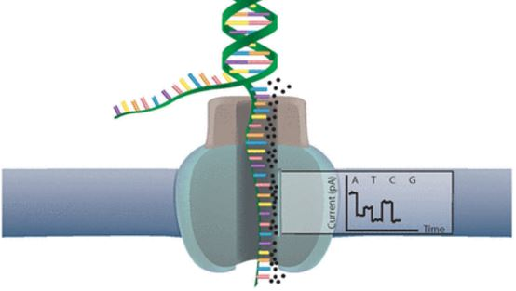
Nanopore sequencing [Ron]
Nanopore sequencing
How it works
Structure of reads
Defining the problem
Currently available mappers
BWA, Last, GraphMap
Constructing a new mapper
Seeding
Chaining
Pathing
Aligning
Results and comparisons

Slide 4
Nanopore Sequencing – How it works
Nanopore Sequencing
Introduced 2012 by Oxford Nanopore Technology
Utilizes electrical

Slide 5
Nanopore Sequencing – How it works
Library preparation
Nanopore sequencing
Analysis

Slide 6
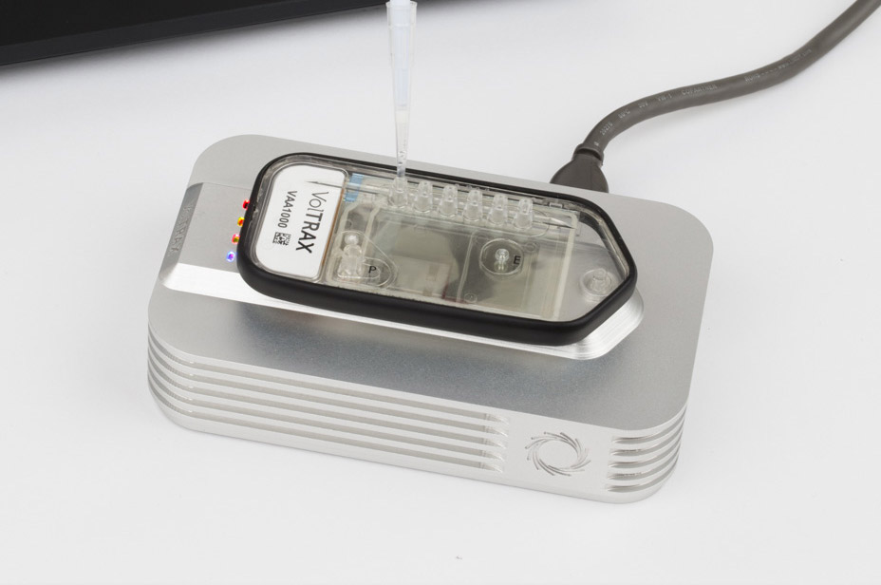
Nanopore Sequencing – How it works
Library preparation
Analysis
Nanopore sequencing
Library preparation Workflow depending on application and input data
Prepare the DNA / RNA compound for nanopore sequencing (NPS)
Manual or Automated
With or without PCR amplification
Various protocol duration lengths
For different input qualities (i.e. low input)
Resulting in different library qualities (1D vs. 2D)

Slide 7
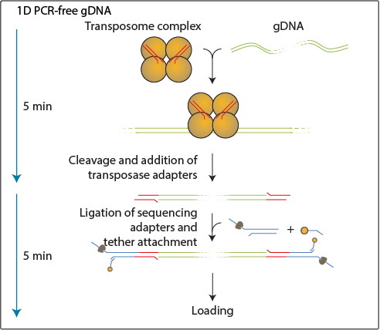
Nanopore Sequencing – How it works
Library preparation
Analysis
Nanopore sequencing
Rapid library preperation
Fast prep in under 10 min
DNA is fragmented using a transposase, which simultaneously attaches adapters to the free ends.
The NPS Y-adapters are then added that allow the DNA to enter the pore
One strand of the duplex is sequenced at a time
Produces lower quality 1D reads

Slide 8
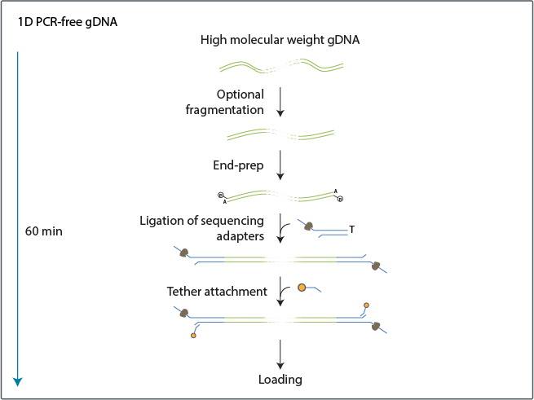
Nanopore Sequencing – How it works
Library preparation
Analysis
Nanopore sequencing
Ligation library preperation (1D)
Genomic DNA may be fragmented, to generate fragments of predefined lengths
Adapters are added to the free ends
NPS Y-Adapters are added
It prepares the sample for '1D' sequencing
Takes up to an hour

Slide 9
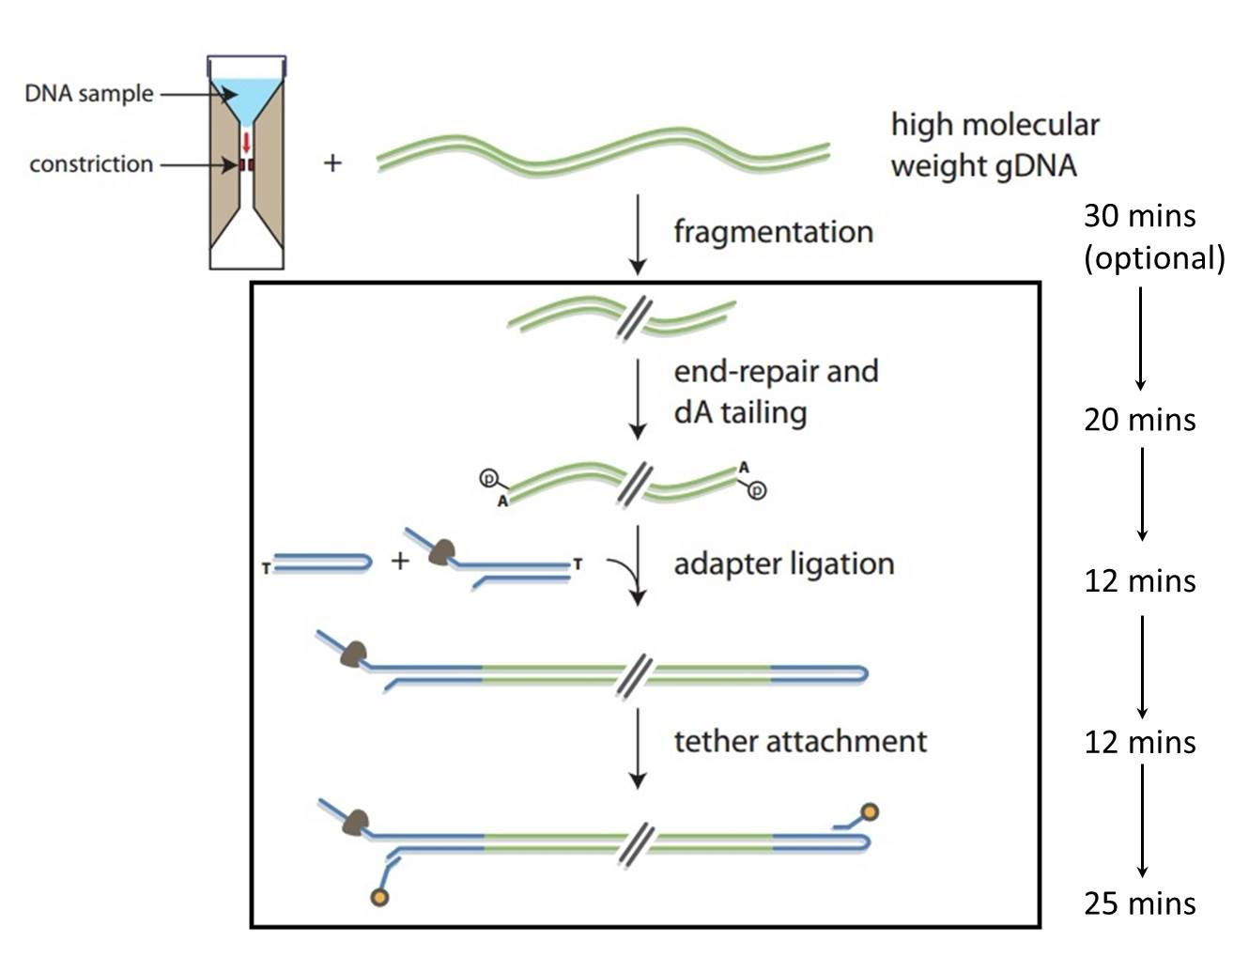
Nanopore Sequencing – How it works
Library preparation
Analysis
Nanopore sequencing
Ligation library preperation (2D)
DNA may be fragmented, to generate fragments of predefined lengths
Optional DNA repair step
Allows barcoding for multiple samples
Adapted protocols for ultra long reads (>100 kb)
Allows low input
Prepares for 2D Sequencing

Slide 10
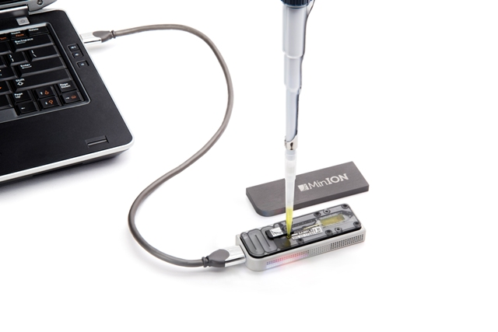
Nanopore Sequencing – How it works
Library preparation
Analysis
Nanopore sequencing
Library is loaded into NPS Device (i.e. portable MinION)

Slide 11
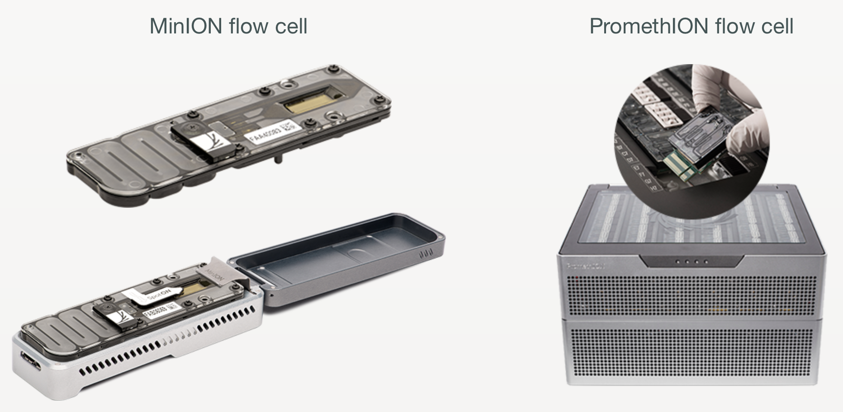
Nanopore Sequencing – How it works
Library preparation
Analysis
Nanopore sequencing
Library is loaded into NPS Device (i.e. portable MinION)
Sequencer contains a replaceable flow cell that contains:

Slide 12
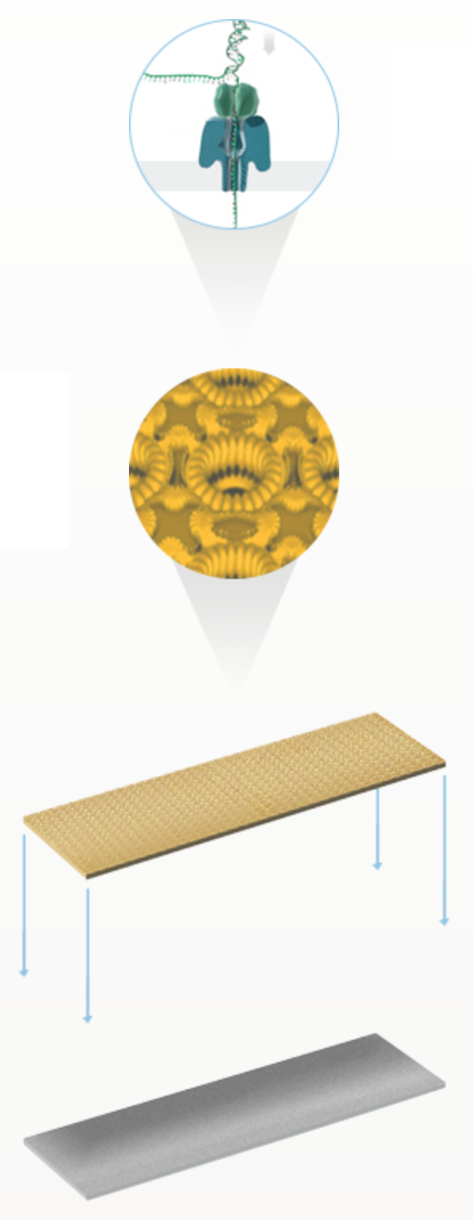
Nanopore Sequencing – How it works
Library preparation
Analysis
Nanopore sequencing
Library is loaded into NPS Device (i.e. portable MinION)
Sequencer contains a replaceable flow cell that contains:
Multiple protein nanopores set in an electrically-resistant polymer membrane
Array of arranged nanopores in microscaffolds
Sensor chip for each microscaffold
Application-Specific Integrated Circuit (ASIC) that measures each nanopore individually

Slide 13
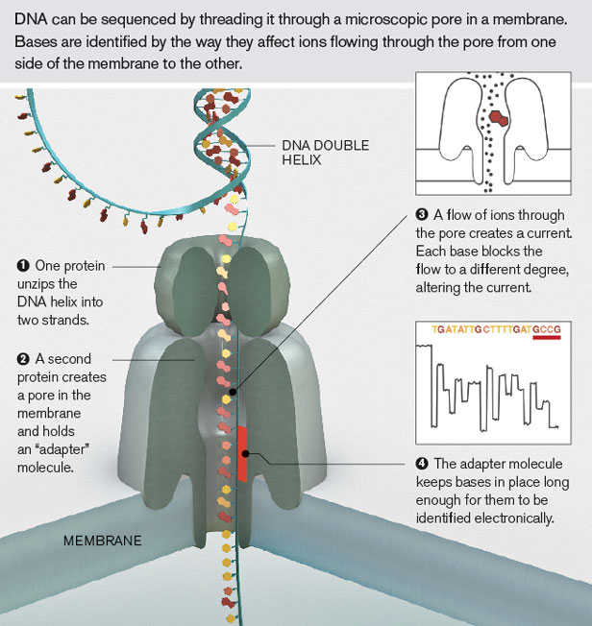
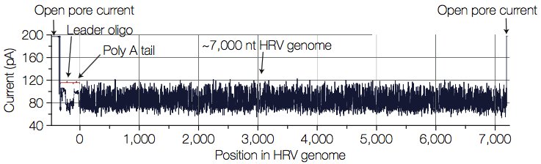
Nanopore Sequencing – How it works
Library preparation
Analysis
Nanopore sequencing

Slide 14
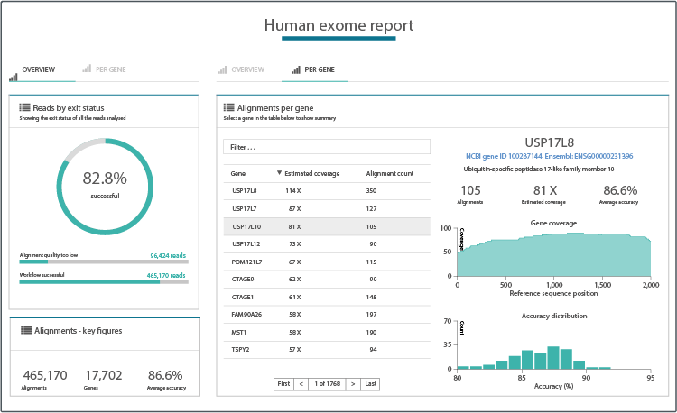
Nanopore Sequencing – How it works
Library preparation
Analysis
Nanopore sequencing

Slide 15
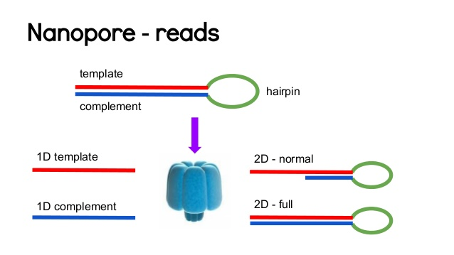
Structure of reads
Two groups: Fail and Pass (low and high quality)
High quality → 2D with complement and template
Low quality → All other reads

Slide 16
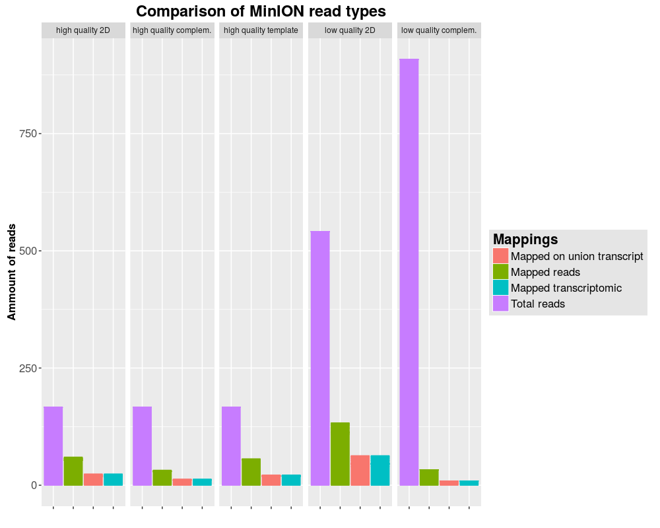
Properties of MinION reads

Slide 17
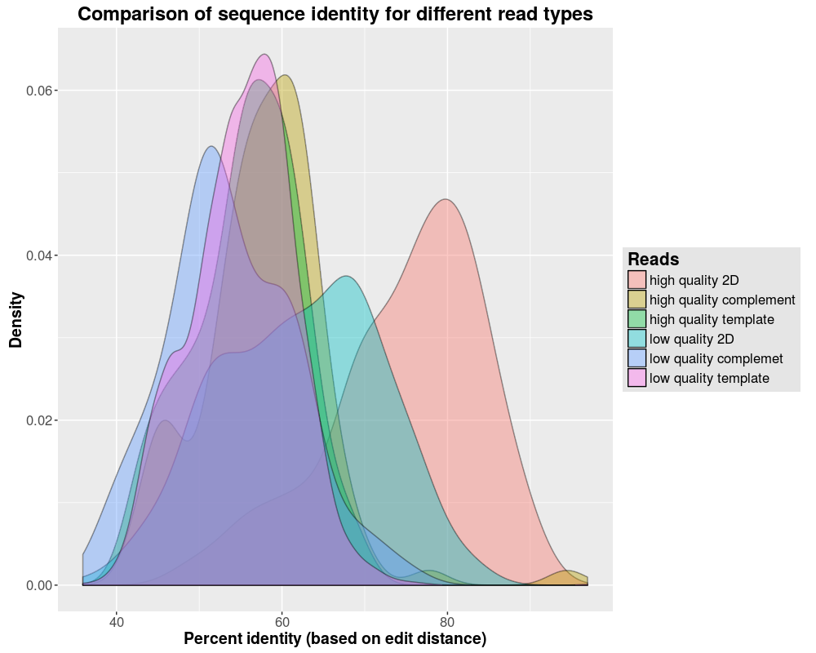
Properties of the reads
Quality comparison between MinION read types

Slide 18
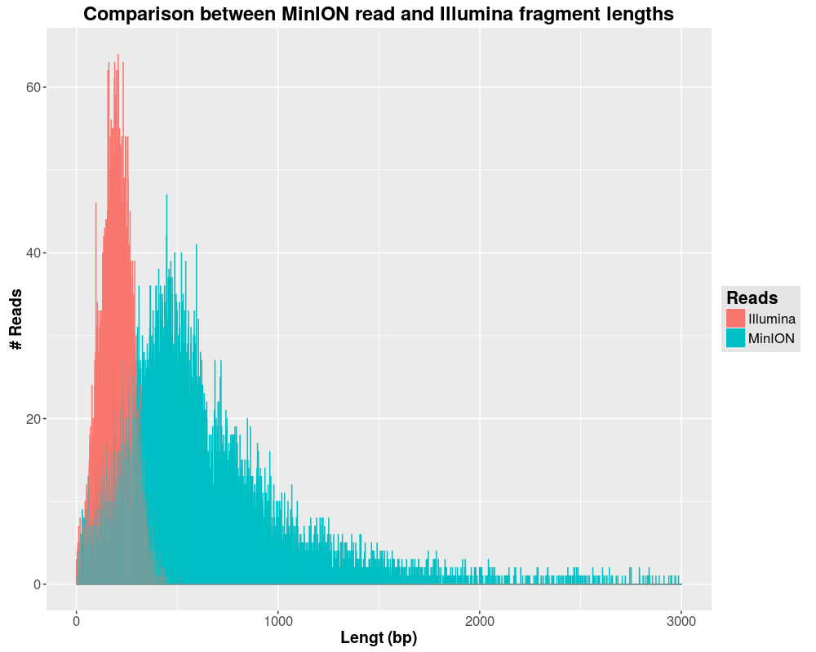
Comparison with Illumina
Read length distribution
Mean length: ~1000
Mean sd: 100
Error rate: 0,3
InDel rate: 0,01

Slide 19
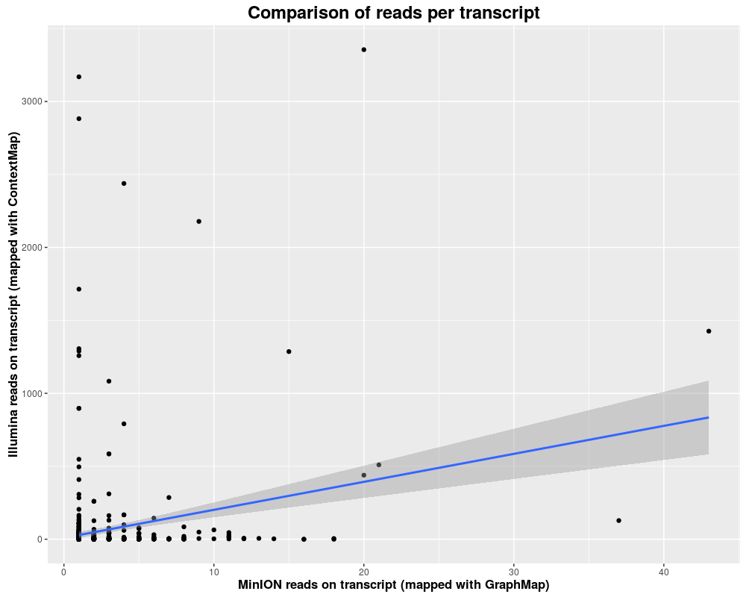
Comparison with Illumina
Read types per transcript (comparison Illumina vs. MinION)
Illumina reads:
Mapping on 148.322 transcripts
MinION reads
Mapping on 679 transcprits
→not enough reads for detection of alternative splicing

Slide 20
Currently available mappers
Nanopore sequencing
How it works
Structure of reads
Comparision with Illumina
Currently available mappers
BWA, Last, GraphMap
Constructing a new mapper
Seeding
Chaining
Pathing
Aligning
Results and comparisons

Slide 21
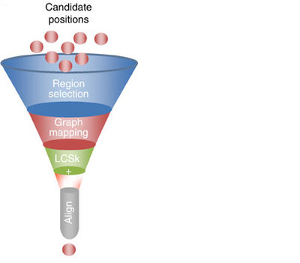
Currently available mappers
Finding candidate positions /seeds:
BWA-MEM: maximal exact matches (MEM)
or supermaximal exact matches (SMEM)
with canonical seed-and-extend paradigm and re-seeding
LAST: Hamming distance based spaced seeds
GraphMap: gapped spaced seeds
similar to gappes q-gram filters for Levenshtein distance
MGMM – A long read Mapper
21
Notes:
21

Slide 22
Currently available mappers
First selection of seeds:
GraphMap: clustering into candidate regions:
- into anchors under graph-based vertex-centrix construction
BWA-MEM: Chaining:
-seeds that are colinear and close to each other are a chain
-chainfiltering short chains that are largely contained in a
long chain and are much worse than the long chain
MGMM – A long read Mapper
22
Notes:
22

Slide 23
Currently available mappers
Chaining, scoring and filtering:
GraphMap: Extending anchors into alignments using LCSk
-variable lengths of corresponding anchors
-a list of consecutive anchors in the target and the query sequence
-filtering with L1 regression
the number of exact kmers covered by the anchor
the length of the query sequence which matched the target
the number of bases covered by anchors
the read length
BWA-MEM: Seed extension:
-ranking seeds by length of the chain it belongs to and
then by the seed length
-dropping seeds that are contained in an alignment found before
-extending seeds with a banded affine-gap-penalty dynamicprogramming
-heurisitcs to avoid the extension of poorly aligned regions
-chooses between local and end-to-end alignments
MGMM – A long read Mapper
23
Notes:
23

Slide 24
Constructing a new mapper
Nanopore sequencing
How it works
Structure of reads
Comparision with Illumina
Currently available mappers
BWA, Last, GraphMap
Constructing a new mapper
Seeding
Chaining
Pathing
Aligning
Results and comparisons

Slide 25
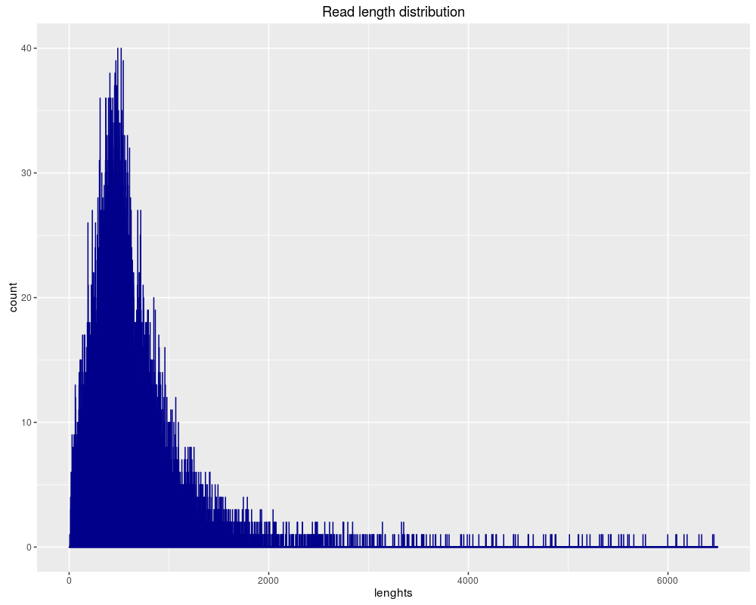
Construction – Seeding
Seeding
Reads are too long to be aligned as one
Short reads can be aligned with close to zero mismatches and String search
Splitting the read into small seeds

Slide 26
Construction – Seeding
Seeding
Fixed seed length of 35 bp with 5 bp shift
Up to 7 seeds per bp
Mapping with Bowtie
End-to-End alignment
Allowing 1 mismatch
No mapping on reverse strand

Slide 27
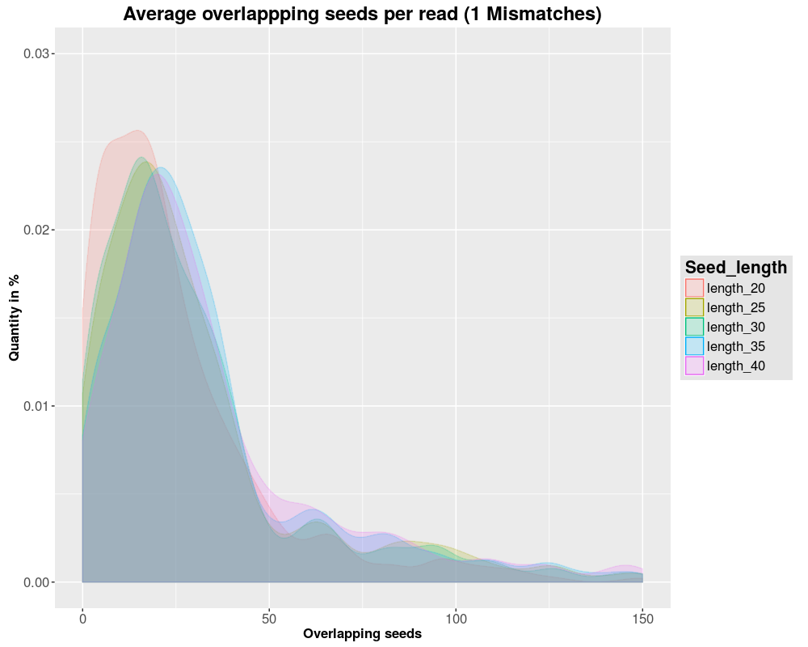
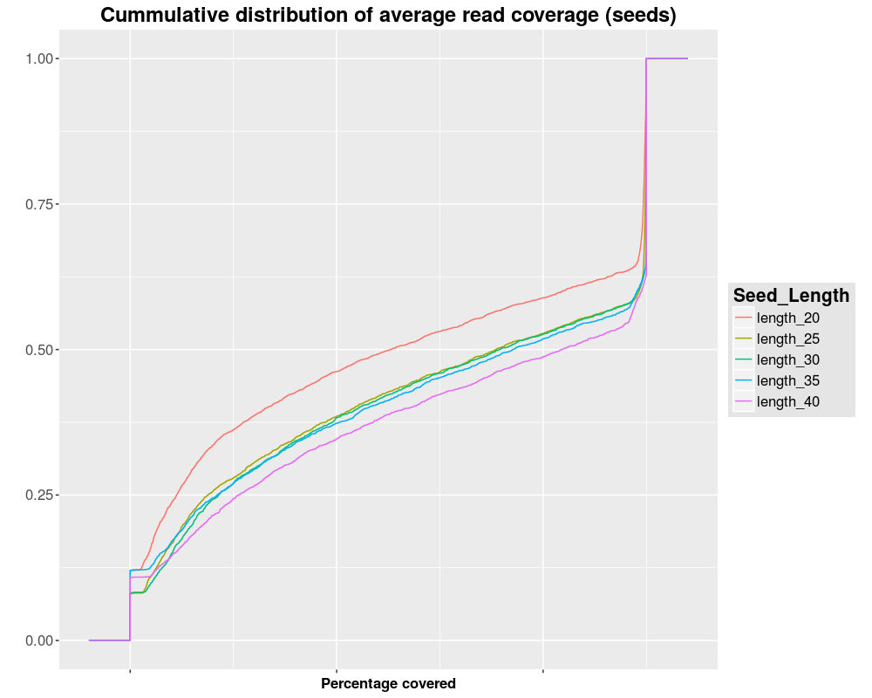
Construction – Seeding
Distribution of overlapping seeds per read and coverage

Slide 28
Construction – Chaining
Chaining
Mapping of single seeds is possibly random
Seed groups in same genomic region indicate a possible mapping
Filtering of misplaced seeds

Slide 29
Construction – Chaining
Chaining
Detection of overlapping seeds in correct order
Stitching to longer seed chains
Grouping of seeds with fitting genomic and transcriptomic coordinates
Filtering of reverse and forward chains
Seed chains are written to fastM files for alignment

Slide 30
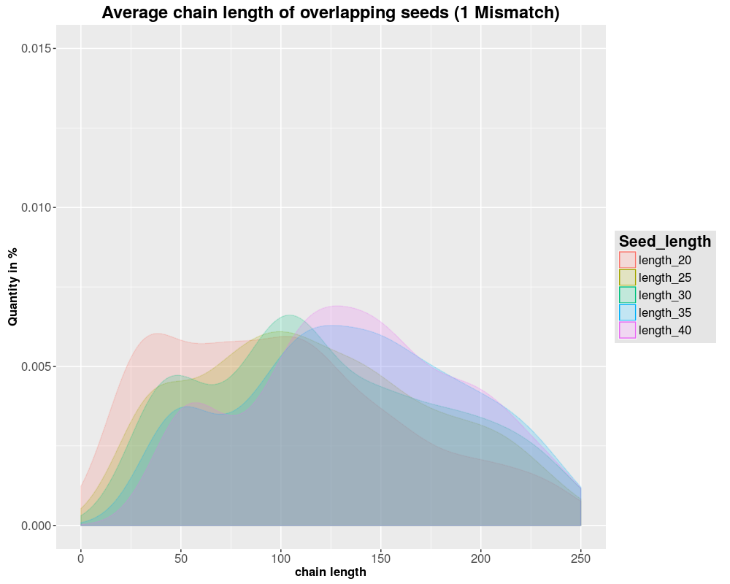
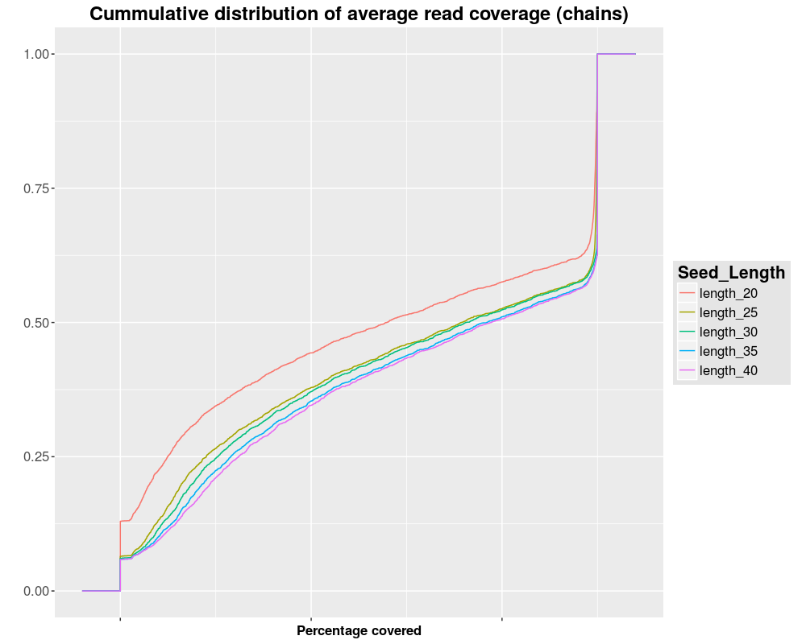
Construction – Chaining
Distribution of overlapping seeds per read and coverage

Slide 31
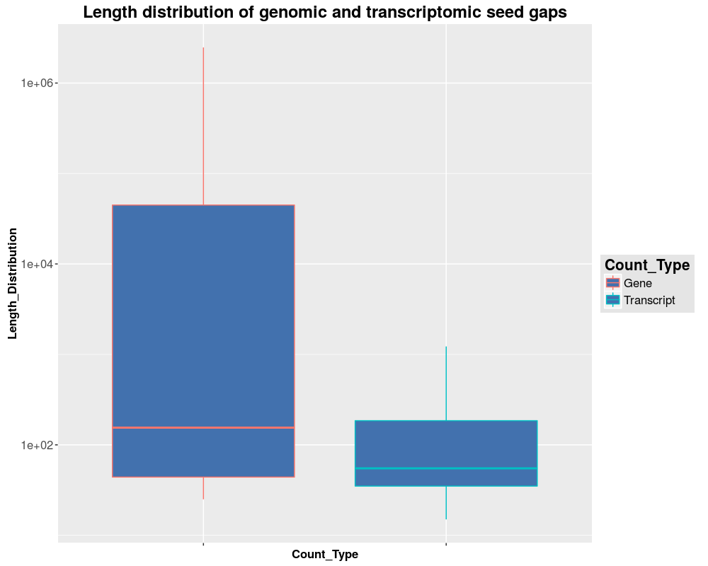
Construction – Pathing
Exon / Intron Pathing
Gaps between Seed Chains are too large to be aligned
Genomic Length = Transcriptomic Length + Introns
Identified Introns can be skipped during alignment

Slide 32
Construction – Pathing
Exon / Intron Pathing
Step 1: Generate all possible read start and stop positions from known transcripts
Step 2: Find all solutions to fill seed gaps with a tolerance of 5% to allow InDels

Slide 33
Construction – Alignment
Alignment
Goal: Compare Pathing solutions to pick most likely variant
Near-linear alignment inside of exons (Close to O(n^2), n = transcript size per Pathing variant)

Slide 34
Construction – Alignment
Alignment
Step 1: Gotoh alignment of all Paths
Step 2: Retain maximum Path for every seed gap
Step 3: Stitch retained Paths for every seed chain

Slide 35
Construction – Alignment
Alignment – Parameter Tuning
Low InDel rate (~1%) -> High gap costs
Short InDels (Avg. 1) -> Low GO and high GE costs
High mismatch rate (~30%) -> Low Mismatch costs
Complex interaction of mapping parameters makes systematic tuning hard

Slide 36
Results & comparisons
Nanopore sequencing
How it works
Structure of reads
Currently available mappers
BWA, Last, GraphMap
Constructing a new mapper
Seeding
Chaining
Pathing
Aligning
Results & comparisons

Slide 37
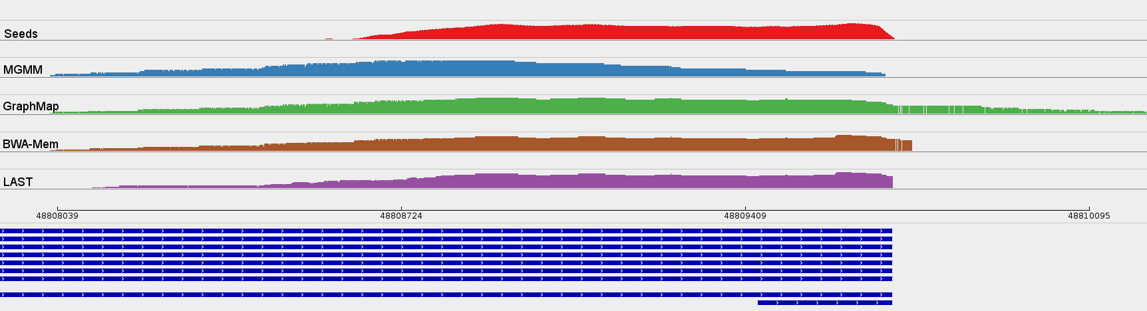
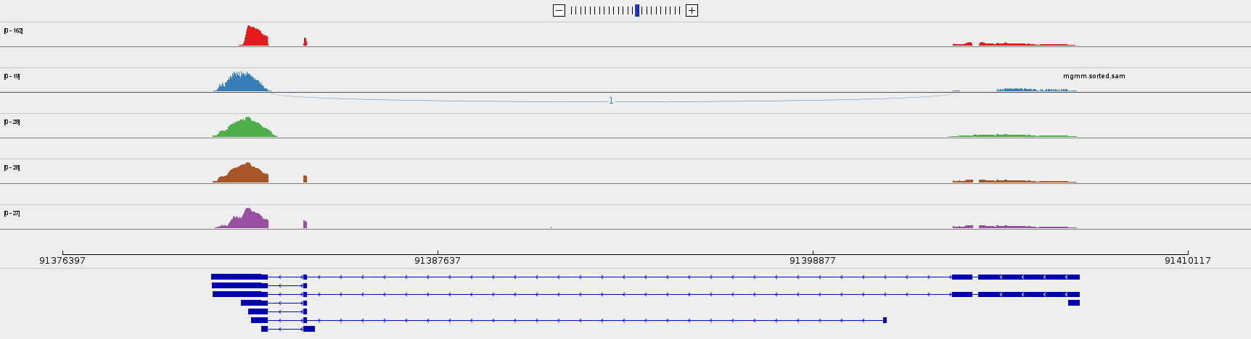
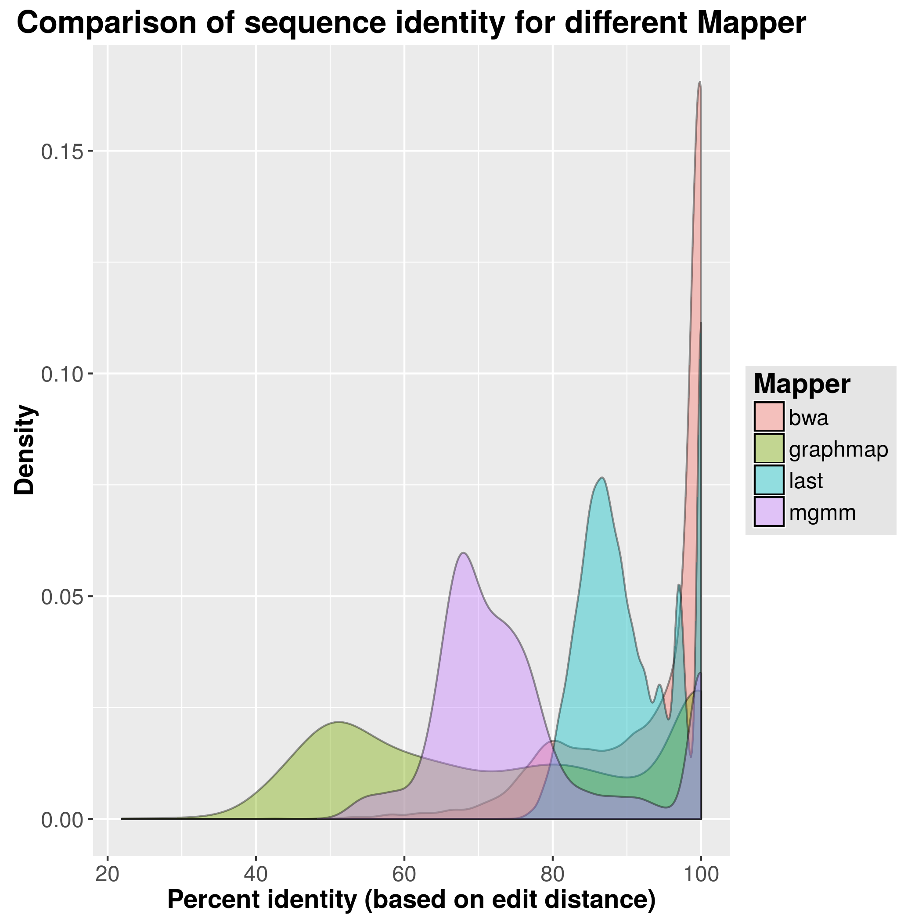
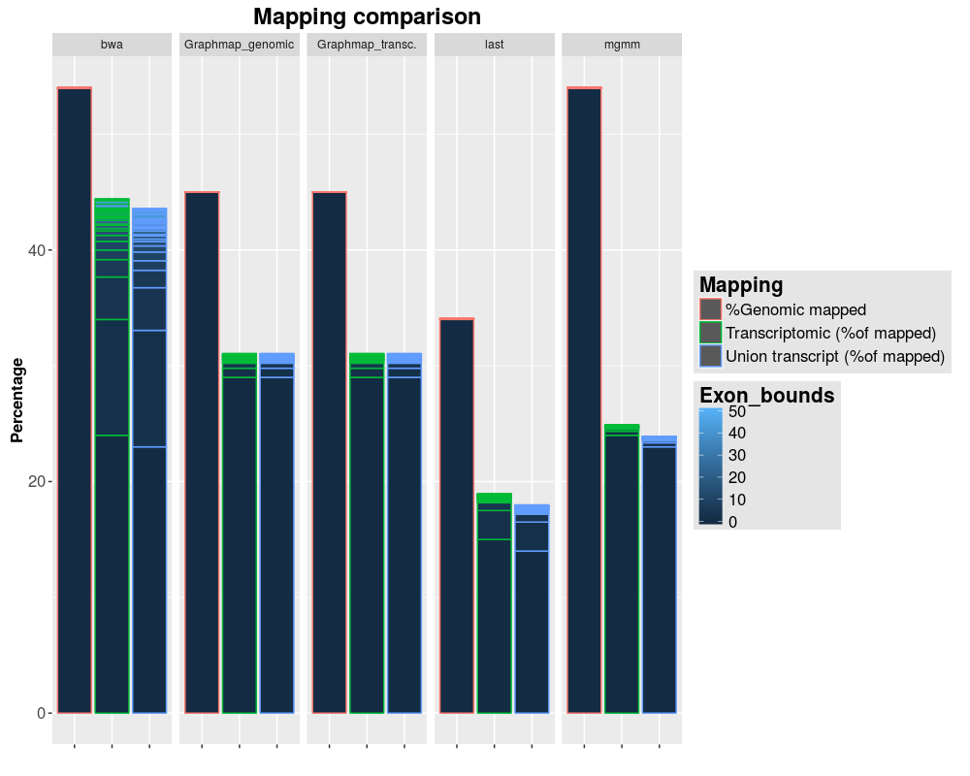
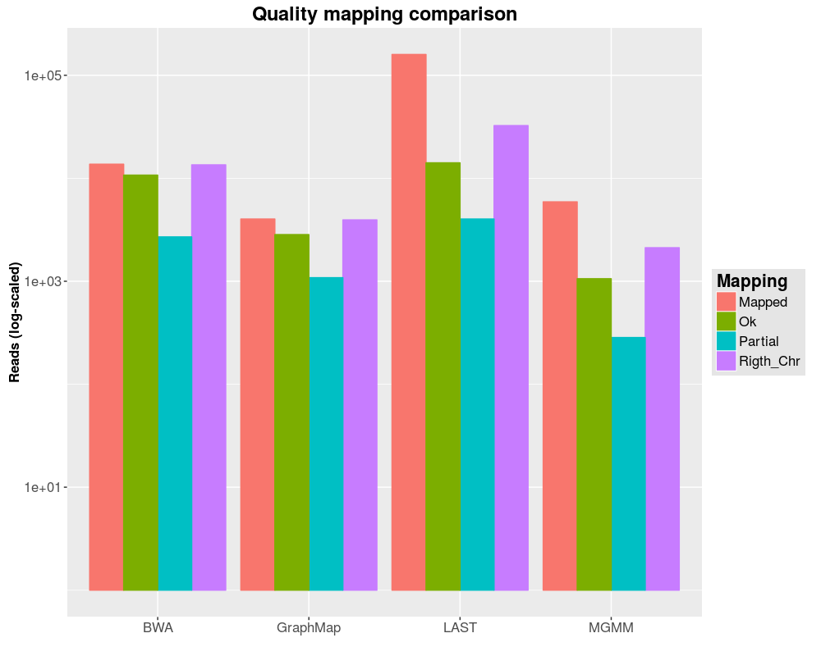
Results & comparisons

Slide 38
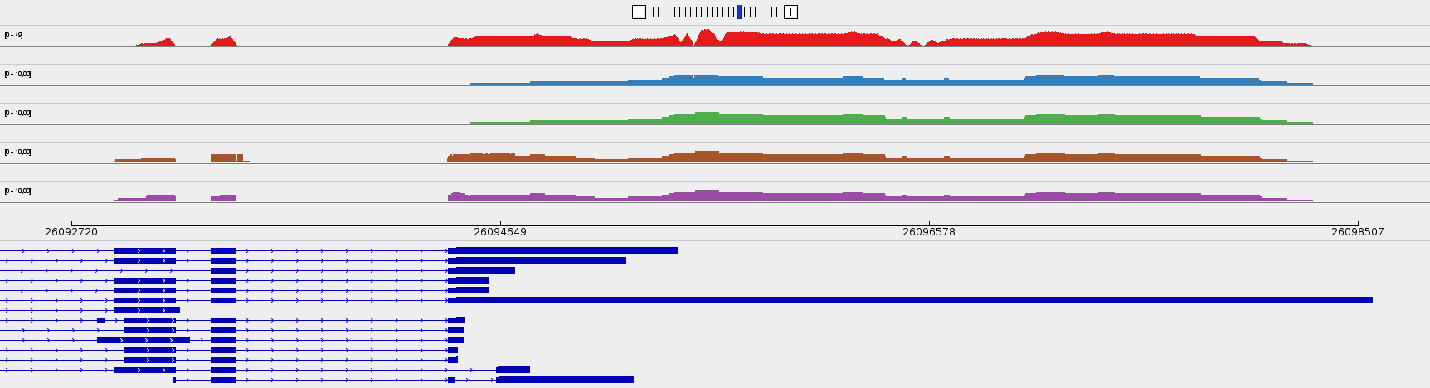
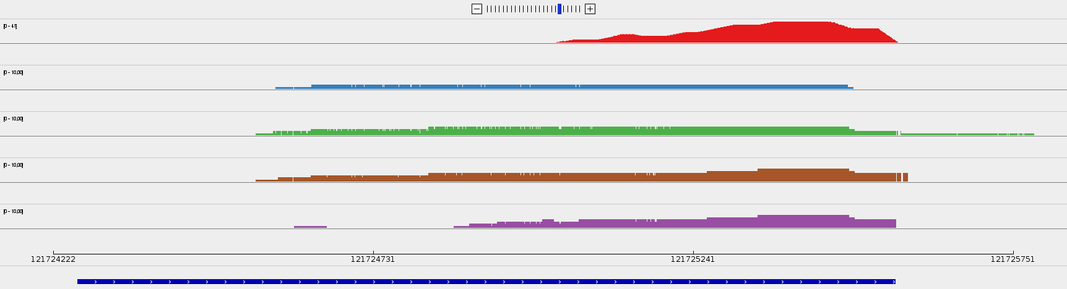
Results & comparisons

Slide 39
Results & comparisons

Slide 40
Results & comparisons
 | GraphMap | Last | BWA | MGMM
Annotated Alignments | 5538 | 159283 | 14594 | 5983
Mapped Reads | 4023 | 159283 | 13698 | 5905
Wrong Chromosome | 79 | 126809 | 191 | 3788
Right Cromosome | 3944 | 32474 | 13507 | 2117
Partial | 1103 | 4022 | 2706 | 284
Ok | 2819 | 14126 | 10716 | 1058
Consistent | 1243 | 13892 | 6963 | 685

Slide 41
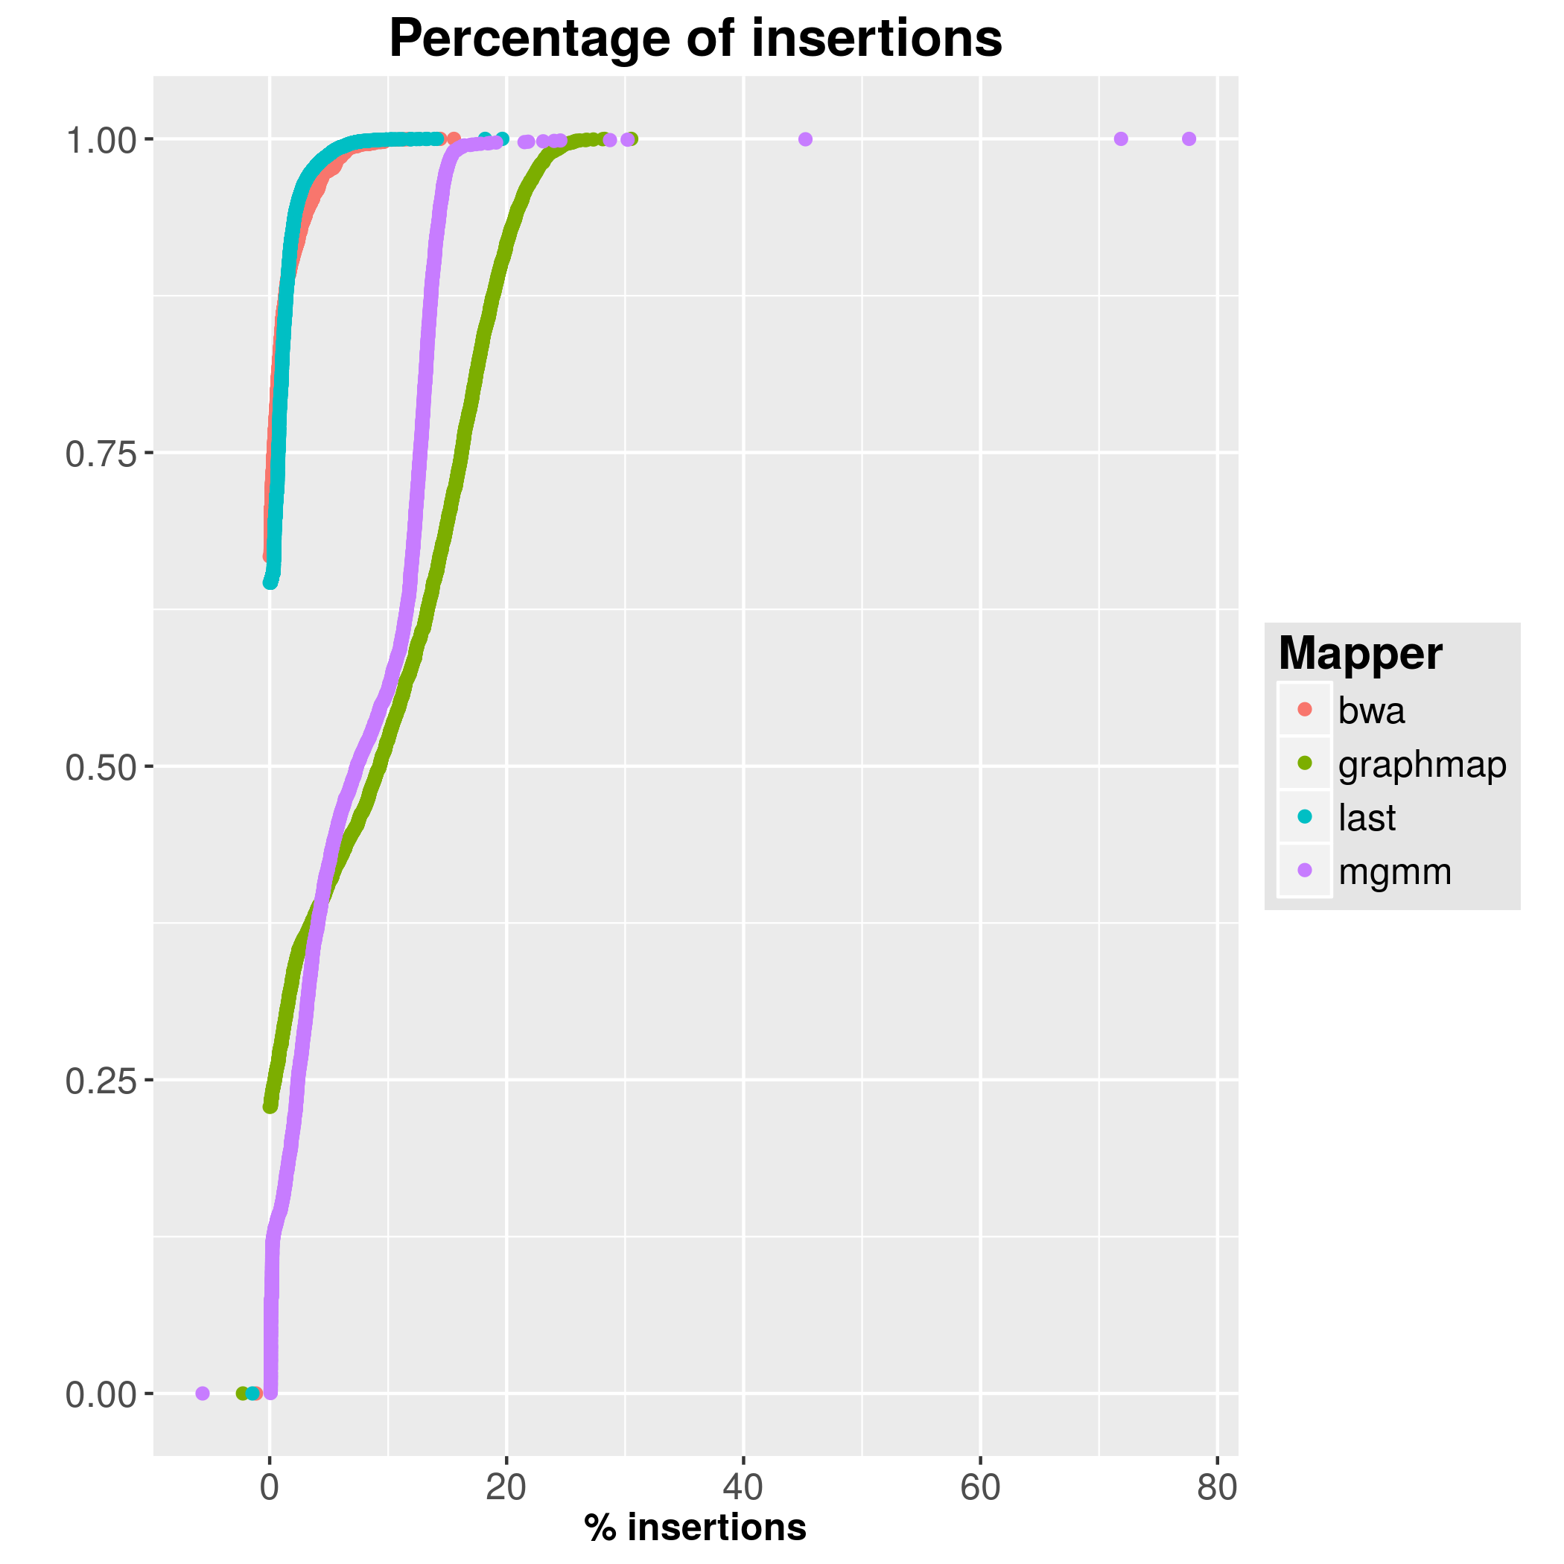
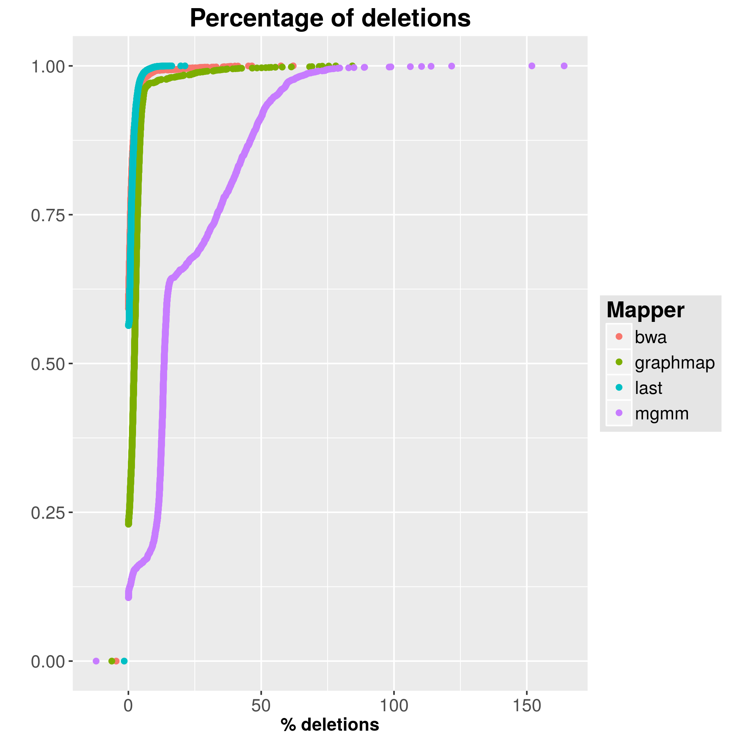
Results & comparisons

