Slide 1
Artifacts of Adversarial Examples
Reuben Feinman
reuben.feinman@nyu.edu

Slide 2
Motivation
Something fundamentally interesting about the adversarial example phenomenon
Adversarial examples are pathological
If we can understand the pathology, we can build universal adversarial example detectors that cannot be bypassed w/out changing the true label of a test point

Slide 3
CNN Overview
Images are points in high-D pixel space
Images have small intrinsic dimensionality
Pixel space is large, but perceptually meaningful structure has fewer independent degrees of freedom
i.e. images lie on a lower-D manifold
Different classes of images have different manifolds
CNN classifier objective: approximate an embedding space wherein class manifolds can be linearly separated
Tenenbaum et al. 2000

Slide 4
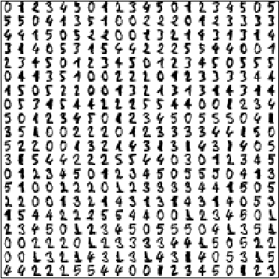
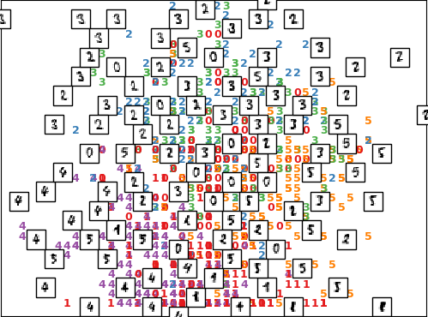
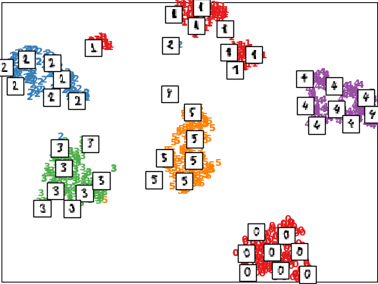
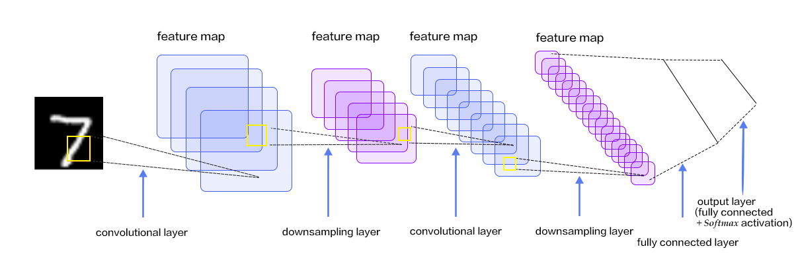
CNN Classifier Objective
Input Space
Embedding Space

Slide 5
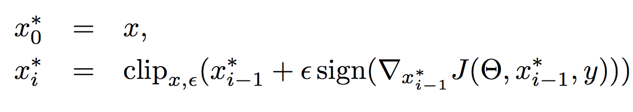
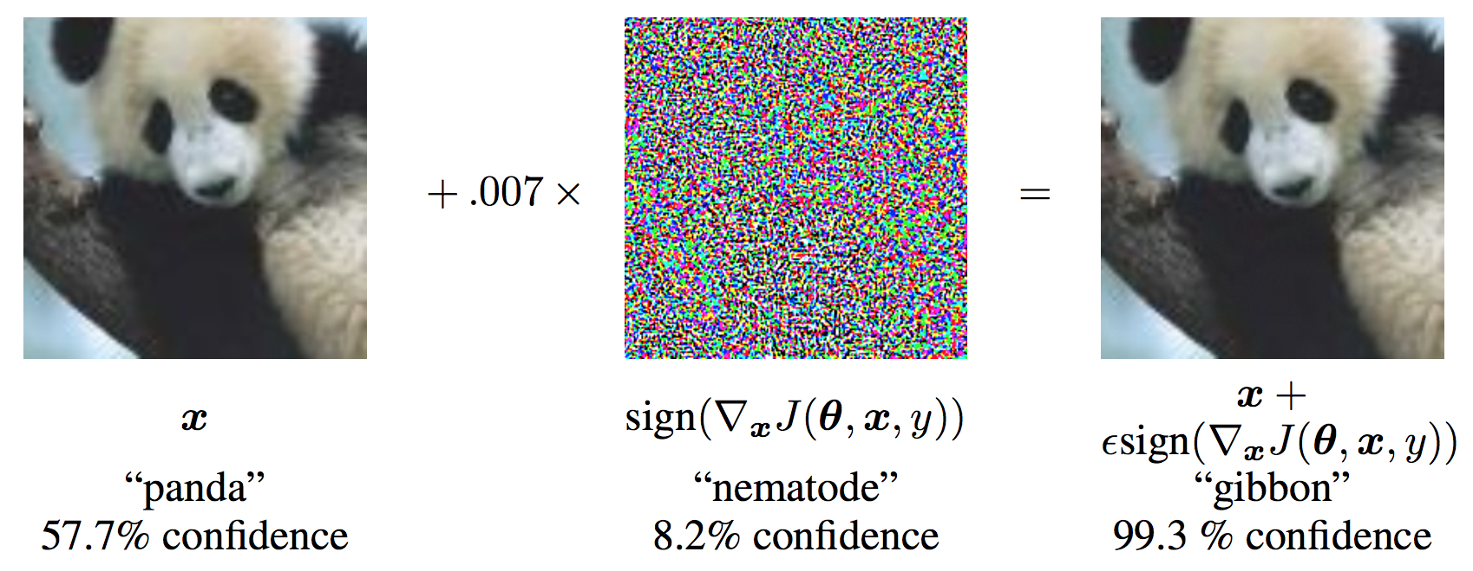
Adversarial Examples
Basic iterative method (BIM):
Can be targeted or untargeted
Small perturbations cause misclassification

Slide 6
Where will adversarial points land?
We don’t know…
Only know that they will cross the decision boundary
x*
x*
x*
Our hypothesis: in the embedding space, points lie off of the data manifold of the target class
x
Source
Target
x*

Slide 7

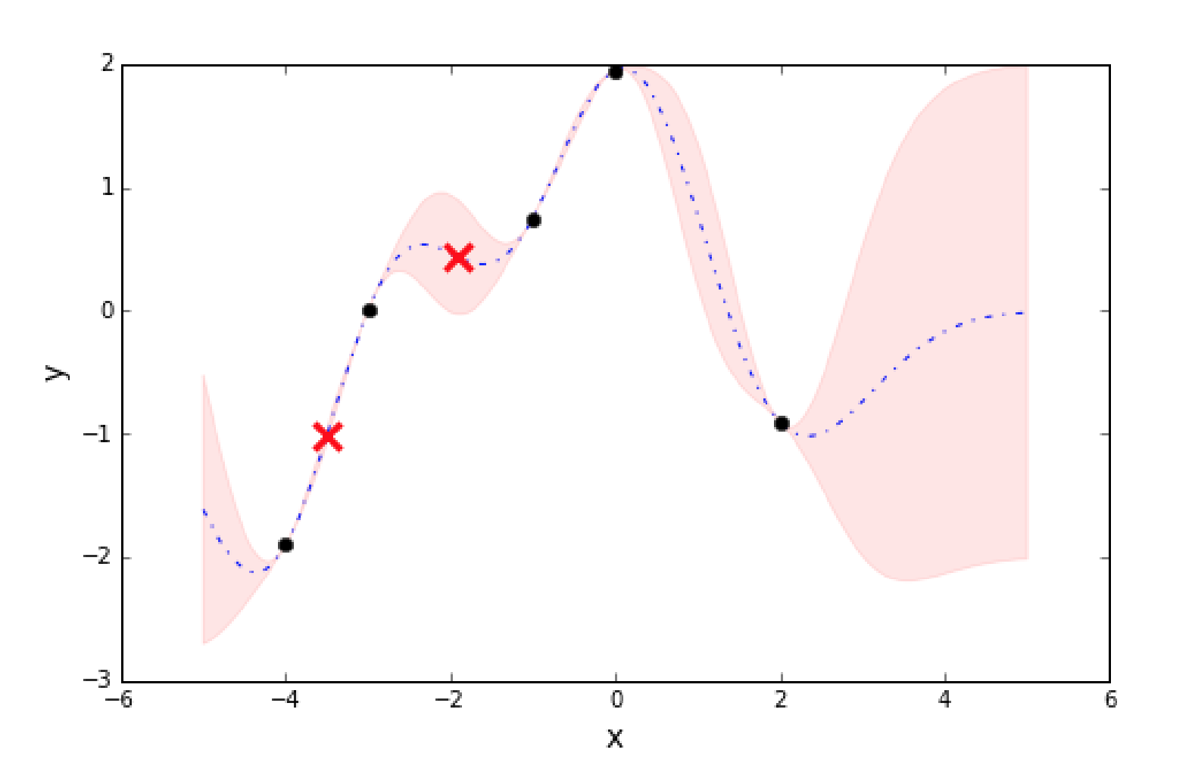
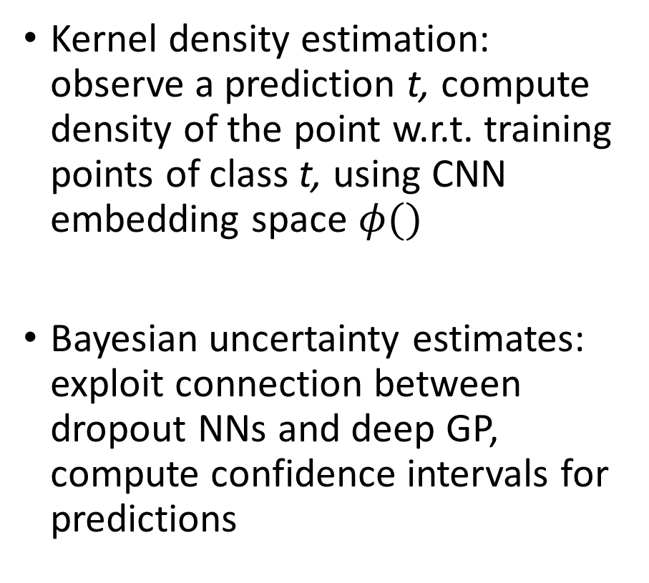
Artifacts of Adversarial Examples
Kernel density estimation: observe a prediction t, compute density of the point w.r.t. training points of class t, using CNN embedding space $φ()$
Bayesian uncertainty estimates: exploit connection between dropout NNs and deep GP, compute confidence intervals for predictions
*
*

Slide 8
Artifacts of Adversarial Examples
% of time that density(x*) < density(x):
% of time that uncert(x*) > uncert(x):
 | MNIST | CIFAR-10
BIM-A | 98.0% | 76.4%
BIM-B | 90.5% | 98.8%
Combine these two features in a classifier and we get a pretty detector with nice ROCs…
 | MNIST | CIFAR-10
BIM-A | 99.2% | 83.4%
BIM-B | 60.7% | 4.0%
Feinman et al. 2017

Slide 9
Adaptive Attacks
Rather than guide sample toward target class, guide it toward a specific embedding vector of a sample from the target class
Replace softmax loss in BIM with embedding vector distance
Detector fails…
x
Source
Target
x*

Slide 10
What’s going on?
Attacks can manipulate sample to look however desired in the CNN embedding space
Remember that CNN embedding is merely an approximation of the lower-dimensional Hilbert space where our data manifolds are formed
Pixel space is vast, and for many points our approximation breaks down
Can we detect the breakdown? i.e. detect when our embedding space is irrelevant for a given point

Slide 11
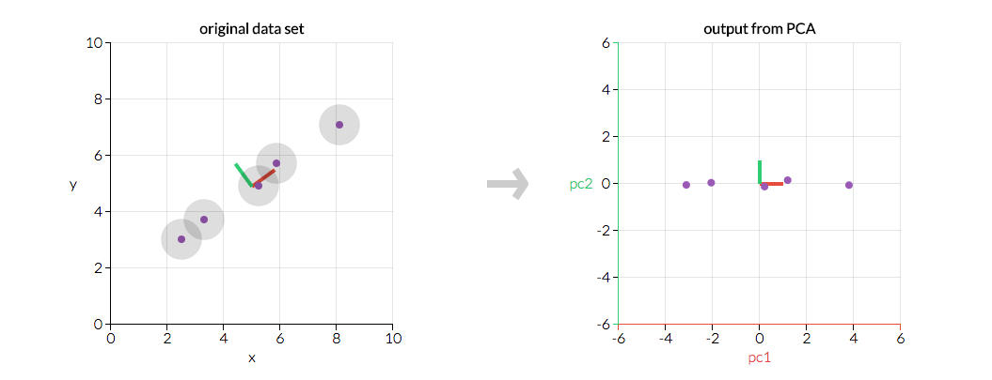
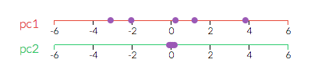
PCA Detector
Idea:
Perform PCA on our normal training data
At test time, project test points into PCA basis and observe the lowest-ranked component values
If values are large, assume adversarial
Adversarial point

Slide 12
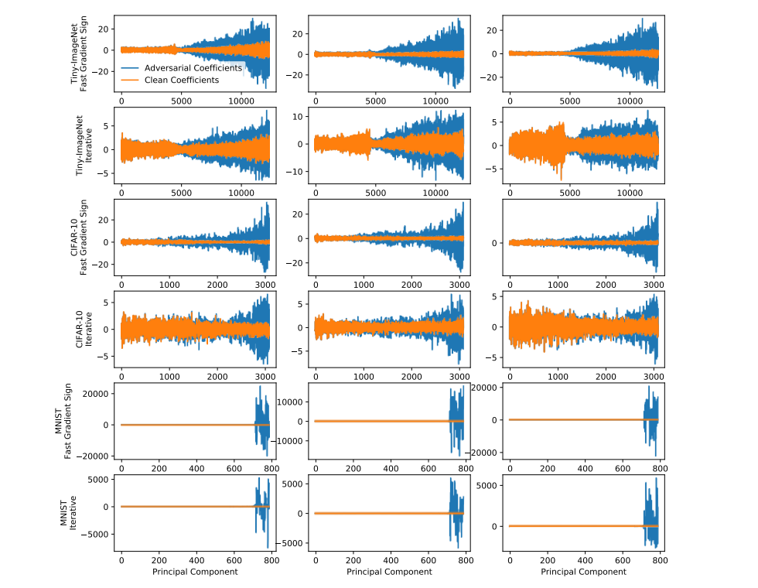
PCA Detector
Findings: adversarial examples place large emphasis on lowest-ranked components
Hendrycks & Gimpel 2017

Slide 13
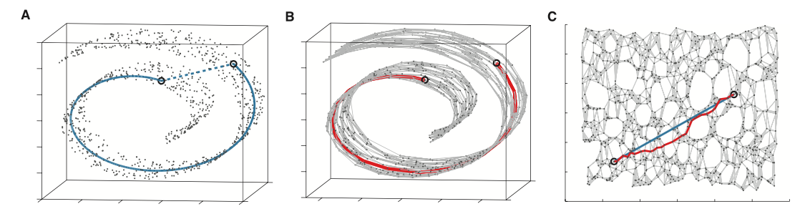
Can we find a better method?
PCA is a gross simplification of the embedding space learned by a CNN
Future direction: is there an analogous off-manifold analysis we can find for our CNN embedding?
e.g. “Swiss roll” dataset
Tenenbaum et al. 2000

Slide 14
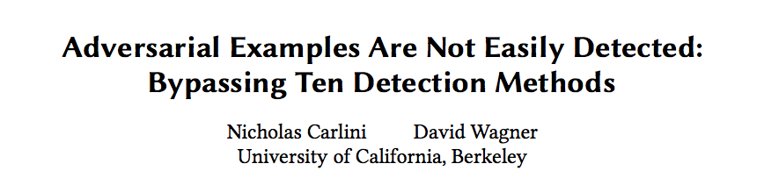
FYI: Carlini Evaluation
Conclusion: Feinman et al. method most effective
Requires 5x more distortion to evade than any other defense
Good way to evaluate going forward: amount of perceptual distortion required to evade a defense
Ultimate goal: find a defense that requires true label of the image to change

Slide 15
Thank you!
Work done in collaboration with
Symantec Center for Advanced Machine Learning &
Symantec Research Labs

