Slide 1
OLAP Preliminaries
DS 707 Data Analytics

Slide 2
Objectives
Review of data analysis in traditional SQL
Understand the need for dimensional data models
Understand multi-dimensional modeling and operations

Slide 3
Know your data… again!
What is the data we have? What are the attributes / features we have?
What is the source of the data we have? How reliable is it?
How much data do we have?
How recent is the data?
How reliable is the data?
How usable is the data?
What are your observations with respect to the above on the data you have?

Slide 4
Conventional Approaches
MIS Reports
+ Point-click interface for generating reports
Static, non-interactive, inflexible
More details means more reports
Spreadsheets
+ Formulae, pivots, and other add-ons
Limited by basic 2-D view
Can at most visualize 3-D using rows, columns and pages/sheets
Formula evaluation slow when large amount of data is present

Slide 5
Conventional Approaches (cont)
SQL
+ Non-procedural, standardized
Operators not powerful enough for heavy analysis
Language is tuned for efficient performance of OLTP-style queries

Slide 6
Retail Store Conceptual Model
[Rewind to conceptual modeling in Data Management class!]

Slide 7
Typical Analyst Questions
Q1: How does the sale of cosmetics compare across the stores?
Q2: What products get sold most during puja season?
Q3: How many “non-local” customers come to each store? What do they buy?

Slide 8
Can you write the SQL?
Q1: How does the sale of cosmetics compare across the stores?

Slide 9
Can you write the SQL?
Q2: What products get sold most during puja season?

Slide 10
Moral of the Story
Analytics queries in SQL can be:
Very difficult to write
Very inefficient
Hard to maintain
Less flexible
Why?

Slide 11
Multi-Dimensional Design Concepts
Ref: Chapters 10 & 11 from Data Warehousing Fundamentals by Paulraj Ponniah

Slide 12
Multidimensional Data
Data is interpreted as measurements along multiple dimensions
A central measurement is chosen (say, value of sales) and projected along all possible dimensions

Slide 13
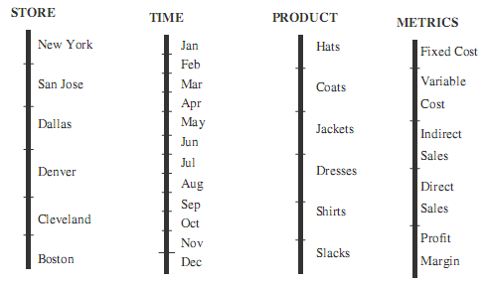
Example

Slide 14
Multi-dimensional schema
M is a multi-dimensional schema defined by a 4-tuple
M = {D, V, F, A}
D is a set of dimensions with values d_{ij} for each dimension D_{i}
V is a set of fact variables
F is a set of facts each fact variable V_{i}
F is a mapping from D₁ x D_{2 …} x D_{n} to R₁ x R₂ x….x R_{n} , n = |V|
A is a set of aggregation operators

Slide 15
Example Dimensional Schema
D = {Store, Time, Product, Metrics}
D1 = {New York, San Jose, Dallas, Denver, Cleveland, Boston}
D2 = {Jan, Feb, … Dec}
D3 = {Hats, Coats, Jackets, Dresses, Suits, Slacks}
V = {Direct Sales}
A = {Sum, Avg}

Slide 16
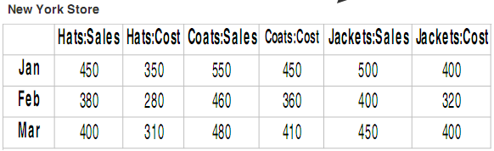
Sample Facts
D = {Store, Time, Product, Metrics}
D1 = {New York, San Jose, Dallas, Denver, Cleveland, Boston}
D2 = {Jan, Feb, … Dec}
D3 = {Hats, Coats, Jackets, Dresses, Suits, Slacks}
V = {Sales,Cost}
A = {Sum, Avg}
F1: < New York Store, Jan, Hats, {450,350} >
F2: < New York Store, Feb, Hats, {380,280} >
F3: < New York Store, Mar, Hats, {400,310} >

Slide 17
Data Cube
Data Cubes allow data to be modeled and viewed from multiple perspectives
Perspectives are modeled as dimensions (axes)
Each cell in the cube represents some aggregation of the data (avg, sum, etc.)

Slide 18
n-D Cubes
Cubes can be n-dimensional
A 1-D cube with only time as the dimension
A 2-D cube with time and product category as the dimensions
A 3-D cube with time, product category and location as the dimensions
A 4-D cube with time, product category, location and supplier as the dimensions
and so on…

Slide 19
Matrix View
F1: < New York Store, Jan, Hats, {450,350} >
F2: < New York Store, Feb, Hats, {380,280} >
F3: < New York Store, Mar, Hats, {400,310} >
SalesData [New York] [Jan] [Hats] = {450, 350}
SalesData [New York] [Feb] [Hats] = {450, 350}
SalesData [New York] [Mar] [Hats] = {450, 350}

Slide 20
Dimensional Modeling (ROLAP)

Slide 21
What is Dimensional Modeling?
Normalization-centric database design is intended for online transaction processing systems (OLTP)
Data warehouse systems are designed differently to cater to needs that are different from OLTP systems
Dimensional modeling is a technique popularized by Ralph Kimbal exclusively for creating multi-dimensional models using relational databases
So what?

Slide 22
Dimensional Modeling Concepts
Cube
Cuboid
Facts
Dimensions
Star Schema
Snowflaking
Slowly Changing Dimensions

Slide 23
Data Cube
Data Cubes allow data to be modeled and viewed from multiple perspectives
Perspectives are modeled as dimensions (axes)
Each cell in the cube represents some aggregation of the data (avg, sum, etc.)

Slide 24
n-D Cubes
Cubes can be n-dimensional
A 1-D cube with only time as the dimension
A 2-D cube with time and product category as the dimensions
A 3-D cube with time, product category and location as the dimensions
A 4-D cube with time, product category, location and supplier as the dimensions
and so on…

Slide 25
Lattice of Cuboids
0-D (apex) cuboid
all
1-D cuboid
time
category
location
supplier
2-D cuboid
category, supplier
time, category
time, location
time, supplier
category, location
location, supplier
3-D cuboid
time, category, supplier
Location, supplier, category
time, category, location
time, location, supplier
4-D (base) cuboid
Time, location, supplier, category

Slide 26
Facts & Dimensions
Facts and dimensions are central to dimensional modeling
The process of designing a data warehouse using facts and dimensions is broadly referred to as dimensional modeling

Slide 27
Fact Table
A fact table is a collection of facts
Facts represent numerical performance measurements
Facts are typically numeric and additive
Facts account for nearly 90% of the dimensional database
All measurements in a fact table must be at the same grain
So what?

Slide 28
Measures
Measures are aggregate functions that can be evaluated at each cell in the cube
Distributive measures
Value obtained over n aggregate values is same as the value obtained from the full set (e.g., count(), sum(), min(), max() etc.)
Algebraic measures
Computed using a combination of distributive functions (e.g., avg() = sum() / count())
Holistic measures
Neither distributive nor algebraic (e.g., median, mode, rank, etc.)

Slide 29
Dimensions
Contains the textual descriptors of the fact data
Critical to provide the ability to slice and dice the fact data
Dimension tables are shallow and wide
Have relatively fewer rows
Have 50 to 100 columns

Slide 30
Date Dimension
Is “Date” an attribute or a table? How to decide?
Date can be viewed as table with the following attributes
Date table is an important dimension present in all data warehouses
Date Key | 76
Date | 15-Aug-11
Full Date Description | 15th August, 2011
Day of Week | Monday
Day Number in Calendar Month | 15
Week Number in Calendar Month | 3
Day Number in Calendar Year | 226
Calendar Year | 2011
Holiday Indicator | Holiday
So what?
More attributes?

Slide 31
Star Schema
A relational schema where one particular table serves as the central table (and is known as the FACT TABLE)
The FACT TABLE is linked via Foreign Keys to a set of DIMENSION TABLES
Dimension Table
FACT
TABLE
Dimension Table
Dimension Table
Dimension Table
Dimension Table
Dimension Table
Dimension Table

Slide 32
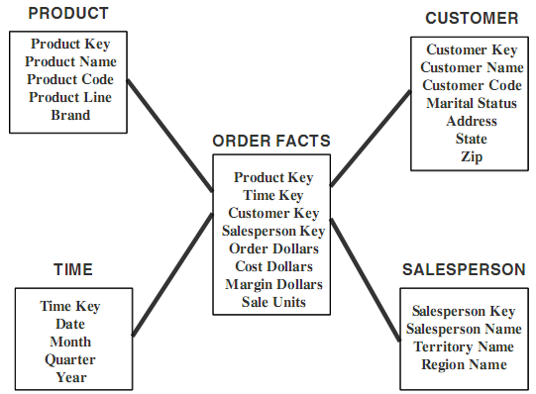
Example Star Schema
Which are the fact variables?

Slide 33
Inside a Dimension table
Contains entry point for analysis
Dimension tables have a key
Table is wide
Textual attributes (as opposed to numeric)
Attributes may not be related
E.g., Package_size and Brand could be two attributes of Product
Not normalized
Attributes may be hierarchically related
E.g., city, state, country
May have multiple hierarchies
E.g., Financial_Year, Calendar_Year
So what?

Slide 34
Inside a Fact Table
Concatenated key
Consistent granularity (all rows at the same data grain)
Fully Additive Measures/Facts
Sales_Value, Quantity
Semi-additive Measures/Facts
Percentages
Table is deep, not wide
Sparse data - May have gaps
No measures available for store holidays
May have degenerate dimensions
Order_Number

Slide 35
Summary
We looked at conventional methods for data analysis using SQL
We looked at multi-dimensional view of data that is amenable to analysis
We had an introduction to dimensional model as a way to create multi-dimensional models in relational databases

