Slide 1
Efficient Cube Computation
DS 707 Data Analytics

Slide 2
Cube - Example
SalesData = { <Store, Time, Product> , <Sales> , <Sum> }
Store = {Chennai, Delhi, Bangalore, Hyd, Kolkata, Mumbai}
Time = {Jan, Feb, Mar}
Product = {Hats, Coats}
List of Cuboids
Store
Time
Product
Store, Time
Store, Product
Time, Product
Store, Time, Product
ALL
In a cube with N dimensions, there 2^{N} cuboids

Slide 3
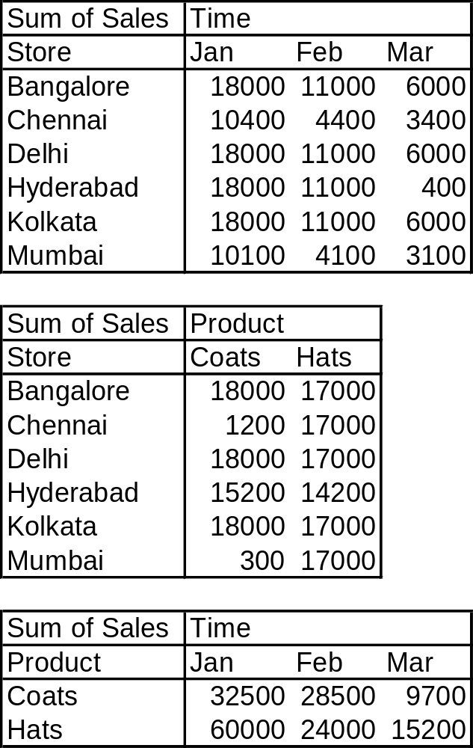
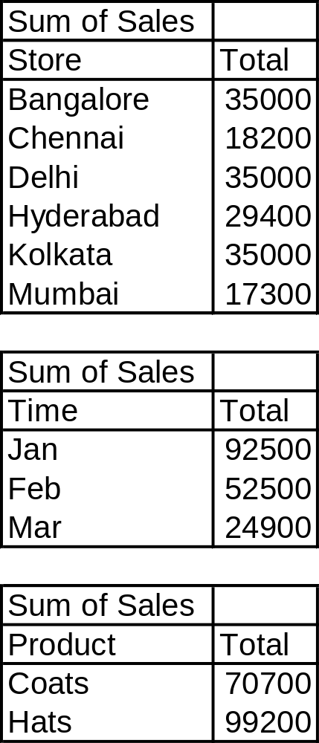
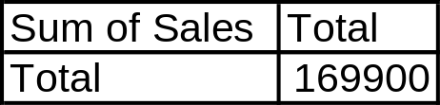
SalesData – Cuboids
Notes:
No, the base cuboid is not shown here!

Slide 4
Partial Materialization
Computing aggregates for all the cells in a cube might be expensive
Identifying a subset of dense cuboids in a large cube and materializing only those cubes is called partial materialization

Slide 5
Iceberg Cube
In a iceberg cube, we store only those cells whose aggregate value is above a some minimum support threshold
Helps identify a subset of dense cuboids in a large cube

Slide 6
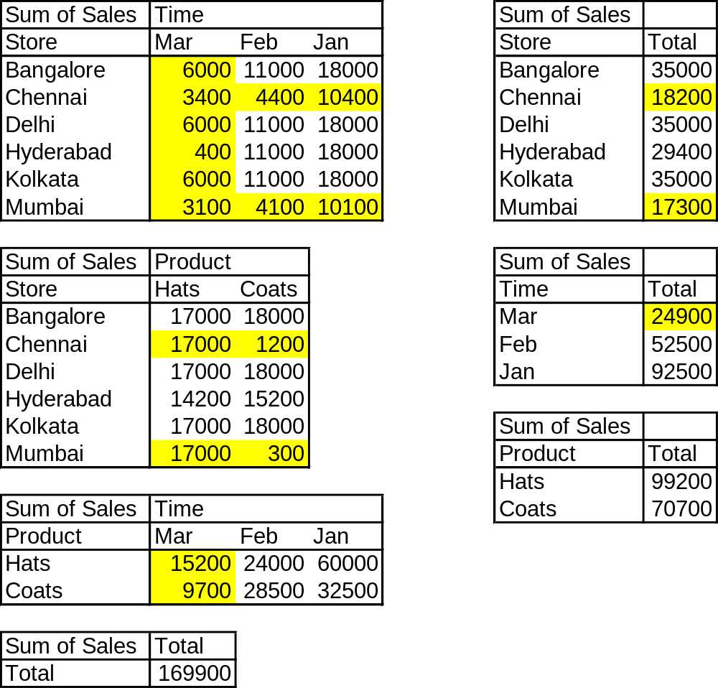
Iceberg Cube - Example
Refer to the handout for the base cuboid
Minimum support = 25,000

Slide 7
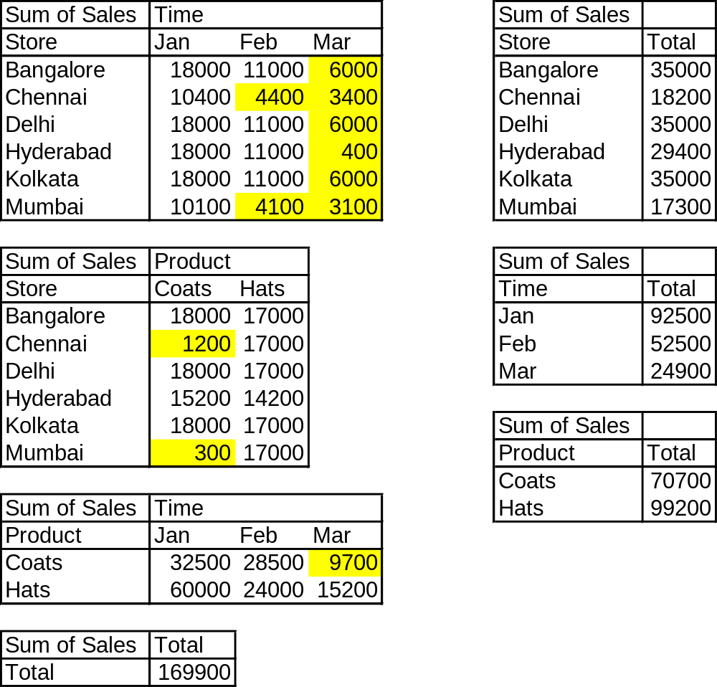
Iceberg Cube - Example
But how to identify the icebergs without doing the computation in the first place??

