Slide 1
OLAP Performance Management
DS 707 Data Analytics

Slide 2
Outline
Query characteristics of OLAP vs OLTP
Indexing strategies for OLAP
Data Partitioning
Some other strategies

Slide 3
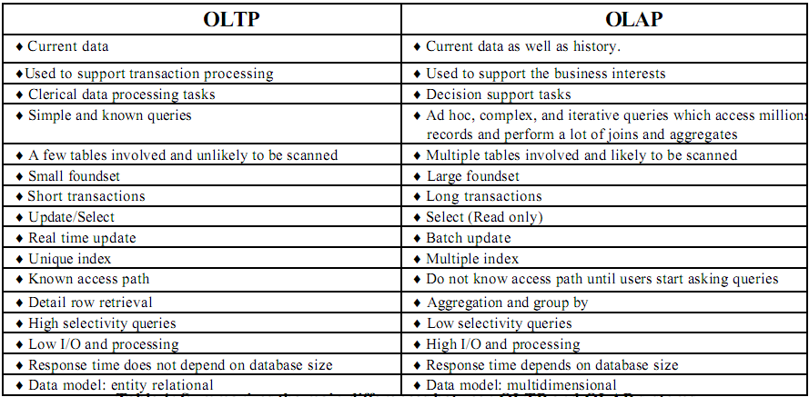
Query Characteristics - 1

Slide 4
Query Factors - 2
Column Characteristics
Cardinality
Refers to the number of unique values
Distribution
Refers to the frequency of each unique value
Query Characteristics
Selectivity
Refers to the number of rows returned by a predicate in proportion to the number rows in the table; higher the ratio, lower the selectivity and vice versa
Low selectivity queries may not make use of index even if it exists (why?)
Access paths
Join conditions
Notes:
· Cardinality data: The cardinality data of a column is the number of distinct values in the column. It
is better to know that the cardinality of an indexed column is low or high since an indexing technique
may work efficiently only with either low cardinality or high cardinality.
· Distribution: The distribution of a column is the occurrence frequency of each distinct value of the
column. The column distribution guides us to determine which index type we should take.
· Value range: The range of values of and indexed column guides us to select an appropriate index
type. For example, if the range of a high cardinality column is small, an indexing technique based on
bitmap should be used. Without knowing this information, we might use a B -Tree resulting in a
degradation of system performance.

Slide 5
Indexing

Slide 6
Indexing in OLAP systems
B-Tree Index
Bitmap Index
Pure bitmap index
Encoded bitmap index
Joined bitmap index
Join Index
Projection Index

Slide 7
B-Tree Index
B-Tree is a multi-level indexing structure
Because a single-level index is an ordered file, we can create a primary index to the index itself;
In this case, the original index file is called the first-level index and the index to the index is called the second-level index.
We can repeat the process, creating a third, fourth, ..., top level until all entries of the top level fit in one disk block

Slide 8
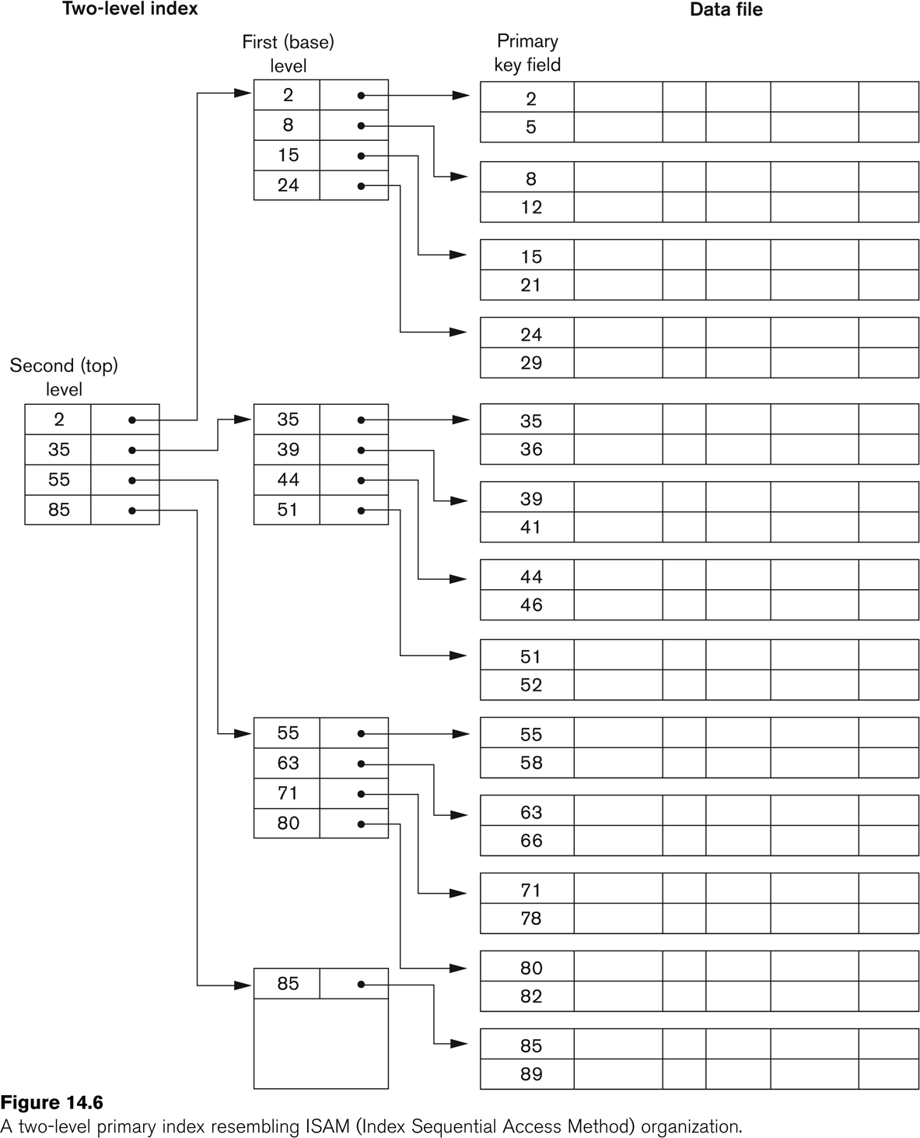

Slide 9
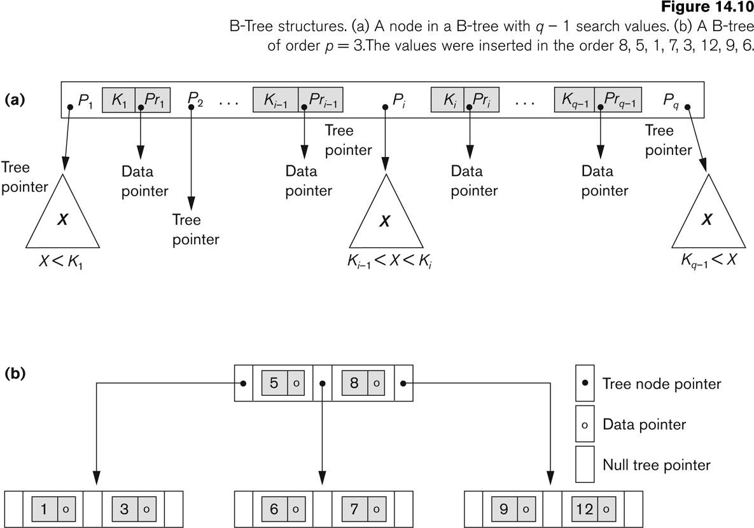
B-Tree Structure

Slide 10
B-Trees in Data Warehouses
B-Tree indexing is useful when the column cardinality is high
Works well for key columns of dimension tables
Is NOT suitable for low cardinality columns
Why?

Slide 11
Bitmap Index
Suppose C is a low cardinality column with values (a, b, c)
Create three bit vectors b1, b2, b3
If there are N rows in the table, then the length of the bit vector is also N
A bit value 1 at position i in the vector b1 indicates that the i-th tuple has value C = a
Example?

Slide 12
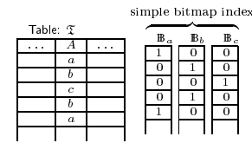
Bitmap Index Example
Domain(A) = {a, b, c}

Slide 13
Use of bitmap index
Example 1
SELECT …
FROM T
WHERE A = b;
Example 2
SELECT …
FROM T
WHERE A = b OR A = c;

Slide 14

JOIN bitmap indices
Whenever a low cardinality column is used in the WHERE clause of a JOIN query, JOIN bitmap indices can be useful
Example:
SELECT …
FROM CUSTOMER C, ACCOUNT A
WHERE C.Cust_ID = A.Cust_ID
AND C.Gender = ‘F’;
What is the length
of the vector?
Here Account can be indexed on Gender even though the original table does not contain the Gender column

Slide 15
Encoded Bitmap Index
While a simple bitmap index contains one vector for each distinct value, a encoded bitmap index uses log2(C) where C is the number of distinct values

Slide 16
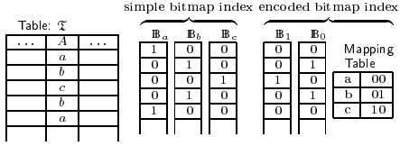
Encoded Bitmap Index Example

Slide 17
Use of encoded bitmap index
Example 1
SELECT …
FROM T
WHERE A = b;
Example 2
SELECT …
FROM T
WHERE A = b OR A = c;

Slide 18
Bitmap Indices in Data Warehouse
Bitmap indices are used for attributes of dimension tables because they have low cardinality in general
JOIN bitmap indices are useful because fact tables are always joined with dimension tables
So what?

Slide 19
Join Index
JOIN index enables faster computation of JOIN operations
The tables are “pre-joined” by creating a link between the corresponding tuple identifiers
So what?

Slide 20
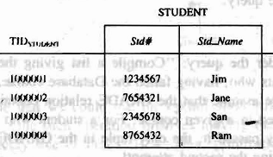
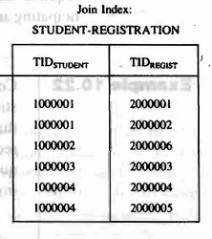
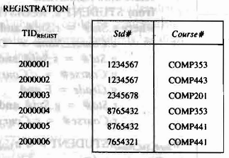
Join index example

Slide 21
JOIN Index in Data Warehouse
JOIN indices work well for single-level joins
Most of the JOINs in a data warehouse are single-level joins
JOINs in OLAP are more stable compared to JOINs in OLTP
Why?
So what?
Notes:
JOIN indices are more useful in OLAP than in OLTP

Slide 22
Projection Index
Similar to (same as?) the concept of a column store
Only the column values are extracted from a table and stored separately in exactly the same row order
More column values can be extracted per disk access from a projection index compared to each disk access from a row store
Explain in English ☺

Slide 23
Projection Index - Example

Slide 24
Partitioning

Slide 25
Issues with large tables
Fact tables typically run into hundreds of thousands of rows
Loading takes excessive time
Building indices takes several hours
Backup and recovery take a long time
So what?

Slide 26
Data Partitioning
Data Partitioning is a systematic way of splitting a single large table into multiple smaller tables
This correspondingly splits the index also from one large index to multiple smaller indices
Each partition has same logical structure; they vary only their physical structure
So what?

Slide 27
Types of partitioning
Vertical partitioning
Wide tables are split by grouping subset of columns together into smaller tables
Usually works well for wide dimension tables
Horizontal partitioning
Deep tables are split by extracting subset of rows into smaller tables
Usually works well for deep fact tables
Example?

Slide 28
Cube Materialization

Slide 29
Cube Materialization
What is cube materialization?
Dense vs Sparse cubes
Types of cube materialization
Full cube
Iceberg cube
Shell cube

Slide 30
Dense vs Sparse Cubes
Data may not be available for all combinations of all values of all dimensions
When the ratio of the number of values available for a given dimension to the total number of dimension values is HIGH, then that dimension is called a dense dimension (else it is a sparse dimension)
A cube that has a large number dense dimensions is called a dense cube (else it is a sparse cube)

Slide 31
Cube Materialization
Cube materialization refers to the process of pre-computing the cubes
Helps in avoiding doing expensive combinations of JOINs, GROUP BY and AGGREGATE functions
Many vendors support cube materialization (e.g., Materialized views from Oracle)

Slide 32
Full Cube
All possible of combinations of all possible dimensions are computed
How many cuboids exist in a cube having N dimensions?
How many cells are there in each cuboid?

Slide 33
Full Cube - Example
SalesData = { <Store, Time, Product> , <Sales> , <Sum> }
Store = {Chennai, Delhi, Bangalore, Hyd, Kolkata, Mumbai}
Time = {Jan, Feb, Mar}
Product = {Hats, Coats}
List of Cuboids
Store
Time
Product
Store, Time
Store, Product
Time, Product
Store, Time, Product
ALL
In a cube with N dimensions, there 2^{N} cuboids

Slide 34
Cube Materialization - Example
SalesData = { <Time, Product> , <Revenue> , <Sum> }
Time = {Jan, Feb, Mar, Apr, May, Jun, July, Aug, Sep, Oct, Nov, Dec}
Product = {Hats, Coats}

Slide 35
SalesData – Number of cells?
List of Cuboids
Store
Time
Product
Store, Time
Store, Product
Time, Product
Store, Time, Product
ALL
# of cells
6
3
2
6 X 3
6 X 2
3 X 2
6 X 3 X 2
1
Base Cuboid
Total Number of Cells 84
For each cuboid with k dimensions, the number of cells is Π(|d_{i}|) for i = 1 .. k

Slide 36
SalesData – Cuboids
Are all cuboids shown here?
Notes:
No, the base cuboid is not shown here!

Slide 37
Partial Materialization
Computing aggregates for all the cells in a cube might be expensive
Identifying a subset of dense cuboids in a large cube and materializing only those cubes is called partial materialization

Slide 38
Iceberg Cube
In a iceberg cube, we store only those cells whose aggregate value is above a some minimum support threshold
Helps identify a subset of dense cuboids in a large cube

Slide 39
Iceberg Cube - Example
Minimum support = 10,000
Reduces computation by 23%

Slide 40
Iceberg Cube - Example
But how to identify the icebergs without doing the computation in the first place??

Slide 41
Shell Cube
In a shell cube, cuboids only for a small number of dimensions are materialized

Slide 42
Other Strategies

Slide 43
Other strategies
Materialized views
Works well for pre-computed summaries
Parallel Query Processing
Works well on partitioned tables
Disabled referential integrity checks
Improves LOAD performance
How?

Slide 44
Summary
OLAP performance management strategies are different compared to OLTP performance management
Dimensional modeling distinguishes OLAP from OLTP at the logical design level (does not require vendor support)
Indexing and other related strategies work at the physical design level (requires vendor support)

