Slide 1
Switching functions
The postulates and sets of Boolean logic are presented in generic terms without the elements of K being specified
In EE we need to focus on a specific Boolean algebra with K = {0, 1}
This formulation is referred to as “Switching Algebra”

Slide 2
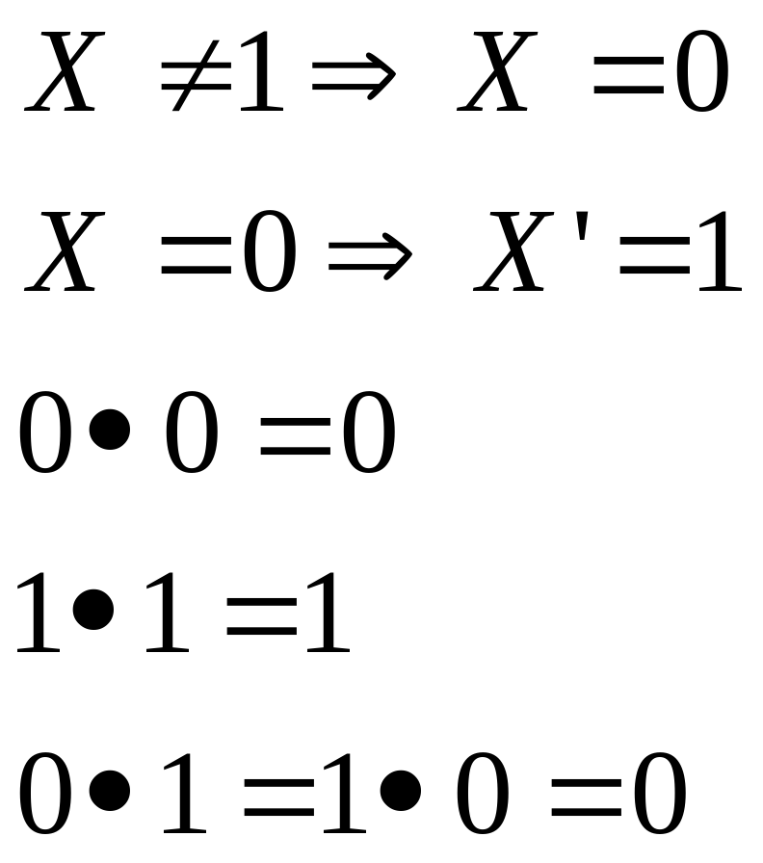
Switching functions
Axiomatic definition:

Slide 3
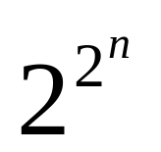
Switching functions
Variable: can take either of the values ‘0’ or ‘1’
Let f(x₁, x₂, … x_{n}) be a switching function of n variables
There exist 2^{n} ways of assigning values to x₁, x₂, … x_{n}
For each such assignment of values, there exist exactly 2 values that f(x₁, x₂, … x_{n}) can take
Therefore, there exist switching functions of n variables

Slide 4
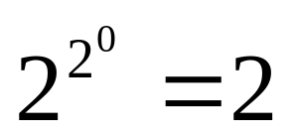
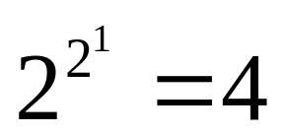
Switching functions
For 0 variables there exist how many functions?
  f₀ = 0; f₁ = 1
For 1 variable a there exist how many functions?
  f₀ = 0; f₁ = a; f₂ = ā; f₃ = 1;

Slide 5
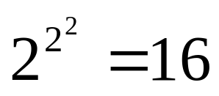
Switching functions
For n = 2 variables there exist how many functions?
The 16 functions can be represented with a common expression:
  f_{i} (a, b) = i₃ab + i₂ab + i₁āb + i₀āb
  where the coefficients i_{i} are the bits of the binary expansion of the function index
  (i)₁₀ = (i₃i₂i₁i₀)₂ = 0000, 0001, … 1110, 1111

Slide 6
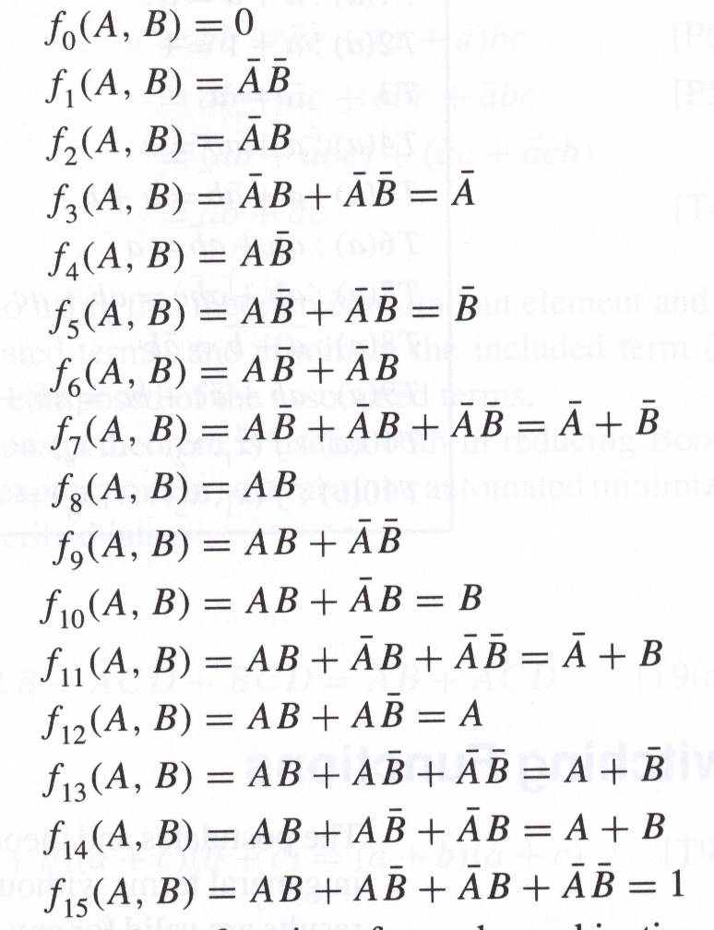
Switching functions

Slide 7
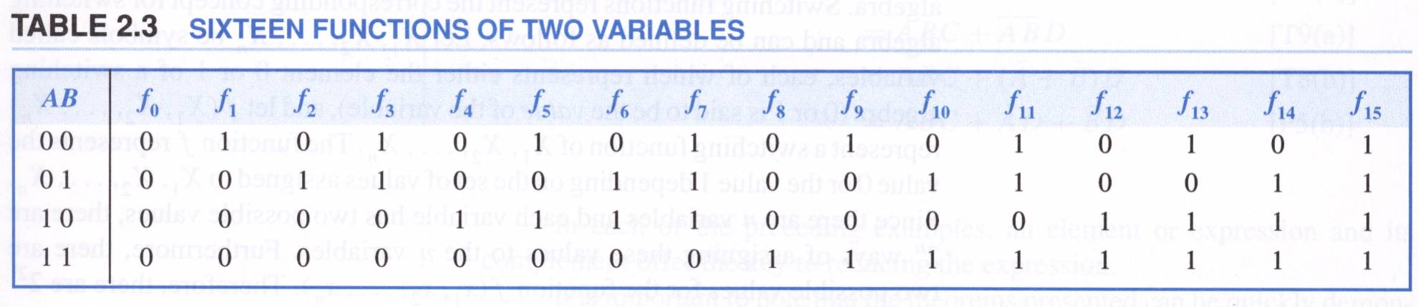
Switching functions
Truth tables
  A way of specifying a switching function
  List the value of the switching function for all possible values of the input variables
  For n = 1 variables the only non-trivial function is ā

Slide 8
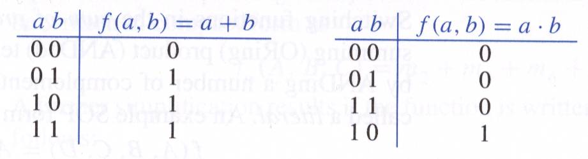
Switching functions
Truth tables of the 4 functions for n = 1
Truth tables of the AND and OR functions for n = 2
a | f(a) = 0
0 | 0
1 | 0
a | f(a) = a
0 | 0
1 | 1
a | f(a) = ā
0 | 1
1 | 0
a | f(a) = 1
0 | 1
1 | 1

Slide 9
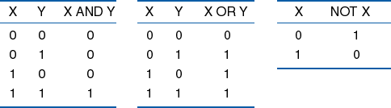
Boolean operators
Complement: X′ (opposite of X)
AND: X × Y
OR: X + Y
binary operators, described
functionally by truth table.

Slide 10
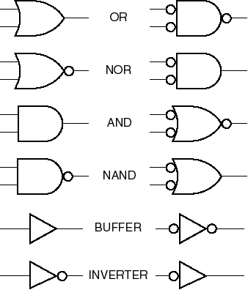

Alternate Gate Symbols

Slide 11
Alternate Gate Symbols

Slide 12
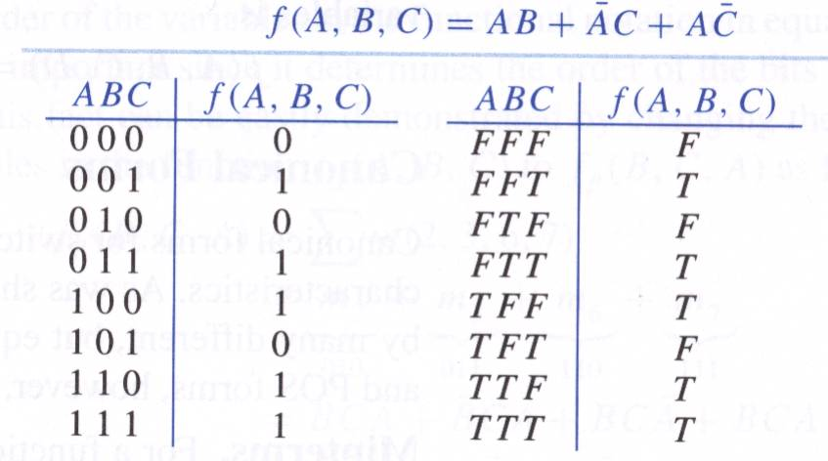
Switching functions
Truth tables
  Can replace “1” by T “0” by F

Slide 13
Algebraic forms of Switching functions
Sum of products form (SOP)
Product of sums form (POS)

Slide 14
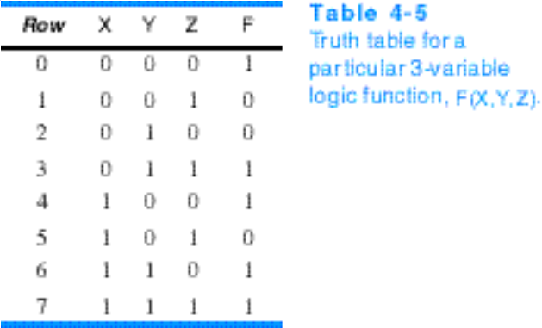
Logic representations:
(a) truth table (b) boolean equation
from 1-rows in truth table:
F = X’Y’Z’ + X’YZ + XY’Z’ + XYZ’ + XYZ
F = Y’Z’ + XY + YZ
from 0-rows in truth table:
F = (X + Y + Z’)(X + Y’ + Z)(X’ + Y + Z’)
F = (X + Y’ + Z)(Y + Z’)

Slide 15
Definitions:
Literal --- a variable or complemented variable (e.g., X or X')
product term --- single literal or logical product of literals (e.g., X or X'Y)
sum term --- single literal or logical sum of literals (e.g. X' or (X' + Y))
sum-of-products --- logical sum of product terms (e.g. X'Y + Y'Z)
product-of-sums --- logical product of sum terms (e.g. (X + Y')(Y + Z))
normal term --- sum term or product term
in which no variable appears more than once
(e.g. X'YZ but not X'YZX or X'YZX'
(X + Y + Z') but not (X + Y + Z' + X))
minterm --- normal product term containing all variables (e.g. XYZ')
maxterm --- normal sum term containing all variables (e.g. (X + Y + Z'))
canonical sum --- sum of minterms from truth table rows producing a 1
canonical product --- product of maxterms from truth table rows producing a 0

Slide 16
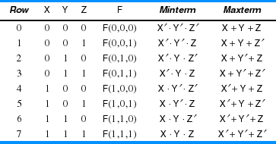
Truth table vs. minterms & maxterms

Slide 17
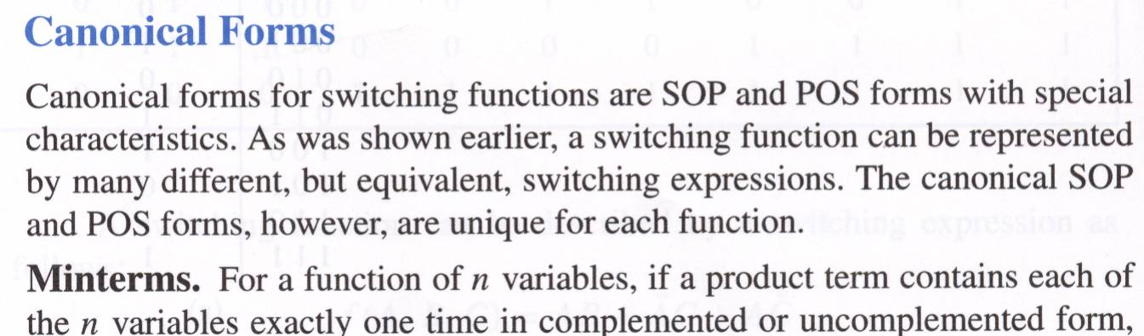
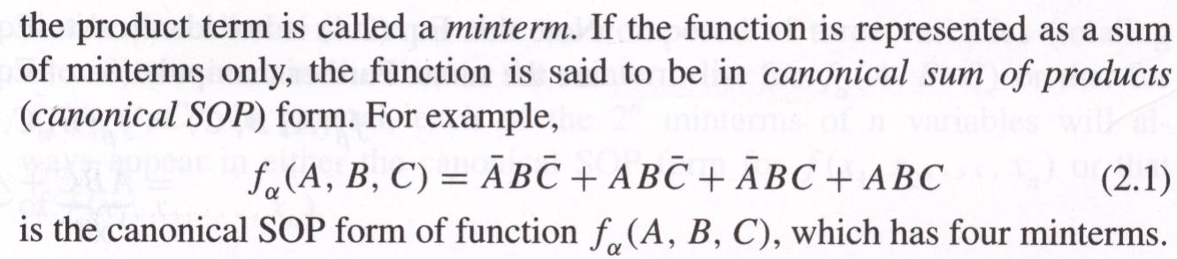
Switching functions

Slide 18
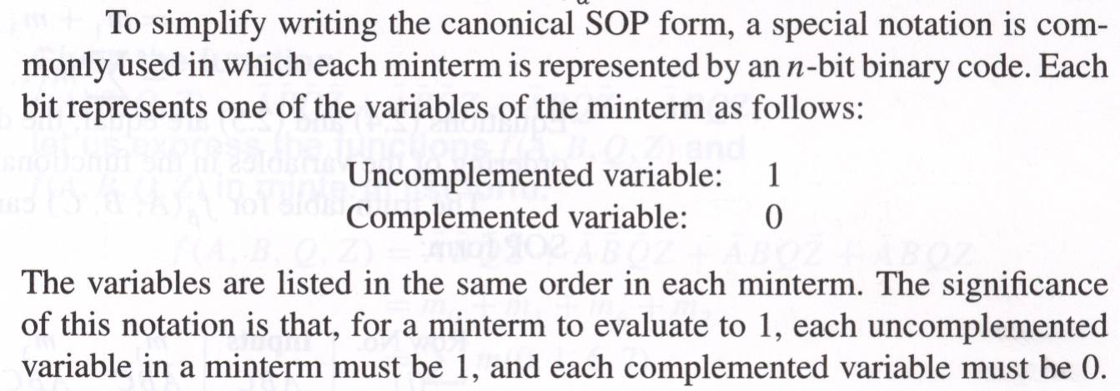
Switching functions

Slide 19
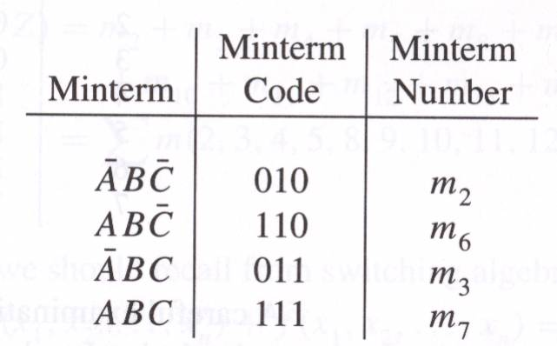
Switching functions

Slide 20
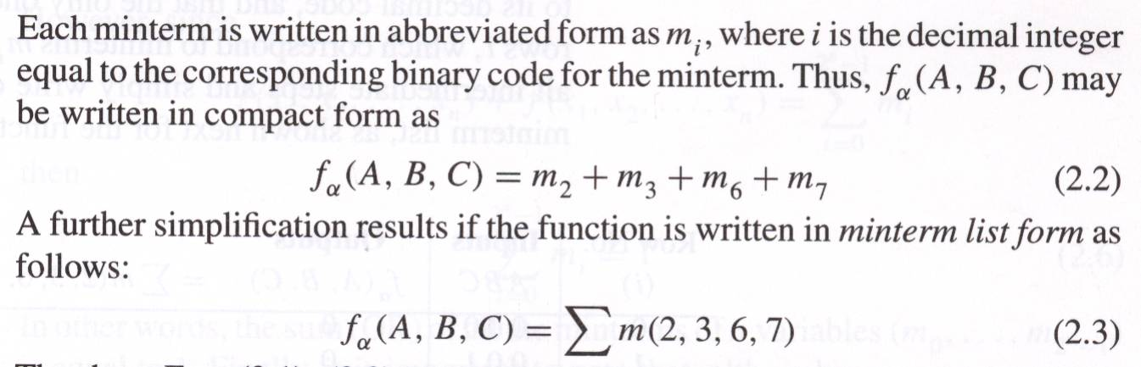
Switching functions
The order of the variables in the function specification is very important, because it determines different actual minterms

Slide 21
Truth tables
Given the SOP form of a function, deriving the truth table is very easy: the value of the function is equal to “1” only for these input combinations, that have a corresponding minterm in the sum.
Finding the complement of the function is just as easy

Slide 22
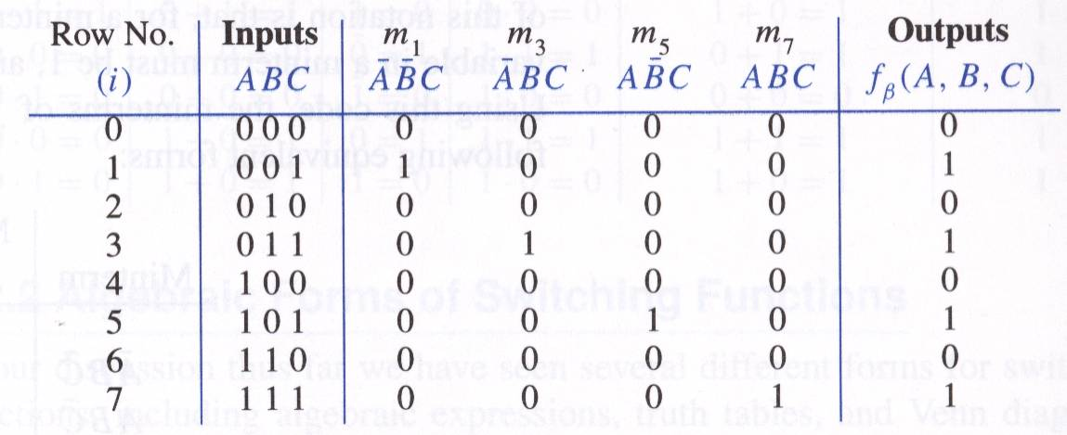
Truth tables

Slide 23
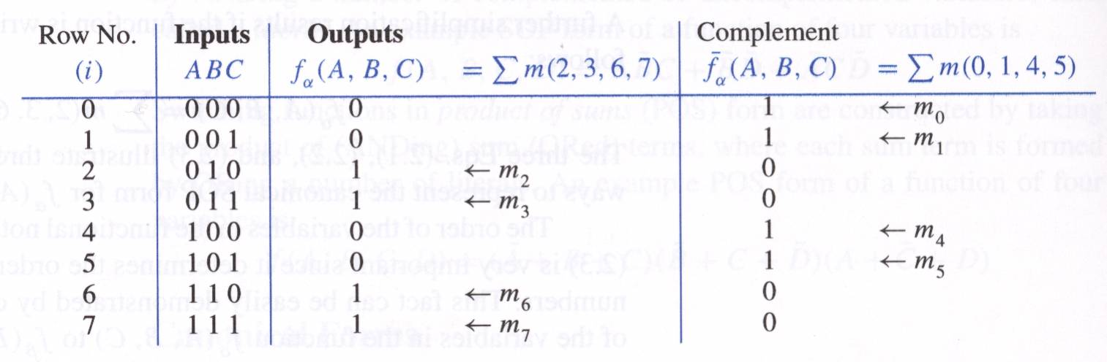
Truth tables and the SOP form

Slide 24
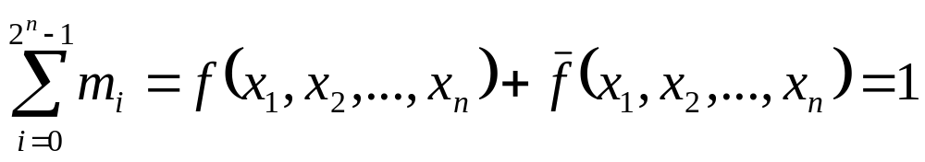
Minterms
How many minterms are there for a function of n variables?
  2^{n}
What is the sum of all minterms of any function ? (Use switching algebra)

Slide 25
Maxterms
A sum term that contains each of the variables in complemented or uncomplemented form is called a maxterm
A function is in canonical Product of Sums form (POS), if it is a product of maxterms

Slide 26
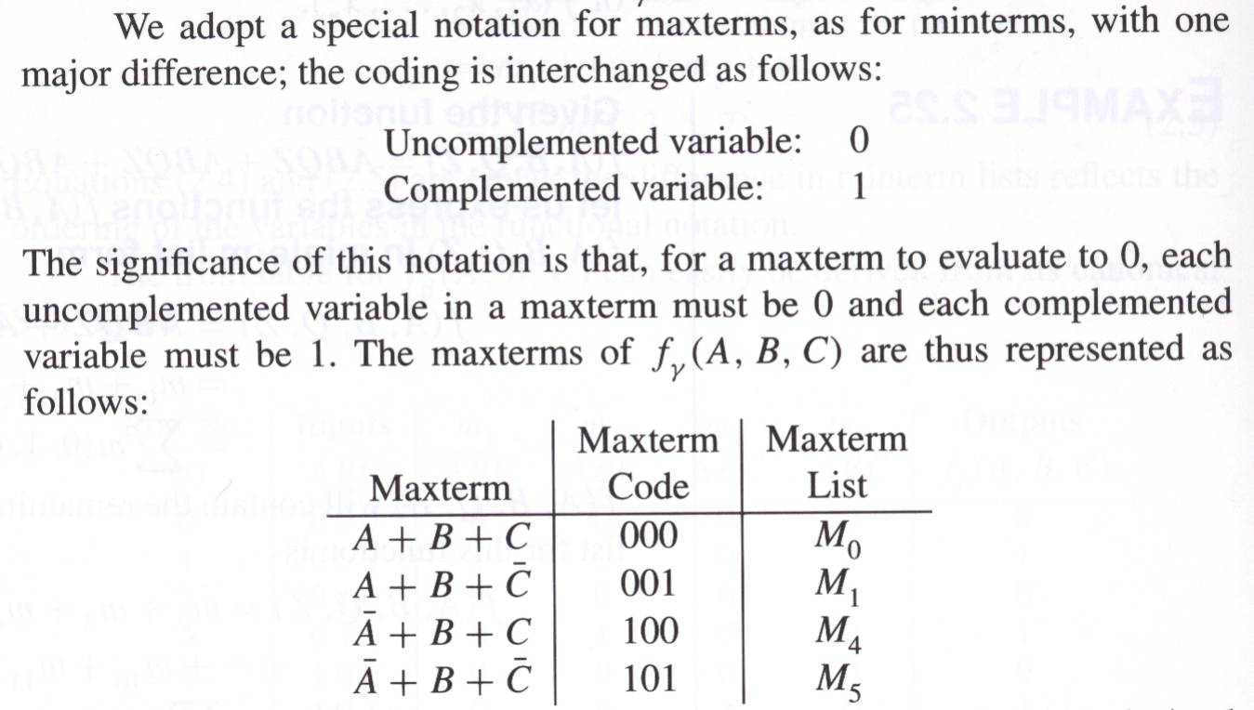
Maxterms

Slide 27
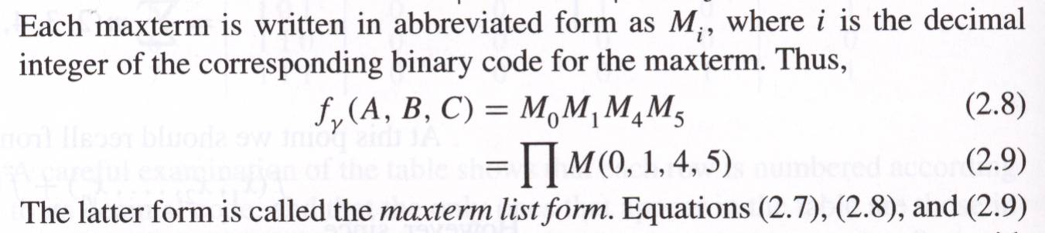
Maxterms
As with minterms, the order of variables in the function specification is very important.
If a truth table is constructed using maxterms, only the “0”s are the ones included
  Why?

Slide 28
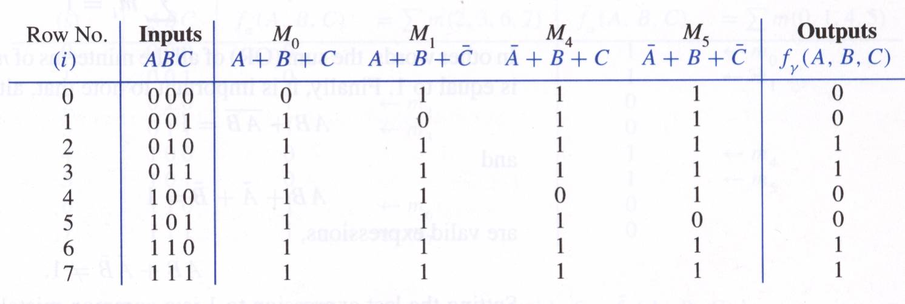
Maxterms

Slide 29
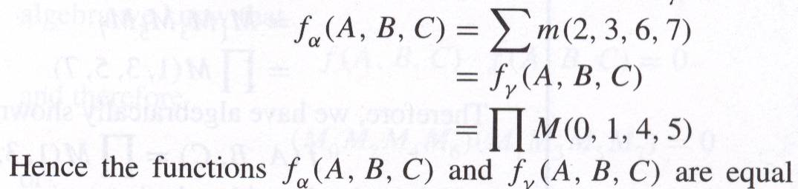
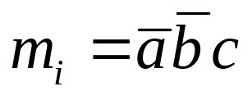
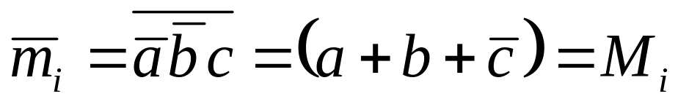
Maxterms
It is easy to see that minterms and maxterms are complements of each other. Let some minterm ; then its complement

Slide 30
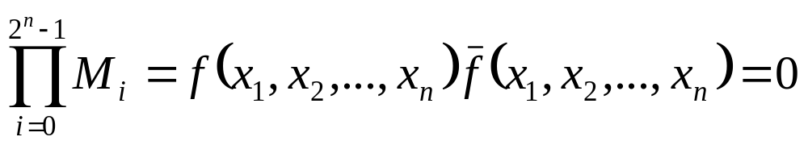
Maxterms
How many maxterms are there for a function of n variables?
  2^{n}
What is the product of all maxterms of any function? (Use switching algebra)

Slide 31
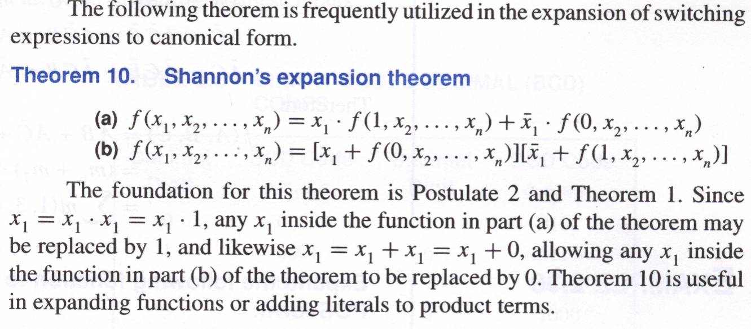
Derivation of canonical forms

Slide 32
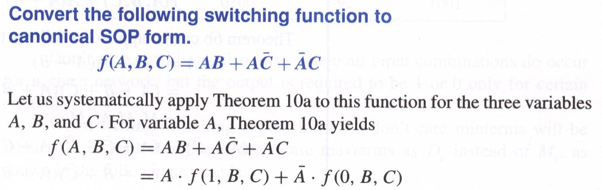
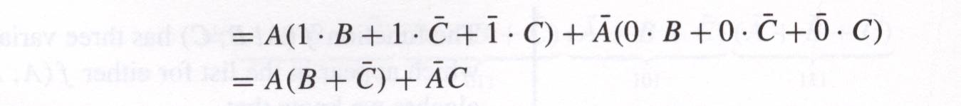
Derivation of canonical forms

Slide 33
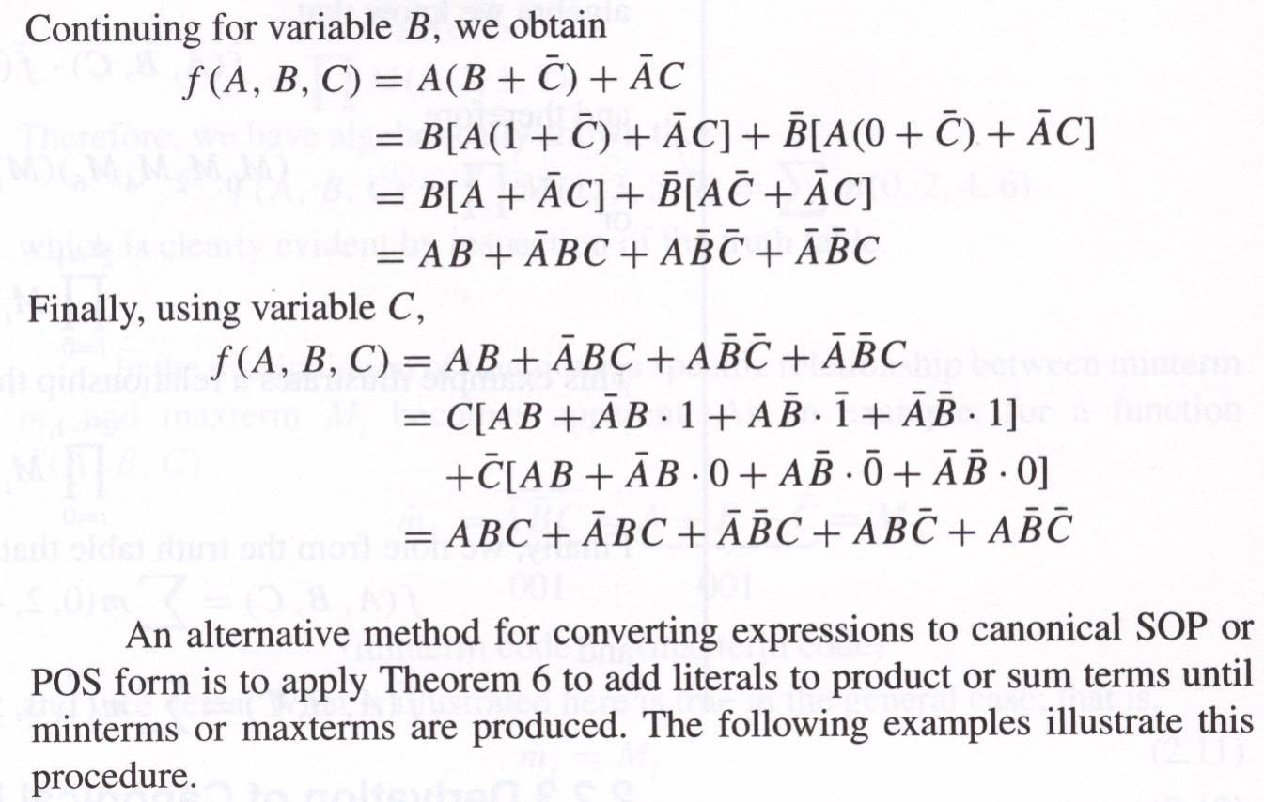
Derivation of canonical forms

Slide 34
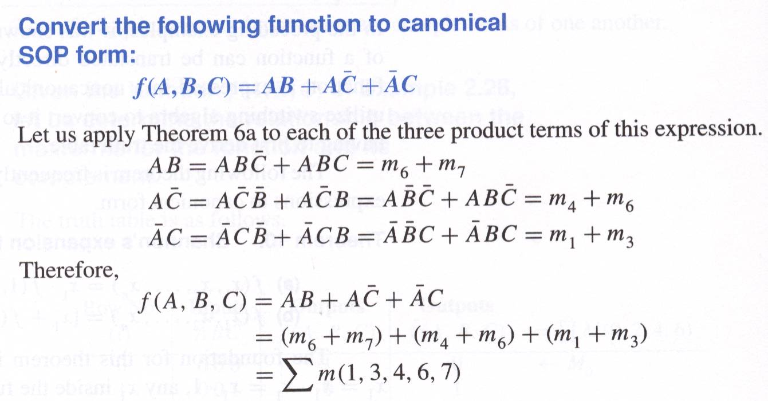
Derivation of canonical forms

Slide 35
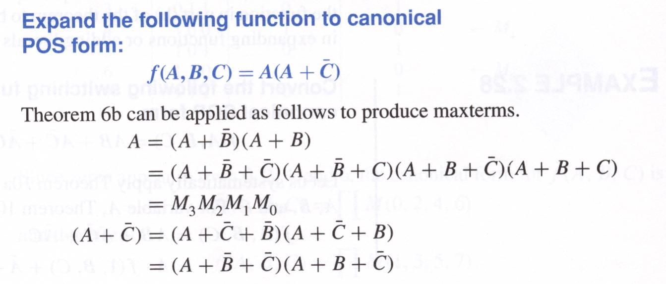
Derivation of canonical forms

Slide 36
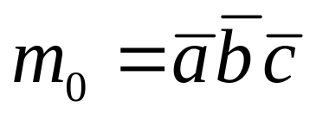
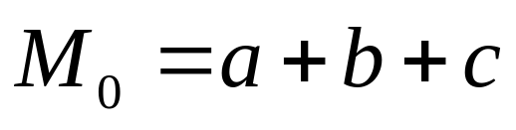
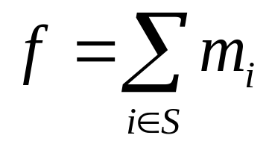
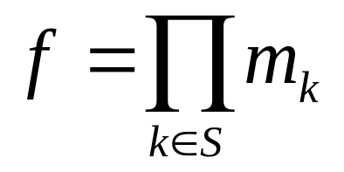
Canonical forms
SOP Sum of minterms 2^{n} minterms 0…2^{n}-1 Variable “true” if bit = 1 Complemented if bit =0 | POS Product of maxterms 2^{n} maxterms 0…2^{n}-1 Variable “true” if bit = 0 Complemented if bit =1
Contain each variable in either true or complemented form

Slide 37
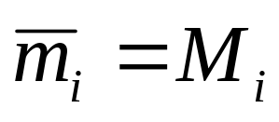
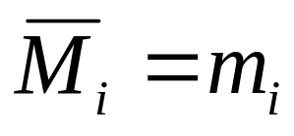
Canonical forms
SOP If row i of the truth table is = 1, then minterm m_{i} is included in f (i∈S) | POS If row k of the truth table is = 0, then maxterm M_{i} is included in f (k∈S)

Slide 38
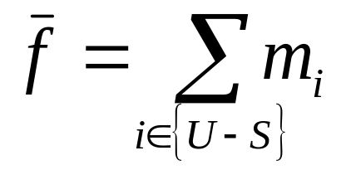
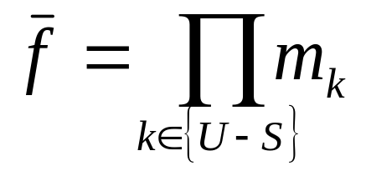
Canonical forms
SOP The sum of all minterms = 1 If Then | POS The product of all maxterms = 0 If Then
Where U is the set of all 2^{n} indexes

Slide 39
Shortcut notation:
F = X’Y’Z’ + X’YZ + XY’Z’ + XYZ’ + XYZ
= Σ (0, 3, 4, 6, 7)
F = (X + Y + Z’)(X + Y’ + Z)(X’ + Y + Z’)
= Π (1, 2, 5)
Note equivalences:
Σ (0, 3, 4, 6, 7) = Π (1, 2, 5)
[Σ (0, 3, 4, 6, 7)]’ = Σ (1, 2, 5) = Π (0, 3, 4, 6, 7)
[Π (1, 2, 5)]’ = Π (0, 3, 4, 6, 7) = Σ (1, 2, 5)

Slide 40
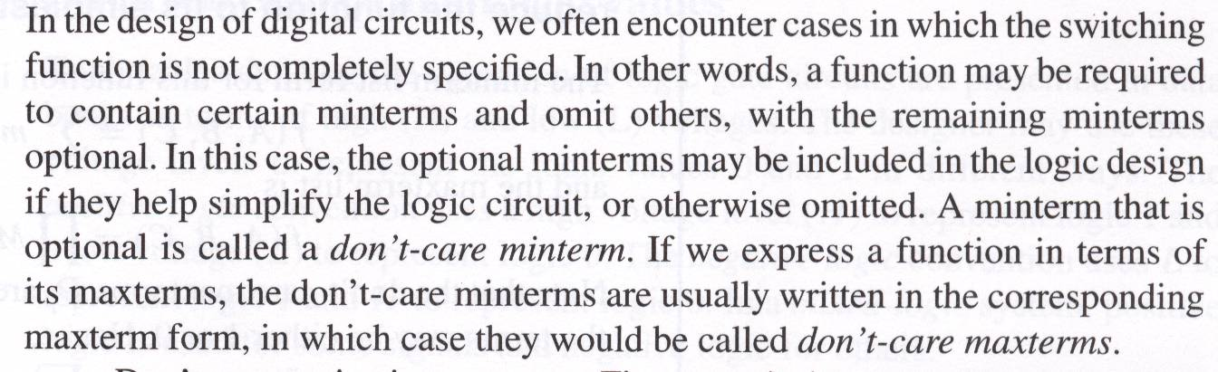
Incompletely specified functions

Slide 41
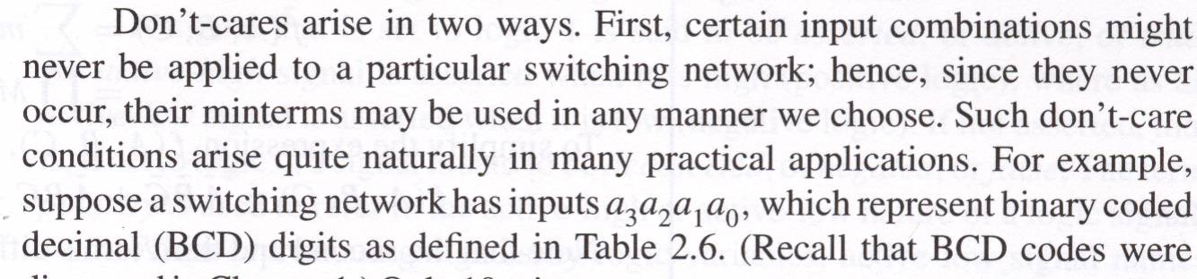
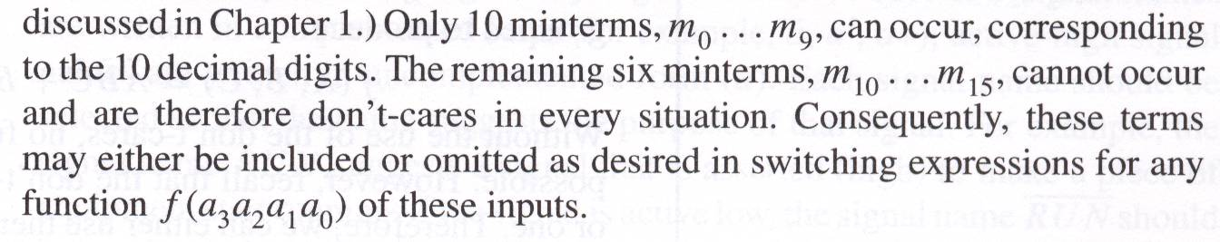
Incompletely specified functions

Slide 42
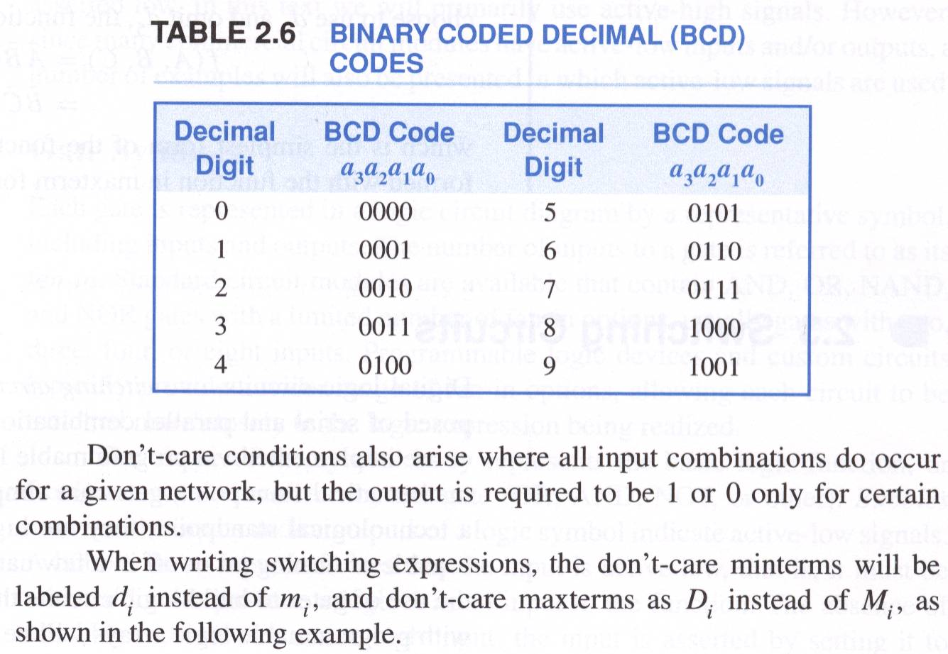
Incompletely specified functions

Slide 43
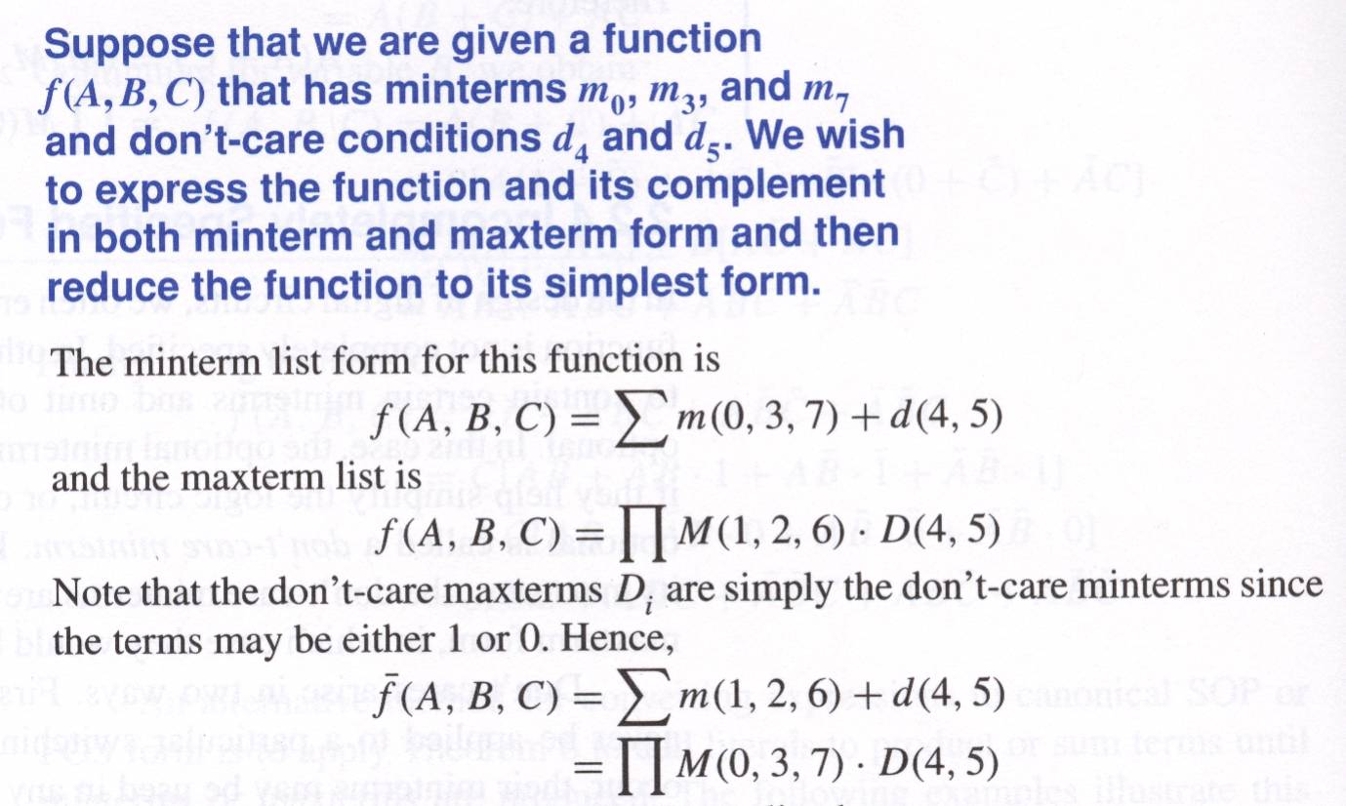
Incompletely specified functions

Slide 44
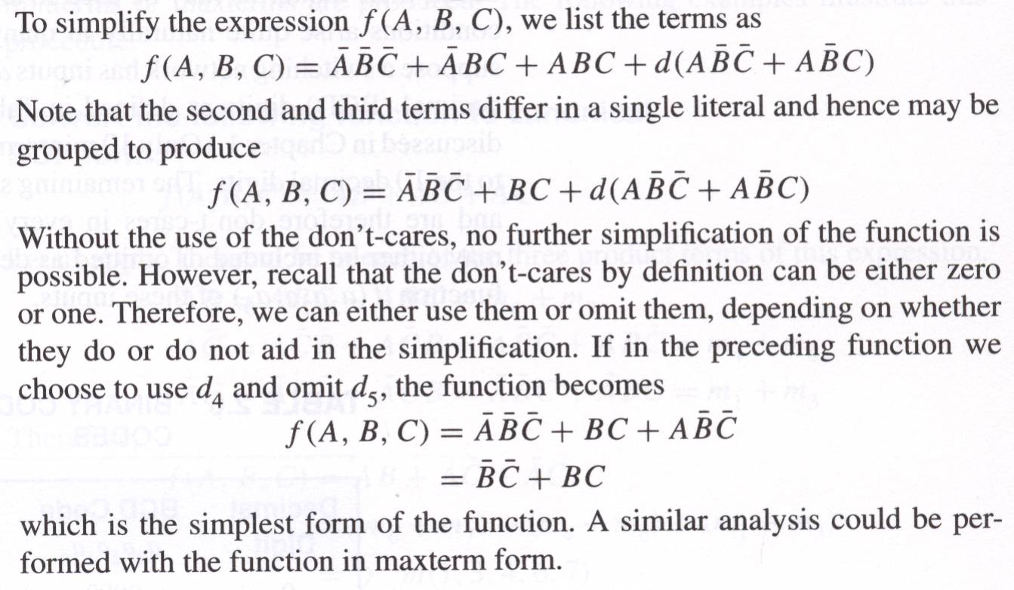
Incompletely specified functions

