Slide 1
Spatial Databases: Weather data and OSM
Anna, Amanda, Robert
Institut für Informatik
FU Berlin
19.11.15

Slide 2
Data sources
Json data files of long term and short term weather data:
  https://developer.yahoo.com/weather/
  http://api.wunderground.com/api/326229dc7cedcc66/geolookup/q/Germany/Berlin.json
Grib data files of long and short term weather data:
  http://www.grib.us/
  http://www.saildocs.com/
  http://www.nco.ncep.noaa.gov/pmb/docs/grib2/grib2_doc.shtml

Slide 3
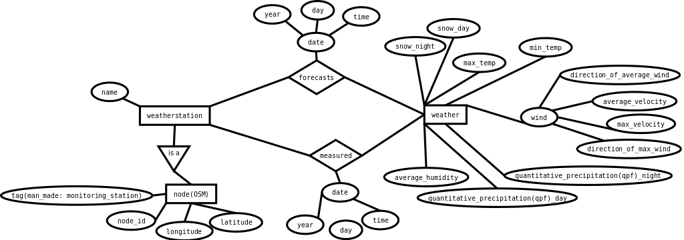
ER diagram

Slide 4
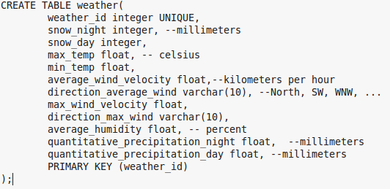
Data base set up and Data import
Transformed the ER diagram to the db schema:
Using pgfutter to import json file data into our data base
Grib data import: ????

Slide 5
Used Tools for the project
postgres, postgis as data base
Pgfutter for import
Java back-end
Tomcat web server
openlayers lib for visualisation + Java script for front end

Slide 6
Thank You!

Slide 7
Sources

