Slide 1
Predictive maintenance for railway systems with supervised machine learning: a case study
Raihana Ferdous
Date: 07/03/2025

Slide 2
Motivation & Objective
Identifying maintenance requirement in railway is significant
to improve overall operational efficiency
to minimize disruptions to workflow by addressing potential equipment issues before they escalate
Predictive maintenance (PdM) solution has emerged as a viable solution to anticipate maintenance needs and preempt system failures
Data driven PdM – a promising solution to failure detection and prediction
maintenance needs are identified through statistical, machine learning (ML), and deep learning (DL) solutions
that monitor the system logs and recommend interventions before a failure occurs

Slide 3
Current maintenance approach
Manual approach that mainly relies on experts’ opinions
Each Trenord train has 18 devices per vehicle, each with its own diagnostics
onboard diagnostic platform stores diagnostic data from each vehicle
experts analyze the diagnostic data to identify faults and determine maintenance need
Lacks an automatic prediction system to
recognize potential failures before they occur
enable preventive maintenance operations

Slide 4
Proposal
Objective: Developing a data-driven PdM solution for an on-board system, i.e., the Traction Control Unit (TCU), which is one of the complex on-board devices of a train
activity performed: a feasibility study on predicting faults and maintenance needs for railway traction systems
leveraging the information from historical data of the rolling stocks shared by Trenord

Slide 5
Trenord DataSet
Log data of the TCU for 9 rolling stocks for around 3-year period
Consists of two types of log data:
Diagnostic data –
represents diagnostic events associated to alerts (i.e., alerts due to exceeding a threshold)
consists of a database of faults, problems, and malfunctions recorded on-board
Maintenance data (only 473 records) consists of
Corrective maintenance data - maintenance activities as a consequence of faults that happened during the service
Scheduled maintenance data - maintenance activities according to the rolling stock maintenance plan

Slide 6
Analysis of diagnostic data
Each diagnostic event
recorded according to the time of occurrence
associated with an alert
contains information regarding the event, such as
alert type and code, latitude & longitude, velocity, carriage number, etc
Domain experts of Trenord defines :
270 alerts for TCU (each is identified with a code Id and severity)
11 alerts are identified as critical out of 270
Notes:
Our preliminary activity towards developing a data-driven PdM solution is to analyse the on-board diagnostic data only, and check the feasibility of building a forecasting model for predicting future alerts.
Here we specifically focus on predicting the number of critical alerts, which, according to the domain experts, can be used as an indicator of possible faults.
time-series data is - a series of data points or observations recorded at different or regular time intervals

Slide 7
Data description – TCU
TrainID | Train Name | Diagnostic Data (Duration) | Diagnostic Data (Total number of TCU events in the file) | Diagnostic data (Number of alert events after filtering) | Number of critical alerts (after filtering) | Diagnostic data (num. of days- after filtering)
T1 | TSR 070 | Jan. 2021 – May.2024 | 618334(out of 1219660) | 67976 | 340 | 775
T2 | TSR 086 | June. 2021 – May.2024 | 1428721(out of 1928723) | 286597 | 3565 | 857
T3 | TSR 040 | Nov. 2020 – May.2024 | 1185790(out of 1892948) | 186347 | 8413 | 1066
T4 | TSR 008 | Jul. 2020 –May.2024 | 705257( out of 1027019) | 101066 | 830 | 694
T5 | TSR 020 | Nov. 2022 –Apr.2024 | 111451( out of 295560) | 11928 | 3066 | 397
T6 | TSR 017 | Nov. 2022 –Apr.2024 | 219365( out of 400668) | 23235 | 237 | 375
T7 | TSR 033 | Dec. 2022 –May.2024 | 227751( out of 583850) | 41889 | 495 | 401
T8 | TSR 059 | July 2023 –May.2024 | 272088( out of 453231) | 45041 | 369 | 226
T9 | TSR 064 | Nov. 2022 April2024 | 1191626( out of 1401976) | 162828 | 1752 | 391
Filtering is performed to remove the redundant alert records.

Slide 8
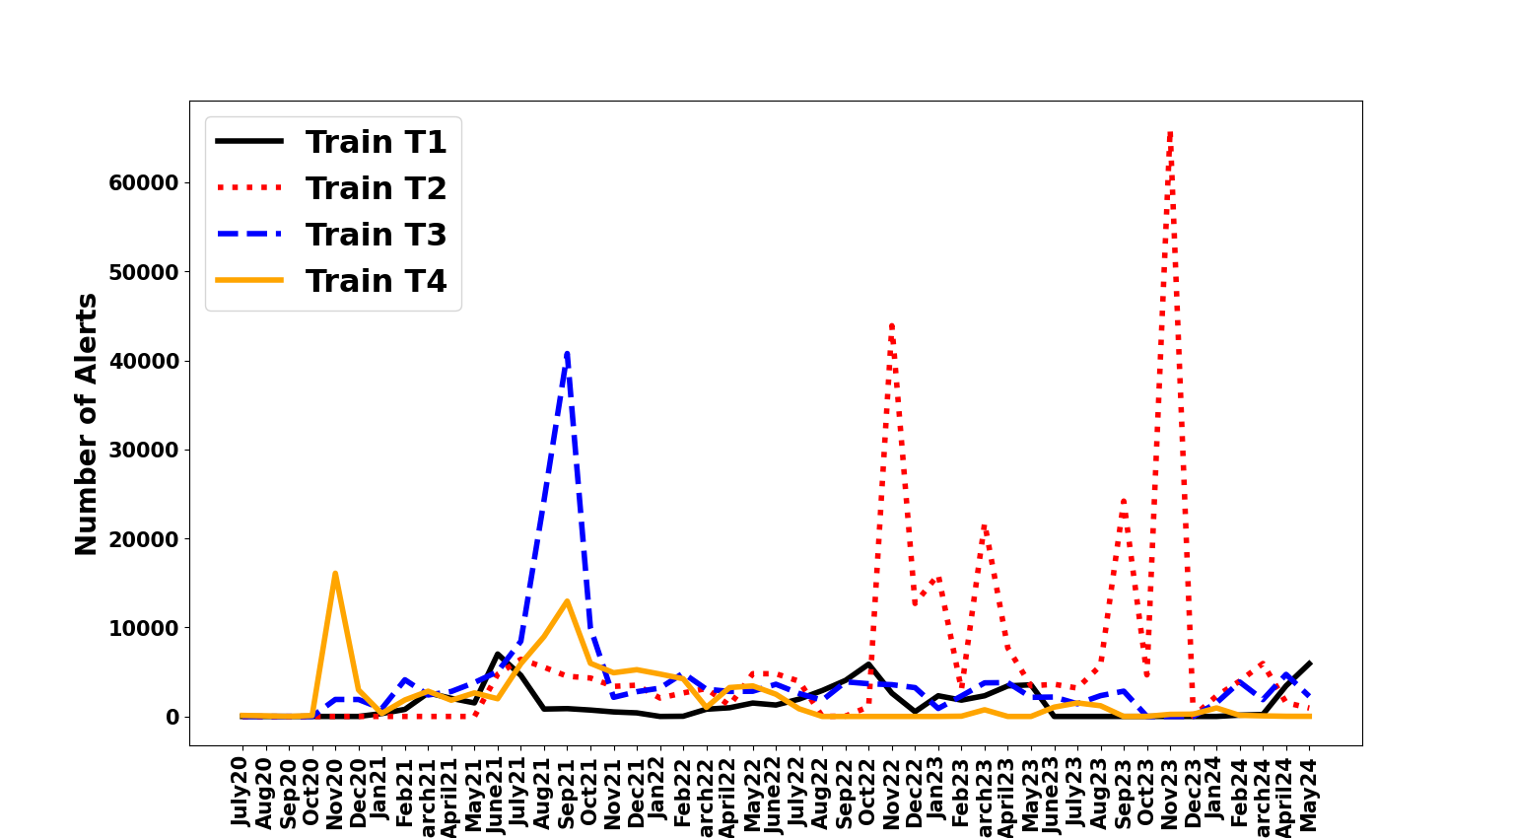
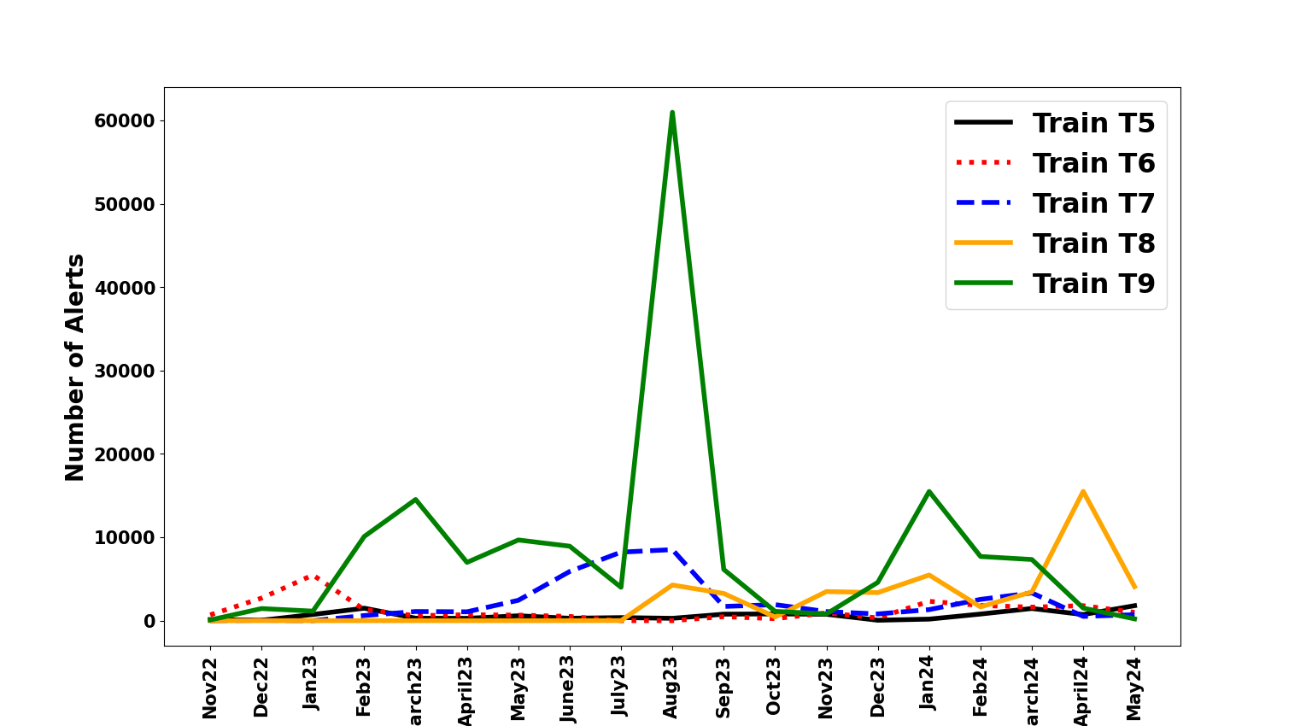
Number of Alerts
Distinct characteristics for each train
One model may not suitable to forecast all train

Slide 9
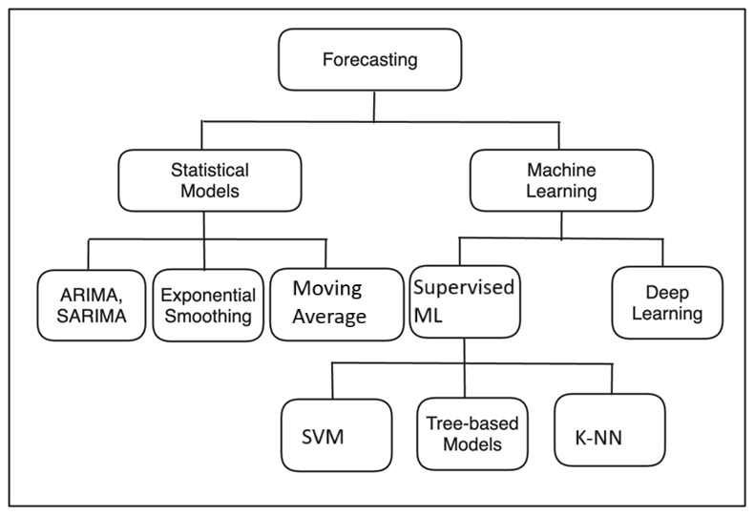
Alert Prediction Model
On-board diagnostic data is multivariate time series data
We focus on building a time series forecasting model for predicting future alerts
Considering alerts and critical alerts info, which, according to the domain experts, can be used as an indicator of possible faults

Slide 10
Time series forecasting using Statistical Model
Train ID | Train Name | Random Walk | Moving Average | ARIMA | SARIMA | Exponential Smoothing (simple) | Exponential Smoothing (triple)
T1 | TSR 070 | 1346.95 | 1237.91 | 882.41 | 973.13 | 6204.91 | 8733.10
T2 | TSR 086 | 21345.1 | 21538.03 | 21239.53 | 17463.36 | 22177.47 | 24653.78
T3 | TSR 040 | 650.81 | 503.38 | 1379.48 | 975.05 | 706.61 | 2303.67
T4 | TSR 008 | 731.75 | 975.8 | 567.88 | 889.98 | 6196.78 | 8414.62
T5 | TSR 020 | 422.26 | 456.07 | 467.58 | 643.08 | 682.71 | 1369.07
T6 | TSR 017 | 300.03 | 561.93 | 335.57 | 376.98 | 1421.29 | 1229.50
T7 | TSR 033 | 779.13 | 623.19 | 771.6 | 990.88 | 668.51 | 3236.79
T8 | TSR 059 | 4863.32 | 4504.38 | 876.99 | 567.99 | 5001.63 | 8002.72
T9 | TSR 064 | 3034.96 | 7811.52 | 7688.7 | 9786.88 | 23604.63 | 1673.38
Root Mean Square Error (RMSE) is used as an indicator to evaluate the forecast accuracy - measures the average of the squares of the errors
The smaller the value of RMSE, the closer the model is to the best fit

Slide 11
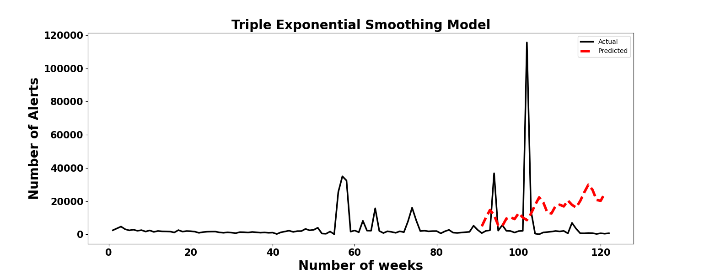
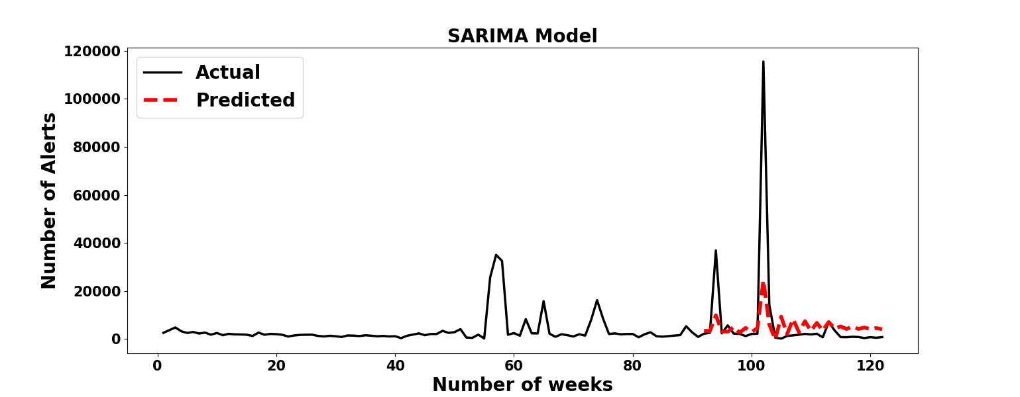
T2 – TSR086

Slide 12
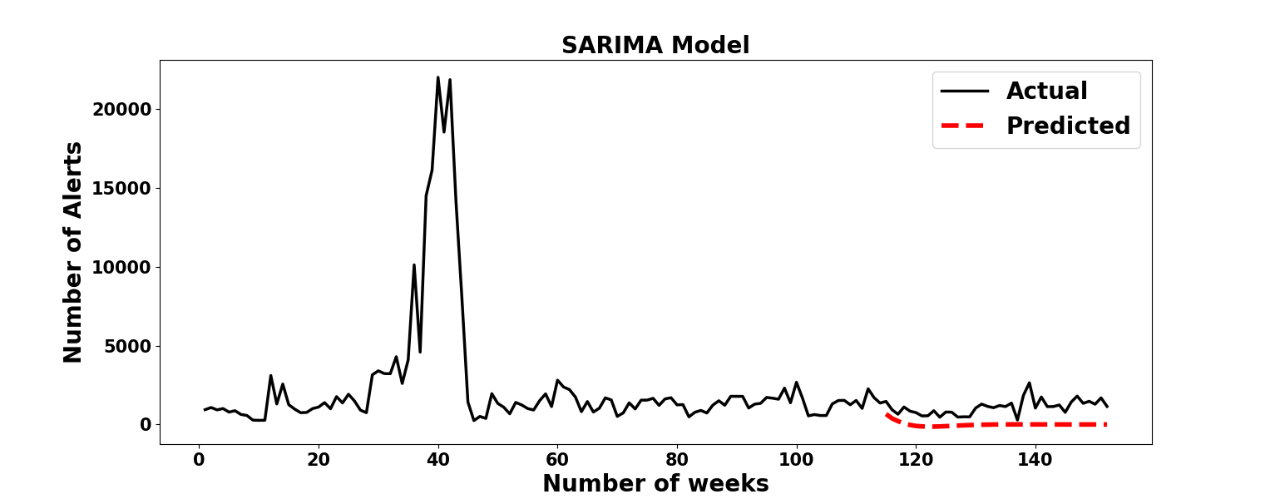
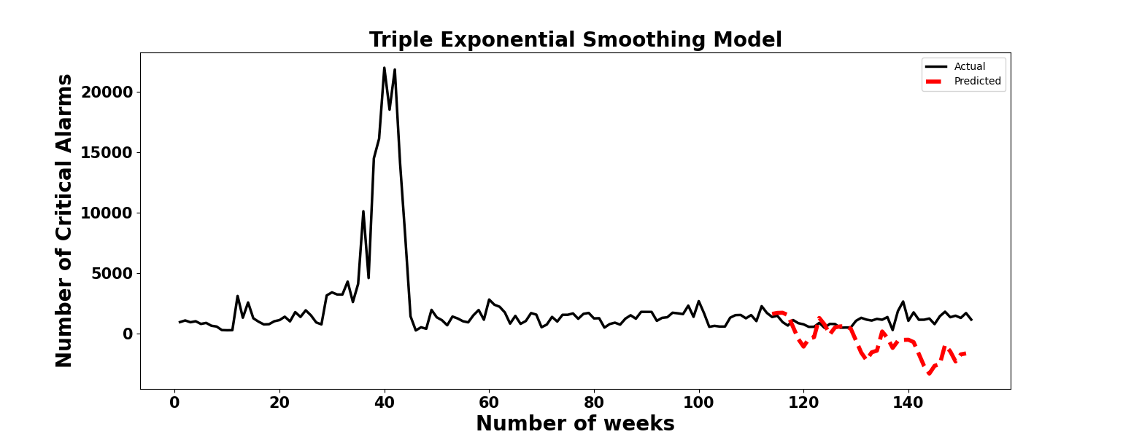
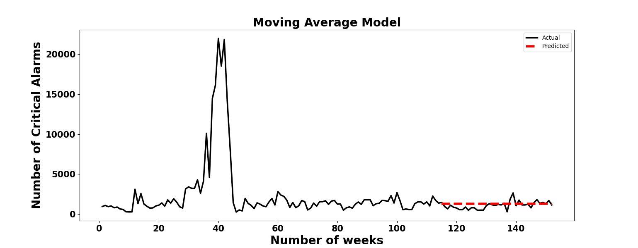
T3 – TSR040

Slide 13
Limitations of Statistical approach
Statistical methods do not perform well with multivariate data as it is harder to model
Multi-variate single step time series forecasting problem can be reframed as a supervised learning problem
We can leverage a variety of machine learning algorithms, to improve the forecasting accuracy

Slide 14
Trenord DataSet
Log data of the TCU for 9 rolling stocks for around 3-year period
Consists of two types of log data:
Diagnostic data –
represents diagnostic events associated to alerts (i.e., alerts due to exceeding a threshold)
consists of a database of faults, problems, and malfunctions recorded on-board
Maintenance data (only 473 records) consists of
Corrective maintenance data - maintenance activities as a consequence of faults that happened during the service
Scheduled maintenance data - maintenance activities according to the rolling stock maintenance plan

Slide 15
Analysis of diagnostic data
Each diagnostic event
recorded according to the time of occurrence
associated with an alert
contains information regarding the event, such as
alert type and code, latitude & longitude, velocity, carriage number, etc
Domain experts of Trenord defines :
270 alerts for TCU (each is identified with a code Id and severity)
11 alerts are identified as critical out of 270
Notes:
Our preliminary activity towards developing a data-driven PdM solution is to analyse the on-board diagnostic data only, and check the feasibility of building a forecasting model for predicting future alerts.
Here we specifically focus on predicting the number of critical alerts, which, according to the domain experts, can be used as an indicator of possible faults.
time-series data is - a series of data points or observations recorded at different or regular time intervals

Slide 16
Time series forecasting using ML – Data Preparation
Need to represent time series data applicable for supervised learning algorithms
To make a time series as supervised learning problem, we need to map input variables (X) to output variables (y) using a function 𝑓,
𝑦=𝑓(𝑋)
Feature Engineering to convert time series into supervised ML dataset
Sliding Window/Lag Method – including values at prior time steps
Used Supervise ML algo – Logistic Regression, Random Forest, Support Vector Machine

Slide 17
Time series forecasting using ML - Objective
Input : Given diagnostic data sampled per week for the training period of n week
Output : Predict alert in (n+1)th week
1 : if the num alert goes above a threshold (weighted avg)
0: if the num alert remains below a threshold
Alert threshold : weighted average of weekly alerts

Slide 18
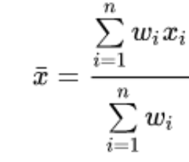
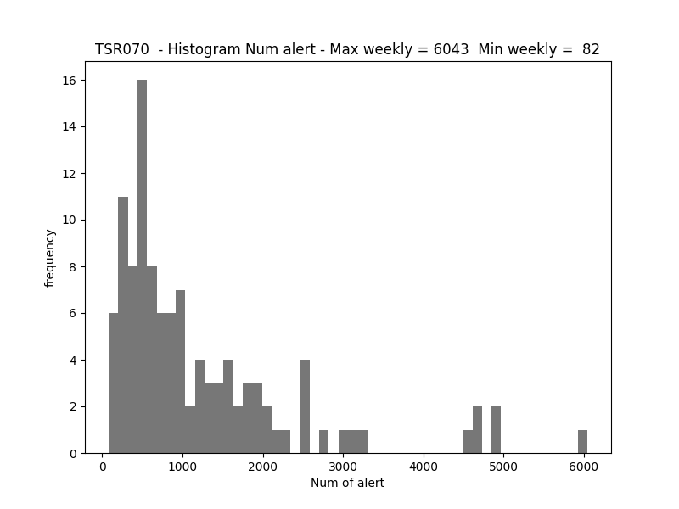
Calculate threshold – Weekly weighted average alerts
weighted average accounts importance/frequency (i.,e., weight) of each data point in dataset while calculating the average
calculated by multiplying each data point by its corresponding weight, summing the products, and dividing by the sum of the weights
For calculating the weighted weekly average alert
We assign the frequency as the weight for each data point
Weekly weighted average alert= 774

Slide 19
Time series forecasting using ML – Feature Engineering
Four classes of features that we can create from our time series dataset:
Date Time Features: these are components of the time step itself for each observation
Month (the week belong to)
Year (the week belong to)
Current and Lag Features: Dependent variable with their current value and values at prior time steps (window size) to capture the patterns and trends in our time-series data
Num of alert in a week
Number of critical alert in a week
Number of alerts for last n weeks (n=8)
Number of critical alerts for last n weeks (n=8)
Window Features: Summary statistics across the values in the sliding window and include these as features in dataset (window size = 8 week)
Average alerts for the window
Avereage critical alert for the window
Std of alerts for the window
Std of critical alert for the window

Slide 20
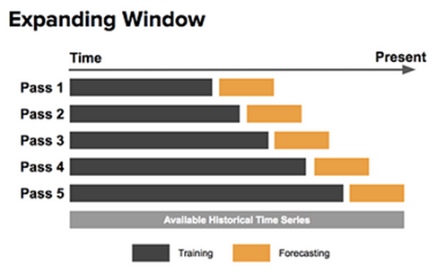
Experimental detail - Validation criteria
Validation Method - K-fold Cross validation is not feasible for time series validation
Walk-Forward Validation - Process of iteratively train the model using past data and then testing its accuracy on the next data point
This process is repeated, with the training set being updated at each step to include the most recent data, allowing the model to adapt to changing patterns in the time series
Hyperparameter optimization –
hyperparameter optimization is performed for each ML algorithm (e.g., random forest, SVM)
training set is also used
grid search approach is adopted to iteratively explore different combinations of hyperparameters to find the optimal settings

Slide 21
Experiments - Evaluation metrics & Baseline model
Split of dataset
First 60% week for training
Remaining 40% for testing
Evaluation metrics - Accuracy, F1-score, Precision, Recall, and Mean Absolute Error
Baseline Model to compare - Random Walk predictor
one of the simplest yet powerful models in time series forecasting - It assumes that all future values depend on the last observed value
does not consider any underlying patterns, such as trend and seasonality

Slide 22
Time series forecasting using ML algo-Accuracy
Train ID | Train Name | Max weekly alert | Alert Threshold (Weighted weekly Avg alerts) | Baseline Model - Random Walk | Logistic Regression | Random Forest | Support Vector Machine | Naive Bayes | K-NN | Gradient Boosting
T1 | TSR 070 | 6043 | 775 | 43% | 47% | 97% | 90%
T2 | TSR 086 | 115963 | 1949 | 46% | 65% | 100% | 94%
T3 | TSR 040 | 24687 | 1518 | 47% | 54% | 98% | 98%
T4 | TSR 008 | 16988 | 1079 | 56% | 56% | 95% | 98%
T5 | TSR020 | 1730 | 268 | 59% | 68% | 95% | 81%
T6 | TSR017 | 10611 | 673 | 55% | 55% | 100% | 100%
T7 | TSR033 | 12174 | 723 | 54% | 54% | 95% | 95%
T8 | TSR059 | 13522 | 2227 | 75% | 50% | 91% | 66%
T9 | TSR064 | 48717 | 3088 | 61% | 71% | 95% | 90%
Random Forests
performs best for
8 out of 9 train data

Slide 23
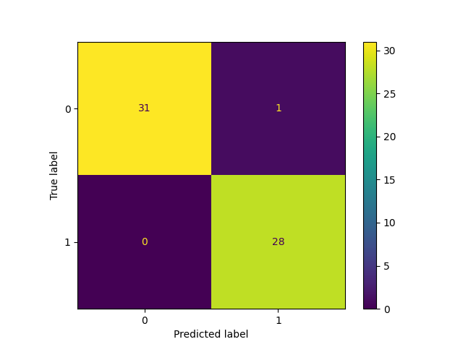
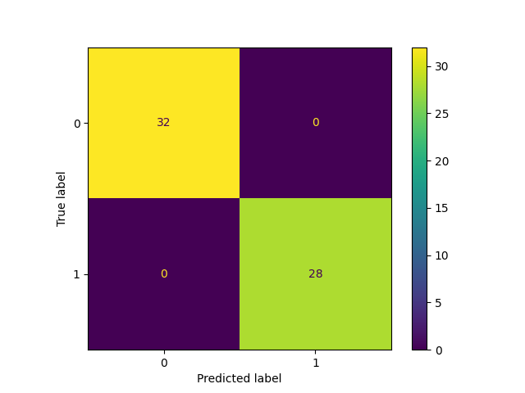
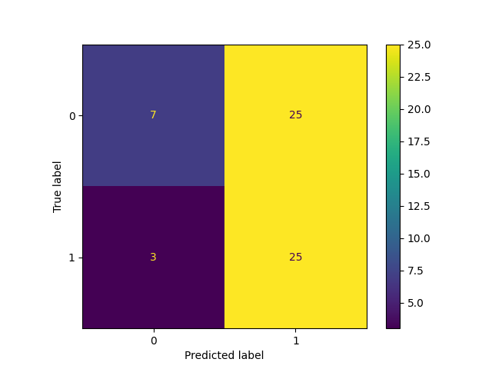
Confusion Matrix – T1- TSR040
Support Vector Machine
Logistic Regression
Random Forest

Slide 24
Time series forecasting using ML algo- Validation Result
Train ID | Train Name | Best Algorithm | Results
T1 | TSR 070 | Random Forests | Accuracy: 97%, Precision:1, Recall:0.97, F1-Score: 0.98, MeanAbsoluteError: 2.3%
T2 | TSR 086 | Support Vector Machine | Accuracy: 100%, Precision:1, Recall:1, F1-Score: 1, MeanAbsoluteError: 0%
T3 | TSR 040 | Random Forests Support Vector Machine | Accuracy: 98%, Precision: 0.96, Recall:1 , F1-Score: 0.98, MeanAbsoluteError: 1.6%
T4 | TSR 008 | Support Vector Machine | Accuracy: 97%, Precision: 0.93, Recall: 1, F1-Score:0.97, MeanAbsoluteError: 5.1%
T5 | TSR020 | Random Forests | Accuracy: 95%, Precision: 0.94, Recall: 1, F1-Score:0.95,MeanAbsoluteError: 4.5%
T6 | TSR017 | Random Forests Support Vector Machine | Accuracy:100% , Precision: 1, Recall:1, F1-Score: 1, MeanAbsoluteError: 0
T7 | TSR033 | Random Forests Support Vector Machine | Accuracy:95% , Precision: 0.9, Recall:1, F1-Score: 0.95, MeanAbsoluteError: 4.5%
T8 | TSR059 | Random Forests | Accuracy:91% , Precision: 1, Recall:0.9, F1-Score: 0.91, MeanAbsoluteError: 8.3%
T9 | TSR064 | Random Forests | Accuracy:95% , Precision: 0.91, Recall:1, F1-Score: 0.95, MeanAbsoluteError: 4.7%

Slide 25
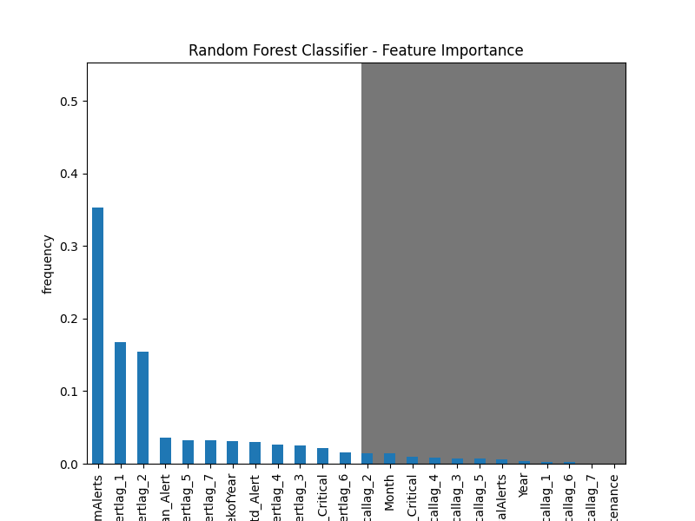
Experiments – Lag variables & feature importance
Finding suitable window size for prior time steps - to capture the patterns and trends in our time-series data
Experiments perform varying window
Improve performance from 4 to 8 weeks window, increasing after that does not make any difference
Finding suitable feature set
Accuracy–
For Logistic regression and SVM improve sometimes using features about time, such as, month and year
Random forest works better only with lag (prior time step data) information

Slide 26
Experiments – Feature set
Window size for prior time steps - to capture the patterns and trends in our time-series data

Slide 27
Thank You

Slide 28
Backup

Slide 29
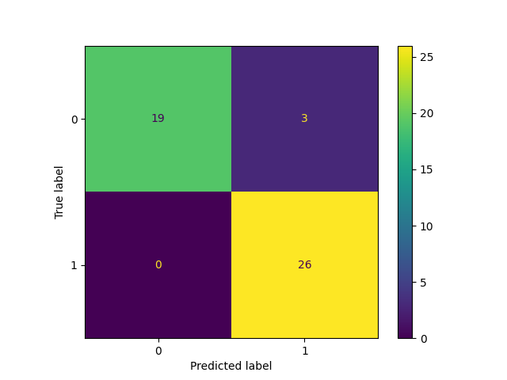
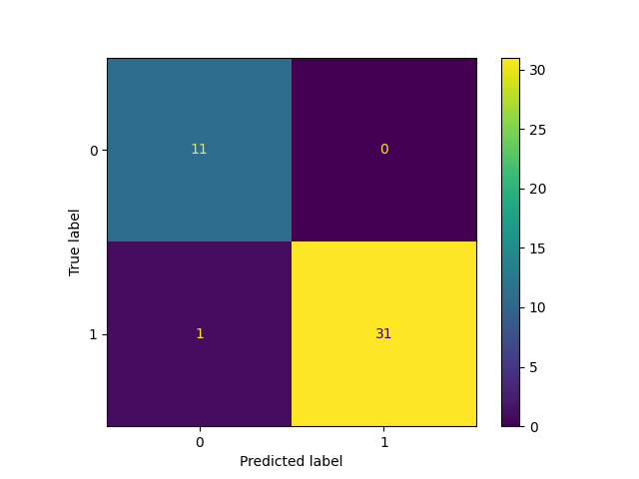
TSR-086
TSR-070

Slide 30
Experiments changing the lag parameter – from 4 to 8 it gives better result
Experiments using daily and weekly sampled data – while using daily sampled one will have more data points
Need to write down following sections:
Feature engineering
Spliting the data
Train the model
Hyperparameter tuning
Assess model performance

