Slide 1
Monthly Update Jan, 2020
Richard

Slide 2
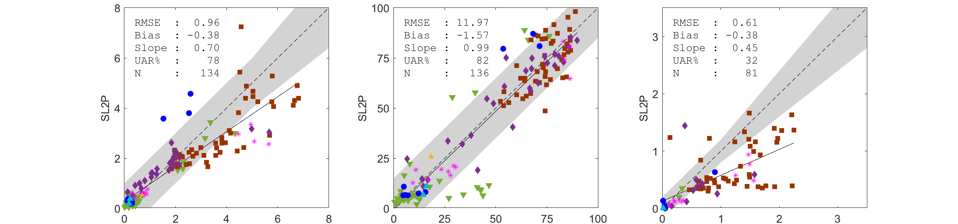
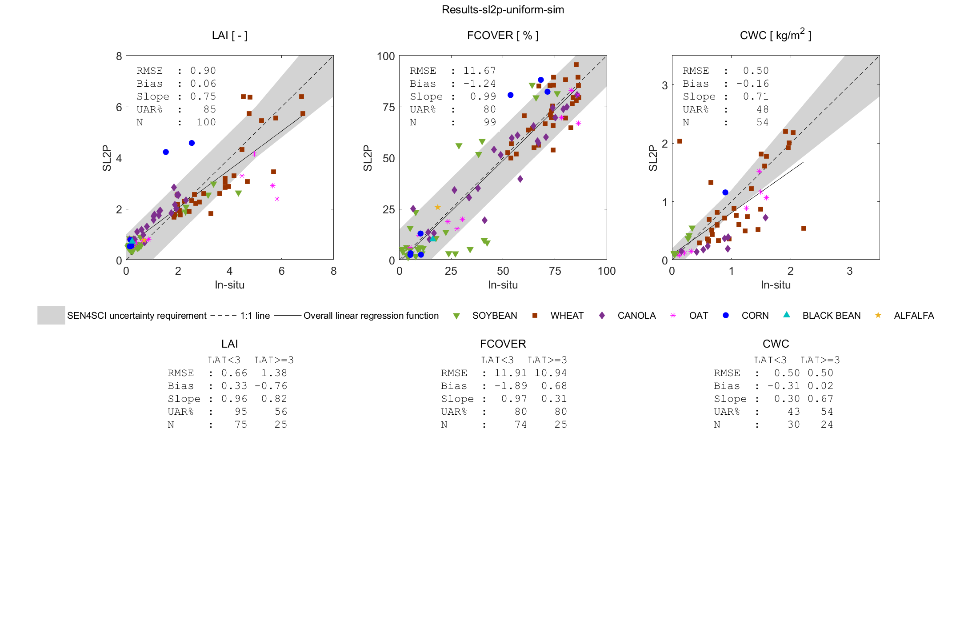
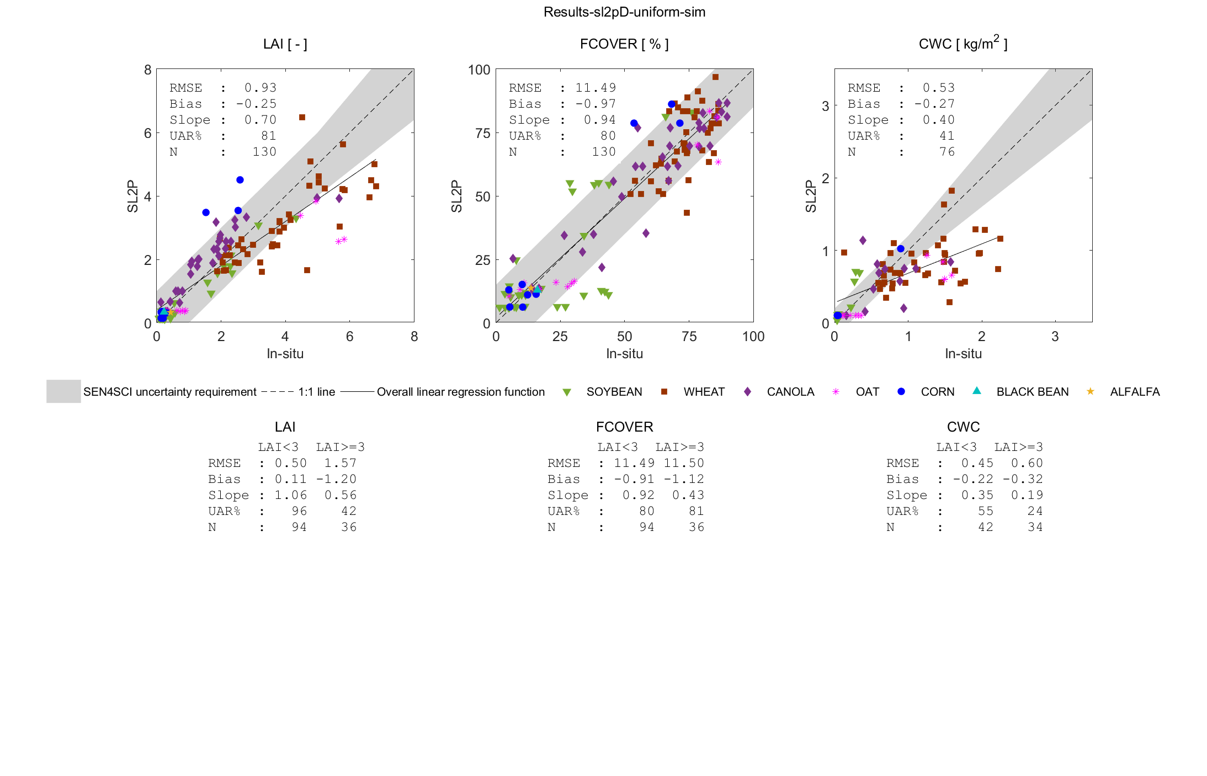
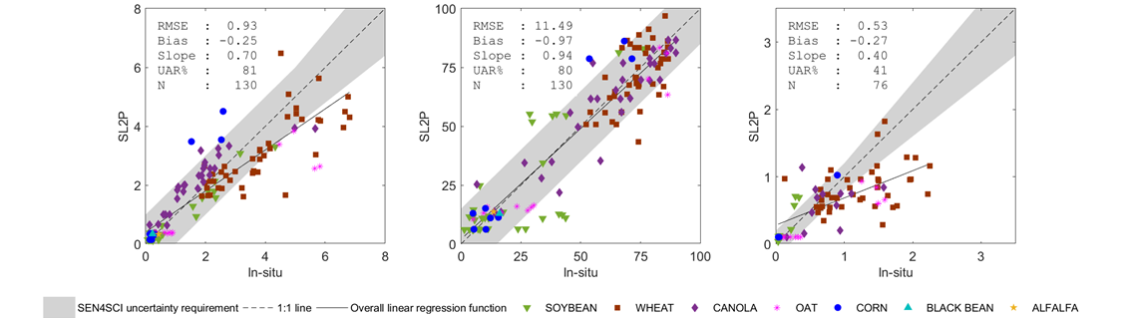
Uniform priors constrained by estimated Directional Area Scattering Factor provide well posed retrievals of canopy variables over crops using Sentinel-2 Multispectral Imager Data Richard Fernandes and Najib Djami
SL2P-Global LAI [-]
SL2P-Global FCOVER [%]
SL2P-Global CWC [kg/m²]
SL2P-Uniform LAI [-]
SL2P-Uniform FCOVER [%]
SL2P-Uniform CWC [kg/m²]
SL2PD-Uniform LAI [-]
SL2PD-Uniform FCOVER [%]
SL2PD-Uniform CWC [kg/m²]

Slide 3
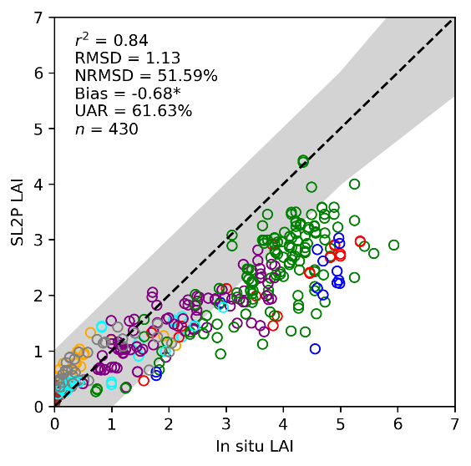
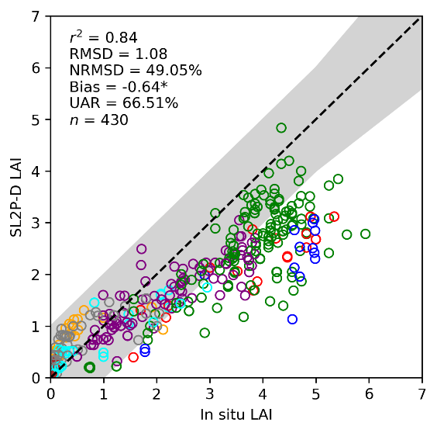
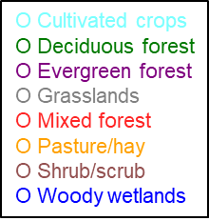
Validation of baseline and modified Sentinel-2 Simplified Level 2 Prototype Processor leaf area index retrievals over the North American continent Luke A. Brown¹*, Courtney Meier², Harry Morris¹, Richard Fernandes³, Najib Djamai³, Francis Canisius³, Gang Hong³, Gabriele Bai⁴, Christophe Lerebourg⁴, Nadine Gobron⁵, Christian Lanconelli⁵, Marco Clerici⁵, and Jadunandan Dash¹
Validation of SL2P-D
Validation of SL2P-D

Slide 4
Implementation of SL2P on Google Earth Engine Richard Fernandes, ++
https://code.earthengine.google.com/?scriptPath=users/rfernand387/neimage:SL2P-CCRS
https://code.earthengine.google.com/?accept_repo=users/rfernand387/neimage

