Slide 1
DataBridge
Annie Wong, Brian Zick, Chris McCarty, Randall Ferrance

Slide 2
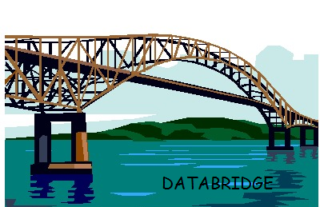
Overview
Single Client Server
Client controls the server
Mouse Emulation
Terminal Access
Chat between Client and Server

Slide 3
Possible Uses
Controlling Netflix on laptop when plugged into TV across the room
Chatting with whoever is on your home computer
Parents talk to children from work
Help family members with computer issues while not on a computer
Find basic information on computer on the go.

Slide 4
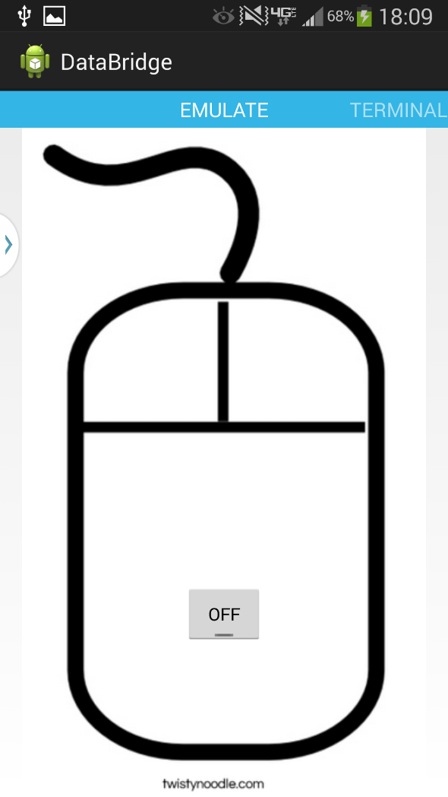
Mouse Emulator
Allows client control of server mouse pointer.
Uses phone movement

Slide 5
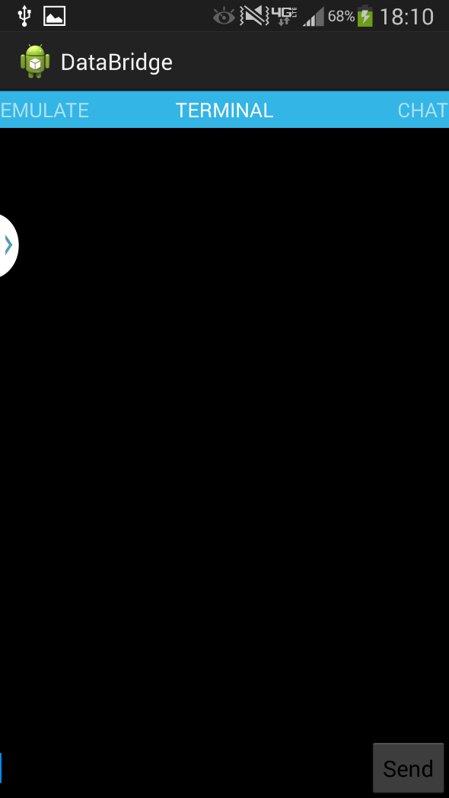
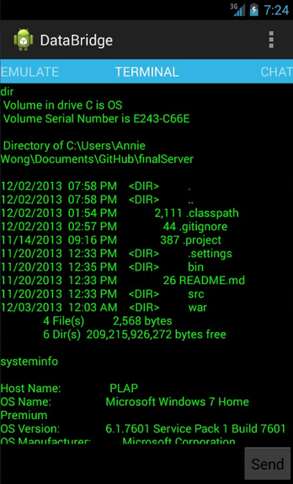
Terminal Emulator
Allows remote use of terminal.
Currently supports simple commands

Slide 6
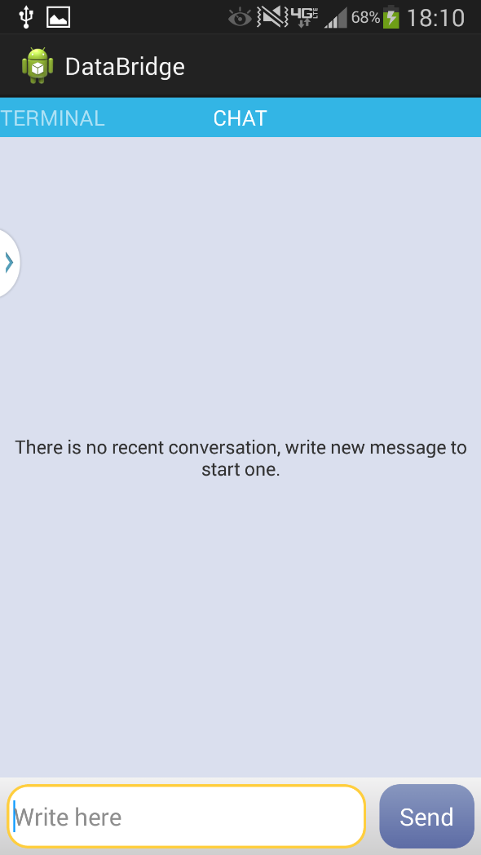
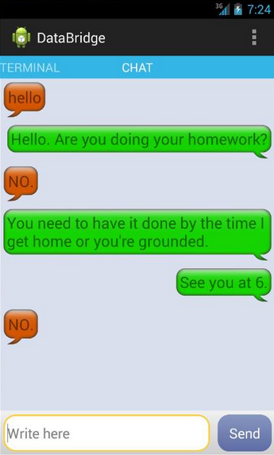
Chat
Messages can be sent between client and server.

Slide 7
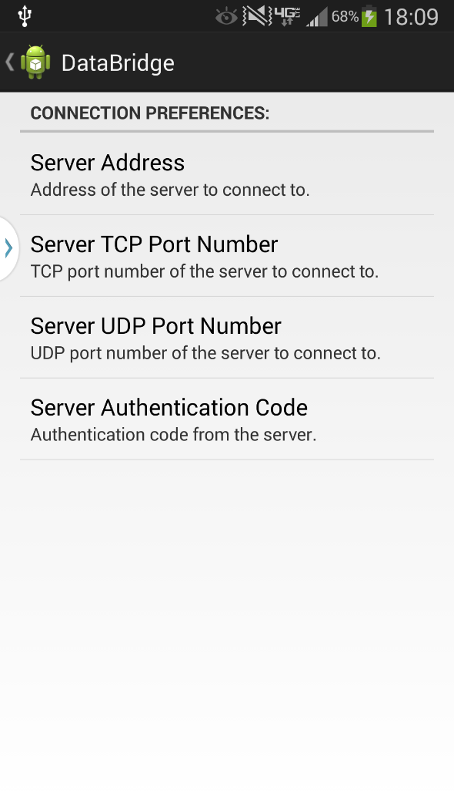
Settings
Page that is first opened when app is launched.
Change Server Address.
Change TCP/UDP port numbers.
Enter Authentication for UDP

Slide 8
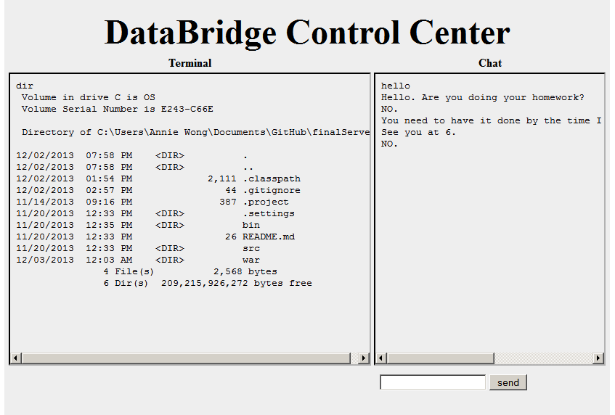
Server Control Center
Terminal command logs
Chatting with your android phone

Slide 9
GitHubs
https://github.com/rferrance/DataBridge
Final Application Repo
https://github.com/castlebravo/DataBridgeServer
Final Server Repo
https://github.com/aywong/finalServer
Working repo, not final

Slide 10
Questions?

Slide 11
Source
Image:
http://38ccda.medialib.glogster.com/media/ac57b46d05ee61023f6c297d44aaea9349af2f721b70e868bf78fda40a49fbb3/cartoon-bridge.jpg

