Slide 1
DataBridge
Annie Wong, Brian Zick, Chris McCarty, Randall Ferrance

Slide 2
Overview
Single Client Server
Client controls the server
Mouse Emulation
Terminal Access
Chat between Client and Server

Slide 3
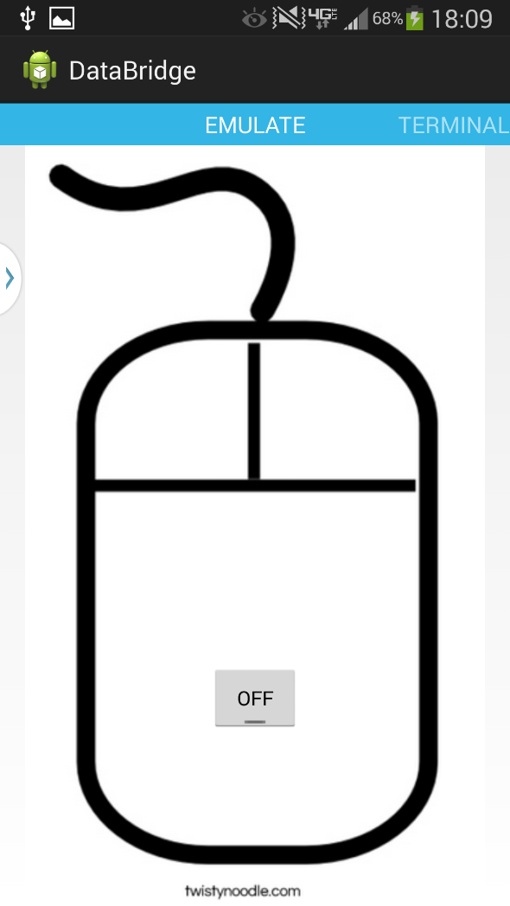
Mouse Emulator
Allows client control of server mouse pointer.
Uses phone movement

Slide 4
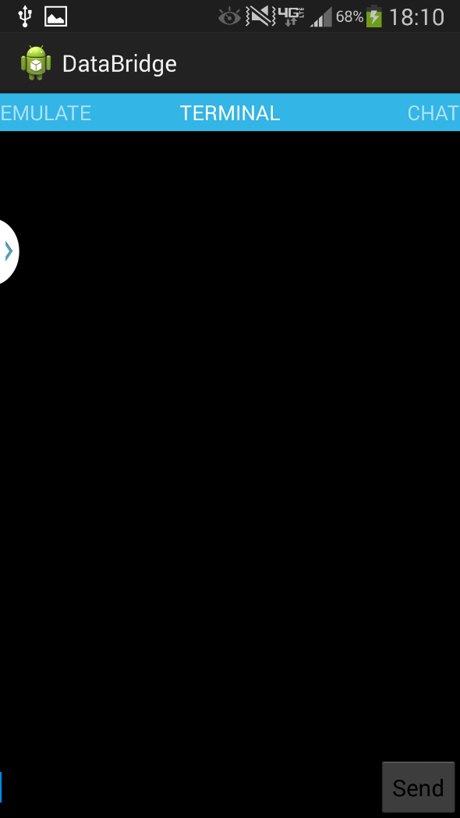
Terminal Emulator
Allows remote use of terminal.
Currently supports simple commands

Slide 5
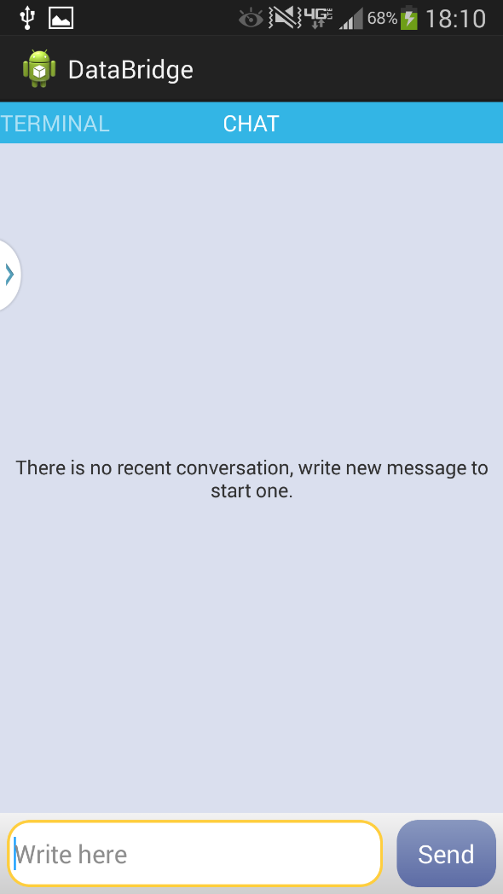
Chat
Messages can be sent between client and server.

Slide 6
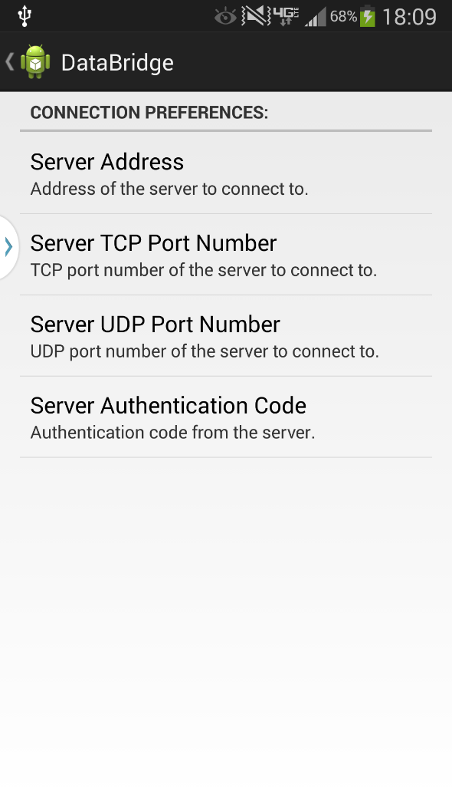
Settings
Page that is first opened when app is launched.
Change Server Address.
Change TCP/UDP port numbers.
Enter Authentication for UDP

