Slide 1
INFO 5602
Information Visualization
Why U.S. flights are always late
(Dashboard Report)
Rey Stone

Slide 2
Table of Contents
Context
Motivation
Research questions
Data source
Charts
Dashboard
Answers to questions
URL

Slide 3
Context
Invention of the plane until the late 1970s, air travel was regulated
  Prices were managed by the U.S. government
  Airlines couldn’t compete
  “Had” to care about passengers
Deregulation of U.S. airlines in 1978
  Opened airlines to compete in the free market
  Made travel more accessible to the average person
  Made ticket prices cheaper
  Cut all the good commodities
  Cut functional stuff as well

Slide 4
Motivation
Modern air travel is used by everyone for various reasons
  Vacations
  Business
  Family
Increased vocal testimonies (and personal experience) of poor air travel in the past couple of years than ever before
  Annoying add-ons
  Shrinking carry-on space
  Increasing ticket prices
Delays impact everyone (regardless of how rich you are)
  A person in first-class is still waiting the same amount of time as a person in economy

Slide 5
Research questions
What is the biggest cause of flight delays?
  How many delayed flights? How many minutes does each delay cost?
Does a busier time of year mean more delays?
  Holidays? Vacation?
Which airports experience the most delays?
  Without invoking: https://xkcd.com/1138/

Slide 6
Data source
Source:
  Bureau of Transportation Statistics Airline On-Time Statistics and Delay Causes
  Aggregation of all U.S. flights since June 2003
  Looking at specifically after COVID flights from 2023 to 2026
Limitations:
  This dataset aggregates flights monthly, so no time, or per day data for each flight
  Only for domestic U.S. flights; global patterns cannot be observed
  NAS definitions of “extreme-weather” does not encapsulate all weather-related issues
  Data is only for arriving flights to a specific airport.
    A delay at SFO might have originated elsewhere.
Prep:
  Each row was one flight
  Split all data into separate sheets: carrier, airports, causes, month

Slide 7
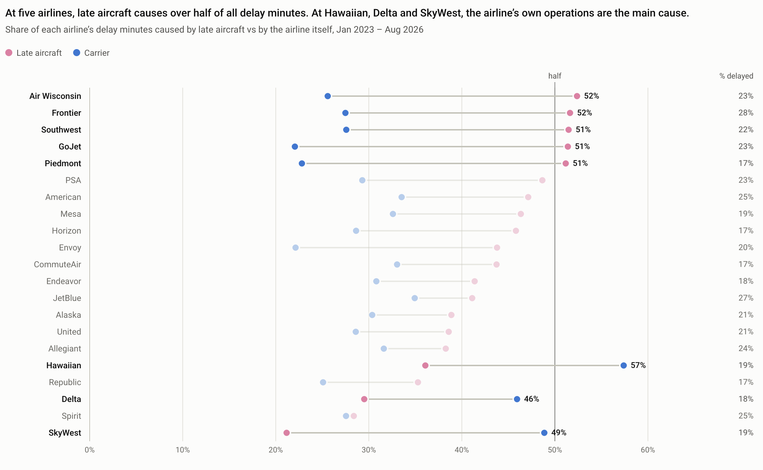
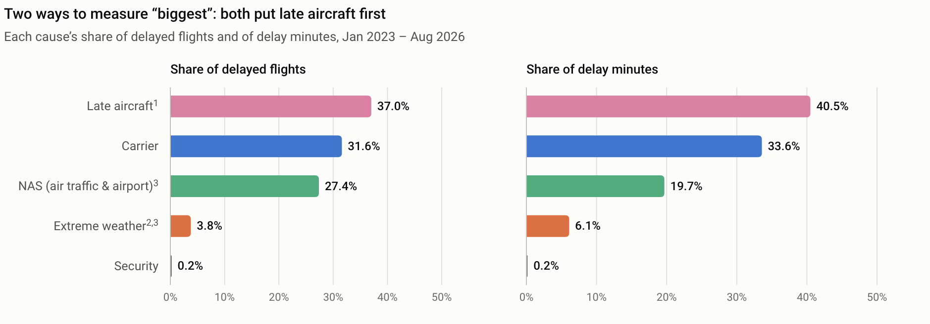
Charts – Q1
Notes:
The first chart answers “Q1” by considering two separate ways to interpret it:
1. How many delayed flights each cause affected.
2. How many minutes each cause costs.
Filter for redistributing “late aircraft” to their “source” cause.
The second chart compares how each airline is stacking up against each other.
They are ranked in ascending order of the “late aircraft” cause.
We see that there are only three airlines where their own operations effect delays more than a late aircraft does.

Slide 8
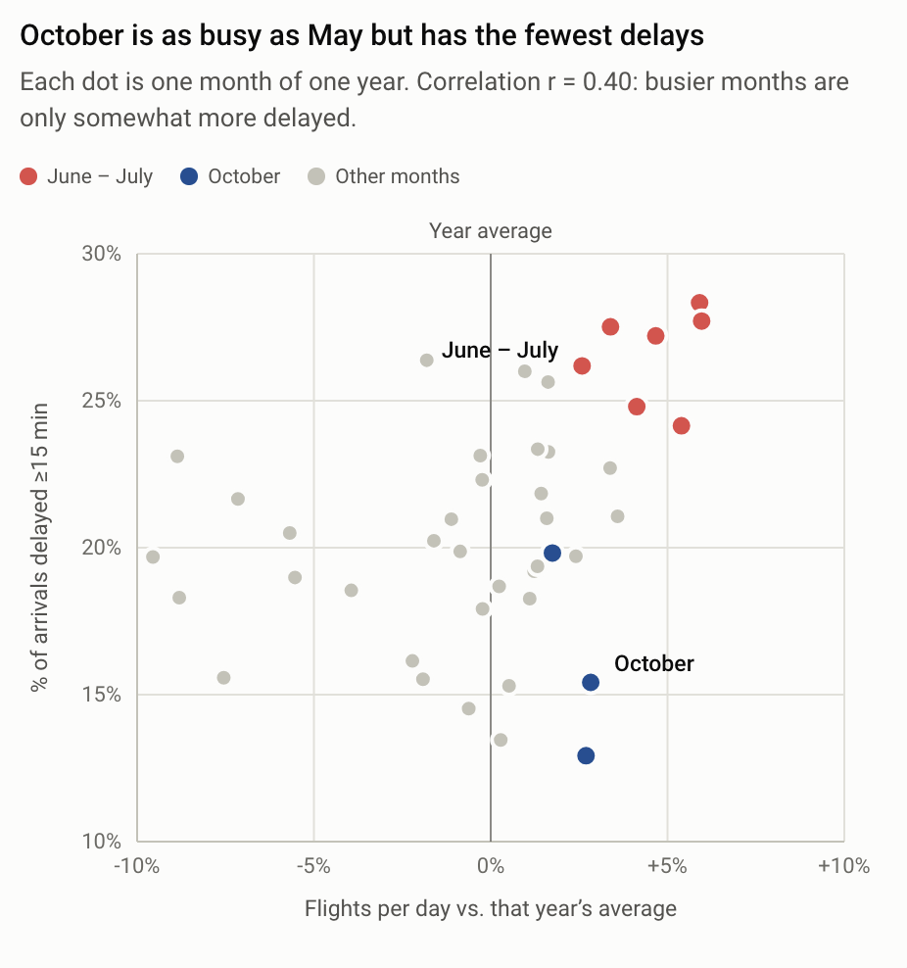
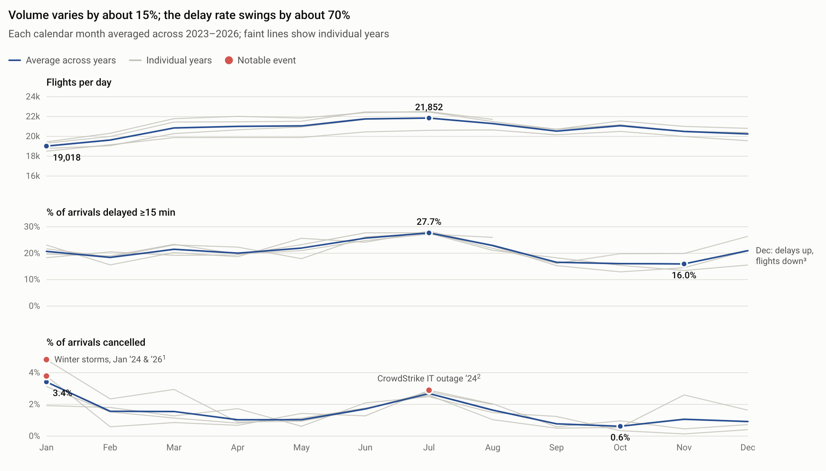
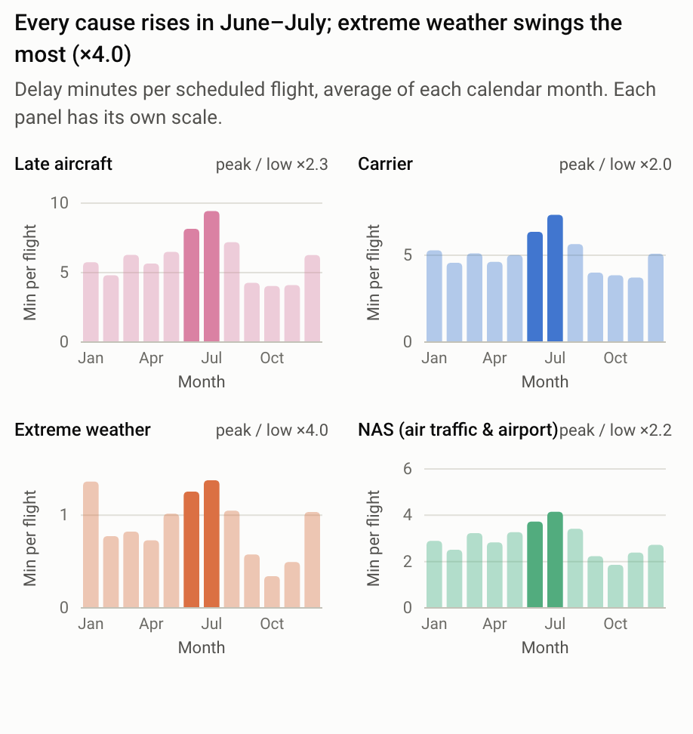
Charts – Q2
Notes:
The first chart offers insight to how many domestic flights are happening over the course of a year. (We can see that the pattern is pretty much the same from 2023-2026).
Top-left: We can see that delays and volume are only moderately correlated. October being one counter-example: lots of flights but the least number of delays.
Bottom-right: Summer months are the worst months for delays as everything just goes wrong during those months.

Slide 9
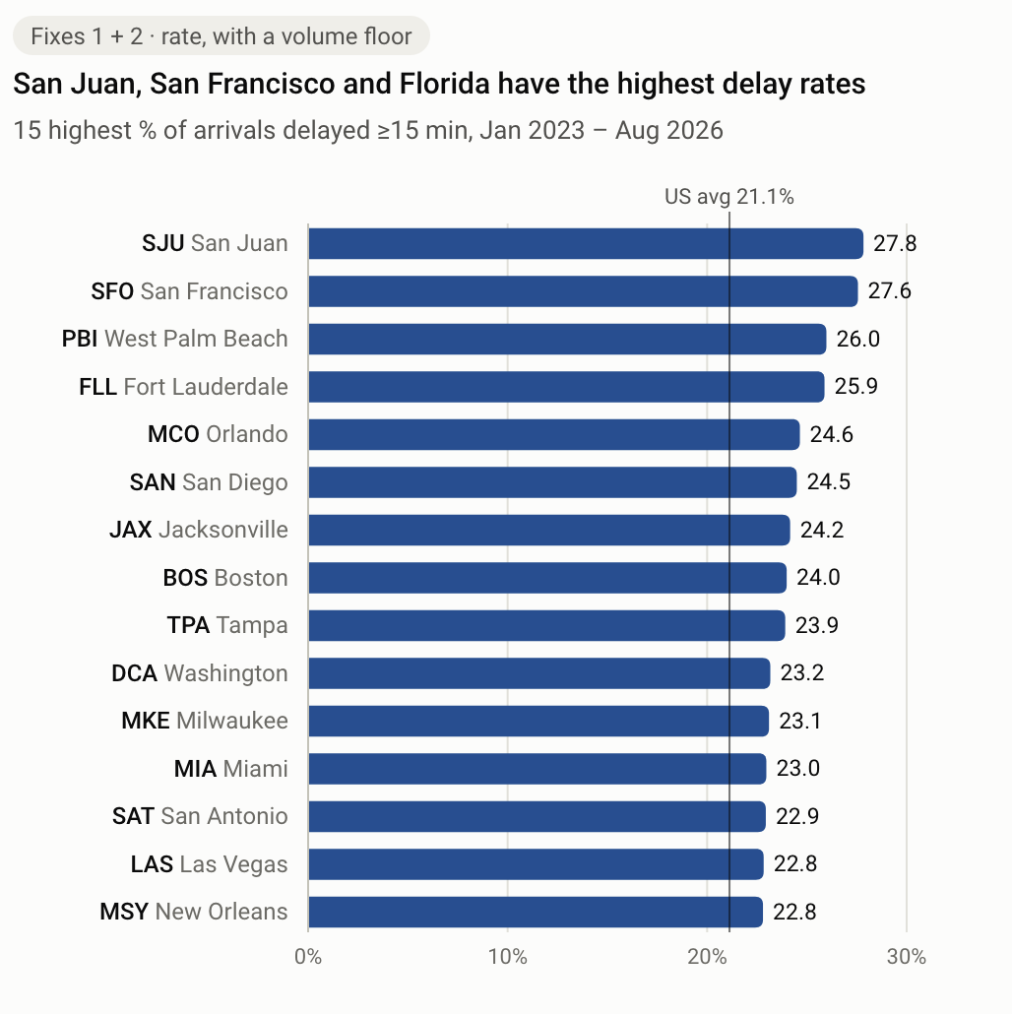
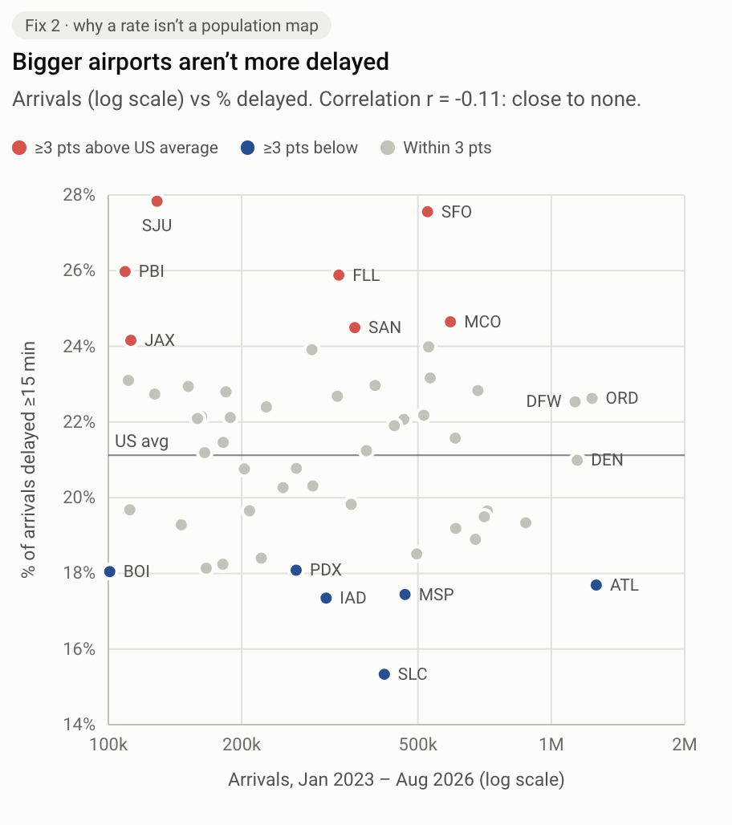
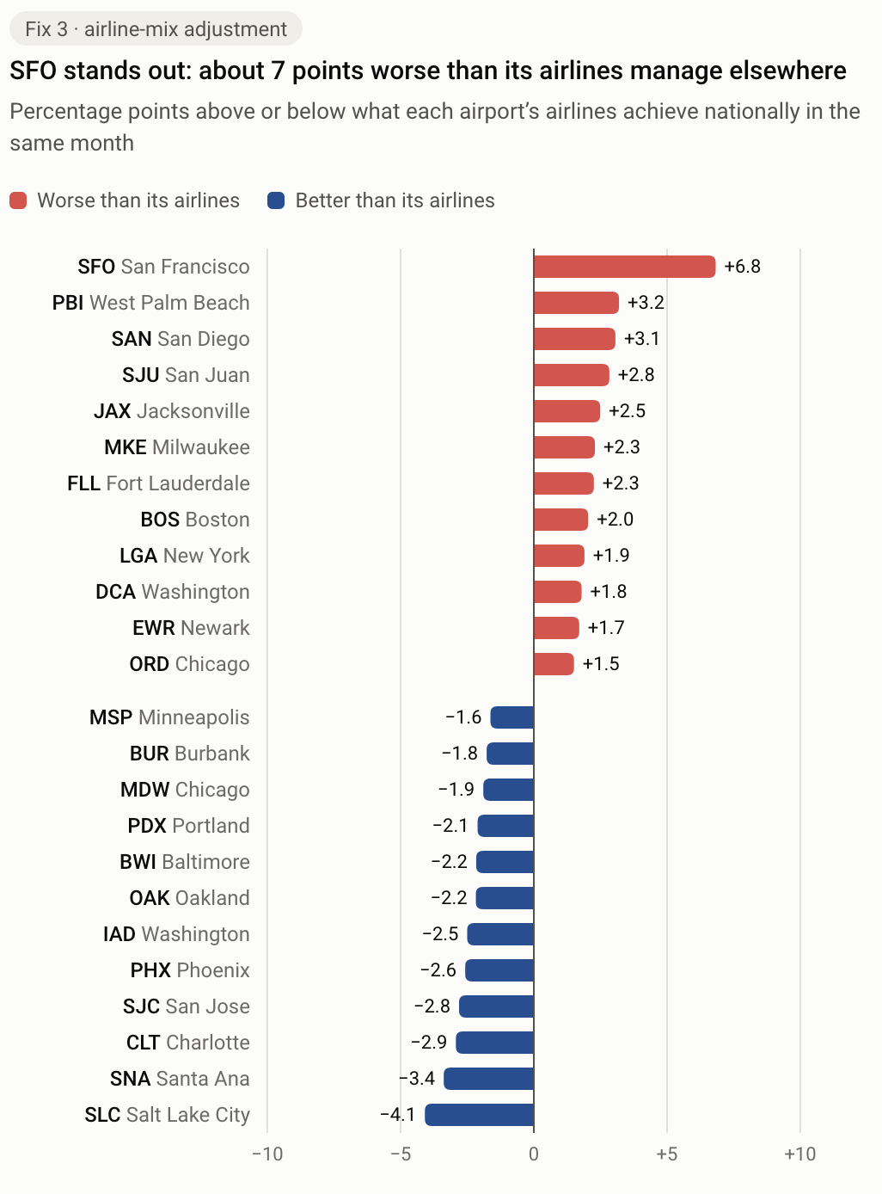
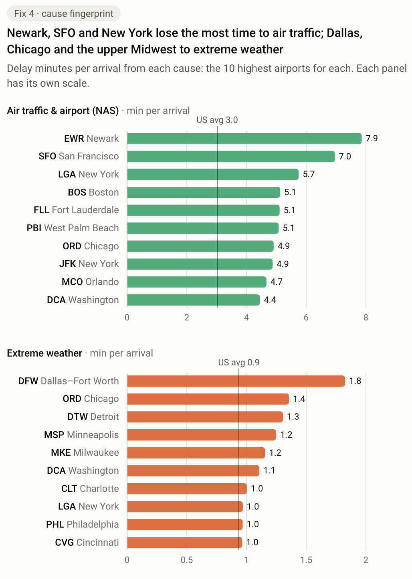
Charts – Q3
Notes:
Refer to fun population heat map here.
Instead of counting delayed flights, I used the rate -- % of delayed flights.
Since this database is inclusive of both international airports and regional airports, I introduced two filters: 1 to only show airports with more than 100k arrivals, 2: to shrink smaller airports so their delay rate doesn’t swing drastically
Chart one just shows which airports are the most delayed.
Chart two is a scatterplot which shows that the % of delayed arrivals at certain airports are not correlated with the number of arrivals to each airport at all.
Chart three is comparing each airport with the airlines that fly to it. Here we can see that some airports handle delays worse than if the airline was handled somewhere else.
Chart four is showing the main causes of an AIRPORT delay. Late aircrafts are an effect of these main causes, and airline delays are independent of airport delays.

Slide 10
Dashboard
This slide was left intentionally blank as an exercise to the reader.
Notes:
Go to the website.

Slide 11
Answers
What is the biggest cause of delays?
  Late aircrafts, but that is more like a domino effect
  The main source is the airline’s own operations
Which time of year is the busiest, and does busy mean more delays?
  Domestic flight volume barely changes throughout the year
  Delays double in the summer. Cause? Extreme weather
Which airports experience the most delays?
  Looking at airports with more than 100k arrivals, San Juan , SF, and West Palm Beach have the worst
    Airlines have more success at other airports than these ones
  Newark, San Francisco, New York, lost time due to air traffic
  Dallas Fort-Worth, Chicago, Detroit, lost time due to extreme weather
Notes:
Flight delays are just one factor to a bigger issue within aviation. Have to look at

Slide 12
URLS
https://info-5602-dashboard.vercel.app/
https://github.com/rfhcs/info-5602-dashboard

Slide 13
Sources
Answer In Progress. Flying is getting worse, here’s why. https://www.youtube.com/watch?v=Aa3vkKRCczg
OT delay. Bureau of Transportation Statistics. https://www.transtats.bts.gov/ot_delay/OT_DelayCause1.asp?20=E
Robert Peterson. Impacts of Airline Deregulation. https://onlinepubs.trb.org/onlinepubs/trnews/trnews315airlinedereg.pdf
Maxwell Tabarrok. Is Air Travel Getting Worse?. https://www.maximum-progress.com/p/is-air-travel-getting-worse

