Slide 1
INFO 5602
INFORMATION VISUALIZATION
Individual Project Presentation
(Real World Chart Evaluation)
Rey Stone

Slide 2
Chart 1: Context
Why: why was this chart created?
  Predict how the Omicron variant of COVID-19 will spread
Who: who is this chart for?
  The public and subscribers to the Times
What: what did the creators want the target audience to know/do?
  Warn people about the rise in exposure risk to COVID-19
How: what data source did the chart creators use?
  Data sourced by Columbia University (later made available on the NYTimes GitHub)
https://www.nytimes.com/2022/01/06/opinion/omicron-covid-us.html
Notes:
An opinion piece from The New York Times titled “Here’s When We Expect Omicron to Peak” written by Jeffrey Shaman, an epidemiologist from Columbia University.
Why? Created to showcase the prediction of how the omicron variant will spread since omicron was more contagious than the other previous variants of covid.
Who? It was aimed at the public/subscribers of the Times paper.
What? Since it was during the middle of a pandemic, this article was created to warn people of the potential dangers of being out in public and to highlight the potential increase of risk to being exposed to covid.
How? There was no explicit statement of where the data was collected from but assumed to be from public health data from Columbia University or other government sites.

Slide 3
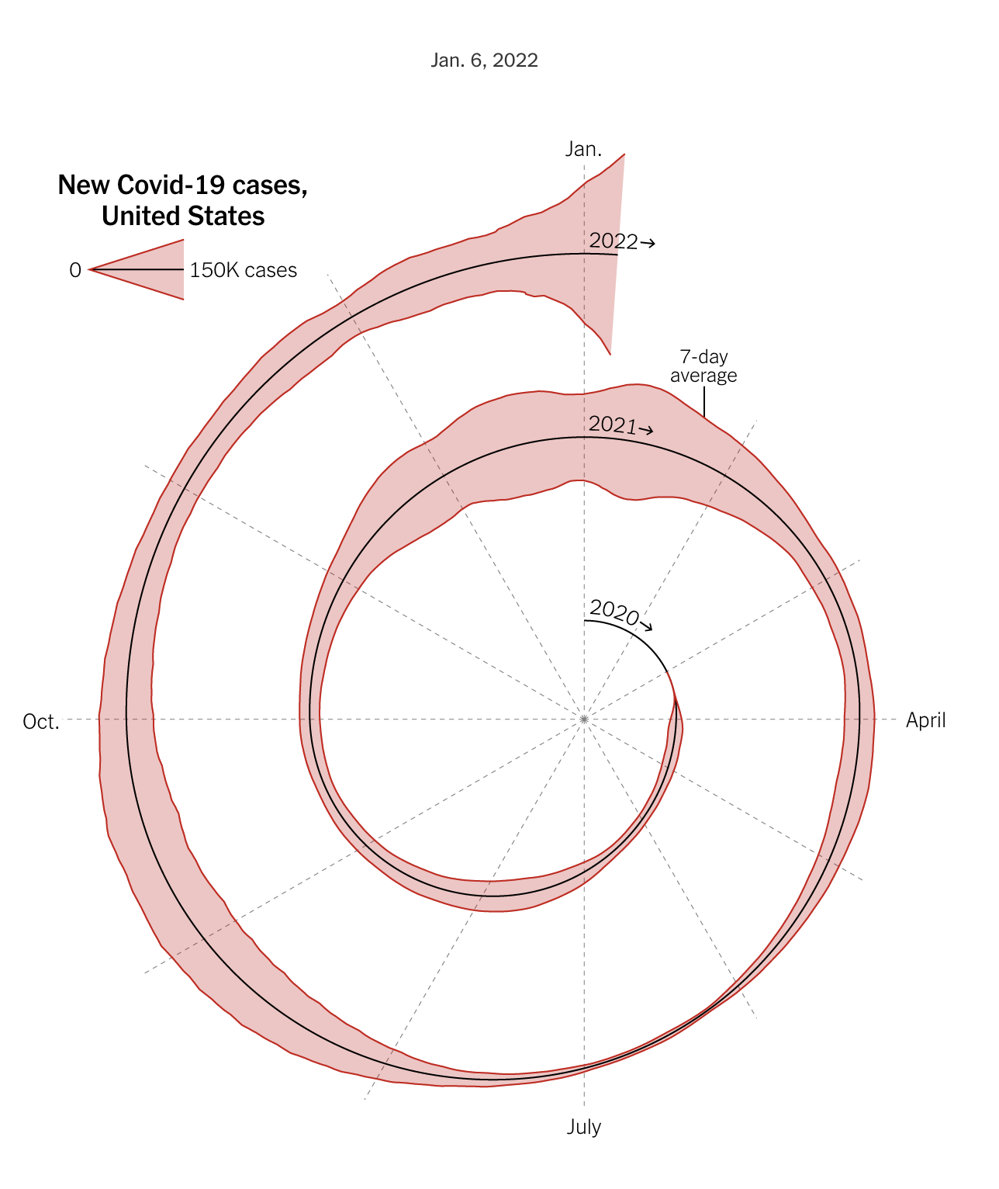
Chart 1: Before
Unconventional spiral time axis
  Very hypnotic
Unclear how many covid cases are confirmed each week
While legend defines a scale, comparing continuous area creates more cognitive load

Slide 4
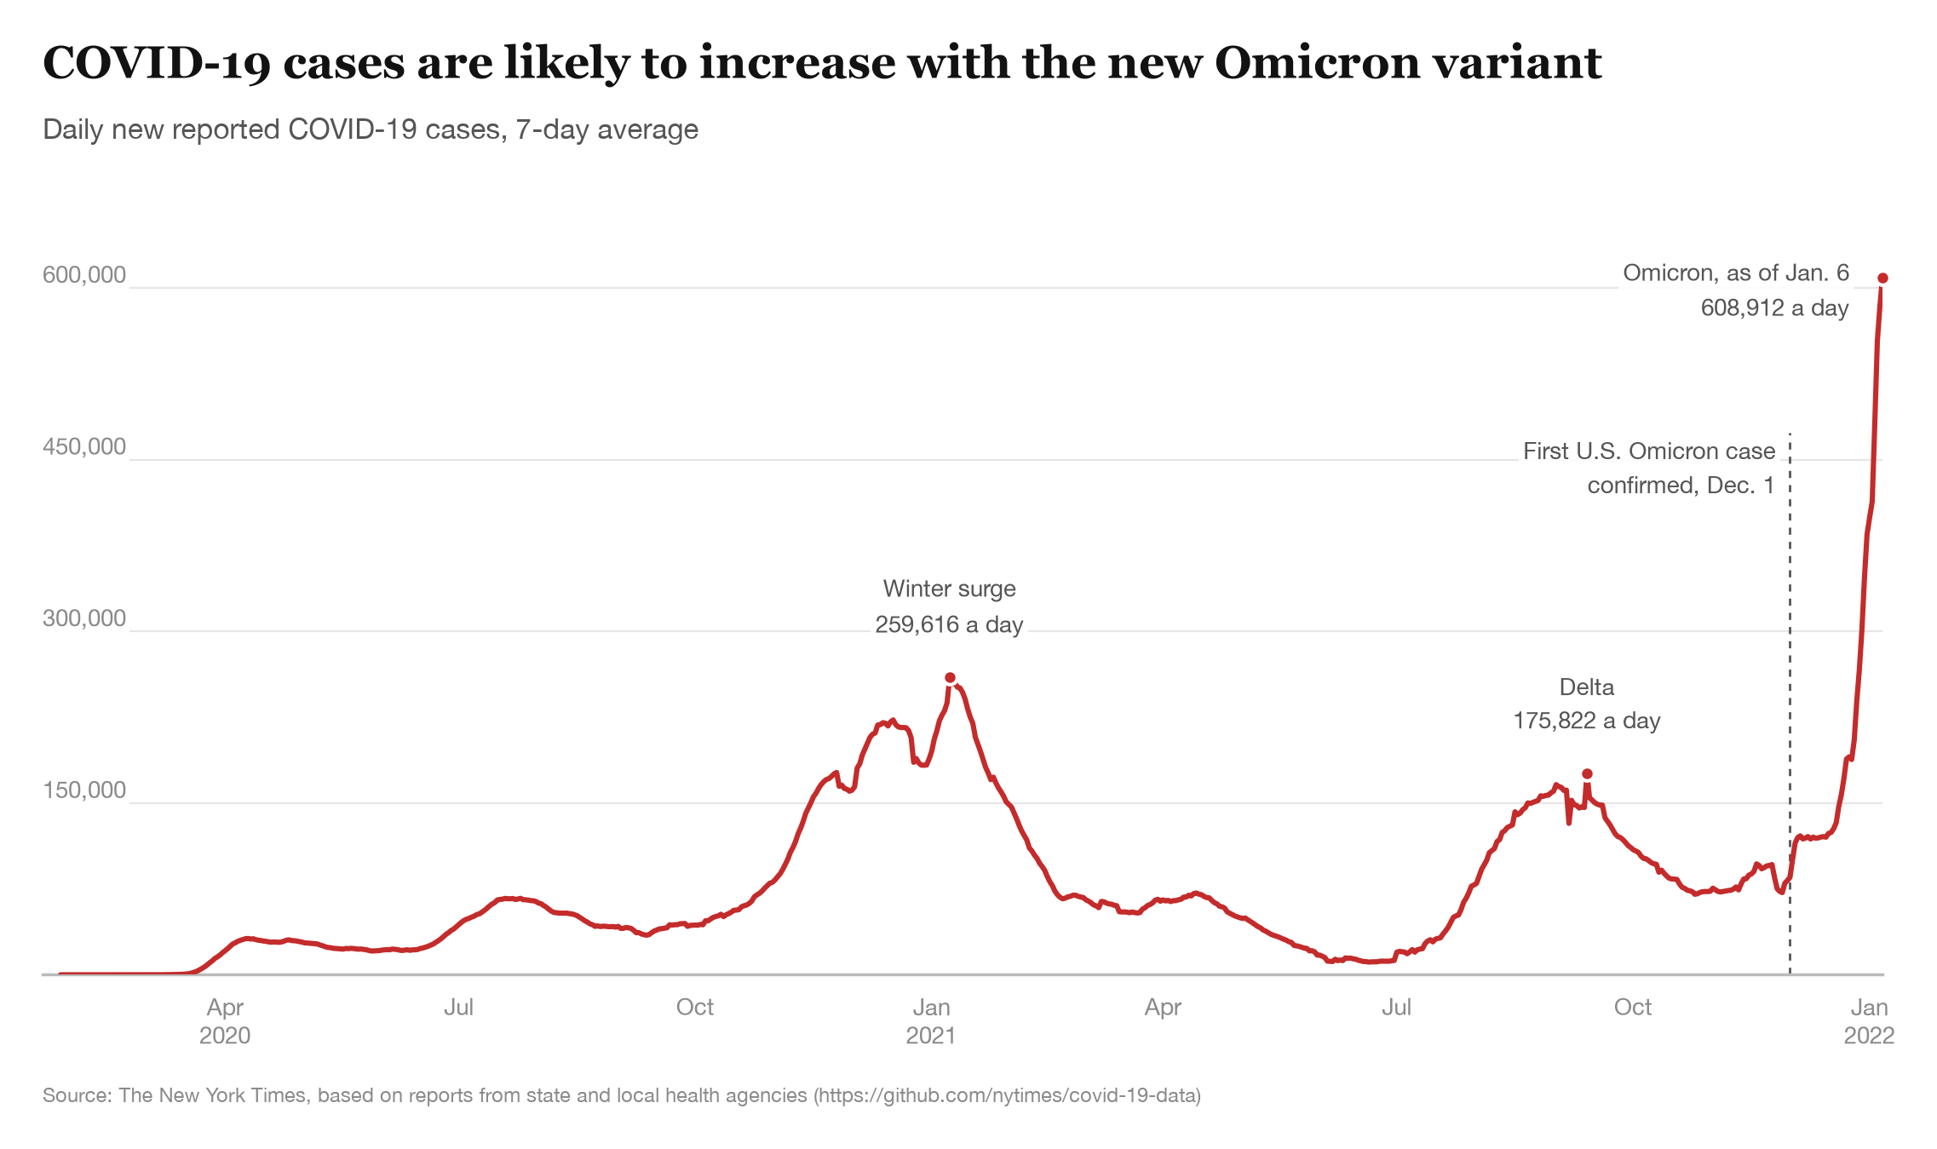
Chart 1: After
Time runs along a linear x-axis
  Linear time is back
Y-axis clearly defines the amount of covid cases
  No need to guess how many cases of covid were confirmed
Used color and annotations to mark significant variants and when they appeared

Slide 5
Chart 1: Before vs After

Slide 6
Chart 2: Context
Why: why was this chart created?
  Visualize/summarize how Americans view other G20 countries in terms of favorability
Who: who is this chart for?
  The public, government representatives, etc.
What: what did the creators want the target audience to know/do?
  Inform the audience of American opinions about other countries
How: what data source did the chart creators use?
  Pew Research Center surveyed ~5,000 adults from September 14 to 20, 2026.
https://www.pewresearch.org/global/2026/10/16/how-do-americans-feel-about-g20-countries/
Notes:
A report titled “How Do Americans Feel About G20 Countries” made by Pew Research Center analysts.
Why? ”To help the public, media, and decision makers understand important topics”. In this case: to visualize and summarize American appeal of G20 countries (which are a group of 20 countries in different regions of the world).
Who? The public, decision makers, other media outlets, etc.
What? The Pew Research official statement for this article was “these questions build a long history of tracking the global image of countries around the world”. Basically, informing the audience of what Americans think of other countries.
How? They surveyed approximately 5,000 American adults who were a part of the Pew Center’s “American Trends Panel”. The survey represents the views of the full U.S. adult population.

Slide 7
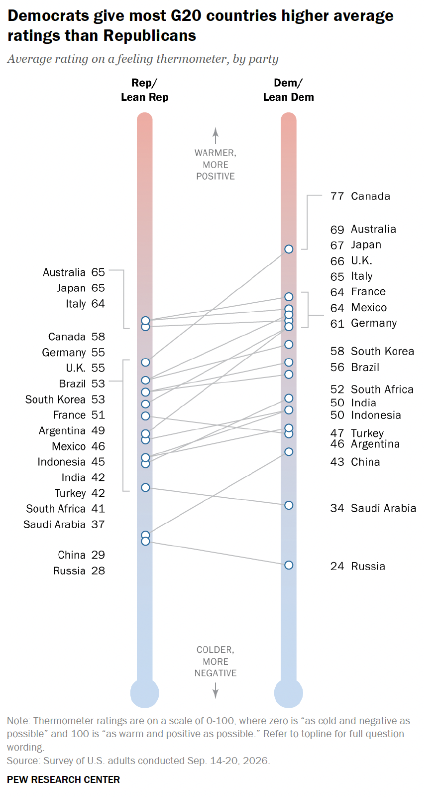
Chart 2: Before
Lines comparing political party intensify cognitive load
Dots on the thermometer represent more than one country
  Makes the comparison between parties difficult
Tries to do two things at once
  Favorite country per party
  Comparing countries across parties
This could have been an email
  (This could have been a bar chart)

Slide 8
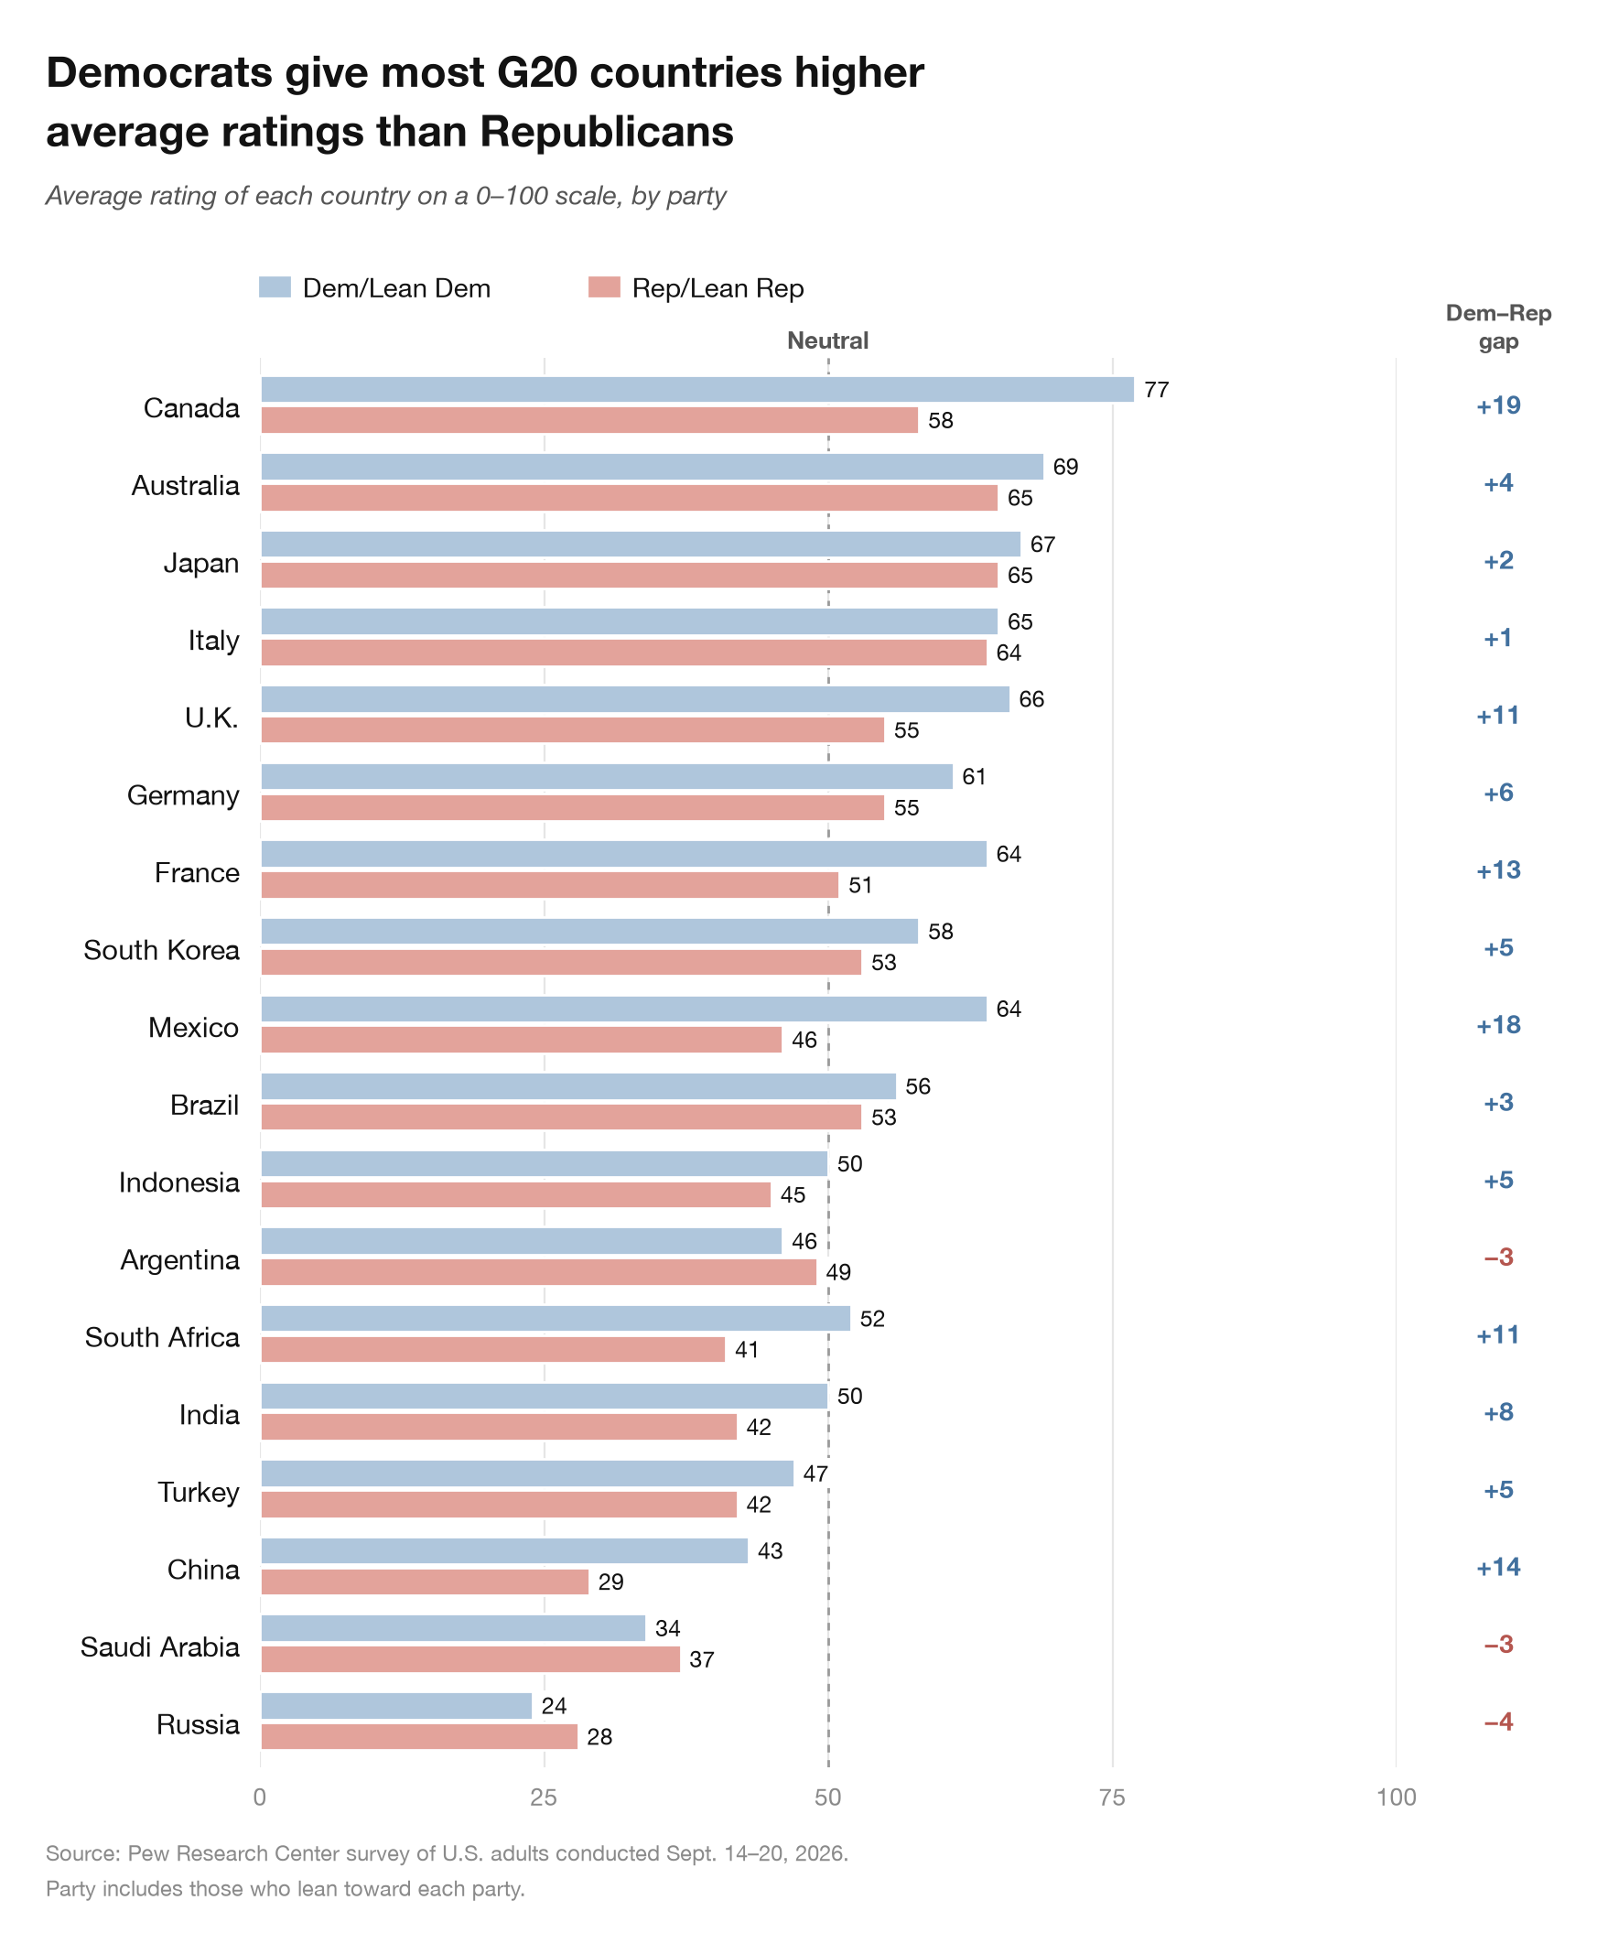
Chart 2: After
Reduced cognitive load by grouping by country for easier comparison
Sorted countries by overall average of both parties
  Shows which countries are most favorable, regardless of party
Added a party-gap column to show how much favorability differs between parties

Slide 9
Chart 2: Before vs After

Slide 10
Chart 3: Context
Why: why was this chart created?
  Emphasize how the U.S.-Israeli war against Iran might impact oil reserves.
Who: who is this chart for?
  The public, other media outlets, etc.
What: what did the creators want the target audience to know/do?
  Inform the audience of how the U.S.-Israeli war against Iran can impact our daily lives.
How: what data source did the chart creators use?
  Kpler: real-time data analytics platform tracking physical commodity flows.
https://www.nytimes.com/2026/06/12/business/energy-environment/iran-war-oil-reserves.html
Notes:
A New York Times article titled “The World is Draining Oil Reserves, Raising Pressure for a Peace Deal”. This article is primarily about the growing concern of the shrinking inventory of crude oil, a necessary commodity for many people around the world, and how ongoing U.S.-Israeli war against Iran is impacting these reserves.
Why? This chart was created to highlight the rapid shrinkage of the oil reserves have become ever since the start of this year compared to other years.
Who? The public, government officers, other media outlets, etc.
What? To inform the audience of how the ongoing war is impacting daily life.
How? Data was taken from a data analytics platform called Kpler which tracks commodity flows, shipping, etc.

Slide 11
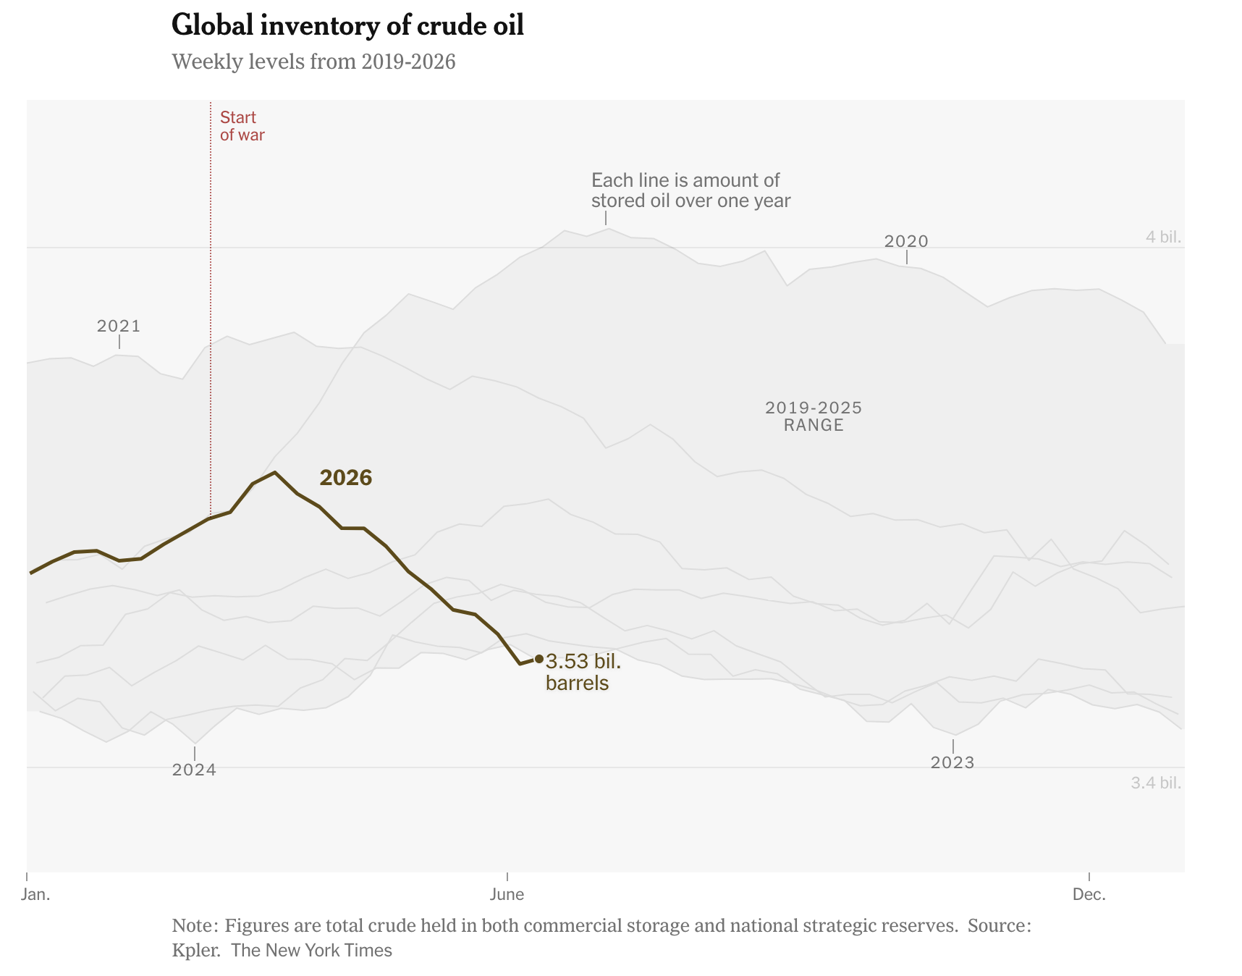
Chart 3: Before
Individual year lines are redundant in the shaded year range
  Especially if you give up halfway through labeling
Clarifying annotations are only making the chart more confusing
Trying to do two things at once (again)
  Range of oil in storage reserves
  Weekly levels per year
Labels for other years are scattered throughout the chart
Notes:
Would have been better as an interactive data visualization

Slide 12
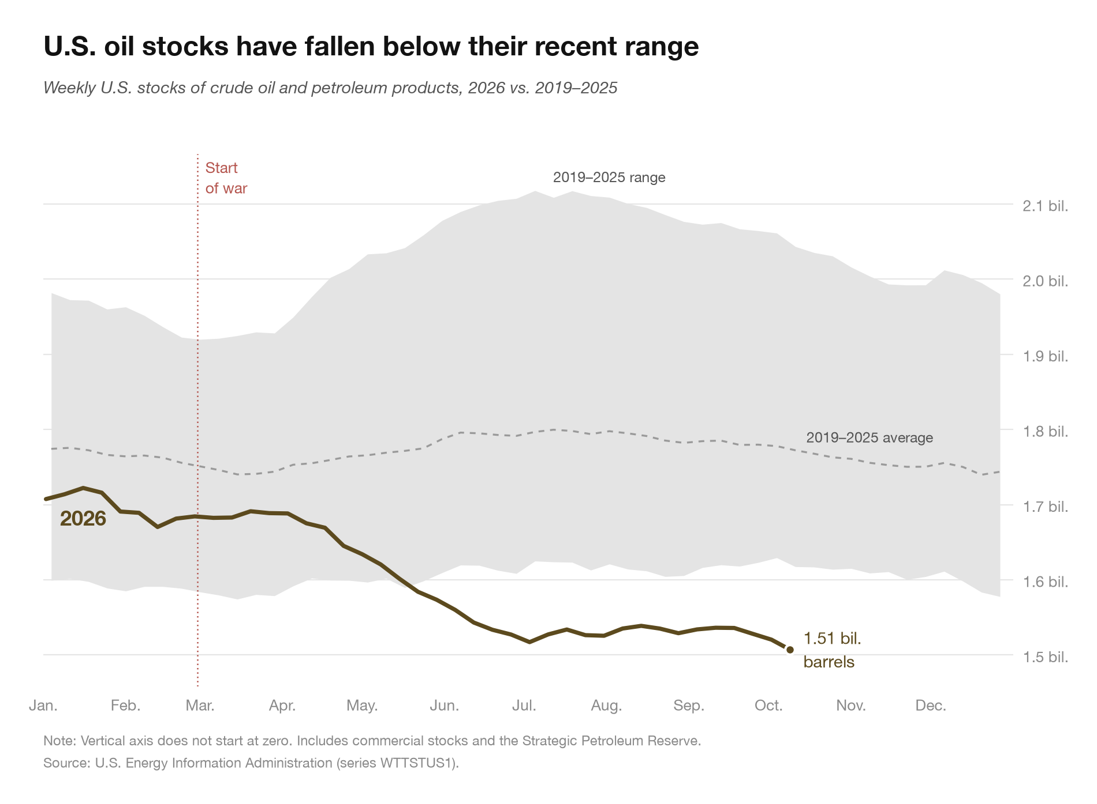
Chart 3: After
Removed individual year lines
  Range is all that is needed for comparison
Only two clear annotations
  2019-2025 range
  2019-2025 average
Added average inventory line for 2019-2025
  Reduces cognitive load by minimizing data to filter through
Note: I did not have access to the global inventory data, so I changed it to the U.S. national inventory to reduce fabrication of data.
Notes:
NOTE THIS IS FOR U.S. ONLY I DID NOT HAVE GLOBAL DATA ACCESS
I’m bad at Photoshop. The imagination is left as an exercise to the audience.

Slide 13
Chart 3: Before vs After

Slide 14
Questions?

