Slide 1
SCS 4107 FINAL CAUSAL PROJECT
Research question
Emergency funds and household bill payment
Would having a three-month emergency fund make people more likely to pay all household bills in full?
A module-by-module causal inference walkthrough using real SHED 2023 data
STUDENT GUIDE | REAL DATA | N = 11,400
Estimated answer
+13.2 percentage points
This is a causal estimate only under the assumptions we explain in the deck.
Federal Reserve SHED 2023 public-use data | empirical run 366437d7f9b5d4f3

Slide 2
COURSE MAP
This presentation follows the capstone sequence
The module labels mirror the project assessment reference.
MODULE 1
MODULES 2-3
MODULE 4
Question, data, and EDA
Causal modeling and DAG construction
Empirical testing of the DAG
Define the study and inspect the real data.
Draw the assumed causes before estimating.
Test predictions that the DAG makes.
MODULES 5-6
MODULE 7
MODULE 8
Deep learning and structural models
Interventions and causal effects
Counterfactuals and parallel worlds
Decide if deep learning helps; state the causal model.
Separate what we observe from what we would change.
Ask what might happen under a different action.
MODULE 9
MODULE 10
Identification in Pearl's hierarchy
Structured causal inference workflow
Explain why the causal answer can be estimated.
Connect question, assumptions, checks, answer, and limits.
Core message
This is not a project that runs one library function. Each step is needed before the final number can be called an estimated causal effect under stated assumptions.
SHED 2023 | empirical run 366437d7f9b5d4f3
02

Slide 3
MODULE 1 | PROJECT SETUP
MODULE 1
Start with one precise causal question
The assessment reference requires a population, treatment, outcome, contrast, and estimand.
Among eligible U.S. adults represented by SHED 2023, what is the estimated effect of having a three-month emergency fund on paying all non-credit-card household bills in full?
WHO?
TREATMENT (EF1)
OUTCOME (EF5C)
TARGET ANSWER
Individual eligible SHED 2023 respondents in the support-retained analytic population.
Has enough emergency savings to cover three months of expenses.
Paid all non-credit-card household bills in full in the prior month.
Average difference: E[Y(1) - Y(0)], reported in percentage points.
What the intervention means
Conceptually give or ensure a three-month emergency reserve, then compare that setting with not having one. SHED did not run this experiment or evaluate a named program.
SHED 2023 | empirical run 366437d7f9b5d4f3
03

Slide 4
MODULE 1 | PROJECT DATA
MODULE 1
What data did we use, and what did we do with it?
All results in this deck come from the validated empirical SHED 2023 bundle.
SHED 2023
11,400
EF1
EF5C
11,400
Federal Reserve public-use survey
Raw survey records
Treatment field
Outcome field
Final analytic sample
1. KEEP RAW DATA
2. VALIDATE
3. RECODE
4. ANALYZE
Read the supplied survey file without changing it.
Check IDs, ages, weights, required fields, and codebook mappings.
Map EF1, EF5C, and seven pre-treatment background variables.
All 11,400 records passed the documented analytic checks.
Data-quality note: six reported ages above 95 were mapped to the official 95+ top-code. BK1 is account ownership, so it is not used as the bill-payment outcome.
SHED 2023 | empirical run 366437d7f9b5d4f3
04

Slide 5
MODULE 1 | EXPLORATORY DATA ANALYSIS
MODULE 1
What did the data look like before causal adjustment?
EDA describes the existing groups. It does not yet answer the causal question.
NO FUND (T = 0)
HAS FUND (T = 1)
4,918
6,482
RAW DIFFERENCE
respondents
respondents
+21.0 points
Observed full-bill-payment rate
This is association only.
Observed full-bill-payment rate
74.30%
95.34%
What EDA taught us
The groups were already different in age, income, education, employment, housing, marital status, and race/ethnicity. Those background differences could explain part of the raw gap, so we need a DAG and an adjustment strategy.
SHED 2023 | empirical run 366437d7f9b5d4f3
05

Slide 6
MODULES 2-3 | CONDITIONAL PROBABILITY AND CAUSAL MODELING
MODULES 2-3
Use a simple causal graph to tell the story
A DAG is an assumption map, not a chart drawn from correlations.
BACKGROUND FACTORS
TREATMENT (T)
OUTCOME (Y)
Income, age, education, employment, housing, marital status, and race/ethnicity.
Has a three-month emergency fund.
Paid all non-credit-card household bills in full.
Background factors can also affect bill payment. This is why two existing groups may not be directly comparable.
Important unmeasured threat
Financial shocks may affect both emergency savings and bill payment. Because SHED does not measure that node, the DAG leaves this path open and the final conclusion stays qualified.
SHED 2023 | empirical run 366437d7f9b5d4f3
06

Slide 7
MODULES 2-3 | CAUSAL MODELING AND SIMULATION
MODULES 2-3
D-separation: make the comparison fairer
This is the rule that turns the causal graph into an adjustment decision.
Plain-English meaning: d-separation asks whether a non-causal route between T and Y is closed after we account for the shared cause.
INCOME
FUND (T)
BILLS (Y)
A shared background factor
Emergency savings status
Full bill payment
Condition on income: compare people within the same income category before comparing fund status.
What gets blocked
The route Income -> Fund and Income -> Bills can create a misleading raw relationship. Conditioning on income closes that measured back-door route. We repeat this logic for each measured common cause.
SHED 2023 | empirical run 366437d7f9b5d4f3
07

Slide 8
MODULES 2-3 | CAUSAL MODELING AND SIMULATION
MODULES 2-3
Apply d-separation to this project
The DAG determines which variables are adjusted for and which are left out.
1. MEASURED COMMON CAUSES
2. ADJUST FOR THEM
3. ESTIMATE T -> Y
Income, education, employment, age, marital status, housing, and race/ethnicity.
Make the observed groups more alike on these pre-treatment factors.
Compare the treatment worlds after blocking measured back-door routes.
DO NOT ADJUST
DO NOT ADJUST
CANNOT ADJUST
Post-treatment financial stress is a mediator. Adjusting for it could remove part of the effect we want to estimate.
Analytic inclusion can act like a collider. Conditioning on a collider can create a false connection.
Financial shock is unmeasured. We disclose this threat and test sensitivity instead.
SHED 2023 | empirical run 366437d7f9b5d4f3
08

Slide 9
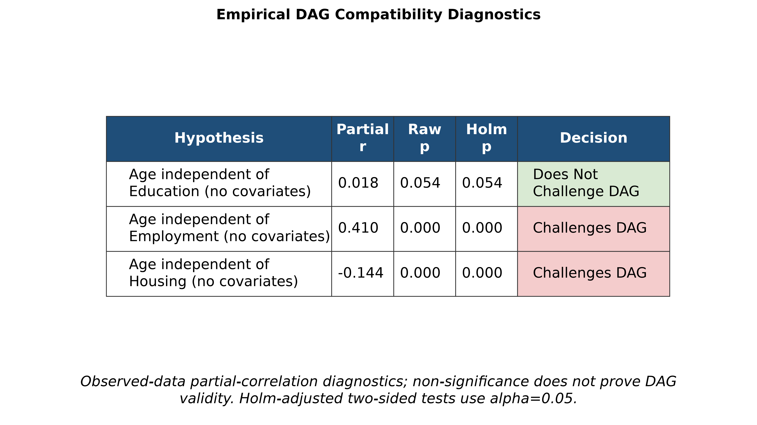
MODULE 4 | EMPIRICAL TESTING OF THE DAG
MODULE 4
Test what the DAG says should be unrelated
The data can challenge a DAG; they cannot prove every arrow is correct.
NEW TERM
DAG implication test
A test of a relationship that the graph says should be absent or weak. We use it to criticize the model, not to prove causation.
WHAT YOU SEE
Age and education did not clearly challenge the DAG (p = 0.054). Age with employment and age with housing did challenge it (both p < .001).
WHY IT MATTERS
Two challenges mean the graph is imperfect. That is a reason to be cautious about assumptions, not a reason to claim the data proved the DAG.
SHED 2023 | empirical run 366437d7f9b5d4f3
09

Slide 10
MODULES 5-6 | DEEP LEARNING AND STRUCTURAL CAUSAL MODELS
MODULES 5-6
Use the simplest model that answers the causal question
Deep learning is optional: it must add causal value, not just complexity.
1. Deep learning decision
2. Structural causal model
3. What we assume
Not used
A structural causal model (SCM) says how variables are generated:
- The model captures the important measured background factors.
- People's reported treatment and outcome are measured correctly enough.
- The model is useful for the counterfactual question, but it is not the true world proven by data.
Why? The dataset is a modest-sized table with a small, named set of causal variables. A complex neural network would not solve the confounding problem and would be harder to explain.
Background factors
affect fund status
and bill payment
Lesson: better prediction is not automatically better causal inference.
The fund may also affect bill payment.
Lesson: causal structure and statistical prediction are different jobs.
SHED 2023 | empirical run 366437d7f9b5d4f3
10

Slide 11
MODULE 7 | INTERVENTIONS AND CAUSAL EFFECTS
MODULE 7
Intervention: compare two settings of the same population
This is different from comparing the two existing groups in the survey.
WHAT WE OBSERVED
WHAT AN INTERVENTION ASKS
Two existing groups
Set fund status in the model
No fund: 74.30% paid all bills Has fund: 95.34% paid all bills Raw gap: +21.0 points
do(T = 0): 79.9% expected full payment do(T = 1): 93.0% expected full payment
change the question
These respondents can differ in income, age, and other background factors.
The model first accounts for measured common causes, then compares these two settings.
Simple definition
An intervention is a 'what if we set this treatment?' question. It does not mean SHED randomized people or that the result is guaranteed for every individual.
SHED 2023 | empirical run 366437d7f9b5d4f3
11

Slide 12
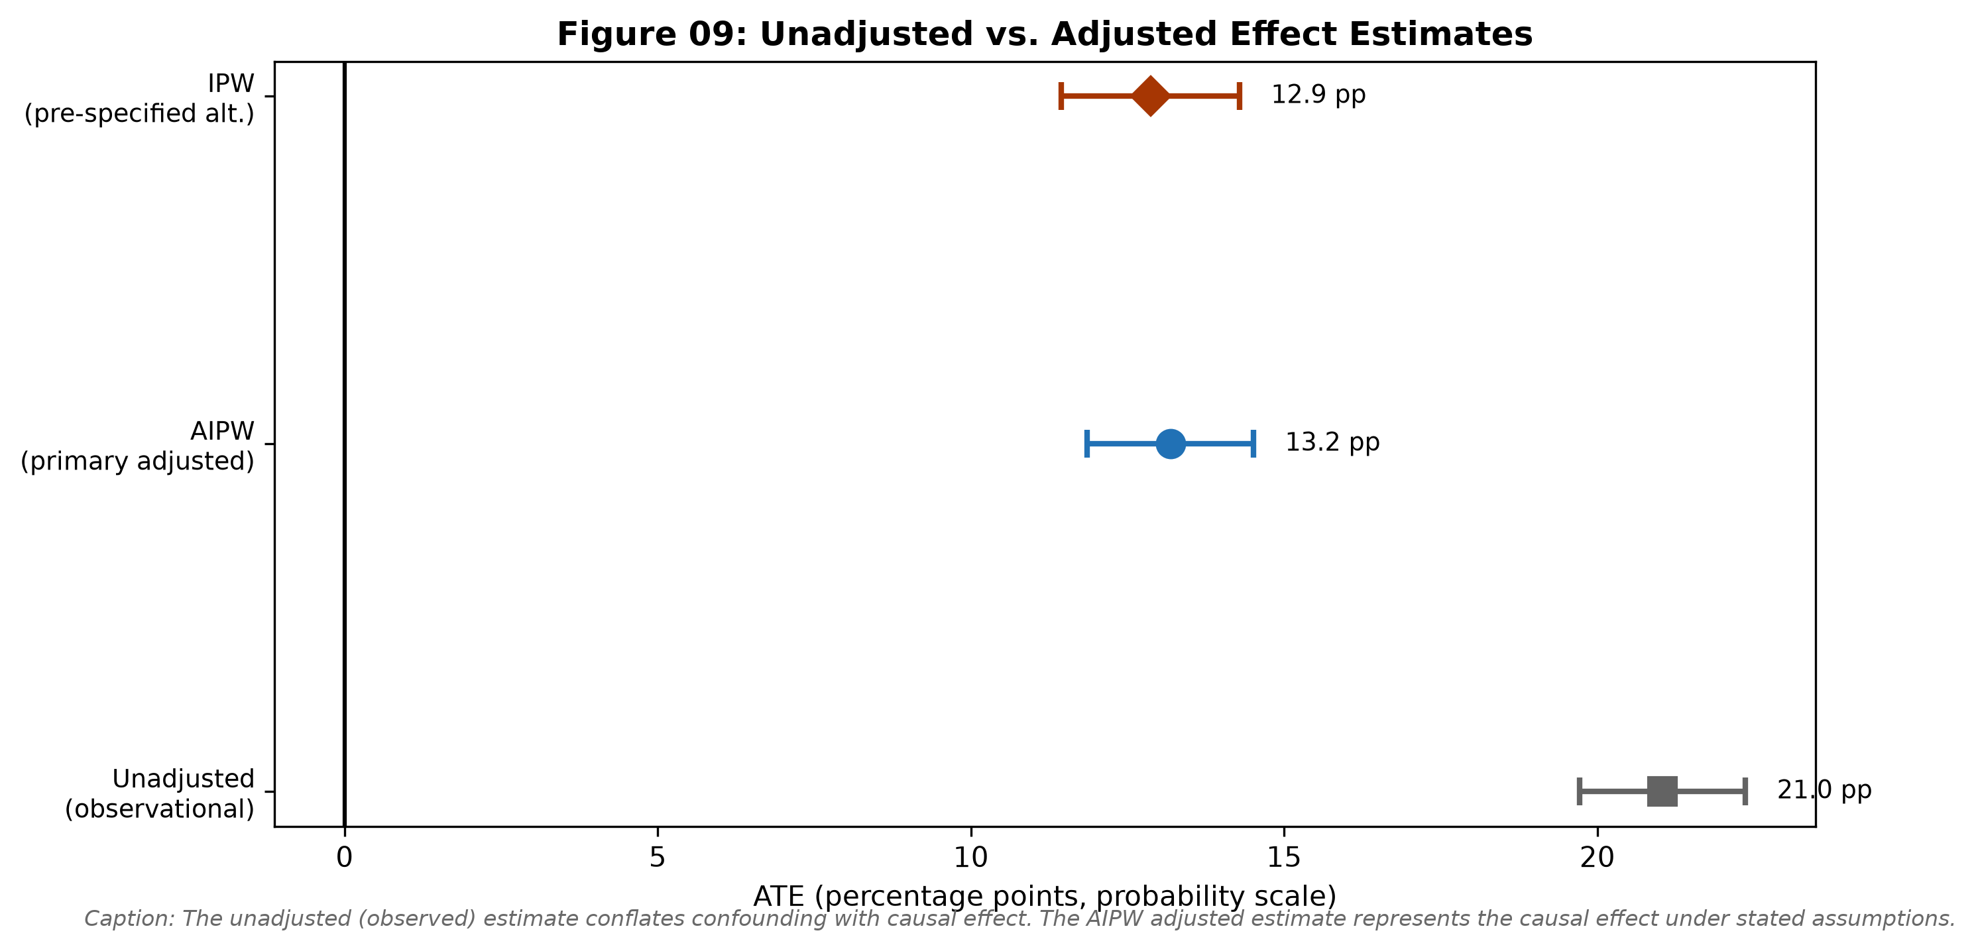
MODULE 7 | INTERVENTIONS AND CAUSAL EFFECTS
MODULE 7
Estimate the effect after making the groups more comparable
The final number comes from the stated identification strategy, not from a library call alone.
NEW TERM
AIPW
Augmented Inverse Probability Weighting. It combines two ideas: estimate the chance of having a fund from background factors, and model bill payment from the same information. Together, this makes the comparison fairer under the assumptions.
WHAT YOU SEE
The raw difference is 21.0 points. The primary AIPW estimate is 13.2 points, with a 95% range of 11.9 to 14.5. The alternative IPW result is 12.9 points.
WHY IT MATTERS
Both adjusted methods give a similar positive estimate. The plot's horizontal bars show the range of uncertainty, not a guarantee.
SHED 2023 | empirical run 366437d7f9b5d4f3
12

Slide 13
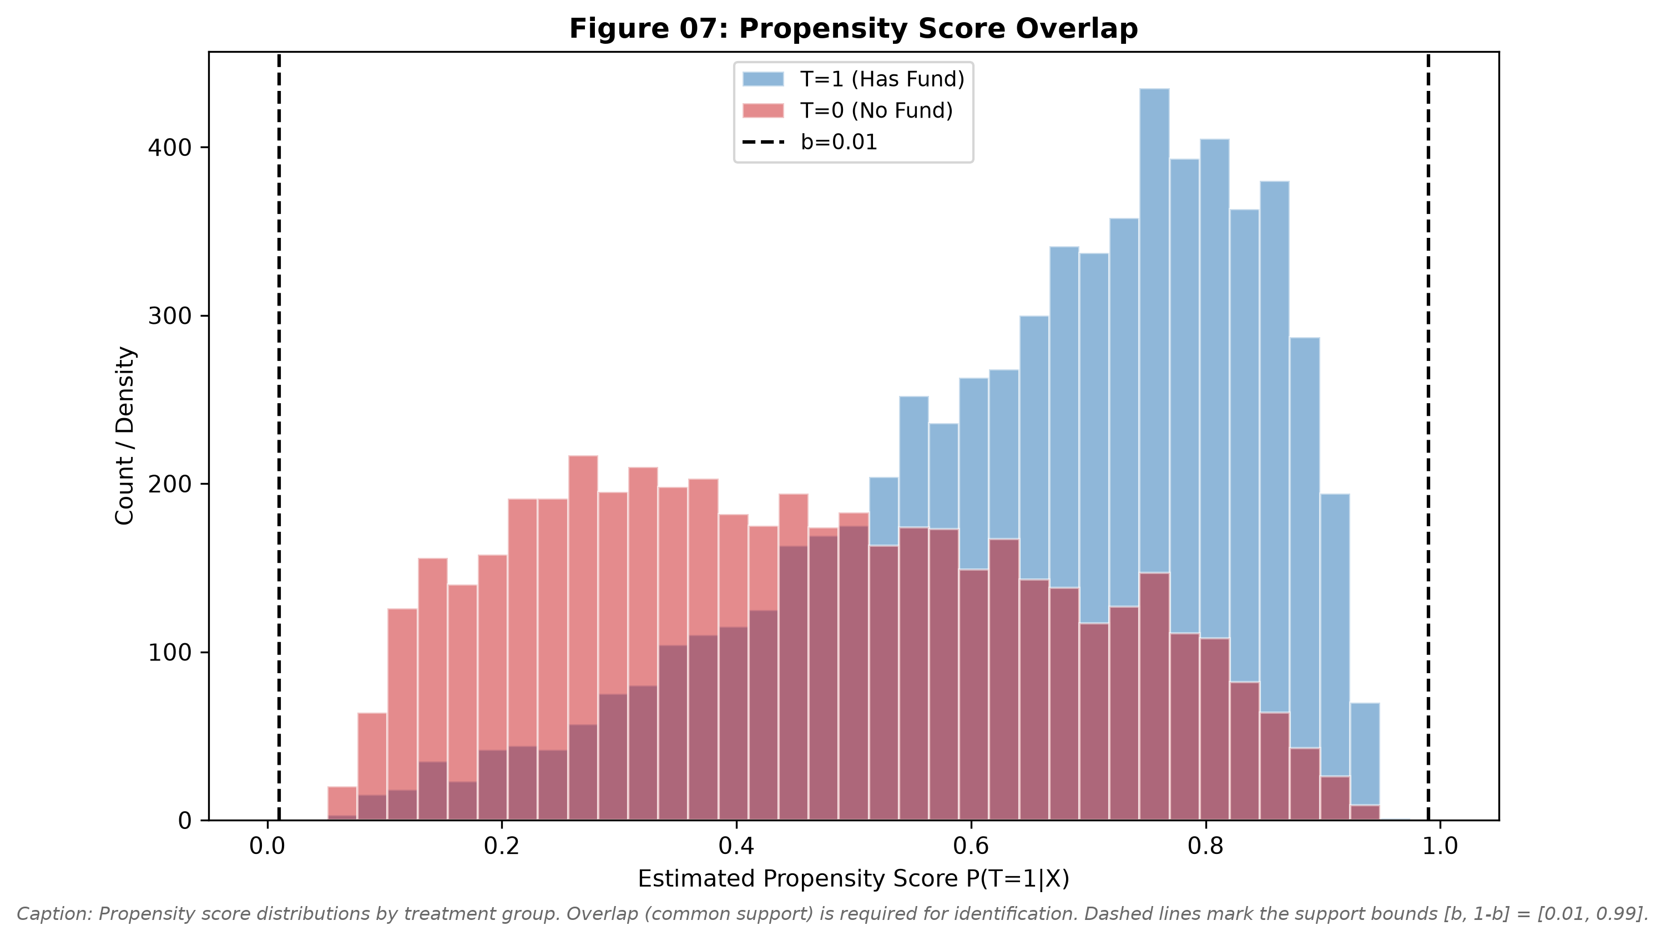
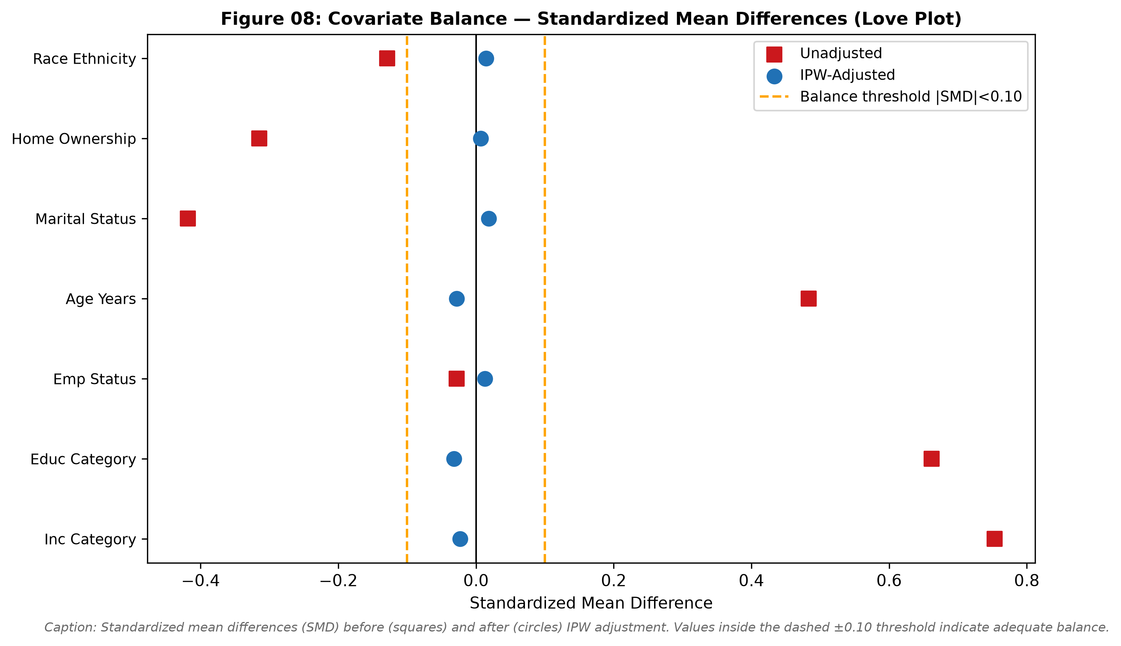
MODULE 7 | INTERVENTIONS AND CAUSAL EFFECTS
MODULE 7
Check whether the adjusted groups can be compared
These diagnostics support the analysis; they do not prove that no hidden factor remains.
Figure 07: overlap
The blue and red bars overlap across much of the chart. This means we can find reasonably similar people in both groups. All respondents stayed within the chosen support bounds.
Figure 08: balance
Red squares show big differences before adjustment. Blue circles are much closer to zero after adjustment. The largest difference fell from 0.753 to 0.032.
Why both figures matter
Overlap says the two groups contain comparable types of people. Balance says the measured background factors are more alike after adjustment. Neither chart can test an unmeasured shock.
SHED 2023 | empirical run 366437d7f9b5d4f3
13

Slide 14
MODULE 8 | COUNTERFACTUALS AND PARALLEL WORLDS
MODULE 8
Counterfactual: keep the people fixed, change the treatment
This asks about a factual subgroup in a modeled alternate world.
1. FACTUAL EVIDENCE
2. COUNTERFACTUAL QUESTION
What we actually saw
What if this same subgroup had a fund?
A subgroup with no emergency fund and no full bill payment N = 1,264
E[Y(1) | T = 0, Y = 0]
model only
Model-estimated full-bill-payment rate: 88.3%
We cannot observe this same subgroup both with and without a fund.
This is a group-level result under the SCM assumptions, not an individual promise or financial advice.
The key difference
An intervention asks about everyone under a setting. A counterfactual starts with factual evidence about a particular group, then asks about that same group under the conflicting setting.
SHED 2023 | empirical run 366437d7f9b5d4f3
14

Slide 15
MODULE 9 | IDENTIFICATION WITHIN PEARL'S CAUSAL HIERARCHY
MODULE 9
Place each question on the causal ladder
Identification is the bridge from an observed dataset to an interpreted causal quantity.
Level 1
Level 2
Level 3
Association
Intervention
Counterfactual
Question: Do people with a fund pay bills more often?
Question: What if we set fund status to yes versus no?
Question: For this factual subgroup, what if it had a fund?
Observed gap: +21.0 points
Estimated effect: +13.2 points
Estimated subgroup rate: 88.3%
This can mix cause with background differences.
This requires the DAG-based adjustment assumptions.
This additionally relies on the structural model.
Identification strategy: Back-door adjustment uses the DAG to control for measured common causes before estimating the intervention contrast.
SHED 2023 | empirical run 366437d7f9b5d4f3
15

Slide 16
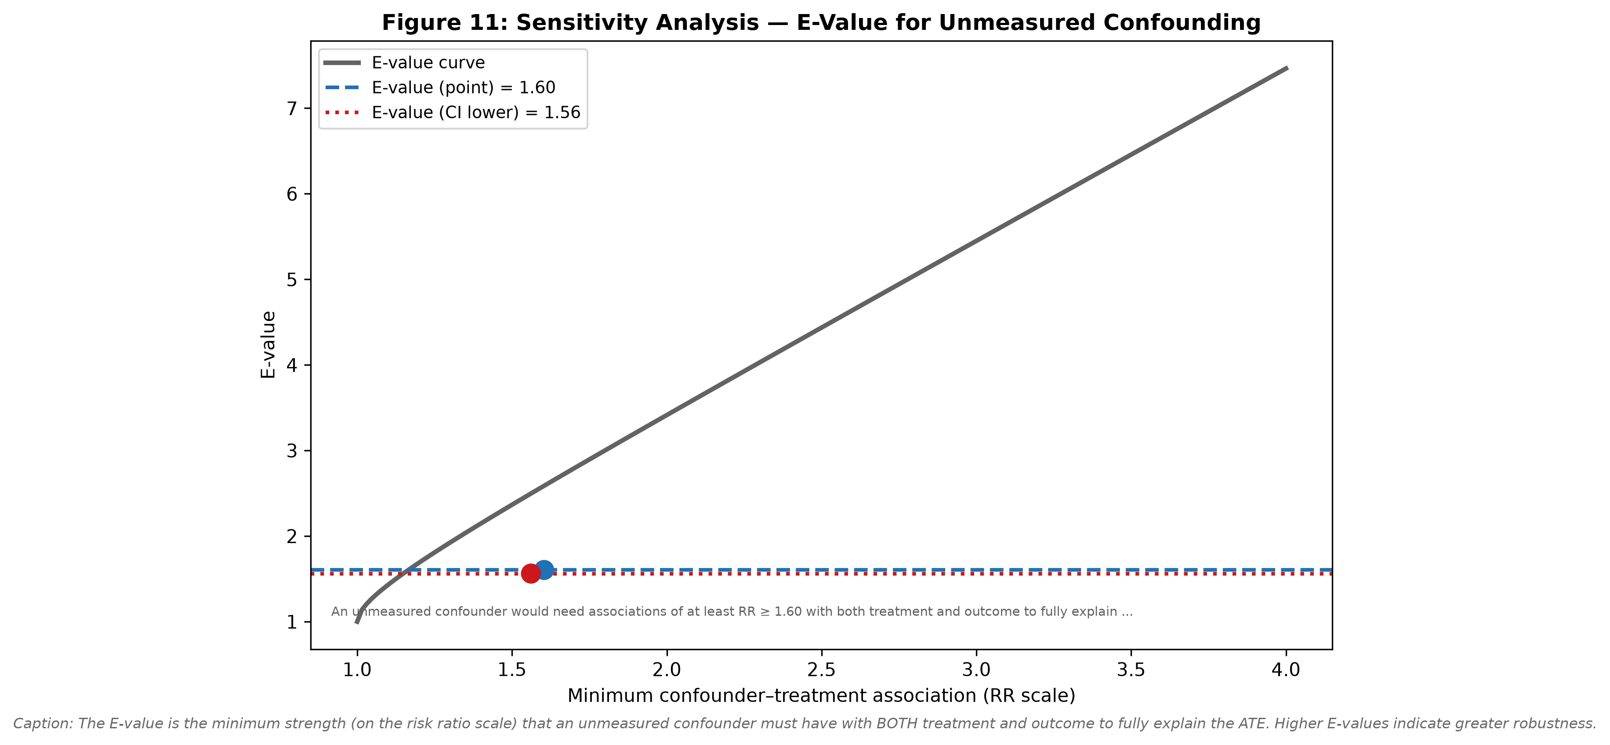
MODULE 9 | IDENTIFICATION AND SENSITIVITY
MODULE 9
Ask how strong a missing factor would need to be
The open FinancialShock path cannot be measured away, so we assess its possible influence.
NEW TERM
E-value
A sensitivity measure. It describes how strongly an unmeasured factor would need to relate to both the emergency fund and bill payment to fully explain away the estimated effect.
WHAT YOU SEE
The blue point estimate is 1.60; the red lower-confidence-bound value is 1.56. The chart is about the potential power of an unseen factor, not evidence that one exists.
WHY IT MATTERS
This keeps the unmeasured FinancialShock threat in the conclusion. Sensitivity analysis makes the claim more transparent, not certain.
SHED 2023 | empirical run 366437d7f9b5d4f3
16

Slide 17
MODULE 10 | STRUCTURED CAUSAL INFERENCE WORKFLOW
MODULE 10
Trace the final result back through every causal decision
A defensible conclusion keeps both the positive estimate and its limits in view.
Question
DAG
Test
Identify
Estimate
Emergency fund -> bill payment
Name causes and threats
Challenge graph implications
Choose a justified adjustment set
AIPW effect and uncertainty
What we can say
What we cannot say
Under the stated causal assumptions, having a three-month emergency fund is estimated to increase full bill payment by about 13.2 percentage points in this SHED 2023 analytic population.
- The cross-sectional survey proves the fund came first.
- Every individual will have the same benefit.
- Unmeasured financial shocks do not matter.
Prepared defense: explain the DAG, the adjustment set, the figure tests, the estimator, the counterfactual, and the limitations.
SHED 2023 | empirical run 366437d7f9b5d4f3
17

