Slide 1

Major Index Price and Return Prediction
Ryan Finegan

Slide 2
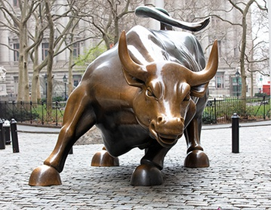
Overview
Introduction
Motivation
Data Collection and Feature Selection
Model Summary and Performance on Various Indices
Conclusion

Slide 3
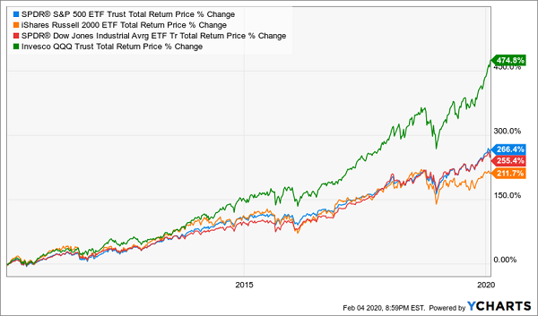
Introduction
Various market indices are tracked to summarize market performance (S&P 500, DJIA, NASDAQ, Russell 2000)
ETFs track these major indices
Track record of great returns

Slide 4
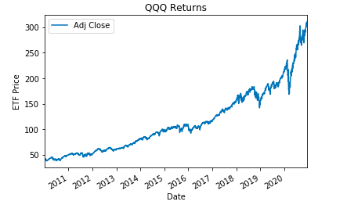
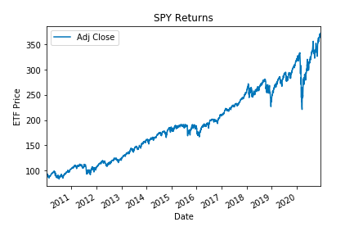
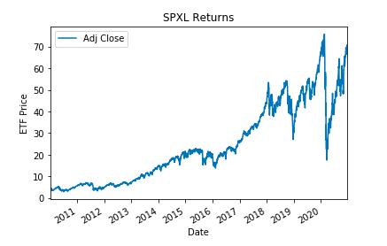
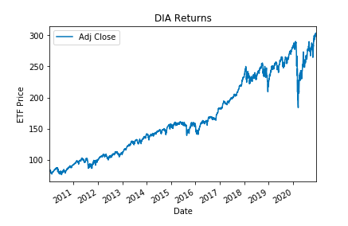
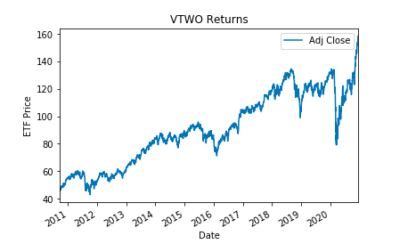
Index Tracking ETF Performance (2010)

Slide 5
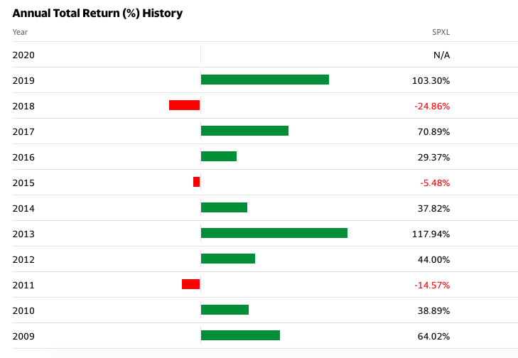
Motivation
QQQ – 20.34% average annual return (10 years)
SPY – 14.08%
SPXL – 26.37%
DIA – 13.01%
VTWO – 11.19%

Slide 6
Data Collection
Data Visualization – Yahoo Finance
Neural Network Price / Returns - Yahoo Finance and FRED API
10 year tick price data from now
Indices/Securities – QQQ, SPY, ^GSPC, SPXL, DJIA, ^IXIC, ^VIX, ^RUT
Macroeconomic statistics – 10yr breakeven IR, 5yr / 5yr forward IR, Baa Corp Bond Yield
Neural Network NLP Returns - Kaggle csv file
06/08/08 – 07/01/16 Reddit WorldNews Channel
25 headlines each trading day (Global)

Slide 7
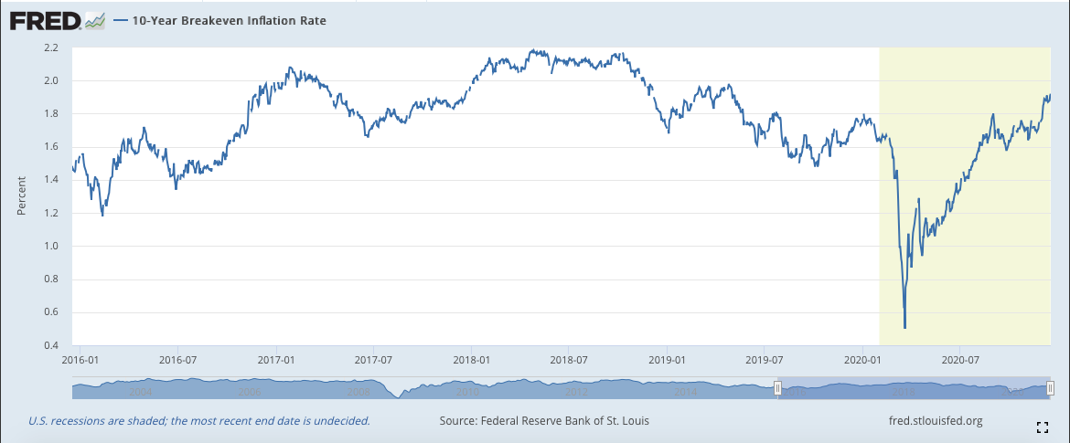
Data Why
Macroeconomic indicators that were updated daily
Inflation and interest rates were two big drivers
Economic growth and unemployment weren’t updated frequently
Sentiment

Slide 8
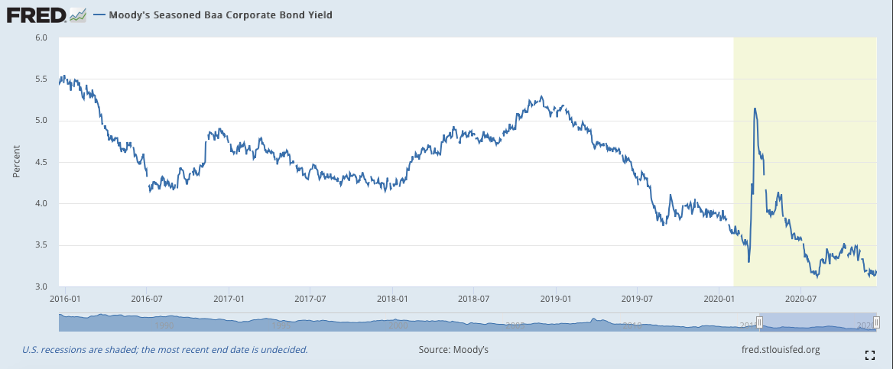
Macroeconomic Drivers
Breakeven Inflation Rate – current value represents markets expected inflation in the next 10 years
Baa Corporate Bond Yield - Interest Rate report updated daily on investment grade firms
5-year, 5-year Forward Inflation Expectation Rate– average expected inflation over 5-year period, that begins 5 years from now

Slide 9
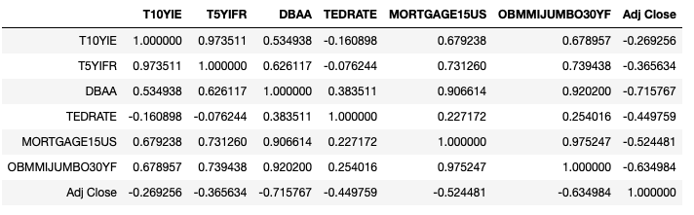
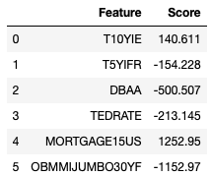
Correlation Matrix / Linear Regression Feature Coefficients
Linear Regression Coefficients and Correlation Matrix to S&P 500 relatively say the same thing
Three strongest features: 15-year Mortgage, 30-year mortgage, and daily BBB corporate bond yield
However, through trial and error, on average neural network model responded better to index price movements with these three:
BBB corporate bond yield, 10 Year Breakeven Inflation Rate, and 5 Year, 5 Year Forward Inflation Rate

Slide 10
NN-Price: Features and Labels
Features: SMA 3 and SMA 9 day of target security, SMA 3 day of macroeconomic daily indicators:
10yr breakeven IR, 5yr / 5yr forward IR, Baa Corp Bond Yield
Label: Adjusted Close Price shifted
Shifted one day so features are matched with adj close of tomorrow

Slide 11
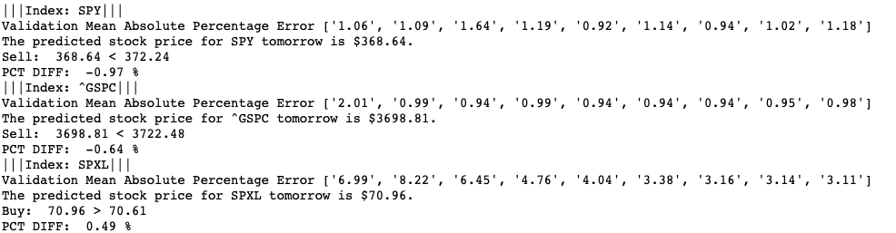
Model Summary – NN (Price)
Data split (train/test/validation) - (80/10/10)
3 layers (input, hidden, output)
Activation Function: Leaky ReLU
Performance Metric: MAPE on validation set

Slide 12
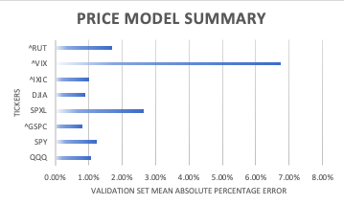
Model Performance – NN (Price)

Slide 13
NN-Returns: Features and Labels
Features: SMA 3 and SMA 9 day of target security, SMA 3 day of macroeconomic daily indicators:
10yr breakeven IR, 5yr / 5yr forward IR, Baa Corp Bond Yield
Label: Binary Variable shifted
Shifted one day so features are matched with adj close binary return of tomorrow
1 – positive return
0 – negative return

Slide 14
Model Summary – NN (Returns)
Data split (train/test/validation) - (67/16.5/16.5)
3 layers (input, hidden, output)
Activation Function (input and hidden): Leaky ReLU
Activation Function (output): Sigmoid
Performance Metric: Binary Accuracy on validation data

Slide 15
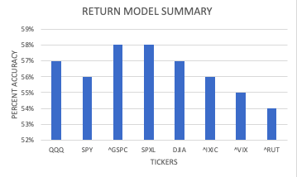
Model Performance – NN (Returns)

Slide 16
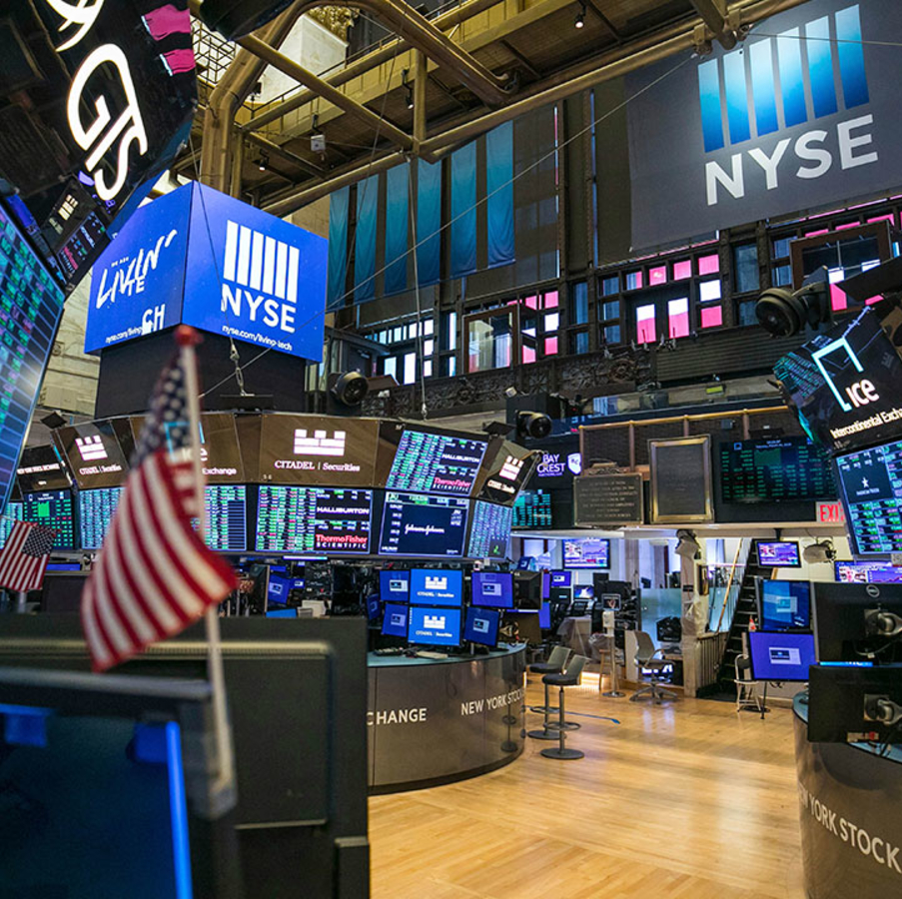
Conclusion
Inflation and interest rates can be used to better predict major American market indices
Deep Neural Networks offer a great way to forecast data due to non-linearity
However, neither model showed enough accuracy to use
In the future, can use other, not as popular, daily economic indicators to lower MAPE / Binary Accuracy
More promising: Twitter Sentiment (however could only get past 7 days)

Slide 17
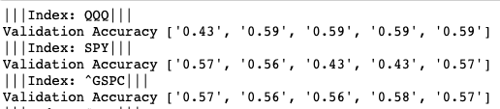
Code Links
Final Code:
https://github.com/rfinegan1/FE-520_FinalProject/blob/main/FE520-finalprojectcode.py
NLP Attempt Code:
https://github.com/rfinegan1/FE-520_FinalProject/blob/main/sp500_nlp.ipynb
Project Repo:
https://github.com/rfinegan1/FE-520_FinalProject

