Slide 1
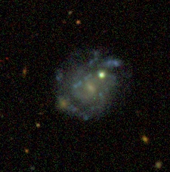
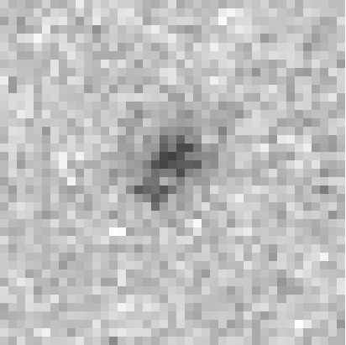

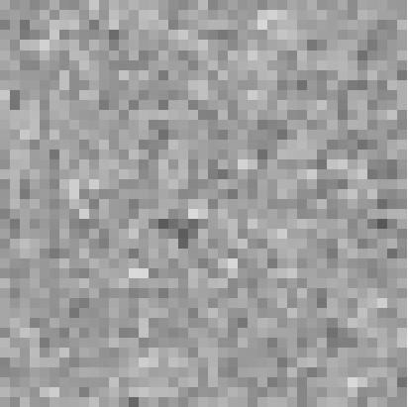
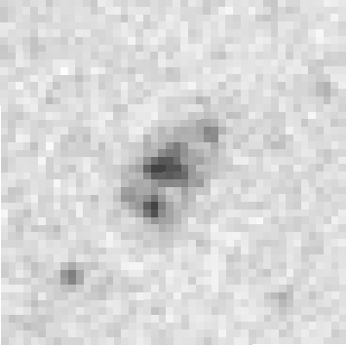

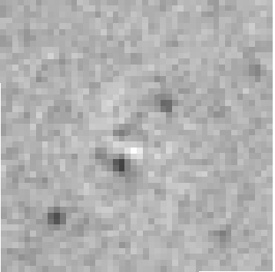
SDSS image NSA-113482
WISE 12μm
Model 12μm
Residual 12μm
n= 0.6; R_{e} = 12.0”±1.5”
χ²_{ν} = 1.26
MIPS 24μm
Model 24μm
Residual 24μm
r-band: n= 1.3; R_{e} = 10.9”
n= 0.7; R_{e} = 10.3”±1.4”
χ²_{ν} = 1.39

Slide 2
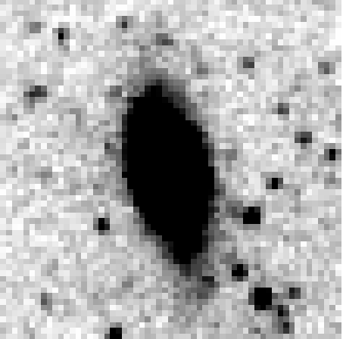
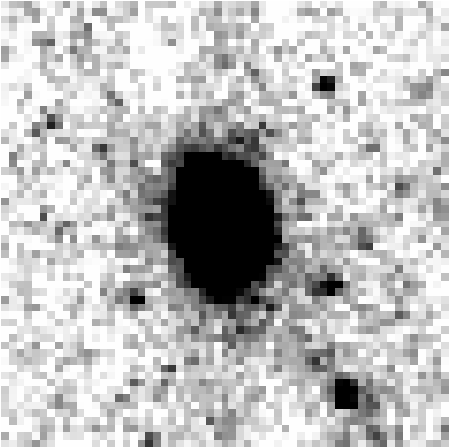
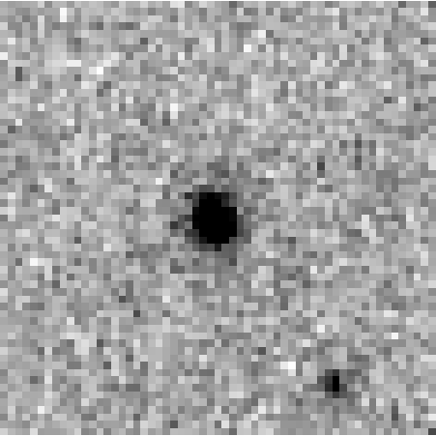
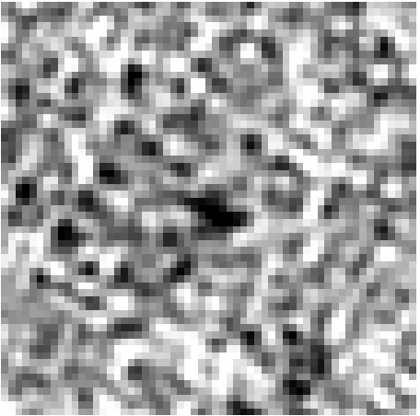
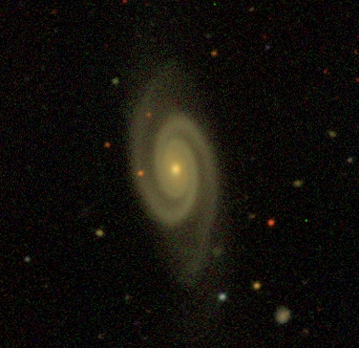
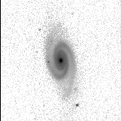
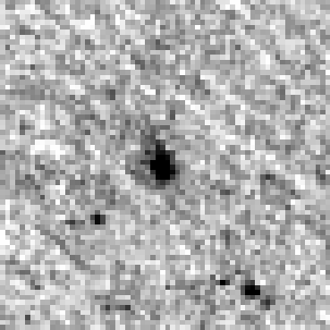
WISE 3.4μm
WISE 4.6μm
WISE 12μm
WISE 22μm
SDSS image NSA-43874
r-band
MIPS 24μm

Slide 3
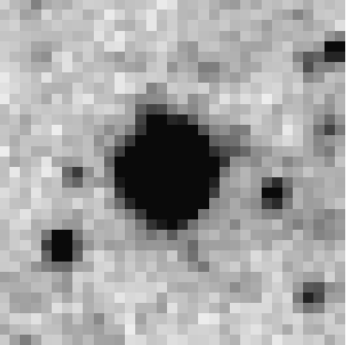
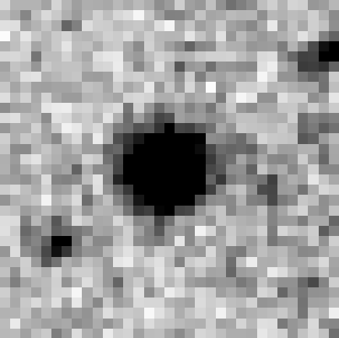
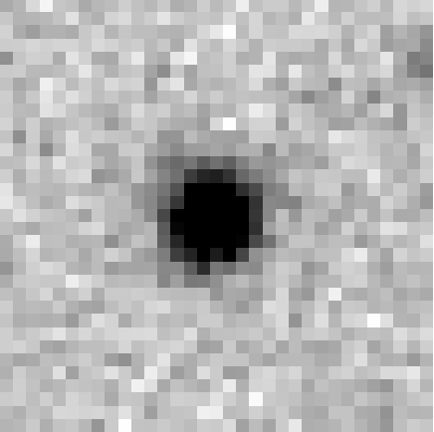
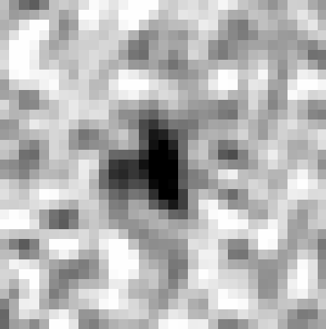
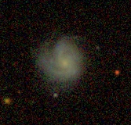
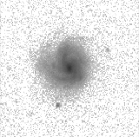
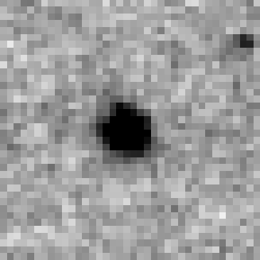
WISE 3.4μm
WISE 4.6μm
WISE 12μm
WISE 22μm
SDSS image NSA-18266
r-band
MIPS 24μm

Slide 4
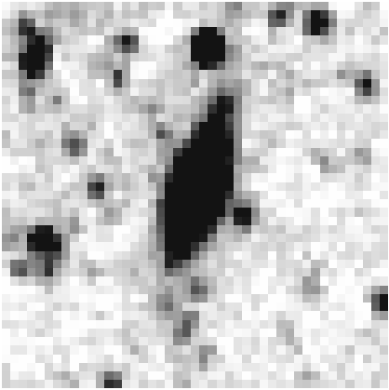
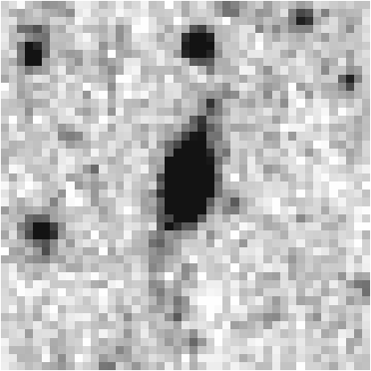
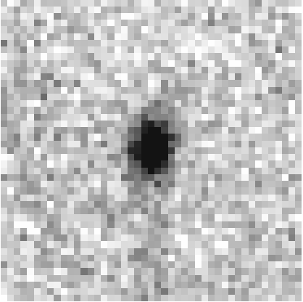
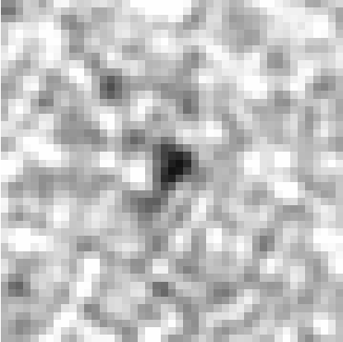
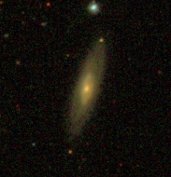
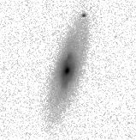
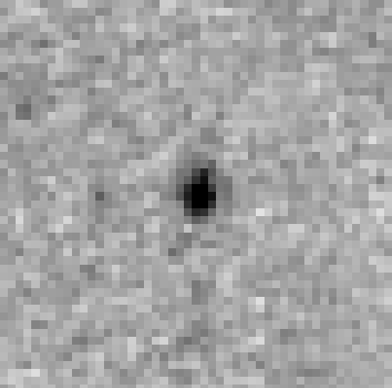
WISE 3.4μm
WISE 4.6μm
WISE 12μm
WISE 22μm
SDSS image NSA-166036
r-band
MIPS 24μm

Slide 5
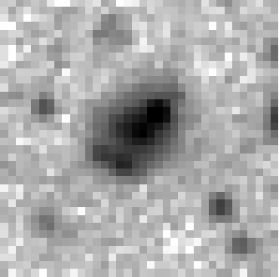
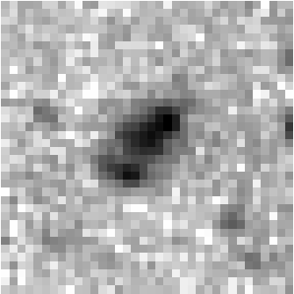
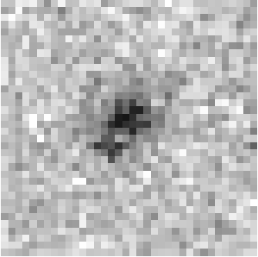
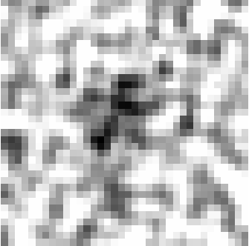
WISE 12μm
Model 12μm
Residual 12μm
SDSS image NSA-113482
n= 0.6; R_{e} = 12.0”±1.5”
χ²_{ν} = 1.26
MIPS 24μm
Model 24μm
Residual 24μm
r-band: n= 1.3; R_{e} = 10.9”
n= 0.7; R_{e} = 10.3”±1.4”
χ²_{ν} = 1.39
WISE 3.4μm
WISE 4.6μm
WISE 12μm
WISE 22μm

Slide 6
WISE 3.4μm
WISE 4.6μm
WISE 12μm
WISE 22μm

Slide 7

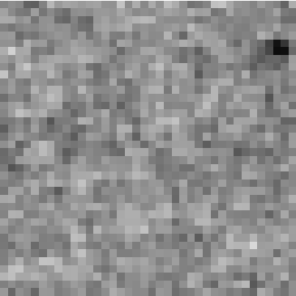
WISE 3.4μm
WISE 4.6μm
WISE 12μm
WISE 22μm
SDSS image NSA-18266
MIPS 24μm
Model 24μm
Residual 24μm

Slide 8
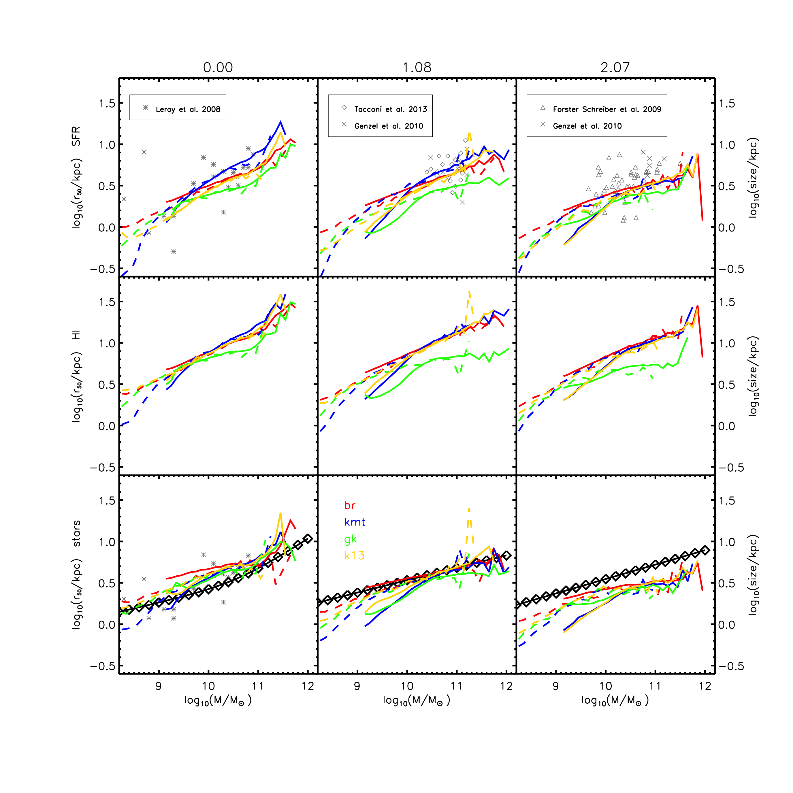
Semi-analytic Models of Xie+2016
Local Cluster Survey Galaxies

Slide 9
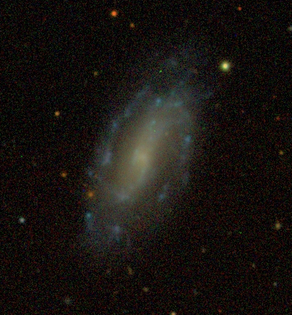
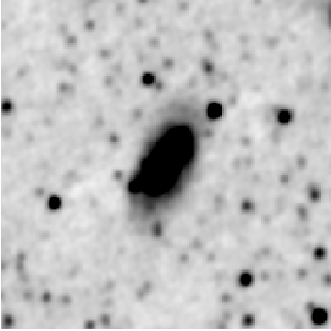
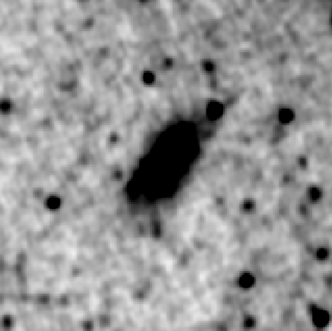
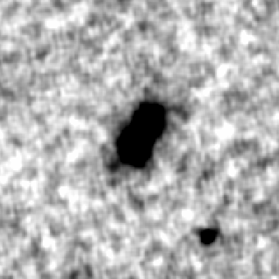
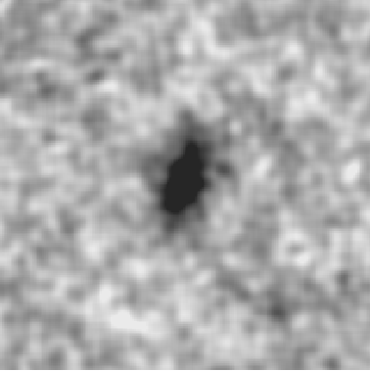
SDSS image NSA-88353
WISE 3.4μm
WISE 4.6μm
WISE 12μm
WISE 22μm

