Slide 1
Flow Prediction
Available Data
Current and Historic Data:
- WWTP Flow
- Temperature
- Precipitation
- River Flow
Future Predicted Data:
- Temperature
- Precipitation
Machine Learning Model
Future Predicted WWTP Flows

Slide 2
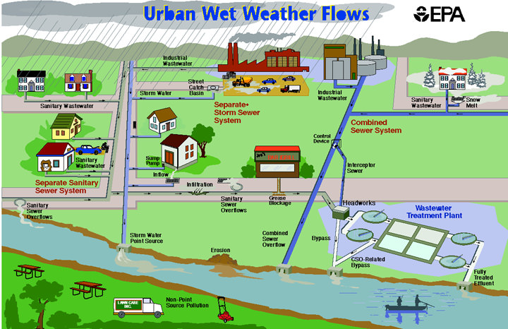
Background of Variable Flows on Wastewater Treatment Plants
Rain Enters Manholes & Open pipes
Ground Water Enters Cracked Pipes

Slide 3
Data Sources
Wasterwater Treatment Plant
WWTP Flow (Current and Historic)
US Geologic Survey
River Flow (Current and Historic)
Precipitation (Current and Historic)
National Weather Service
Temperature (Current and Historic)
Precipitation (Current and Historic)
Temperature (Forecasted)
Precipitation (Forecasted)

