Slide 1



Research Symposium
2008
Melbourne Engineering Graduates Look to the Future
Asynchronous Multi-Agent Reasoning in the Situation Calculus
Ryan Kelly
INFORMATION AND COMMUNICATION SYSTEMS

Slide 2
Vision
Planning the cooperative execution of shared tasks in
rich multi-agent domains:
  incomplete knowledge
  concurrent actions
  partial observability
A fun little example: robotic chefs

Slide 3
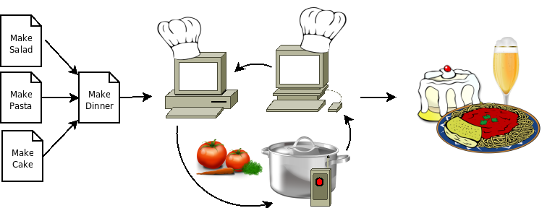
Example: The Cooking Agents
The situation calculus almost fits the bill:
  rich domain features (concurrency, time, …)
  powerful programming language (Golog)
  easy to implement as a logic program

Slide 4
The Situation Calculus
The situation calculus is a formalism for reasoning about
action and change in dynamic worlds
Given a theory of action, we can answer queries about the behavior
of the world using logical inference:
  D
  ╞
  φ
This is great in theory, but not so good in practice…

Slide 5
Reasoning in the Situation Calculus
Fortunately, there are effective reasoning procedures for certain types of query
The standard technique is regression, which works by unwinding actions from the query:
  D ╞ φ[do(a,s)]
  iff
  D ╞ R(φ,a)[s]
Regression allows practical systems to be implemented using the sitcalc

Slide 6
Limitations of the Situation Calculus
The sitcalc has some limitations when reasoning about
multi-agent domains:
  it demands that the world be synchronous
  it does not support common knowledge
  it generates serial plans
My thesis provides:
effective reasoning procedures for
asynchronous multi-agent domains.

Slide 7
Contributions
Major contributions:
  semantics for a multi-agent Golog variant
  techniques for partial-order planning
  new technique for effective inductive reasoning
  reasoning about knowledge with hidden actions
  reasoning about common knowledge
  implementation using distributed logic programming
Key Idea: explicitly represent the local perspective of each agent
Obs(agt,a,s) = o

Slide 8
MIndiGolog: Multi-Agent Golog
MIndiGolog provides a robustly multi-agent semantics for
Golog programs
In particular, it lets us take advantage of true concurrency:
proc MakeSalad(Bowl)
[ ChopTypeInto(Lettuce,Bowl) ||
ChopTypeInto(Tomato,Bowl) ||
ChopTypeInto(Carrot,Bowl) ] ;
mix(Bowl)
end

Slide 9
Joint Executions
Planning a standard Golog execution produces a linear
sequence of actions
The MIndiGolog interpreter produces joint executions, partially-ordered action structures in which:
  independent actions can be performed independently
  synchronisation, when necessary, is automatically derived from the local observations of each agent
  execution can branch on the result of sensing actions

Slide 10
Property Persistence
Asynchronicity implies dealing with arbitrarily-long sequences of hidden actions, which requires inductive reasoning
We extend regression to handle this using a fixpoint construction:
  P⁰(φ,α) = φ
  P^{n}(φ,α) = φ ∧ ∀a: α(a) → R(P^{n-1}(φ,α),a)
  D ╞ P∞(φ,α) ≡ ∀s₁: s ≤_{α} s₁ → φ[s₁]

Slide 11
Knowledge with Hidden Actions
An agent can only plan based on what it knows about the
state of the world:
  Knows(agt,ϕ,s)
In synchronous domains, this can be handled using standard regression:
  Knows(agt,ϕ,do(a,s)) ⇒ Knows(agt,R(ϕ,a),s)
In asynchronous domains, the agent must also know that ϕ cannot be made false by any sequence of hidden actions:
  Knows(agt,ϕ,do(a,s)) ⇒ Knows(agt,R(P(ϕ),a),s)

Slide 12
Common Knowledge
Common knowledge is a fixpoint of “everyone knows”:
  EKnows(ϕ) = ∀agt: Knows(agt,ϕ)
  EKnows ^{n}(ϕ) = EKnows(EKnows ^{n-1}(ϕ))
  CKnows(ϕ) = EKnows ∞(ϕ)
The regression of common knowledge cannot be expressed
using common knowledge
We develop a more powerful epistemic language in which
common knowledge has a proper regression rule

Slide 13
Implementation
Our implementation uses Mozart/Oz, a multi-paradigm language with strong support for logic programming
Using Mozart’s unique distributed logic programming capabilities, the agents can transparently share the planning workload
It is GPL licensed, and will be available for download at:
http://www.csse.unimelb.edu.au/~rfk/
http://www.rfk.id.au/

Slide 14
Conclusion
The situation calculus now has:
effective reasoning procedures for
asynchronous multi-agent domains

