Slide 1

Apache Zookeeper
By Rayan Katib

Slide 2
What is ZooKeeper?
“ZooKeeper is a distributed, open-source coordination service for distributed applications.” –Zookeeper Wiki
The motivation: no need to implement coordination services from scratch.
Exposes common services in simple interface:
Naming
Configuration management
Synchronization
Group services
…

Slide 3
Design Goals and Characteristics
Simple:
Directory tree structure.
Shared hierarchical name space (Z-nodes).
Each node has a path ‘/’.
Similar to normal file system.
ZooKeeper provides: high throughput, low latency, highly available, strictly ordered access to the znodes.
ZooKeeper data is kept in-memory.

Slide 4
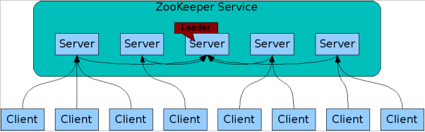
Design Goals and Characteristics
Replicated:
Service is replicated over a set of machines.
All servers store a copy of the data in-memory.
The leader is elected at startup.
Client maintains TCP connection with a single ZooKeeper server.
If TCP connection breaks, client connects to a different server.

Slide 5
Design Goals and Characteristics
Ordered:
All updates are totally ordered.
Stamps each update with a number that reflects the order.
ZooKeeper Transaction id (zxid).
Fast:
Reads are more common than writes.

Slide 6
ZooKeeper Data Model
Z-nodes:
maintains a stat structure that includes version numbers for data changes, ACL changes, and timestamps, to allow cache validations and coordinated updates.
Version number increases with changes.
Persistent node.
Ephemeral z-nodes:
Gets deleted when session ends.
Cannot have children.

Slide 7
Watches
Client sets watches on z-nodes.
Changes in z-node triggers the watch.
ZooKeeper notifies client.
Triggered only once.
For multiple notifications, re-registering the watch is needed.

Slide 8
Consistency Guarantees
Sequential Consistency – Updates are applied in the order.
Atomicity - Updates either succeed or fail.
Single System Image - A client will see the same view of the service regardless of the server that it connects to.
Reliability - Once an update has been applied, it will persist from that time forward until a client overwrites the update.
Timeliness - The clients view of the system is guaranteed to be up-to-date within a certain time bound.

Slide 9
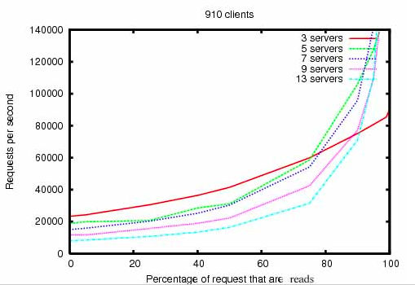
Performance

Slide 10
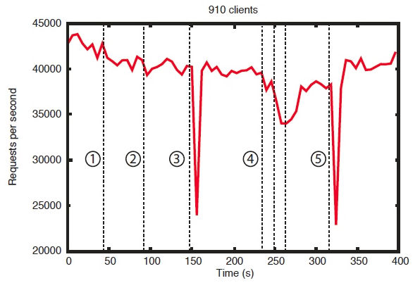
Reliability

Slide 11
Who uses ZooKeeper?
Yahoo
Zynga
Netflix
Linkedin
Rackspace
…

Slide 12
Demo!
Questions?

