Slide 1
Data Mining
Anomaly Detection
Lecture Notes for Chapter 10
Introduction to Data Mining
by
Tan, Steinbach, Kumar
© Tan,Steinbach, Kumar Introduction to Data Mining 11/30/2011 <number>

Slide 2

Anomaly/Outlier Detection
What are anomalies/outliers?
  The set of data points that are
  considerably different than the
  remainder of the data
Natural implication is that anomalies are relatively rare
  One in a thousand occurs often if you have lots of data
  Context is important, e.g., freezing temps in July
Can be important or a nuisance
  10 foot tall 2 year old
  Unusually high blood pressure

Slide 3
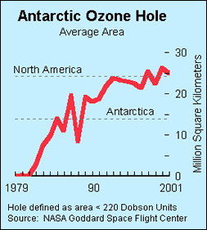
Importance of Anomaly Detection
Ozone Depletion History
In 1985 three researchers (Farman, Gardinar and Shanklin) were puzzled by data gathered by the British Antarctic Survey showing that ozone levels for Antarctica had dropped 10% below normal levels
Why did the Nimbus 7 satellite, which had instruments aboard for recording ozone levels, not record similarly low ozone concentrations?
The ozone concentrations recorded by the satellite were so low they were being treated as outliers by a computer program and discarded!
Sources:
http://exploringdata.cqu.edu.au/ozone.html
http://www.epa.gov/ozone/science/hole/size.html

Slide 4
Causes of Anomalies
Data from different classes
  Measuring the weights of oranges, but a few grapefruit are mixed in
Natural variation
  Unusually tall people
Data errors
  200 pound 2 year old

Slide 5
Distinction Between Noise and Anomalies
Noise is erroneous, perhaps random, values or contaminating objects
  Weight recorded incorrectly
  Grapefruit mixed in with the oranges
Noise doesn’t necessarily produce unusual values or objects
Noise is not interesting
Anomalies may be interesting if they are not a result of noise
Noise and anomalies are related but distinct concepts

Slide 6
General Issues: Number of Attributes
Many anomalies are defined in terms of a single attribute
  Height
  Shape
  Color
Can be hard to find an anomaly using all attributes
  Noisy or irrelevant attributes
  Object is only anomalous with respect to some attributes
However, an object may not be anomalous in any one attribute

Slide 7
General Issues: Anomaly Scoring
Many anomaly detection techniques provide only a binary categorization
  An object is an anomaly or it isn’t
  This is especially true of classification-based approaches
Other approaches assign a score to all points
  This score measures the degree to which an object is an anomaly
  This allows objects to be ranked
In the end, you often need a binary decision
  Should this credit card transaction be flagged?
  Still useful to have a score
How many anomalies are there?

Slide 8
Variants of Anomaly Detection Problems
Supervised
Semi-supervised
Unsupervised:Given a data set D, containing mostly normal (but unlabeled) data points, and a test point x, compute the anomaly score of x with respect to D

Slide 9
Statistical Approaches
Probabilistic definition of an outlier: An outlier is an object that has a low probability with respect to a probability distribution model of the data.
Usually assume a parametric model describing the distribution of the data (e.g., normal distribution)
Apply a statistical test that depends on
  Data distribution
  Parameters of distribution (e.g., mean, variance)
  Number of expected outliers (confidence limit)
Issues
  Identifying the distribution of a data set
    Heavy tailed distribution
  Number of attributes
  Is the data a mixture of distributions?

Slide 10

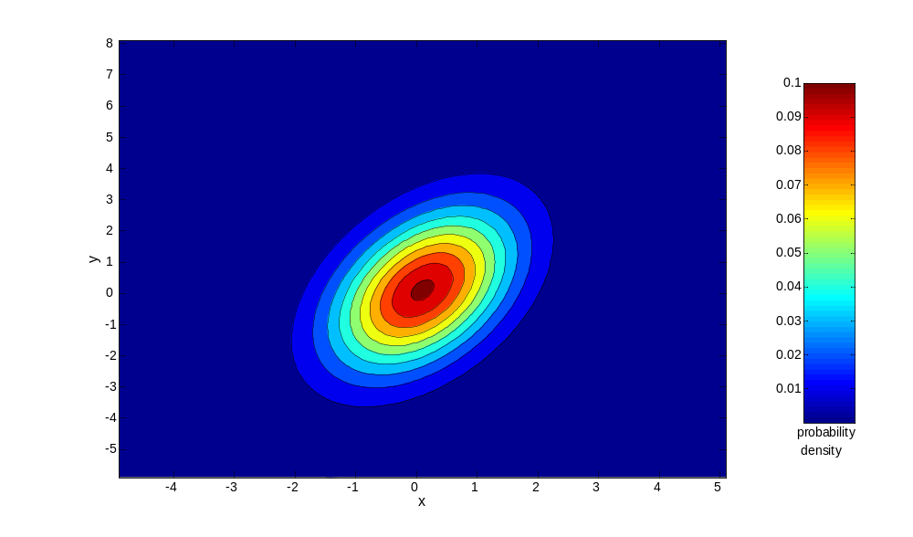
Normal Distributions
One-dimensional Gaussian
Two-dimensional Gaussian

Slide 11
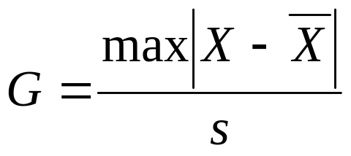
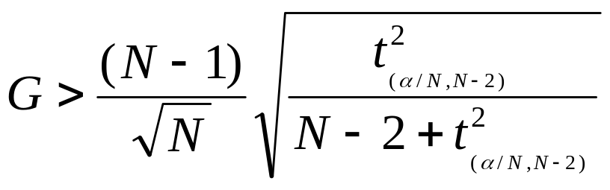
Grubbs’ Test
Detect outliers in univariate data
Assume data comes from normal distribution
Detects one outlier at a time, remove the outlier, and repeat
  H₀: There is no outlier in data
  H_{A}: There is at least one outlier
Grubbs’ test statistic:
Reject H₀ if:

Slide 12
Statistical-based – Likelihood Approach
Assume the data set D contains samples from a mixture of two probability distributions:
  M (majority distribution)
  A (anomalous distribution)
General Approach:
  Initially, assume all the data points belong to M
  Let L_{t}(D) be the log likelihood of D at time t
  For each point x_{t} that belongs to M, move it to A
    Let L_{t+1} (D) be the new log likelihood.
    Compute the difference, Δ = L_{t}(D) – L_{t+1} (D)
    If Δ > c (some threshold), then x_{t} is declared as an anomaly and moved permanently from M to A

Slide 13
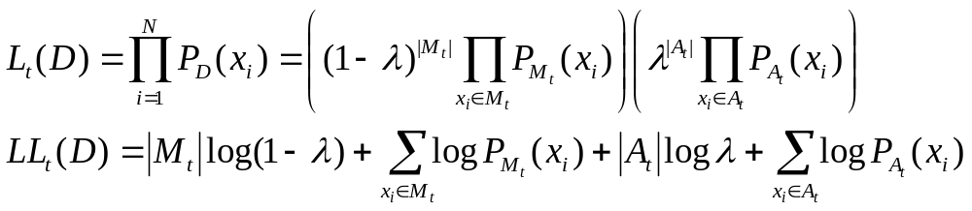
Statistical-based – Likelihood Approach
Data distribution, D = (1 – λ) M + λ A
M is a probability distribution estimated from data
  Can be based on any modeling method (naïve Bayes, maximum entropy, etc)
A is initially assumed to be uniform distribution
Likelihood at time t:

Slide 14
Strengths/Weaknesses of Statistical Approaches
Firm mathematical foundation
Can be very efficient
Good results if distribution is known
In many cases, data distribution may not be known
For high dimensional data, it may be difficult to estimate the true distribution
Anomalies can distort the parameters of the distribution

Slide 15
Distance-Based Approaches
Several different techniques
An object is an outlier if a specified fraction of the objects is more than a specified distance away (Knorr, Ng 1998)
  Some statistical definitions are special cases of this
The outlier score of an object is the distance to its kth nearest neighbor

Slide 16
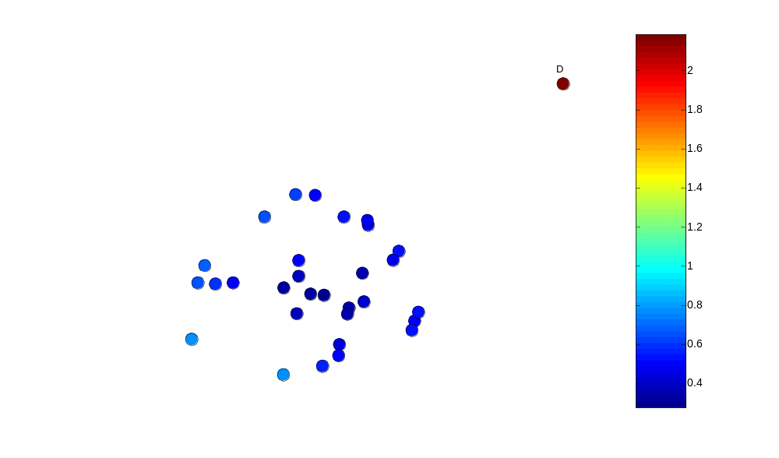
One Nearest Neighbor - One Outlier
Outlier Score

Slide 17
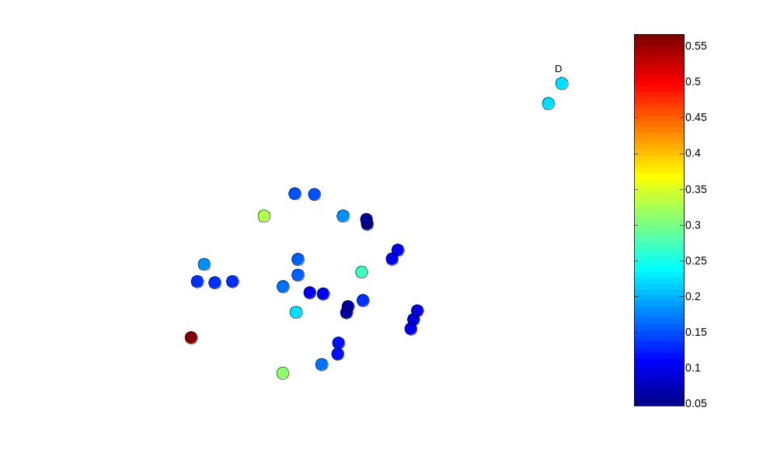
One Nearest Neighbor - Two Outliers
Outlier Score

Slide 18
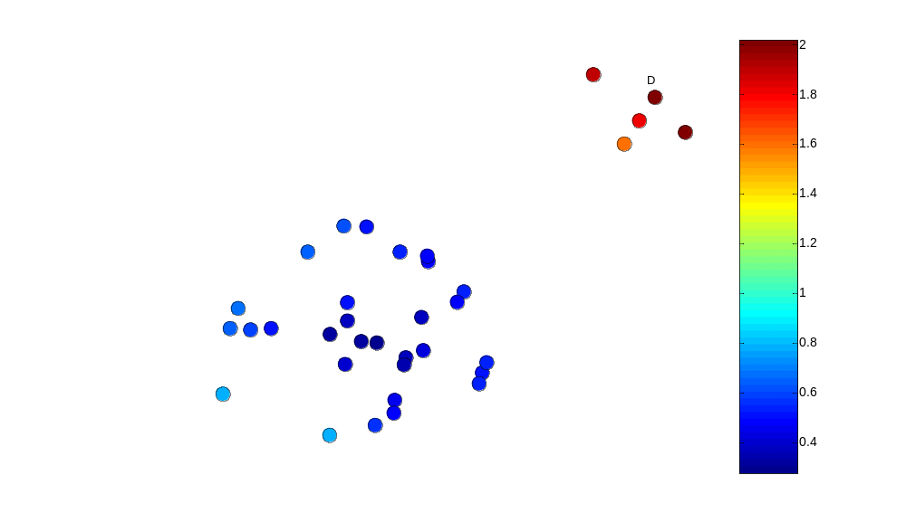
Five Nearest Neighbors - Small Cluster
Outlier Score

Slide 19
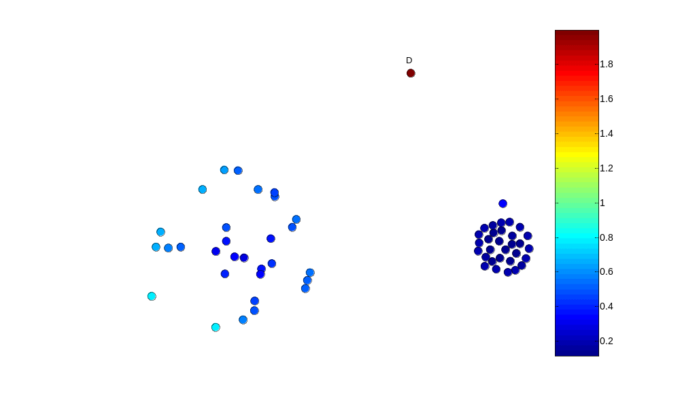
Five Nearest Neighbors - Differing Density
Outlier Score

Slide 20
Strengths/Weaknesses of Distance-Based Approaches
Simple
Expensive – O(n²)
Sensitive to parameters
Sensitive to variations in density
Distance becomes less meaningful in high-dimensional space

Slide 21
Density-Based Approaches
Density-based Outlier: The outlier score of an object is the inverse of the density around the object.
  Can be defined in terms of the k nearest neighbors
  One definition: Inverse of distance to kth neighbor
  Another definition: Inverse of the average distance to k neighbors
  DBSCAN definition
If there are regions of different density, this approach can have problems

Slide 22
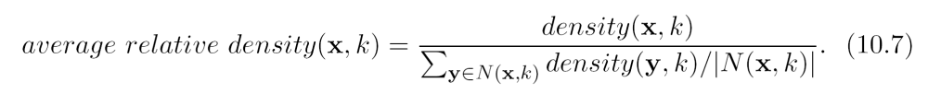
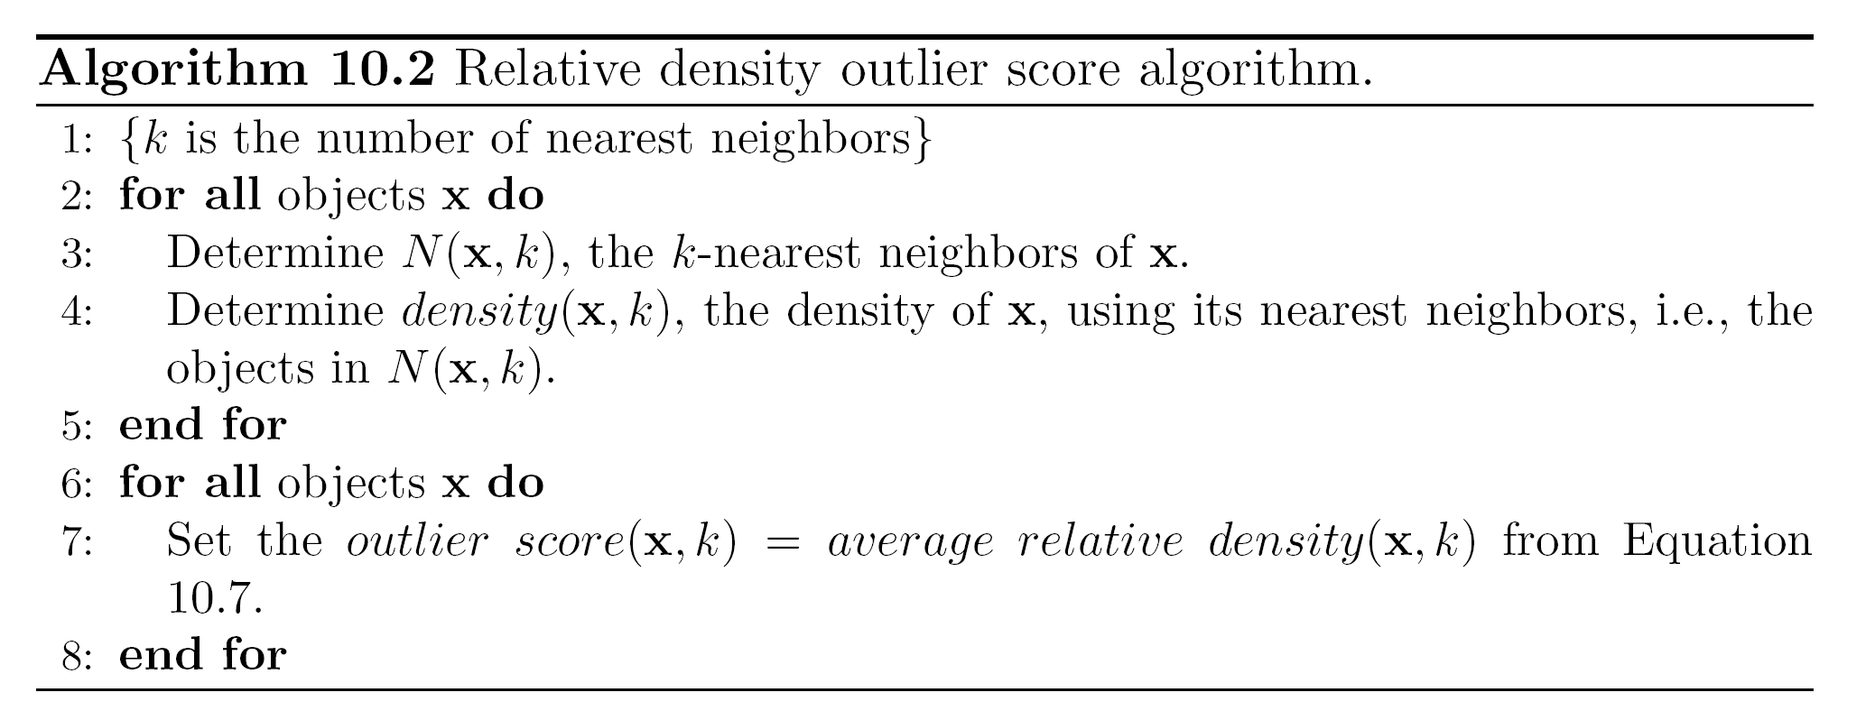
Relative Density
Consider the density of a point relative to that of its k nearest neighbors

Slide 23
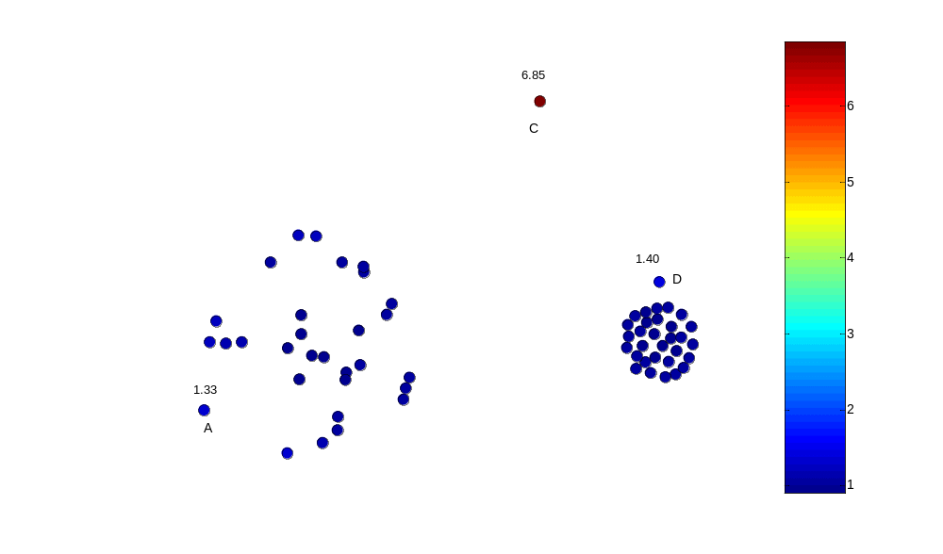
Relative Density Outlier Scores
Outlier Score

Slide 24
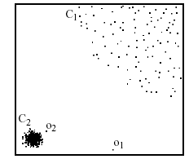
Density-based: LOF approach
For each point, compute the density of its local neighborhood
Compute local outlier factor (LOF) of a sample p as the average of the ratios of the density of sample p and the density of its nearest neighbors
Outliers are points with largest LOF value
In the NN approach, p₂ is not considered as outlier, while LOF approach find both p₁ and p₂ as outliers
p₂
×
p₁
×

Slide 25
Strengths/Weaknesses of Density-Based Approaches
Simple
Expensive – O(n²)
Sensitive to parameters
Density becomes less meaningful in high-dimensional space

Slide 26
Clustering-Based Approaches
Density-based Outlier: An object is a cluster-based outlier if it does not strongly belong to any cluster
  For prototype-based clusters, an object is an outlier if it is not close enough to a cluster center
  For density-based clusters, an object is an outlier if its density is too low
  For graph-based clusters, an object is an outlier if it is not well connected
Other issues include the impact of outliers on the clusters and the number of clusters

Slide 27
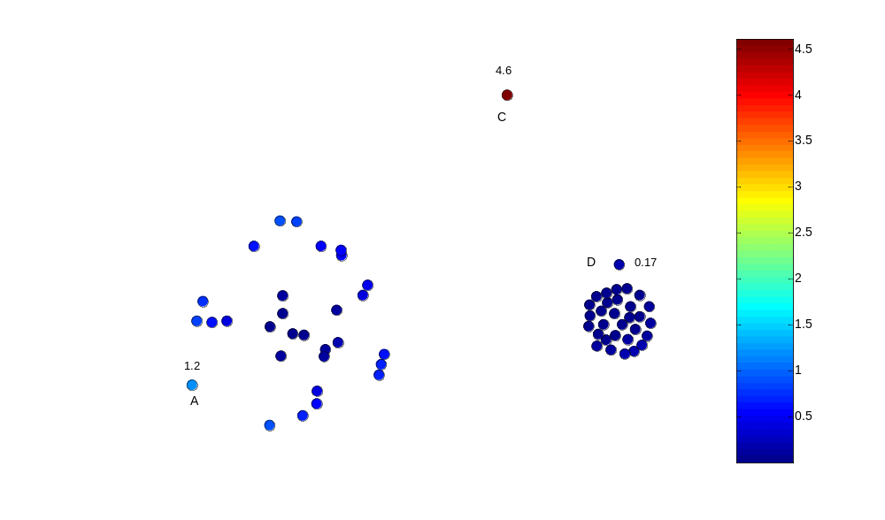
Distance of Points from Closest Centroids
Outlier Score

Slide 28
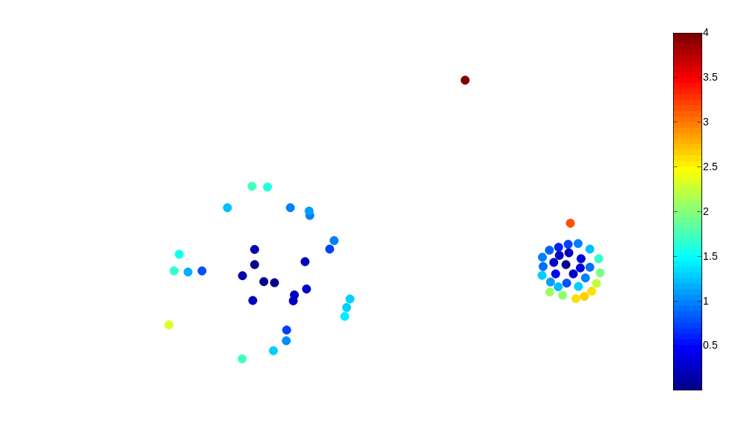
Relative Distance of Points from Closest Centroid
Outlier Score

Slide 29
Strengths/Weaknesses of Distance-Based Approaches
Simple
Many clustering techniques can be used
Can be difficult to decide on a clustering technique
Can be difficult to decide on number of clusters
Outliers can distort the clusters

