Slide 1
Data Mining
Model Overfitting

Slide 2
Classification Errors
Training errors (apparent errors)
  Errors committed on the training set
Test errors
  Errors committed on the test set
Generalization errors
  Expected error of a model over random selection of records from same distribution

Slide 3
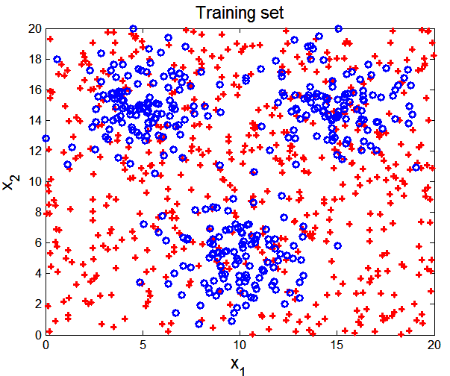
Example Data Set
Two class problem:
+, o
3000 data points (30% for training, 70% for testing)
Data set for + class is generated from a uniform distribution
Data set for o class is generated from a mixture of 3 gaussian distributions, centered at (5,15), (10,5), and (15,15)

Slide 4
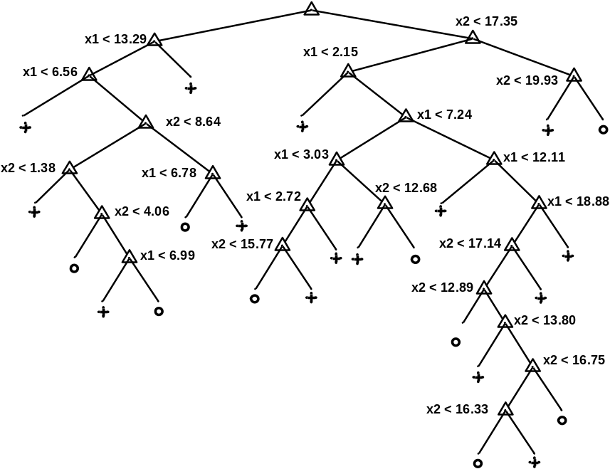
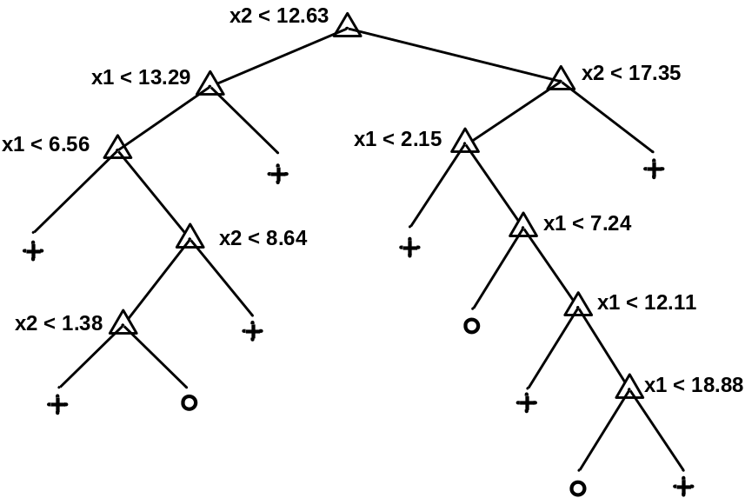
Decision Trees
Decision Tree with 11 leaf nodes
Decision Tree with 24 leaf nodes
Which tree is better?

Slide 5
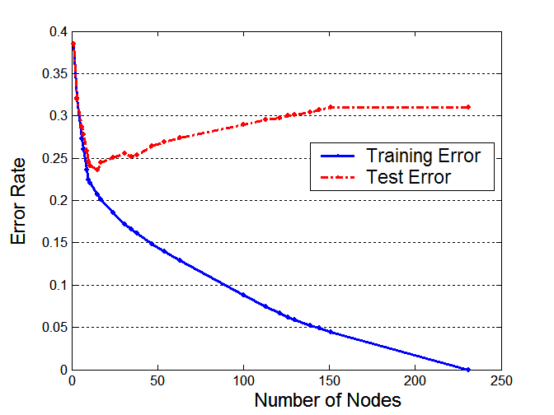
Model Overfitting
Underfitting: when model is too simple, both training and test errors are large
Overfitting: when model is too complex, training error is small but test error is large

Slide 6
Reasons for Model Overfitting
Presence of Noise
Lack of Representative Samples
Multiple Comparison Procedure

Slide 7
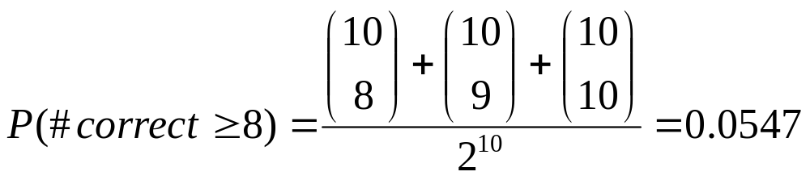
Effect of Multiple Comparison Procedure
Consider the task of predicting whether stock market will rise/fall in the next 10 trading days
Random guessing:
  P(correct) = 0.5
Make 10 random guesses in a row:
Day 1 | Up
Day 2 | Down
Day 3 | Down
Day 4 | Up
Day 5 | Down
Day 6 | Down
Day 7 | Up
Day 8 | Up
Day 9 | Up
Day 10 | Down

Slide 8
Effect of Multiple Comparison Procedure
Approach:
  Get 50 analysts
  Each analyst makes 10 random guesses
  Choose the analyst that makes the most number of correct predictions
Probability that at least one analyst makes at least 8 correct predictions

Slide 9
Effect of Multiple Comparison Procedure
Many algorithms employ the following greedy strategy:
  Initial model: M
  Alternative model: M’ = M ∪ γ,
  where γ is a component to be added to the model (e.g., a test condition of a decision tree)
  Keep M’ if improvement, Δ(M,M’) > α
Often times, γ is chosen from a set of alternative components, Γ = {γ₁, γ₂, …, γ_{k}}
If many alternatives are available, one may inadvertently add irrelevant components to the model, resulting in model overfitting

Slide 10
Notes on Overfitting
Overfitting results in decision trees that are more complex than necessary
Training error does not provide a good estimate of how well the tree will perform on previously unseen records
Need new ways for estimating generalization errors

Slide 11
Estimating Generalization Errors
Resubstitution Estimate
Incorporating Model Complexity
Use Validation Set
Estimating Statistical Bounds

Slide 12
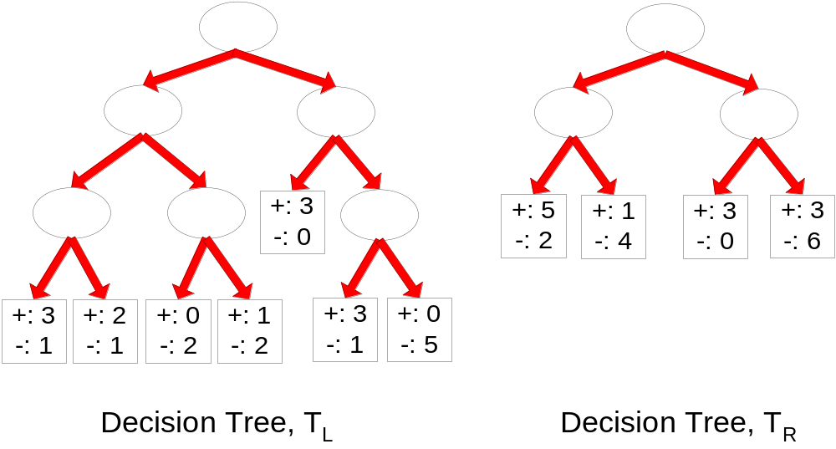
Resubstitution Estimate
Using training error as an optimistic estimate of generalization error
e(T_{L}) = 4/24
e(T_{R}) = 6/24

Slide 13
Incorporating Model Complexity
Rationale: Occam’s Razor
  Given two models of similar generalization errors, one should prefer the simpler model over the more complex model
  A complex model has a greater chance of being fitted accidentally by errors in data
  Therefore, one should include model complexity when evaluating a model

Slide 14
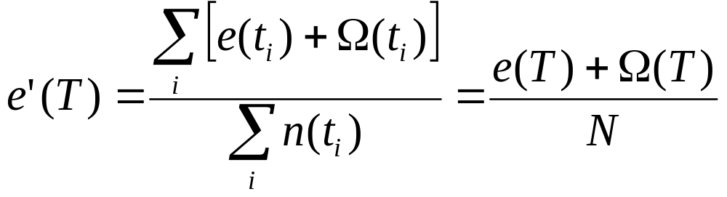
Pessimistic Estimate
Given a decision tree node t
  n(t): number of training records classified by t
  e(t): misclassification error of node t
  Training error of tree T:
    Ω: is the cost of adding a node
    N: total number of training records

Slide 15
Pessimistic Estimate
e(T_{L}) = 4/24
e(T_{R}) = 6/24
Ω = 1
e’(T_{L}) = (4 +7 × 1)/24 = 11/24 = 0.458
e’(T_{R}) = (6 + 4 × 1)/24 = 10/24 = 0.417

Slide 16
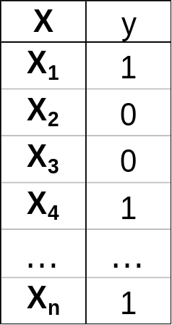
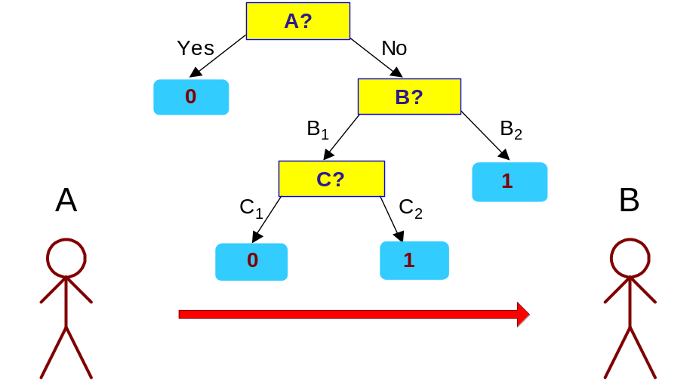
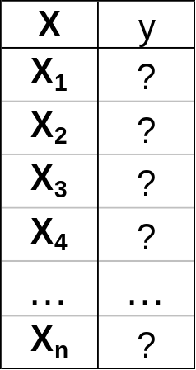
Minimum Description Length (MDL)
Cost(Model,Data) = Cost(Data|Model) + Cost(Model)
  Cost is the number of bits needed for encoding.
  Search for the least costly model.
Cost(Data|Model) encodes the misclassification errors.
Cost(Model) uses node encoding (number of children) plus splitting condition encoding.

Slide 17
Using Validation Set
Divide training data into two parts:
  Training set:
    use for model building
  Validation set:
    use for estimating generalization error
    Note: validation set is not the same as test set
Drawback:
  Less data available for training

Slide 18
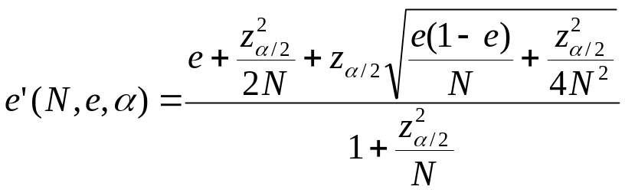
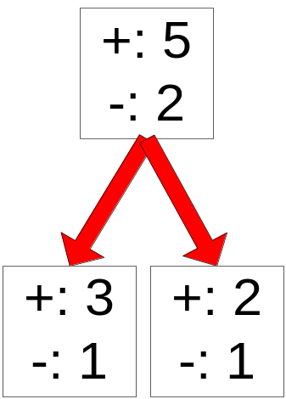
Estimating Statistical Bounds
Before splitting: e = 2/7, e’(7, 2/7, 0.25) = 0.503
e’(T) = 7 × 0.503 = 3.521
After splitting:
e(T_{L}) = 1/4, e’(4, 1/4, 0.25) = 0.537
e(T_{R}) = 1/3, e’(3, 1/3, 0.25) = 0.650
e’(T) = 4 × 0.537 + 3 × 0.650 = 4.098
Therefore, do not split

Slide 19
Handling Overfitting in Decision Tree
Pre-Pruning (Early Stopping Rule)
  Stop the algorithm before it becomes a fully-grown tree
  Typical stopping conditions for a node:
    Stop if all instances belong to the same class
    Stop if all the attribute values are the same
  More restrictive conditions:
    Stop if number of instances is less than some user-specified threshold
    Stop if class distribution of instances are independent of the available features (e.g., using χ ² test)
    Stop if expanding the current node does not improve impurity
    measures (e.g., Gini or information gain).
    Stop if estimated generalization error falls below certain threshold

Slide 20
Handling Overfitting in Decision Tree
Post-pruning
  Grow decision tree to its entirety
  Subtree replacement
    Trim the nodes of the decision tree in a bottom-up fashion
    If generalization error improves after trimming, replace sub-tree by a leaf node
    Class label of leaf node is determined from majority class of instances in the sub-tree
  Subtree raising
    Replace subtree with most frequently used branch

Slide 21
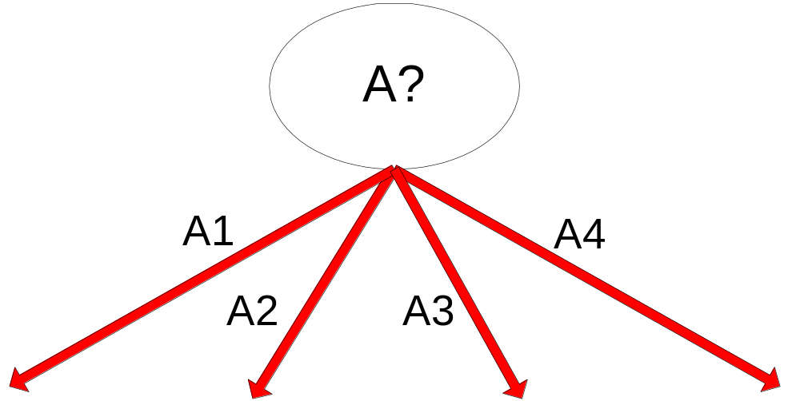
Example of Post-Pruning
Training Error (Before splitting) = 10/30
Pessimistic error = (10 + 0.5)/30 = 10.5/30
Training Error (After splitting) = 9/30
Pessimistic error (After splitting)
= (9 + 4 × 0.5)/30 = 11/30
PRUNE!
Class = Yes | 20
Class = No | 10
Error = 10/30
Class = Yes | 8
Class = No | 4
Class = Yes | 3
Class = No | 4
Class = Yes | 4
Class = No | 1
Class = Yes | 5
Class = No | 1

Slide 22
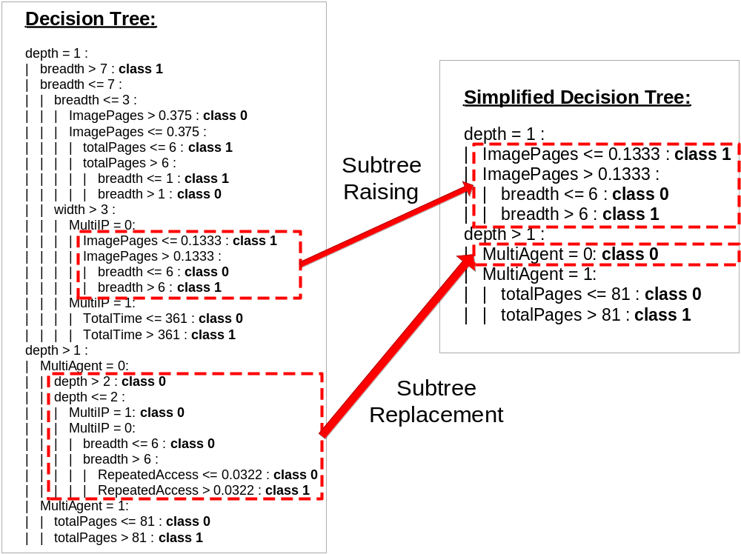
Examples of Post-pruning

Slide 23
Evaluating Performance of Classifier
Model Selection
  Performed during model building
  Purpose is to ensure that model is not overly complex (to avoid overfitting)
  Need to estimate generalization error
Model Evaluation
  Performed after model has been constructed
  Purpose is to estimate performance of classifier on previously unseen data (e.g., test set)

Slide 24
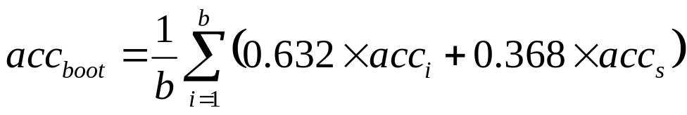
Methods for Classifier Evaluation
Holdout
  Reserve k% for training and (100-k)% for testing
Random subsampling
  Repeated holdout
Cross validation
  Partition data into k disjoint subsets
  k-fold: train on k-1 partitions, test on the remaining one
  Leave-one-out: k=n
Bootstrap
  Sampling with replacement
  .632 bootstrap:

