Slide 1
Data Mining
Classification: Alternative Techniques
Imbalanced Class Problem

Slide 2
Class Imbalance Problem
Lots of classification problems where the classes are skewed (more records from one class than another)
  Credit card fraud
  Intrusion detection
  Defective products in manufacturing assembly line

Slide 3
Challenges
Evaluation measures such as accuracy is not well-suited for imbalanced class
Detecting the rare class is like finding needle in a haystack

Slide 4
Confusion Matrix
Confusion Matrix:
 | PREDICTED CLASS
ACTUAL CLASS |  | Class=Yes | Class=No
 | Class=Yes | a | b
 | Class=No | c | d
a: TP (true positive)
b: FN (false negative)
c: FP (false positive)
d: TN (true negative)

Slide 5
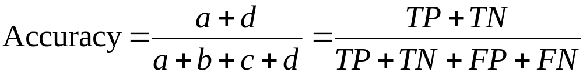
Accuracy
Most widely-used metric:
 | PREDICTED CLASS
ACTUAL CLASS |  | Class=Yes | Class=No
 | Class=Yes | a (TP) | b (FN)
 | Class=No | c (FP) | d (TN)

Slide 6
Problem with Accuracy
Consider a 2-class problem
  Number of Class 0 examples = 9990
  Number of Class 1 examples = 10
If a model predicts everything to be class 0, accuracy is 9990/10000 = 99.9 %
  This is misleading because the model does not detect any class 1 example
  Detecting the rare class is usually more interesting (e.g., frauds, intrusions, defects, etc)

Slide 7
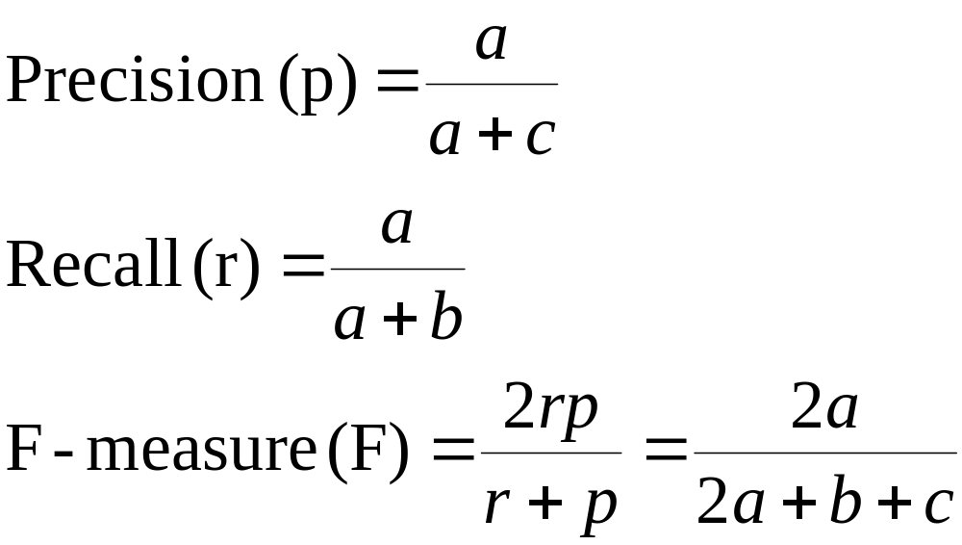
Alternative Measures
 | PREDICTED CLASS
ACTUAL CLASS |  | Class=Yes | Class=No
 | Class=Yes | a | b
 | Class=No | c | d

Slide 8
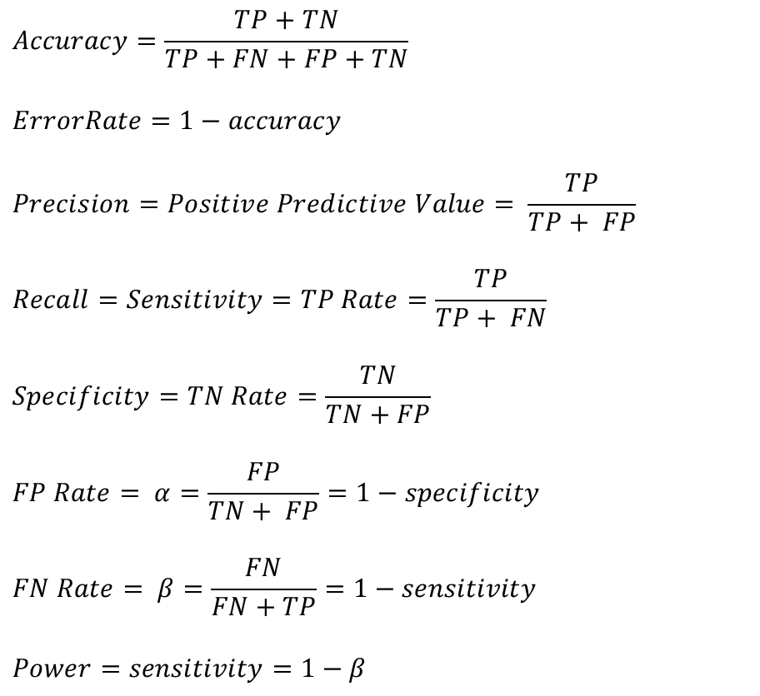
Measures of Classification Performance
 | PREDICTED CLASS
ACTUAL CLASS |  | Yes | No
 | Yes | TP | FN
 | No | FP | TN
α is the probability that we reject the null hypothesis when it is true. This is a Type I error or a false positive (FP).
β is the probability that we accept the null hypothesis when it is false. This is a Type II error or a false negative (FN).

Slide 9
ROC (Receiver Operating Characteristic)
A graphical approach for displaying trade-off between detection rate and false alarm rate
Developed in 1950s for signal detection theory to analyze noisy signals
ROC curve plots TPR against FPR
  Performance of a model represented as a point in an ROC curve
  Changing the threshold parameter of classifier changes the location of the point

Slide 10
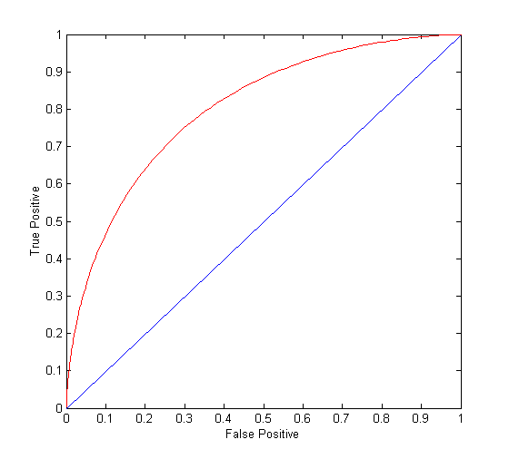
ROC Curve
(TPR,FPR):
(0,0): declare everything
to be negative class
(1,1): declare everything
to be positive class
(1,0): ideal
Diagonal line:
  Random guessing
  Below diagonal line:
    prediction is opposite of the true class

Slide 11
ROC (Receiver Operating Characteristic)
To draw ROC curve, classifier must produce continuous-valued output
  Outputs are used to rank test records, from the most likely positive class record to the least likely positive class record
Many classifiers produce only discrete outputs (i.e., predicted class)
  How to get continuous-valued outputs?
    Decision trees, rule-based classifiers, neural networks, Bayesian classifiers, k-nearest neighbors, SVM

Slide 12
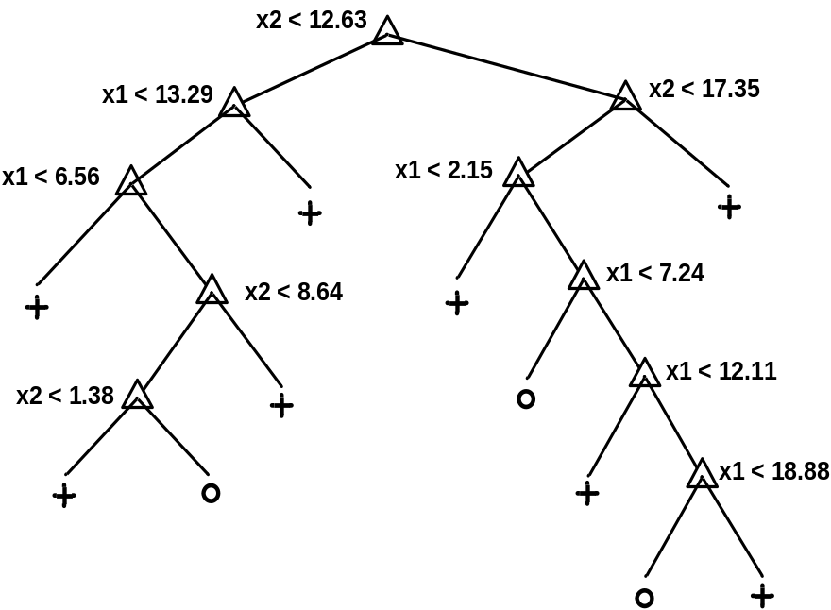
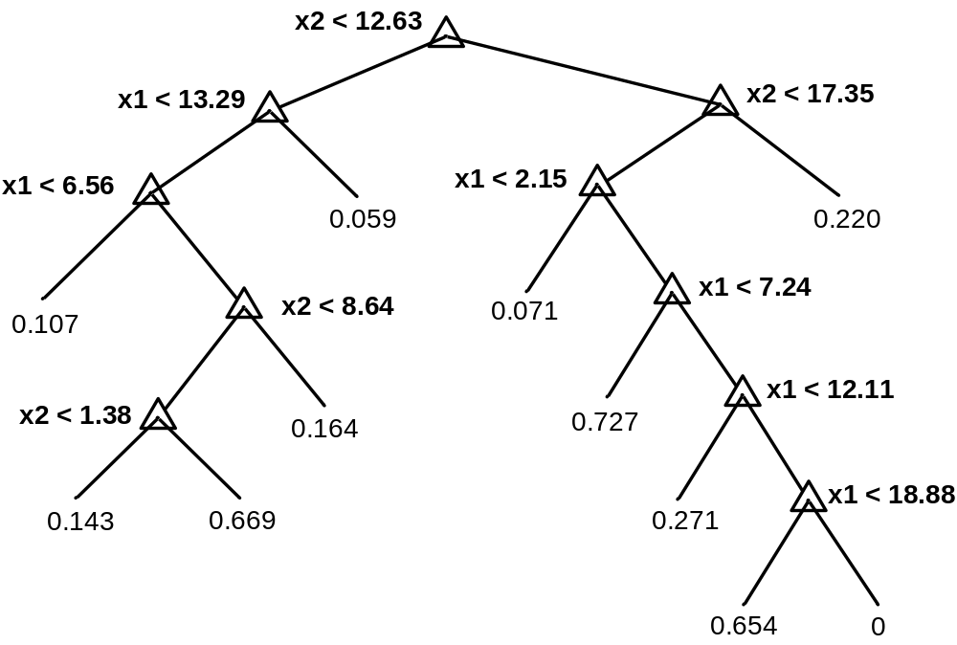
Example: Decision Trees
Decision Tree
Continuous-valued outputs

Slide 13
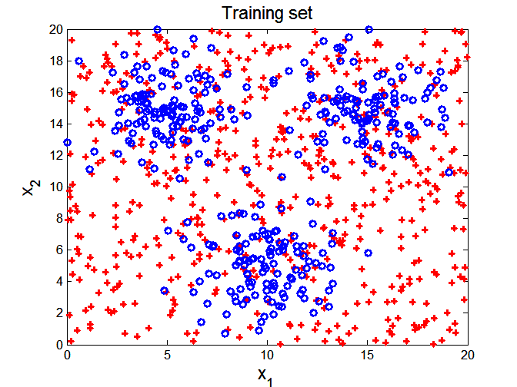

ROC Curve Example

Slide 14
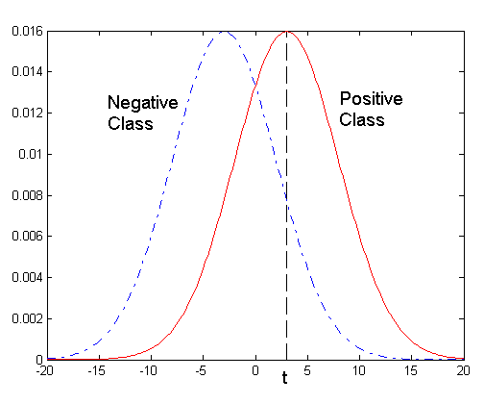
ROC Curve Example
- 1-dimensional data set containing 2 classes (positive and negative)
- Any points located at x > t is classified as positive
At threshold t:
TPR=0.5, FNR=0.5, FPR=0.12, FNR=0.88

Slide 15
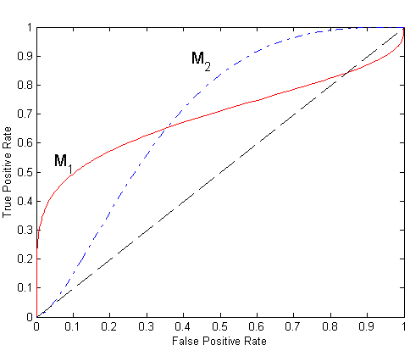
Using ROC for Model Comparison
No model consistently outperform the other
  M₁ is better for small FPR
  M₂ is better for large FPR
Area Under the ROC curve
  Ideal:
    Area = 1
  Random guess:
    Area = 0.5

Slide 16
How to Construct an ROC curve
Use classifier that produces continuous-valued output for each test instance score(+|A)
Sort the instances according to score(+|A) in decreasing order
Apply threshold at each unique value of score(+|A)
Count the number of TP, FP,
TN, FN at each threshold
  TPR = TP/(TP+FN)
  FPR = FP/(FP + TN)
Instance | score(+|A) | True Class
1 | 0.95 | +
2 | 0.93 | +
3 | 0.87 | -
4 | 0.85 | -
5 | 0.85 | -
6 | 0.85 | +
7 | 0.76 | -
8 | 0.53 | +
9 | 0.43 | -
10 | 0.25 | +

Slide 17
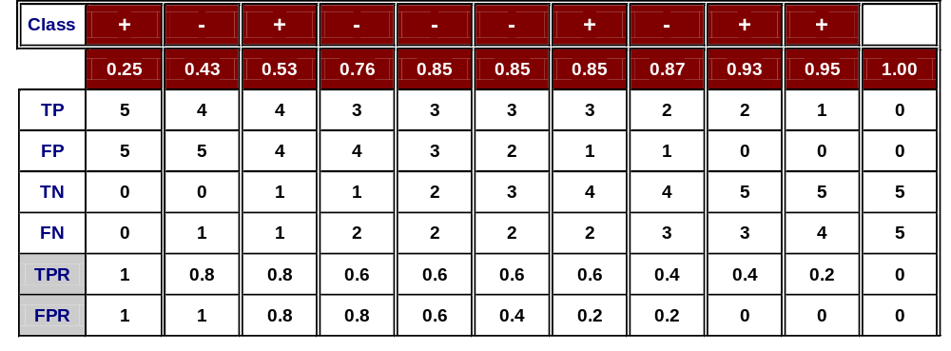
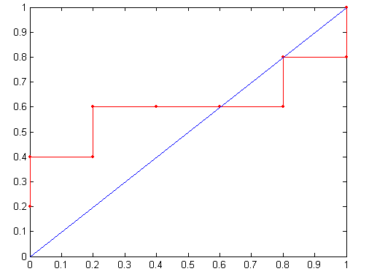
How to construct an ROC curve
Threshold >=
ROC Curve:

Slide 18
Handling Class Imbalanced Problem
Class-based ordering (e.g. RIPPER)
  Rules for rare class have higher priority
Cost-sensitive classification
  Misclassifying rare class as majority class is more expensive than misclassifying majority as rare class
Sampling-based approaches

Slide 19
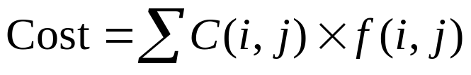
Cost Matrix
 | PREDICTED CLASS
ACTUAL CLASS |  | Class=Yes | Class=No
 | Class=Yes | f(Yes, Yes) | f(Yes,No)
 | Class=No | f(No, Yes) | f(No, No)
C(i,j): Cost of misclassifying class i example as class j
Cost Matrix | PREDICTED CLASS
ACTUAL CLASS | C(i, j) | Class=Yes | Class=No
 | Class=Yes | C(Yes, Yes) | C(Yes, No)
 | Class=No | C(No, Yes) | C(No, No)

Slide 20
Computing Cost of Classification
Cost Matrix | PREDICTED CLASS
ACTUAL CLASS | C(i,j) | + | -
 | + | -1 | 100
 | - | 1 | 0
Model M₁ | PREDICTED CLASS
ACTUAL CLASS |  | + | -
 | + | 150 | 40
 | - | 60 | 250
Model M₂ | PREDICTED CLASS
ACTUAL CLASS |  | + | -
 | + | 250 | 45
 | - | 5 | 200
Accuracy = 80%
Cost = 3910
Accuracy = 90%
Cost = 4255

Slide 21
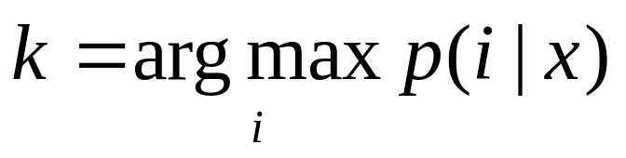
Cost Sensitive Classification
Example: Bayesian classifer
  Given a test record x:
    Compute p(i|x) for each class i
    Decision rule: classify node as class k if
  For 2-class, classify x as + if p(+|x) > p(-|x)
    This decision rule implicitly assumes that
    C(+|+) = C(-|-) = 0 and C(+|-) = C(-|+)

Slide 22
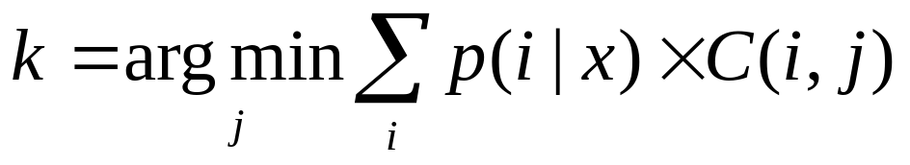
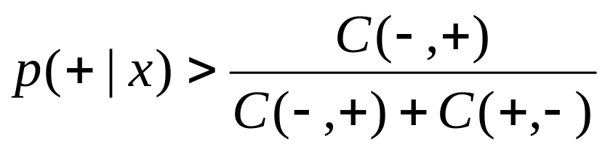
Cost Sensitive Classification
General decision rule:
  Classify test record x as class k if
2-class:
  Cost(+) = p(+|x) C(+,+) + p(-|x) C(-,+)
  Cost(-) = p(+|x) C(+,-) + p(-|x) C(-,-)
  Decision rule: classify x as + if Cost(+) < Cost(-)
    if C(+,+) = C(-,-) = 0:

Slide 23
Sampling-based Approaches
Modify the distribution of training data so that rare class is well-represented in training set
  Undersample the majority class
  Oversample the rare class
Advantages and disadvantages

