Slide 1
Data Mining
Classification: Basic Concepts, Decision Trees, and Model Evaluation
Lecture Notes for Chapter 4
Introduction to Data Mining
by
Tan, Steinbach, Kumar
© Tan,Steinbach, Kumar Introduction to Data Mining 4/18/2004 <number>

Slide 2
Classification: Definition
Given a collection of records (training set )
  Each record is by characterized by a tuple (x,y), where x is the attribute set and y is the class label
    x: attribute, predictor, independent variable, input
    y: class, response, dependent variable, output
Task:
  Learn a model that maps each attribute set x into one of the predefined class labels y

Slide 3
Examples of Classification Task
Task | Attribute set, x | Class label, y
Categorizing email messages | Features extracted from email message header and content | spam or non-spam
Identifying tumor cells | Features extracted from MRI scans | malignant or benign cells
Cataloging galaxies | Features extracted from telescope images | Elliptical, spiral, or irregular-shaped galaxies

Slide 4

General Approach for Building Classification Model

Slide 5
Classification Techniques
Base Classifiers
  Decision Tree based Methods
  Rule-based Methods
  Nearest-neighbor
  Neural Networks
  Naïve Bayes and Bayesian Belief Networks
  Support Vector Machines
Ensemble Classifiers
  Boosting, Bagging, Random Forests

Slide 6
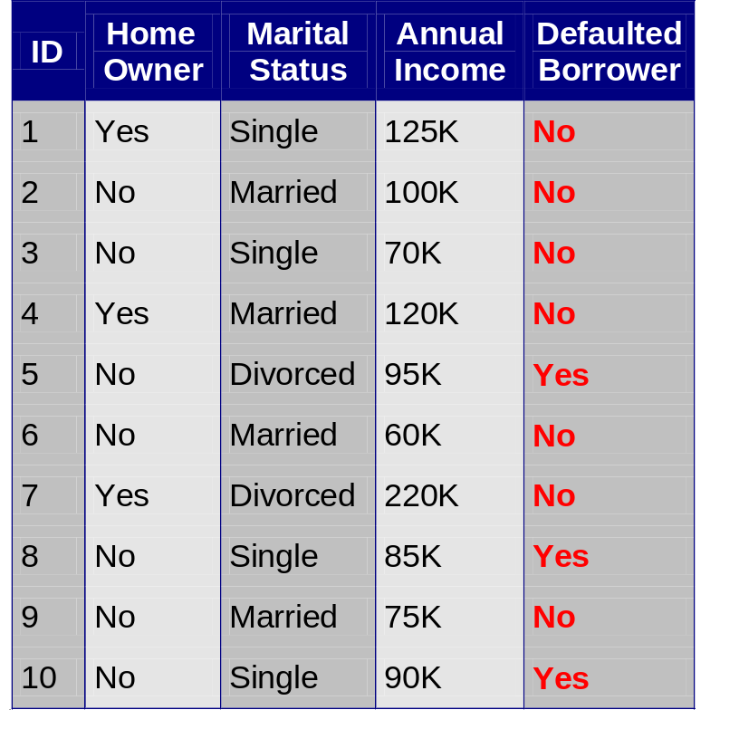
Example of a Decision Tree
categorical
categorical
continuous
class
Splitting Attributes
Home Owner
Yes
No
NO
MarSt
Single, Divorced
Married
Income
NO
< 80K
> 80K
NO
YES
Training Data
Model: Decision Tree

Slide 7
Another Example of Decision Tree
categorical
categorical
continuous
class
Single, Divorced
MarSt
Married
NO
Home Owner
Yes
No
NO
Income
< 80K
> 80K
NO
YES
There could be more than one tree that fits the same data!

Slide 8

Decision Tree Classification Task
Decision Tree

Slide 9
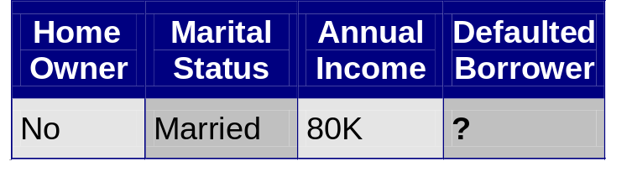
Apply Model to Test Data
Test Data
Start from the root of tree.
Home Owner
Yes
No
NO
MarSt
Single, Divorced
Married
Income
NO
< 80K
> 80K
NO
YES

Slide 10
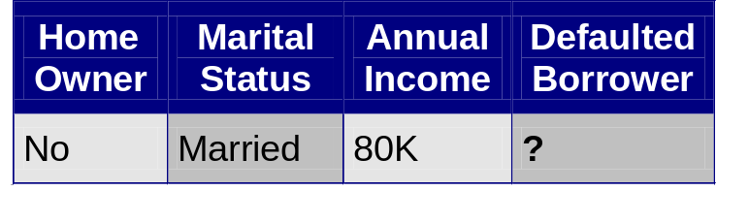
Apply Model to Test Data
Test Data
Home Owner
Yes
No
NO
MarSt
Single, Divorced
Married
Income
NO
< 80K
> 80K
NO
YES

Slide 11
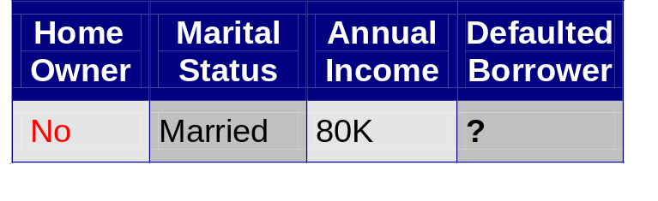
Apply Model to Test Data
Test Data
Home Owner
Yes
No
NO
MarSt
Single, Divorced
Married
Income
NO
< 80K
> 80K
NO
YES

Slide 12
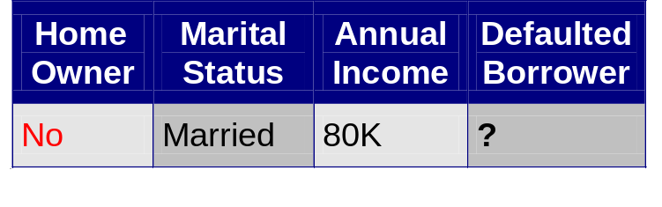
Apply Model to Test Data
Test Data
Home Owner
Yes
No
NO
MarSt
Single, Divorced
Married
Income
NO
< 80K
> 80K
NO
YES

Slide 13
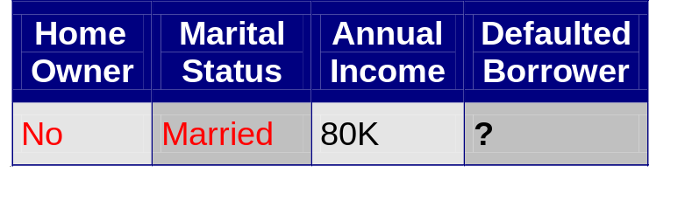
Apply Model to Test Data
Test Data
Home Owner
Yes
No
NO
MarSt
Single, Divorced
Married
Income
NO
< 80K
> 80K
NO
YES

Slide 14
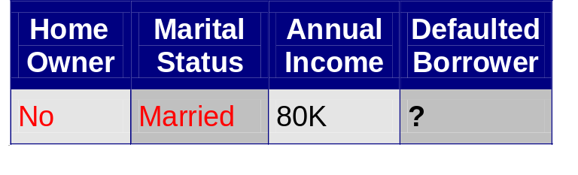
Apply Model to Test Data
Test Data
Home Owner
Yes
No
NO
MarSt
Single, Divorced
Married
Assign Defaulted to “No”
Income
NO
< 80K
> 80K
NO
YES

Slide 15

Decision Tree Classification Task
Decision Tree

Slide 16
Decision Tree Induction
Many Algorithms:
  Hunt’s Algorithm (one of the earliest)
  CART
  ID3, C4.5
  SLIQ,SPRINT

Slide 17
General Structure of Hunt’s Algorithm
Let D_{t} be the set of training records that reach a node t
General Procedure:
  If D_{t} contains records that belong the same class y_{t}, then t is a leaf node labeled as y_{t}
  If D_{t} contains records that belong to more than one class, use an attribute test to split the data into smaller subsets. Recursively apply the procedure to each subset.
D_{t}
?

Slide 18
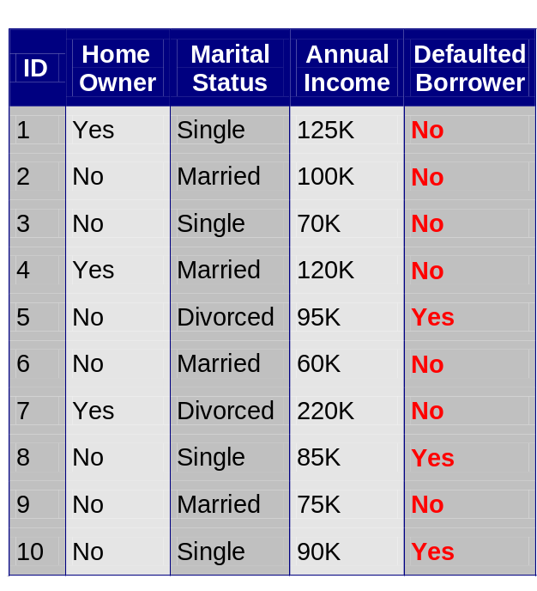
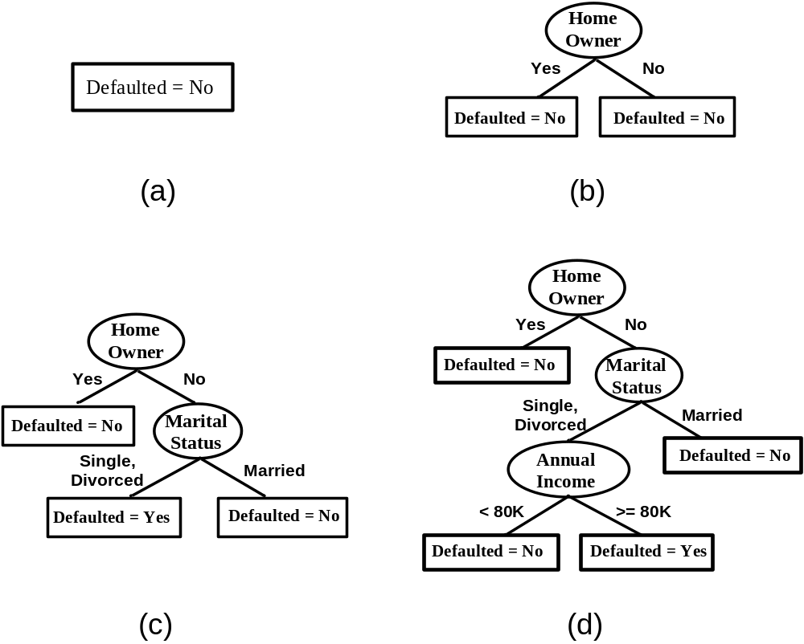
Hunt’s Algorithm

Slide 19
Design Issues of Decision Tree Induction
How should training records be split?
  Method for specifying test condition
    depending on attribute types
  Measure for evaluating the goodness of a test condition
How should the splitting procedure stop?
  Stop splitting if all the records belong to the same class or have identical attribute values
  Early termination

Slide 20
Methods for Expressing Test Conditions
Depends on attribute types
  Binary
  Nominal
  Ordinal
  Continuous
Depends on number of ways to split
  2-way split
  Multi-way split

Slide 21
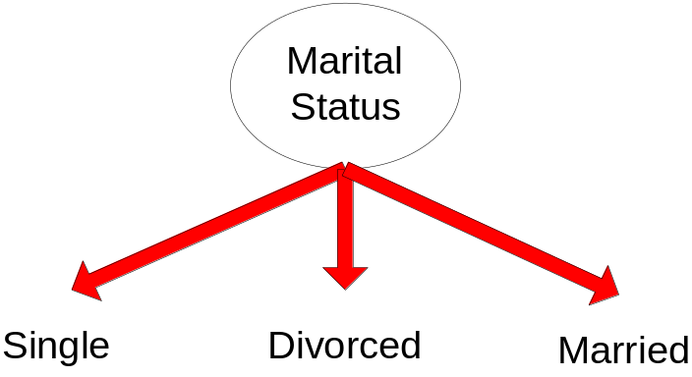
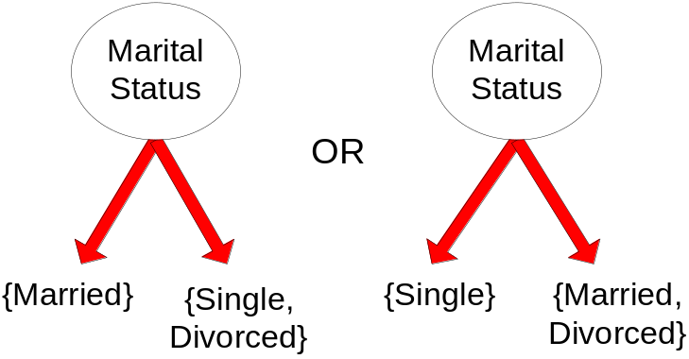
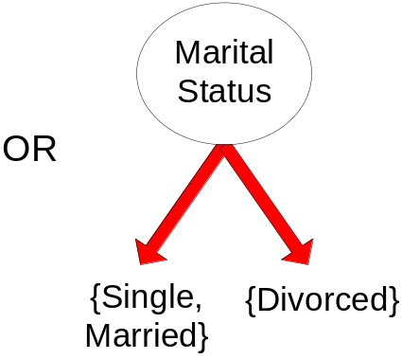
Test Condition for Nominal Attributes
Multi-way split:
  Use as many partitions as distinct values.
Binary split:
  Divides values into two subsets
  Need to find optimal
  partitioning.

Slide 22
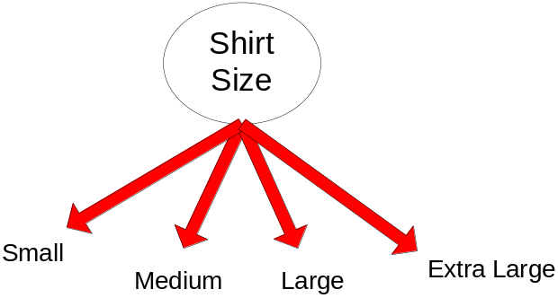
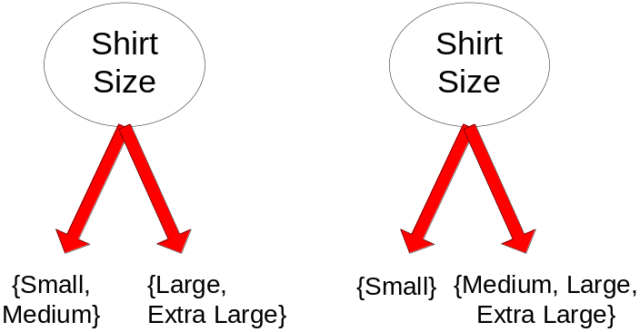
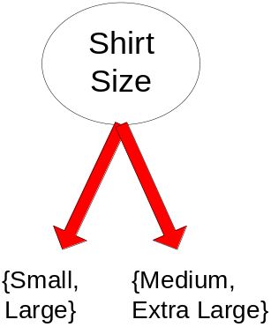
Test Condition for Ordinal Attributes
Multi-way split:
  Use as many partitions as distinct values
Binary split:
  Divides values into two subsets
  Need to find optimal partitioning
  Preserve order property among attribute values
This grouping violates order property

Slide 23
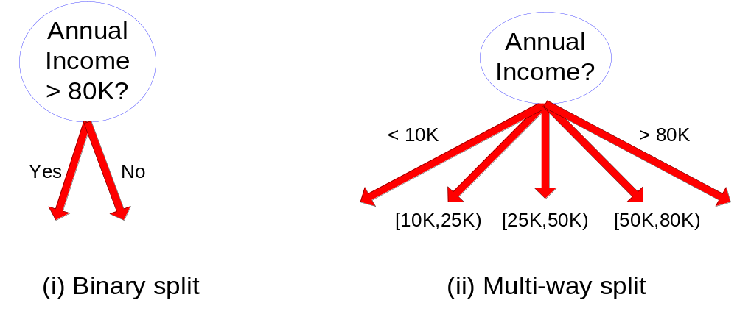
Test Condition for Continuous Attributes

Slide 24
Splitting Based on Continuous Attributes
Different ways of handling
  Discretization to form an ordinal categorical attribute
    Static – discretize once at the beginning
    Dynamic – ranges can be found by equal interval bucketing, equal frequency bucketing
    (percentiles), or clustering.
  Binary Decision: (A < v) or (A ≥ v)
    consider all possible splits and finds the best cut
    can be more compute intensive

Slide 25
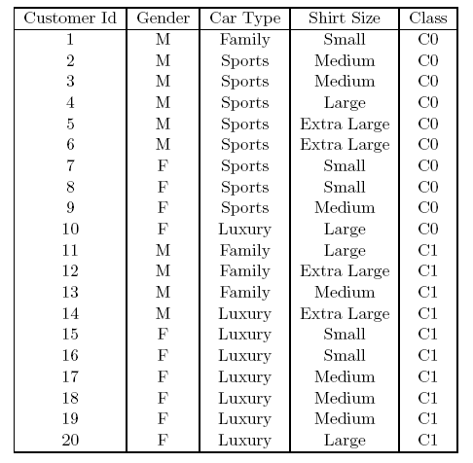
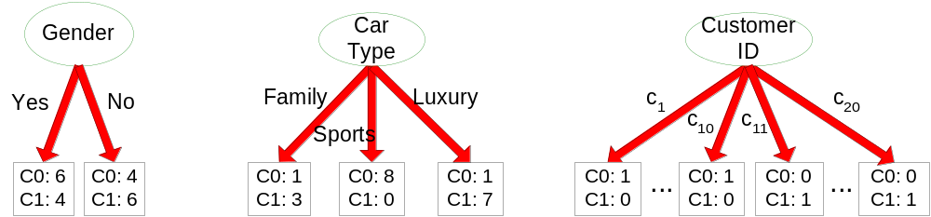
How to determine the Best Split
Before Splitting: 10 records of class 0,
10 records of class 1
Which test condition is the best?

Slide 26


How to determine the Best Split
Greedy approach:
  Nodes with purer class distribution are preferred
Need a measure of node impurity:
High degree of impurity
Low degree of impurity

Slide 27
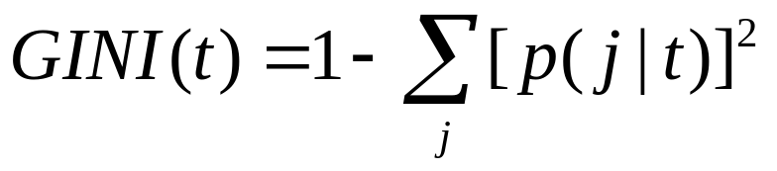


Measures of Node Impurity
Gini Index
Entropy
Misclassification error

Slide 28
Finding the Best Split
Compute impurity measure (P) before splitting
Compute impurity measure (M) after splitting
    Compute impurity measure of each child node
    Compute the average impurity of the children (M)
Choose the attribute test condition that produces the highest gain
or equivalently, lowest impurity measure after splitting (M)
Gain = P – M

Slide 29



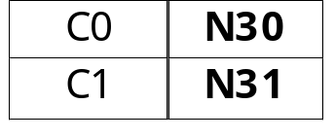

Finding the Best Split
Before Splitting:
P
A?
B?
Yes
No
Yes
No
Node N1
Node N2
Node N3
Node N4
M11
M12
M21
M22
M1
M2
Gain = P – M1 vs P – M2

Slide 30




Measure of Impurity: GINI
Gini Index for a given node t :
    (NOTE: p( j | t) is the relative frequency of class j at node t).
  Maximum (1 - 1/n_{c}) when records are equally distributed among all classes, implying least interesting information
  Minimum (0.0) when all records belong to one class, implying most interesting information

Slide 31



Computing Gini Index of a Single Node
P(C1) = 0/6 = 0 P(C2) = 6/6 = 1
Gini = 1 – P(C1)² – P(C2)² = 1 – 0 – 1 = 0
P(C1) = 1/6 P(C2) = 5/6
Gini = 1 – (1/6)² – (5/6)² = 0.278
P(C1) = 2/6 P(C2) = 4/6
Gini = 1 – (2/6)² – (4/6)² = 0.444

Slide 32

Computing Gini Index for a Collection of Nodes
When a node p is split into k partitions (children)
where, n_{i} = number of records at child i,
n = number of records at parent node p.
Choose the attribute that minimizes weighted average Gini index of the children
Gini index is used in decision tree algorithms such as CART, SLIQ, SPRINT

Slide 33

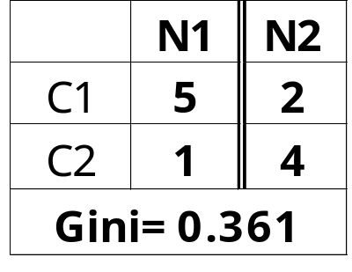
Binary Attributes: Computing GINI Index
Splits into two partitions
Effect of Weighing partitions:
  Larger and Purer Partitions are sought for.
B?
Yes
No
Node N1
Node N2
Gini(N1)
= 1 – (5/6)² – (1/6)²
= 0.278
Gini(N2)
= 1 – (2/6)² – (4/6)²
= 0.444
Gini(Children)
= 6/12 * 0.278 +
6/12 * 0.444
= 0.361

Slide 34
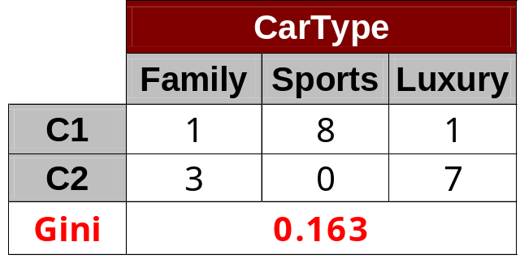
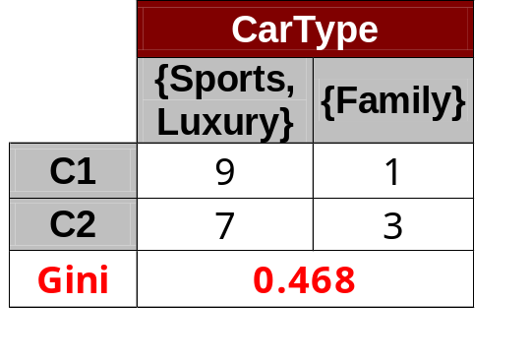
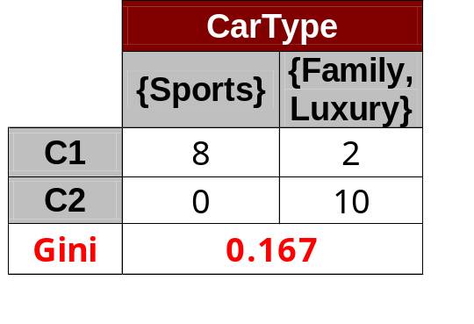
Categorical Attributes: Computing Gini Index
For each distinct value, gather counts for each class in the dataset
Use the count matrix to make decisions
Multi-way split
Two-way split
(find best partition of values)

Slide 35
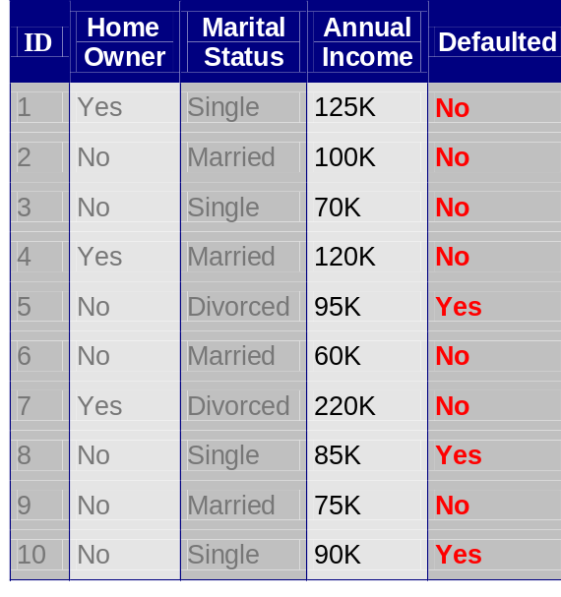
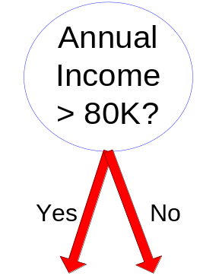
Continuous Attributes: Computing Gini Index
Use Binary Decisions based on one value
Several Choices for the splitting value
  Number of possible splitting values
  = Number of distinct values
Each splitting value has a count matrix associated with it
  Class counts in each of the partitions, A < v and A ≥ v
Simple method to choose best v
  For each v, scan the database to gather count matrix and compute its Gini index
  Computationally Inefficient! Repetition of work.

Slide 36
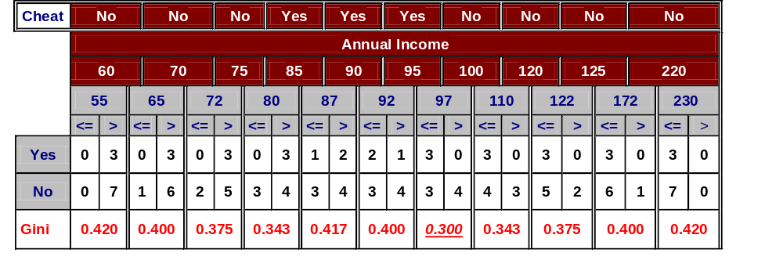
Continuous Attributes: Computing Gini Index...
For efficient computation: for each attribute,
  Sort the attribute on values
  Linearly scan these values, each time updating the count matrix and computing gini index
  Choose the split position that has the least gini index
Sorted Values
Split Positions

Slide 37
Measure of Impurity: Entropy
Entropy at a given node t:
    (NOTE: p( j | t) is the relative frequency of class j at node t).
    Maximum (log n_{c}) when records are equally distributed among all classes implying least information
    Minimum (0.0) when all records belong to one class, implying most information
  Entropy based computations are quite similar to the GINI index computations

Slide 38

Computing Entropy of a Single Node
P(C1) = 0/6 = 0 P(C2) = 6/6 = 1
Entropy = – 0 log 0 – 1 log 1 = – 0 – 0 = 0
P(C1) = 1/6 P(C2) = 5/6
Entropy = – (1/6) log₂ (1/6) – (5/6) log₂ (1/6) = 0.65
P(C1) = 2/6 P(C2) = 4/6
Entropy = – (2/6) log₂ (2/6) – (4/6) log₂ (4/6) = 0.92

Slide 39

Computing Information Gain After Splitting
Information Gain:
    Parent Node, p is split into k partitions;
    n_{i} is number of records in partition i
  Choose the split that achieves most reduction (maximizes GAIN)
  Used in the ID3 and C4.5 decision tree algorithms

Slide 40
Problems with Information Gain
Info Gain tends to prefer splits that result in large number of partitions, each being small but pure
  Customer ID has highest information gain because entropy for all the children is zero

Slide 41


Gain Ratio
Gain Ratio:
    Parent Node, p is split into k partitions
    n_{i} is the number of records in partition i
  Adjusts Information Gain by the entropy of the partitioning (SplitINFO).
    Higher entropy partitioning (large number of small partitions) is penalized!
  Used in C4.5 algorithm
  Designed to overcome the disadvantage of Information Gain

Slide 42
Measure of Impurity: Classification Error
Classification error at a node t :
  Maximum (1 - 1/n_{c}) when records are equally distributed among all classes, implying least interesting information
  Minimum (0) when all records belong to one class, implying most interesting information

Slide 43
Computing Error of a Single Node
P(C1) = 0/6 = 0 P(C2) = 6/6 = 1
Error = 1 – max (0, 1) = 1 – 1 = 0
P(C1) = 1/6 P(C2) = 5/6
Error = 1 – max (1/6, 5/6) = 1 – 5/6 = 1/6
P(C1) = 2/6 P(C2) = 4/6
Error = 1 – max (2/6, 4/6) = 1 – 4/6 = 1/3

Slide 44

Comparison among Impurity Measures
For a 2-class problem:

Slide 45

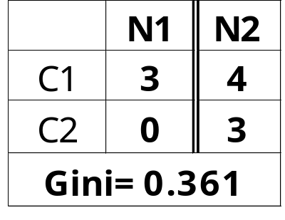
Misclassification Error vs Gini Index
A?
Yes
No
Node N1
Node N2
Gini(N1)
= 1 – (3/3)² – (0/3)²
= 0
Gini(N2)
= 1 – (4/7)² – (3/7)²
= 0.489
Gini(Children)
= 3/10 * 0
+ 7/10 * 0.489
= 0.342
Gini improves but error remains the same!!

Slide 46
Decision Tree Based Classification
Advantages:
  Inexpensive to construct
  Extremely fast at classifying unknown records
  Easy to interpret for small-sized trees
  Accuracy is comparable to other classification techniques for many simple data sets

