Slide 1
Data Mining
Association Analysis: Basic Concepts and Algorithms
Lecture Notes for Chapter 6
Introduction to Data Mining
by
Tan, Steinbach, Kumar
© Tan,Steinbach, Kumar Introduction to Data Mining 10/19/2011 <number>

Slide 2
Data Mining
Association Analysis: Basic Concepts and Algorithms
Basic Concepts
© Tan,Steinbach, Kumar Introduction to Data Mining 10/19/2011 <number>

Slide 3

Association Rule Mining
Given a set of transactions, find rules that will predict the occurrence of an item based on the occurrences of other items in the transaction
Market-Basket transactions
Example of Association Rules
{Diaper} → {Beer},
{Milk, Bread} → {Eggs,Coke},
{Beer, Bread} → {Milk},
Implication means co-occurrence, not causality!

Slide 4

Definition: Frequent Itemset
Itemset
  A collection of one or more items
    Example: {Milk, Bread, Diaper}
  k-itemset
    An itemset that contains k items
Support count (σ)
  Frequency of occurrence of an itemset
  E.g. σ({Milk, Bread,Diaper}) = 2
Support
  Fraction of transactions that contain an itemset
  E.g. s({Milk, Bread, Diaper}) = 2/5
Frequent Itemset
  An itemset whose support is greater than or equal to a minsup threshold

Slide 5

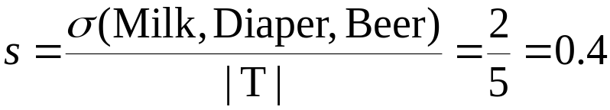

Definition: Association Rule
Association Rule
  An implication expression of the form X → Y, where X and Y are itemsets
  Example:
  {Milk, Diaper} → {Beer}
Rule Evaluation Metrics
  Support (s)
    Fraction of transactions that contain both X and Y
  Confidence (c)
    Measures how often items in Y
    appear in transactions that
    contain X
Example:

Slide 6
Association Rule Mining Task
Given a set of transactions T, the goal of association rule mining is to find all rules having
  support ≥ minsup threshold
  confidence ≥ minconf threshold
Brute-force approach:
  List all possible association rules
  Compute the support and confidence for each rule
  Prune rules that fail the minsup and minconf thresholds
  ⇒ Computationally prohibitive!

Slide 7
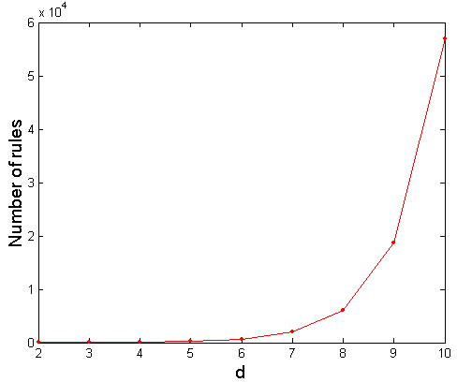
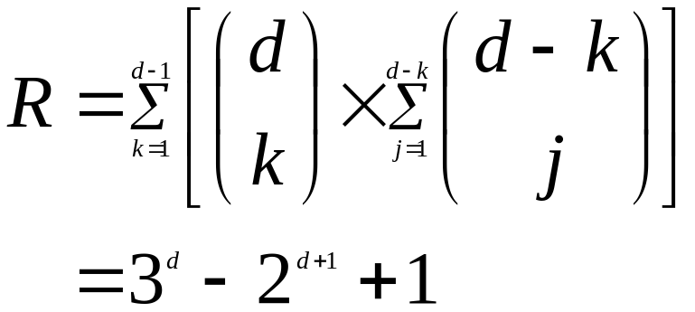
Computational Complexity
Given d unique items:
  Total number of itemsets = 2^{d}
  Total number of possible association rules:
If d=6, R = 602 rules

Slide 8
Mining Association Rules
Example of Rules:
{Milk,Diaper} → {Beer} (s=0.4, c=0.67)
{Milk,Beer} → {Diaper} (s=0.4, c=1.0)
{Diaper,Beer} → {Milk} (s=0.4, c=0.67)
{Beer} → {Milk,Diaper} (s=0.4, c=0.67)
{Diaper} → {Milk,Beer} (s=0.4, c=0.5)
{Milk} → {Diaper,Beer} (s=0.4, c=0.5)
Observations:
All the above rules are binary partitions of the same itemset:
{Milk, Diaper, Beer}
Rules originating from the same itemset have identical support but
can have different confidence
Thus, we may decouple the support and confidence requirements

Slide 9
Mining Association Rules
Two-step approach:
  Frequent Itemset Generation
    Generate all itemsets whose support ≥ minsup
  Rule Generation
    Generate high confidence rules from each frequent itemset, where each rule is a binary partitioning of a frequent itemset
Frequent itemset generation is still computationally expensive

Slide 10

Frequent Itemset Generation
Given d items, there are 2^{d} possible candidate itemsets

Slide 11

Frequent Itemset Generation
Brute-force approach:
  Each itemset in the lattice is a candidate frequent itemset
  Count the support of each candidate by scanning the database
  Match each transaction against every candidate
  Complexity ~ O(NMw) => Expensive since M = 2^{d} !!!

Slide 12
Frequent Itemset Generation Strategies
Reduce the number of candidates (M)
  Complete search: M=2^{d}
  Use pruning techniques to reduce M
Reduce the number of transactions (N)
  Reduce size of N as the size of itemset increases
  Used by DHP and vertical-based mining algorithms
Reduce the number of comparisons (NM)
  Use efficient data structures to store the candidates or transactions
  No need to match every candidate against every transaction

Slide 13
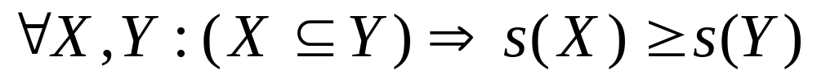
Reducing Number of Candidates
Apriori principle:
  If an itemset is frequent, then all of its subsets must also be frequent
Apriori principle holds due to the following property of the support measure:
  Support of an itemset never exceeds the support of its subsets
  This is known as the anti-monotone property of support

Slide 14


Illustrating Apriori Principle
Found to be Infrequent
Pruned supersets

Slide 15

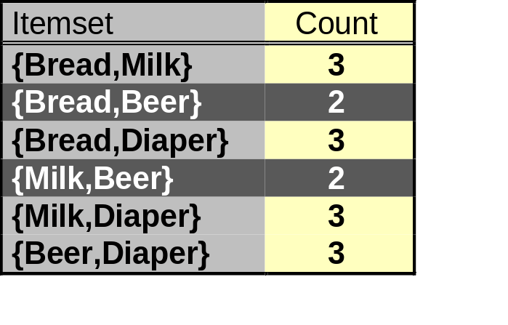
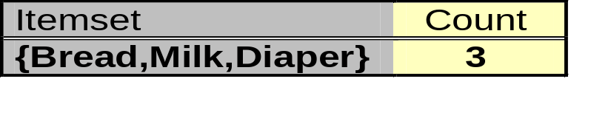
Illustrating Apriori Principle
Items (1-itemsets)
Pairs (2-itemsets)
(No need to generate
candidates involving Coke
or Eggs)
Minimum Support = 3
Triplets (3-itemsets)
If every subset is considered,
⁶C₁ + ⁶C₂ + ⁶C₃ = 41
With support-based pruning,
6 + 6 + 1 = 13

Slide 16
Apriori Algorithm
Method:
  Let k=1
  Generate frequent itemsets of length 1
  Repeat until no new frequent itemsets are identified
    Generate length (k+1) candidate itemsets from length k frequent itemsets
    Prune candidate itemsets containing subsets of length k that are infrequent
    Count the support of each candidate by scanning the DB
    Eliminate candidates that are infrequent, leaving only those that are frequent

Slide 17
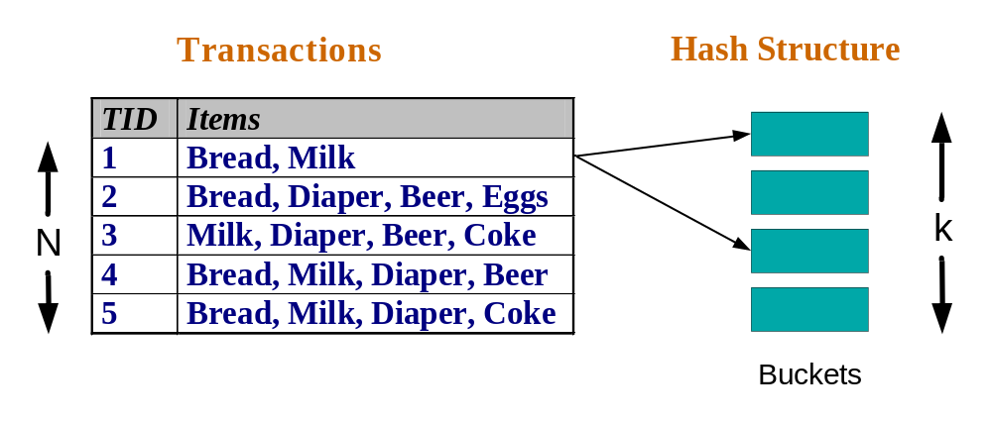
Reducing Number of Comparisons
Candidate counting:
  Scan the database of transactions to determine the support of each candidate itemset
  To reduce the number of comparisons, store the candidates in a hash structure
    Instead of matching each transaction against every candidate, match it against candidates contained in the hashed buckets

Slide 18
Generate Hash Tree
Suppose you have 15 candidate itemsets of length 3:
{1 4 5}, {1 2 4}, {4 5 7}, {1 2 5}, {4 5 8}, {1 5 9}, {1 3 6}, {2 3 4}, {5 6 7}, {3 4 5}, {3 5 6}, {3 5 7}, {6 8 9}, {3 6 7}, {3 6 8}
You need:
Hash function
Max leaf size: max number of itemsets stored in a leaf node (if number of candidate itemsets exceeds max leaf size, split the node)
Hash function
2 3 4
5 6 7
3,6,9
1,4,7
1 4 5
3 4 5
3 5 6
3 5 7
6 8 9
3 6 7
3 6 8
1 3 6
2,5,8
1 2 4
4 5 7
1 2 5
4 5 8
1 5 9

Slide 19
Association Rule Discovery: Hash tree
Hash Function
Candidate Hash Tree
1,4,7
3,6,9
2,5,8
2 3 4
5 6 7
1 4 5
1 3 6
3 4 5
3 5 6
3 6 7
Hash on 1, 4 or 7
3 5 7
3 6 8
1 2 4
1 5 9
6 8 9
1 2 5
4 5 7
4 5 8

Slide 20
Association Rule Discovery: Hash tree
Hash Function
Candidate Hash Tree
1,4,7
3,6,9
2,5,8
2 3 4
5 6 7
1 4 5
1 3 6
3 4 5
3 5 6
3 6 7
Hash on 2, 5 or 8
3 5 7
3 6 8
1 2 4
1 5 9
6 8 9
1 2 5
4 5 7
4 5 8

Slide 21
Association Rule Discovery: Hash tree
Hash Function
Candidate Hash Tree
1,4,7
3,6,9
2,5,8
2 3 4
5 6 7
1 4 5
1 3 6
3 4 5
3 5 6
3 6 7
Hash on 3, 6 or 9
3 5 7
3 6 8
1 2 4
1 5 9
6 8 9
1 2 5
4 5 7
4 5 8

Slide 22
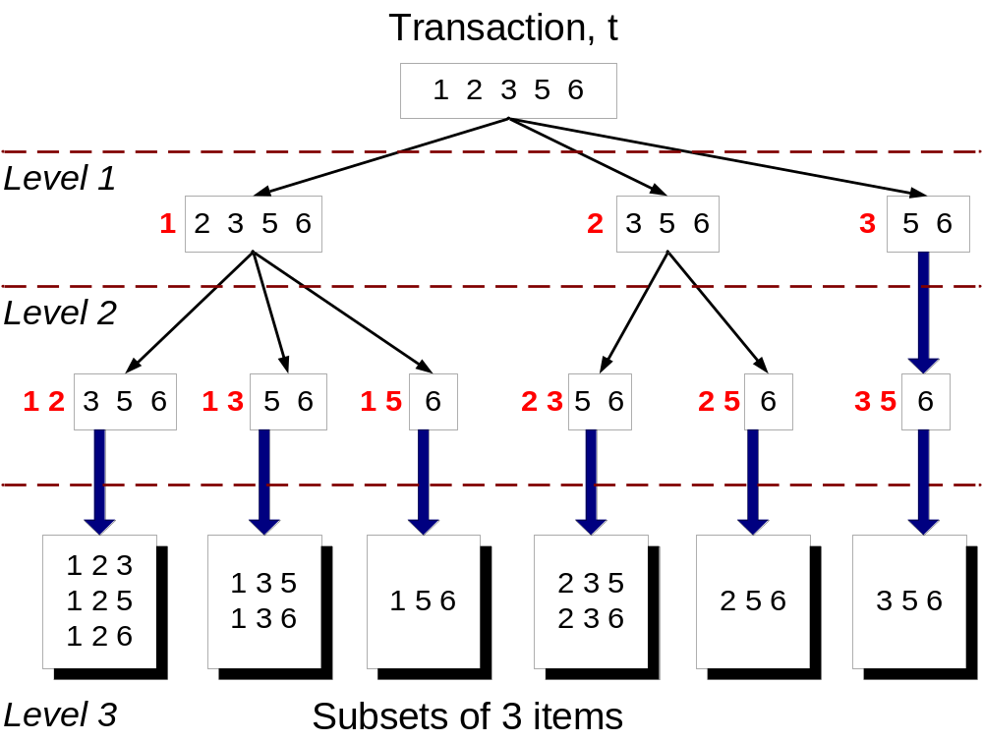
Subset Operation
Given a transaction t, what are the possible subsets of size 3?

Slide 23
Subset Operation Using Hash Tree
1 2 3 5 6
transaction
Hash Function
1 +
2 3 5 6
2 +
3 5 6
1,4,7
3,6,9
3 +
5 6
2,5,8
2 3 4
5 6 7
1 4 5
1 3 6
3 4 5
3 5 6
3 6 7
3 5 7
3 6 8
1 2 4
1 2 5
1 5 9
6 8 9
4 5 7
4 5 8

Slide 24
Subset Operation Using Hash Tree
1 2 3 5 6
transaction
Hash Function
1 +
2 3 5 6
2 +
3 5 6
1,4,7
3,6,9
1 2 +
3 5 6
3 +
5 6
2,5,8
1 3 +
5 6
2 3 4
1 5 +
6
5 6 7
1 4 5
1 3 6
3 4 5
3 5 6
3 6 7
3 5 7
3 6 8
1 2 4
1 2 5
1 5 9
6 8 9
4 5 7
4 5 8

Slide 25
Subset Operation Using Hash Tree
1 2 3 5 6
transaction
Hash Function
1 +
2 3 5 6
2 +
3 5 6
1,4,7
3,6,9
1 2 +
3 5 6
3 +
5 6
2,5,8
1 3 +
5 6
2 3 4
1 5 +
6
5 6 7
1 4 5
1 3 6
3 4 5
3 5 6
3 6 7
3 5 7
3 6 8
1 2 4
1 2 5
1 5 9
6 8 9
4 5 7
4 5 8
Match transaction against 11 out of 15 candidates

Slide 26
Data Mining
Association Analysis: Basic Concepts and Algorithms
Algorithms and Complexity
© Tan,Steinbach, Kumar Introduction to Data Mining 03/24/2006 <number>

Slide 27
Factors Affecting Complexity of Apriori
Choice of minimum support threshold
  lowering support threshold results in more frequent itemsets
  this may increase number of candidates and max length of frequent itemsets
Dimensionality (number of items) of the data set
  more space is needed to store support count of each item
  if number of frequent items also increases, both computation and I/O costs may also increase
Size of database
  since Apriori makes multiple passes, run time of algorithm may increase with number of transactions
Average transaction width
  transaction width increases with denser data sets
  This may increase max length of frequent itemsets and traversals of hash tree (number of subsets in a transaction increases with its width)

Slide 28
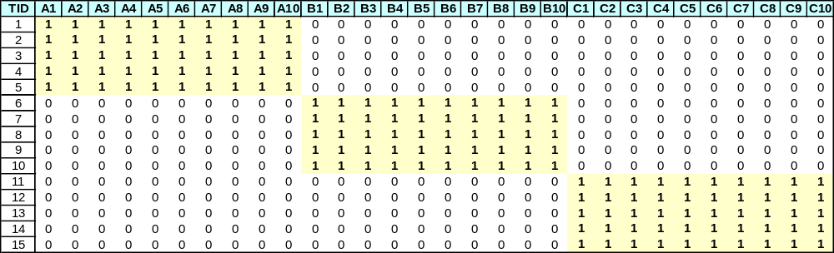
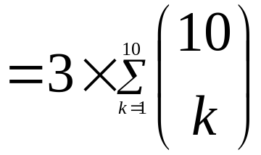
Compact Representation of Frequent Itemsets
Some itemsets are redundant because they have identical support as their supersets
Number of frequent itemsets
Need a compact representation

Slide 29
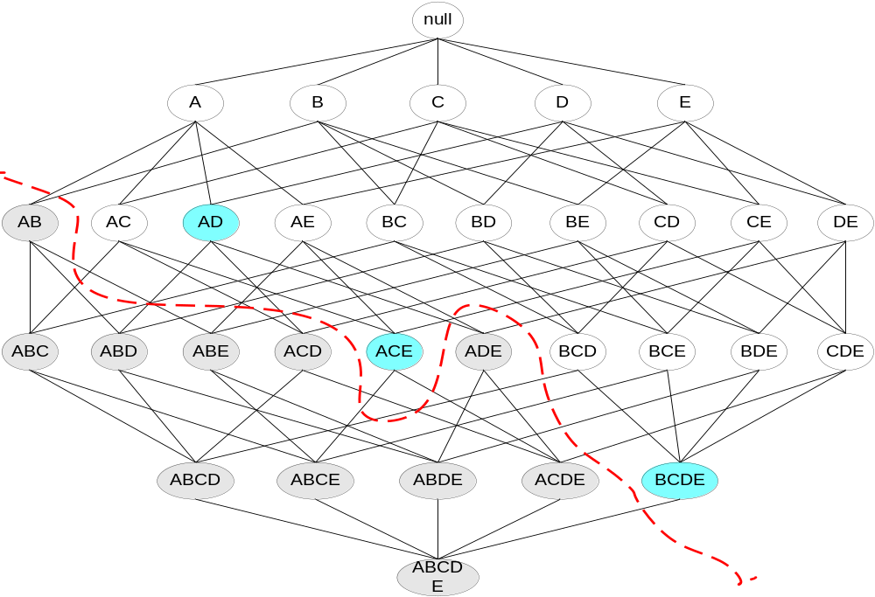
Maximal Frequent Itemset
An itemset is maximal frequent if none of its immediate supersets is frequent
Maximal Itemsets
Infrequent Itemsets
Border

Slide 30
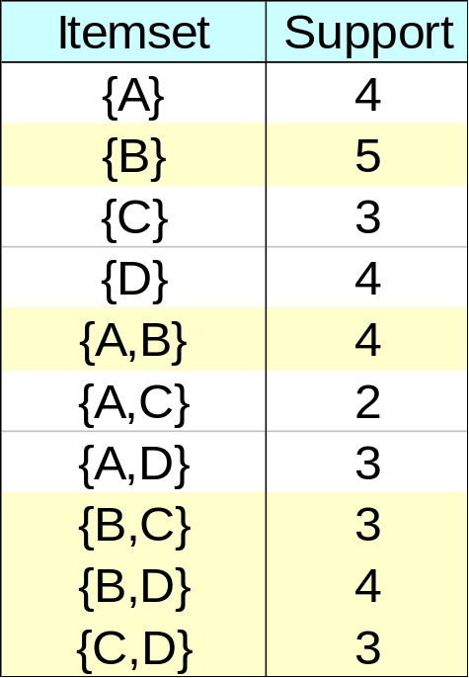
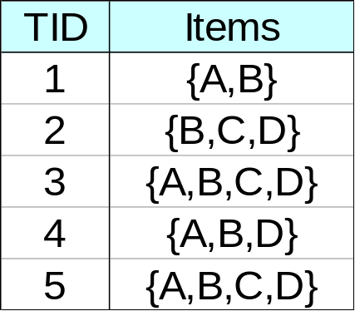
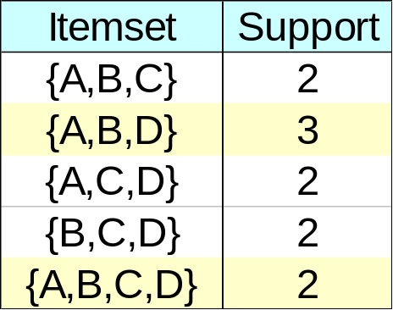
Closed Itemset
An itemset is closed if none of its immediate supersets has the same support as the itemset

Slide 31
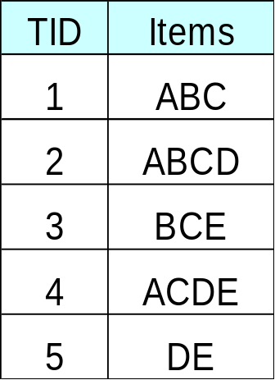
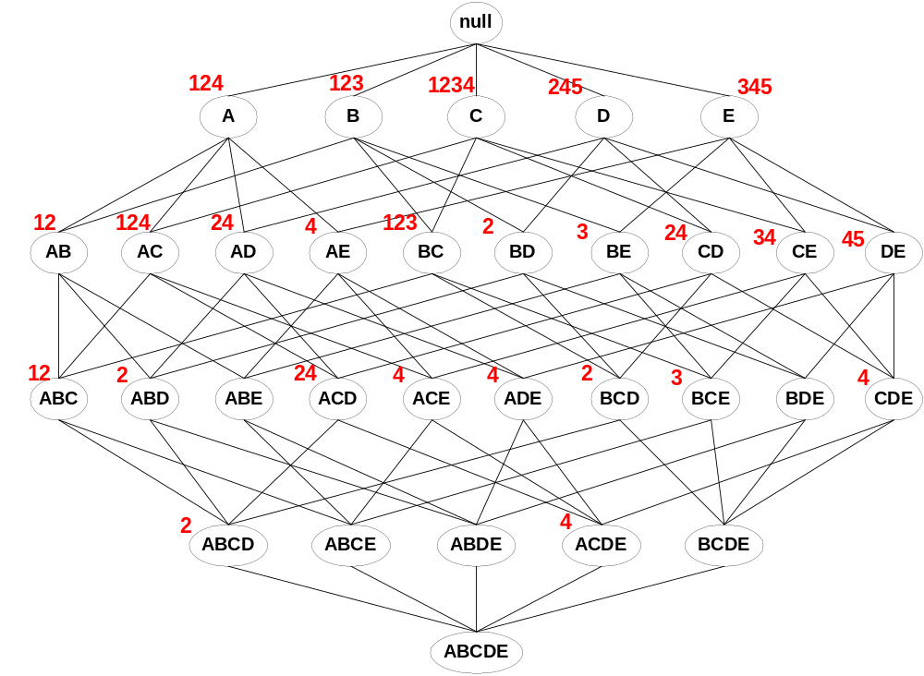
Maximal vs Closed Itemsets
Transaction Ids
Not supported by any transactions

Slide 32
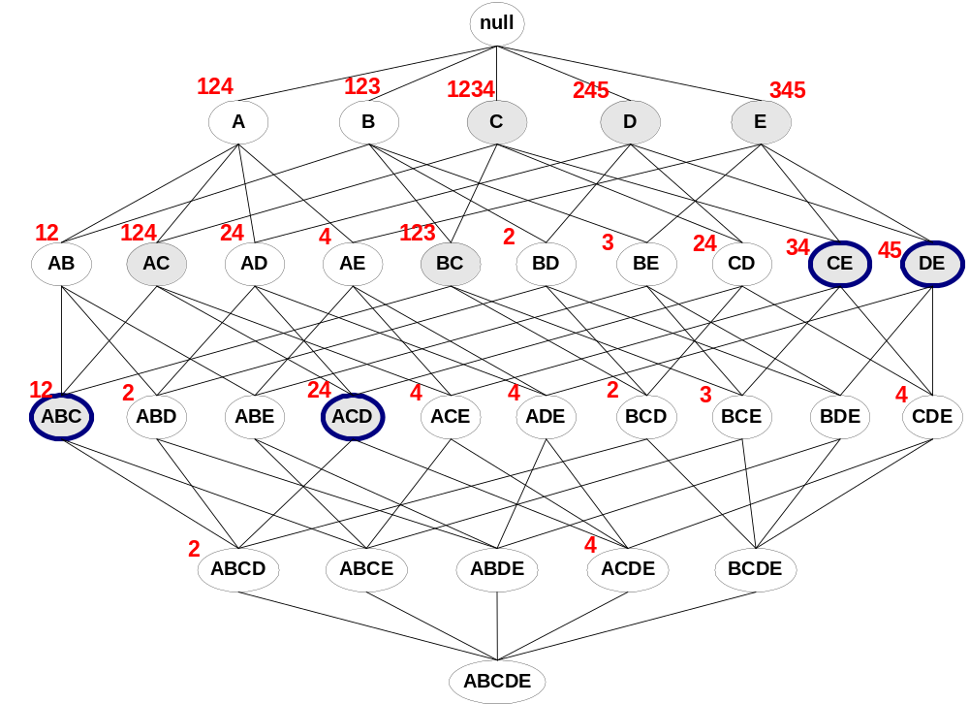
Maximal vs Closed Frequent Itemsets
Minimum support = 2
Closed but not maximal
Closed and maximal
# Closed = 9
# Maximal = 4

Slide 33
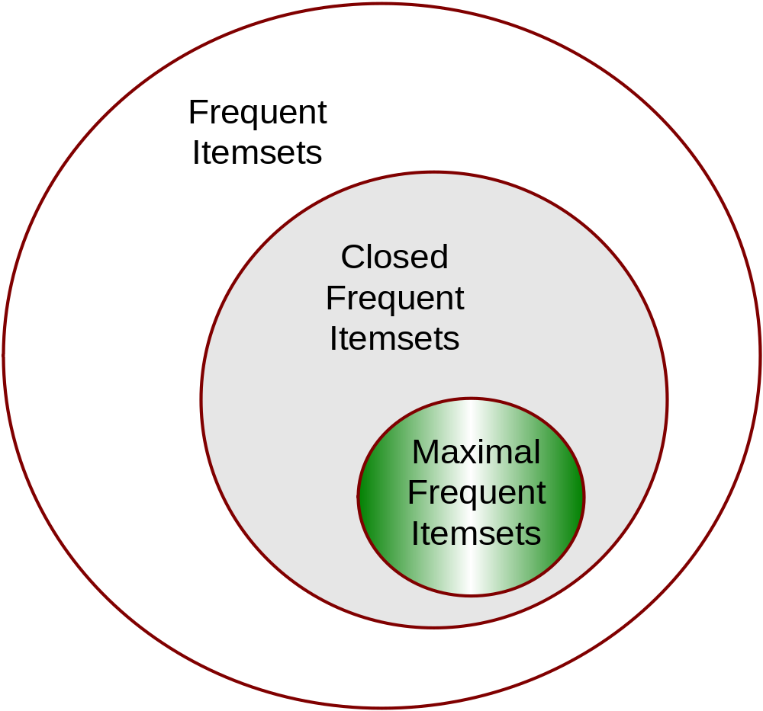
Maximal vs Closed Itemsets

Slide 34
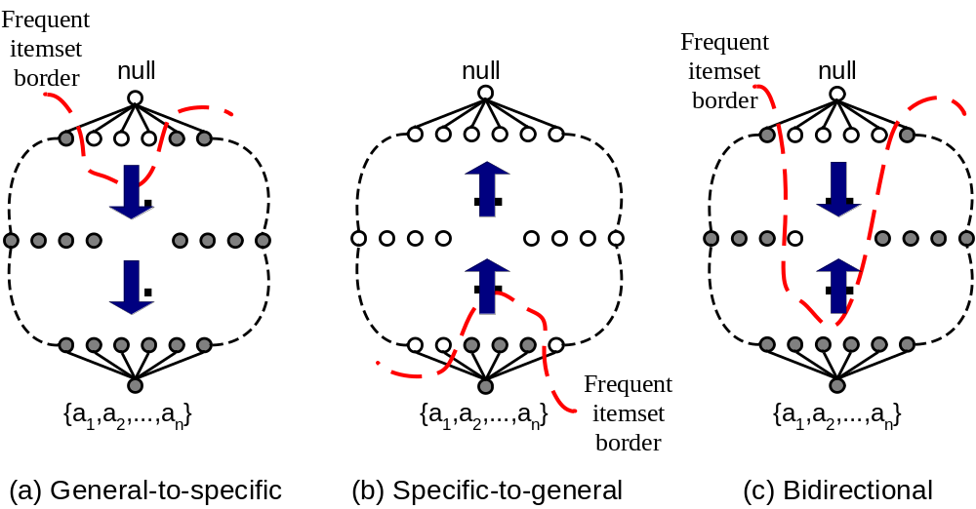
Alternative Methods for Frequent Itemset Generation
Traversal of Itemset Lattice
  General-to-specific vs Specific-to-general

Slide 35
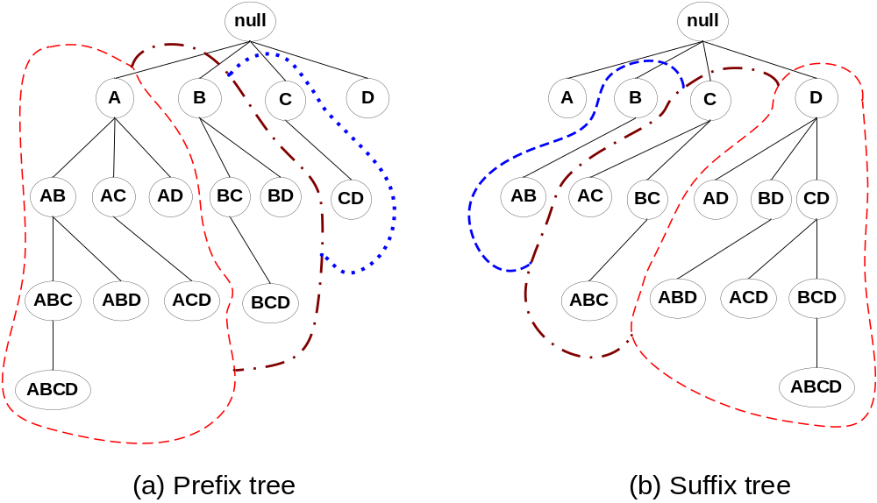
Alternative Methods for Frequent Itemset Generation
Traversal of Itemset Lattice
  Equivalent Classes

Slide 36
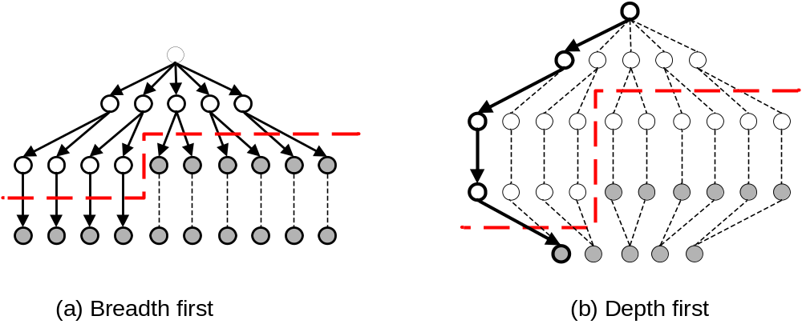
Alternative Methods for Frequent Itemset Generation
Traversal of Itemset Lattice
  Breadth-first vs Depth-first

Slide 37
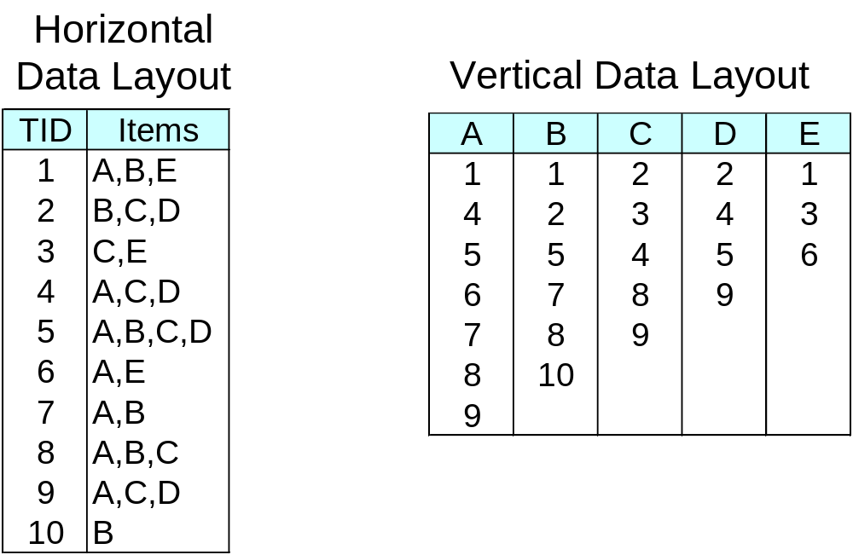
Alternative Methods for Frequent Itemset Generation
Representation of Database
  horizontal vs vertical data layout

Slide 38
FP-growth Algorithm
Use a compressed representation of the database using an FP-tree
Once an FP-tree has been constructed, it uses a recursive divide-and-conquer approach (called FP-growth) to mine the frequent itemsets

Slide 39
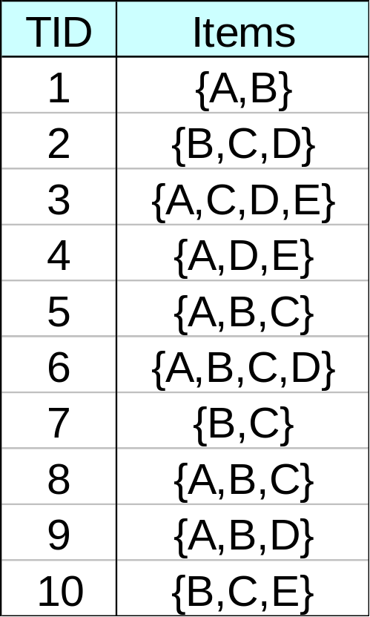
FP-tree construction
null
After reading TID=1:
A:1
B:1
After reading TID=2:
null
A:1
B:1
B:1
C:1
D:1

Slide 40
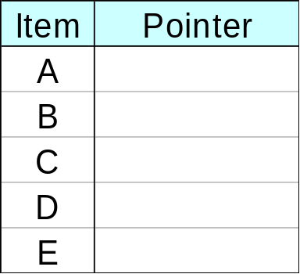
FP-Tree Construction
Transaction Database
null
A:7
B:3
B:5
C:3
C:1
D:1
Header table
D:1
C:3
E:1
D:1
E:1
D:1
E:1
D:1
Pointers are used to assist frequent itemset generation

Slide 41
FP-growth
A
null
B
AB
B:3
A:7
C
BC, AC
ABC
B:5
C:1
D:1
C:3
Header table
C:3
D:1
E:1
D:1
E:1
D:1
D
CD, BD, AD
BCD, ACD, ABD
ABCD
D:1
E:1
Generate frequent itemsets using divide-and-conquer approach
E
DE, CE, BE, AE
CDE, BDE, ADE, BCE, …
BCDE, ACDE, ABCE, …

Slide 42
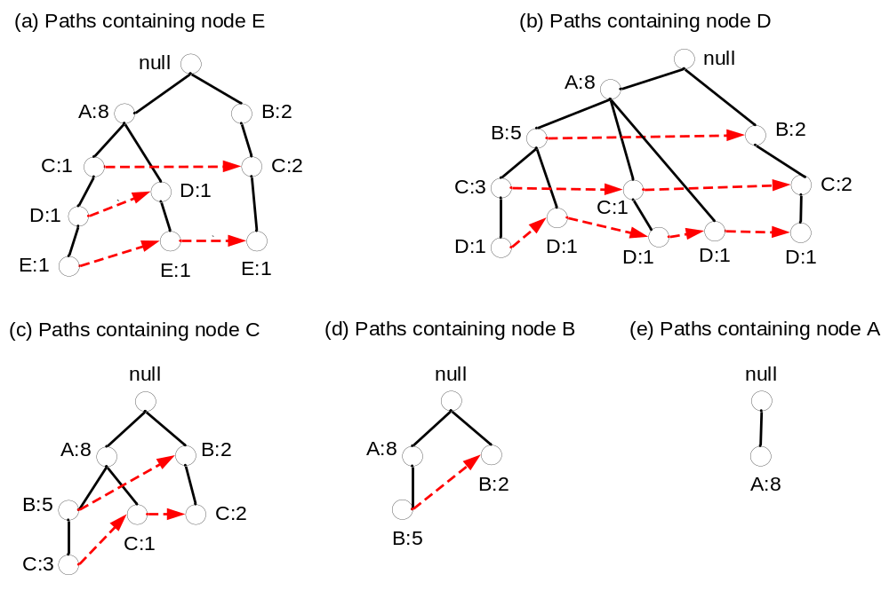
FP-growth

Slide 43
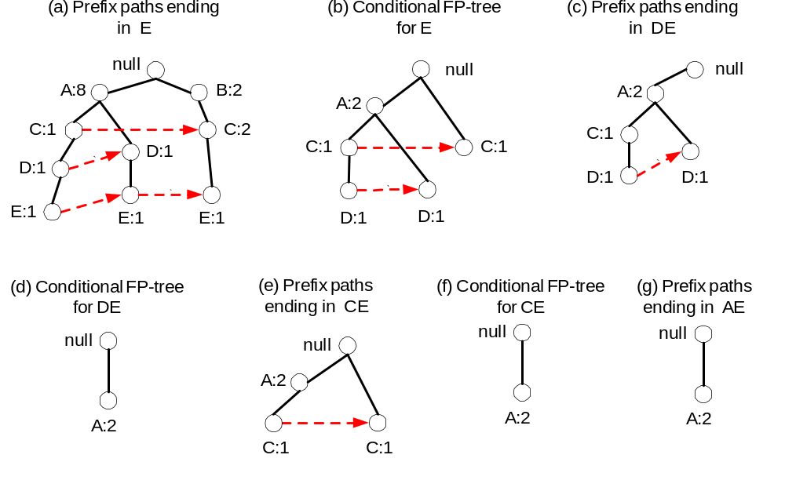
Conditional FP-tree
=> E
=> DE, ADE
=> CE, ACE
=> AE

Slide 44
Rule Generation
Given a frequent itemset L, find all non-empty subsets f ⊂ L such that f → L – f satisfies the minimum confidence requirement
  If {A,B,C,D} is a frequent itemset, candidate rules:
    ABC →D, ABD →C, ACD →B, BCD →A,
    A →BCD, B →ACD, C →ABD, D →ABC
    AB →CD, AC → BD, AD → BC, BC →AD,
    BD →AC, CD →AB,
If |L| = k, then there are 2^{k} – 2 candidate association rules (ignoring L → ∅ and ∅ → L)

Slide 45
Rule Generation
How to efficiently generate rules from frequent itemsets?
  In general, confidence does not have an anti-monotone property
    c(ABC →D) can be larger or smaller than c(AB →D)
  But confidence of rules generated from the same itemset has an anti-monotone property
  e.g., L = {A,B,C,D}:
  c(ABC → D) ≥ c(AB → CD) ≥ c(A → BCD)
    Confidence is anti-monotone w.r.t. number of items on the RHS of the rule

Slide 46
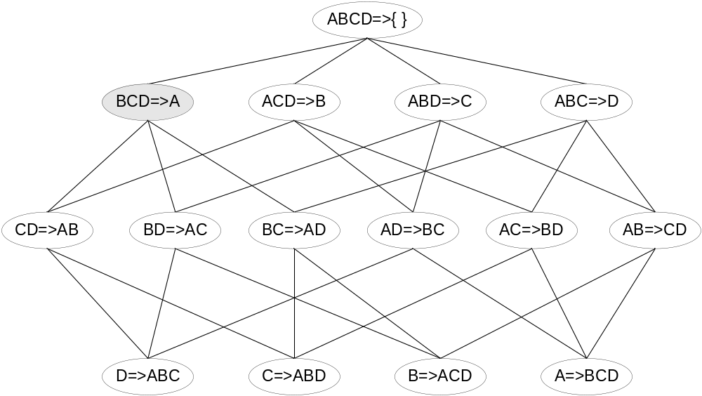

Rule Generation for Apriori Algorithm
Lattice of rules
Low Confidence Rule
Pruned Rules

Slide 47
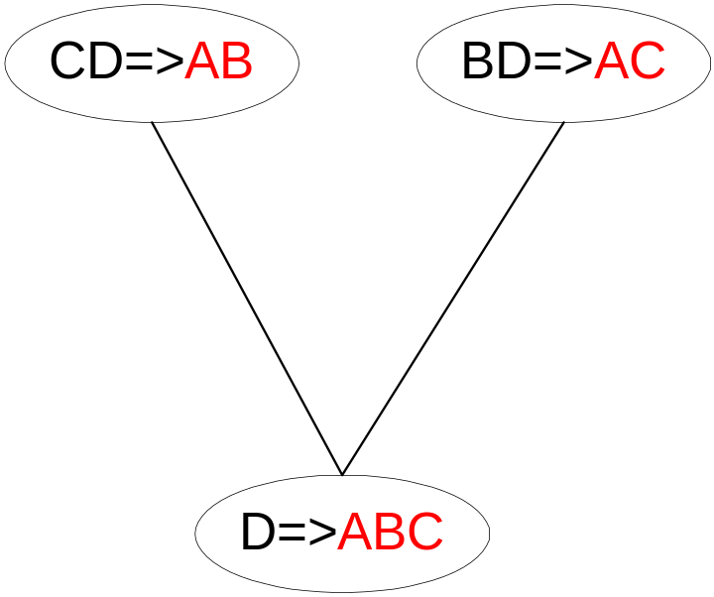
Rule Generation for Apriori Algorithm
Candidate rule is generated by merging two rules that share the same prefix
in the rule consequent
join(CD=>AB,BD=>AC)
would produce the candidate
rule D => ABC
Prune rule D=>ABC if its
subset AD=>BC does not have
high confidence

Slide 48
Data Mining
Association Analysis: Basic Concepts and Algorithms
Pattern Evaluation
© Tan,Steinbach, Kumar Introduction to Data Mining 03/02/2006 <number>

Slide 49
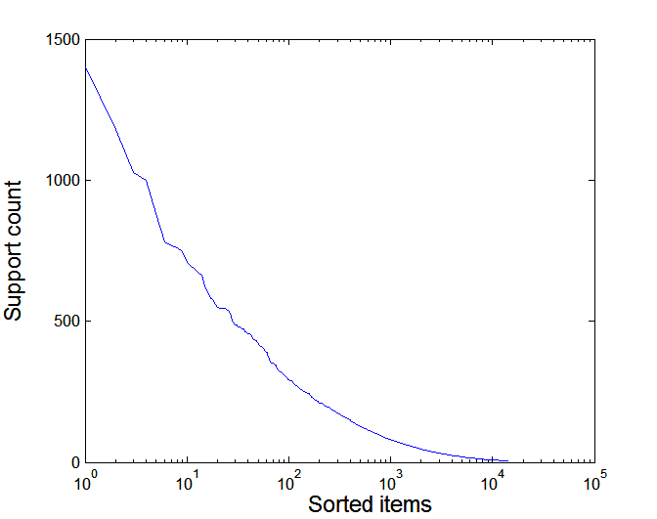
Effect of Support Distribution
Many real data sets have skewed support distribution
Support distribution of a retail data set

Slide 50
Effect of Support Distribution
How to set the appropriate minsup threshold?
  If minsup is too high, we could miss itemsets involving interesting rare items (e.g., expensive products)
  If minsup is too low, it is computationally expensive and the number of itemsets is very large

Slide 51
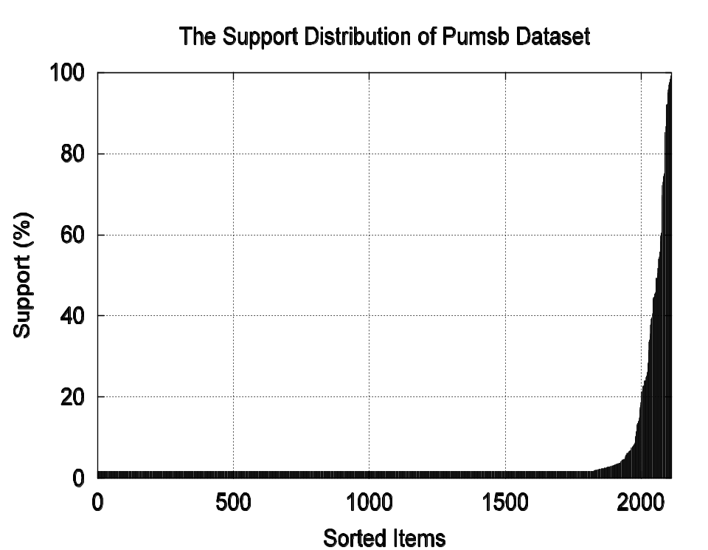
Cross-Support Patterns
A cross-support pattern involves items with varying degree of support
Example: {caviar,milk}
How to avoid such patterns?
caviar
milk

Slide 52
Cross-Support Patterns
Observation:
Conf(caviar→milk) is very high
but
Conf(milk→caviar) is very low
Therefore
min( Conf(caviar→milk),
Conf(milk→caviar) )
is also very low
caviar
milk

Slide 53

h-Confidence
h-confidence:
Advantages of h-confidence:
Eliminate cross-support patterns such as {caviar,milk}
Min function has anti-monotone property
  Algorithm can be applied to efficiently discover low support, high confidence patterns
caviar
milk

Slide 54
Pattern Evaluation
Association rule algorithms can produce large number of rules
  many of them are uninteresting or redundant
  Redundant if {A,B,C} → {D} and {A,B} → {D}
  have same support & confidence
Interestingness measures can be used to prune/rank the patterns
  In the original formulation, support & confidence are the only measures used

Slide 55
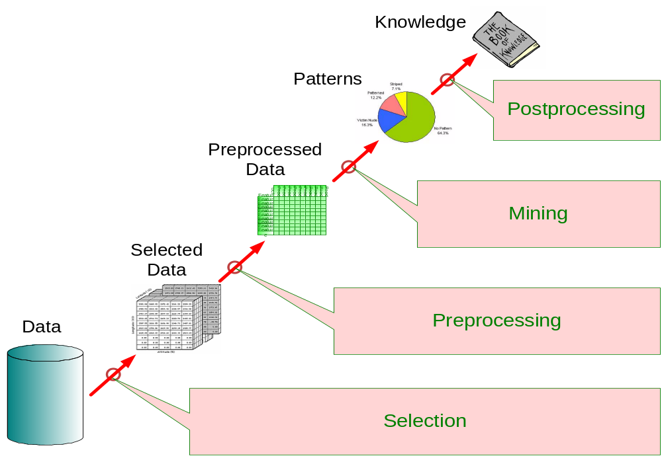
Application of Interestingness Measure
Interestingness Measures

Slide 56
Computing Interestingness Measure
Given a rule X → Y, information needed to compute rule interestingness can be obtained from a contingency table
Contingency table for X → Y
 | Y | Y
X | f₁₁ | f₁₀ | f₁₊
X | f₀₁ | f₀₀ | f_{o+}
 | f₊₁ | f₊₀ | |T|
f₁₁: support of X and Y
f₁₀: support of X and Y
f₀₁: support of X and Y
f₀₀: support of X and Y
Used to define various measures
support, confidence, lift, Gini,
J-measure, etc.

Slide 57
Drawback of Confidence
 | Coffee | Coffee
Tea | 15 | 5 | 20
Tea | 75 | 5 | 80
 | 90 | 10 | 100
Association Rule: Tea → Coffee
Confidence= P(Coffee|Tea) = 0.75
but P(Coffee) = 0.9
Although confidence is high, rule is misleading
P(Coffee|Tea) = 0.9375

Slide 58
Statistical Independence
Population of 1000 students
  600 students know how to swim (S)
  700 students know how to bike (B)
  420 students know how to swim and bike (S,B)
  P(S∧B) = 420/1000 = 0.42
  P(S) × P(B) = 0.6 × 0.7 = 0.42
  P(S∧B) = P(S) × P(B) => Statistical independence
  P(S∧B) > P(S) × P(B) => Positively correlated
  P(S∧B) < P(S) × P(B) => Negatively correlated

Slide 59
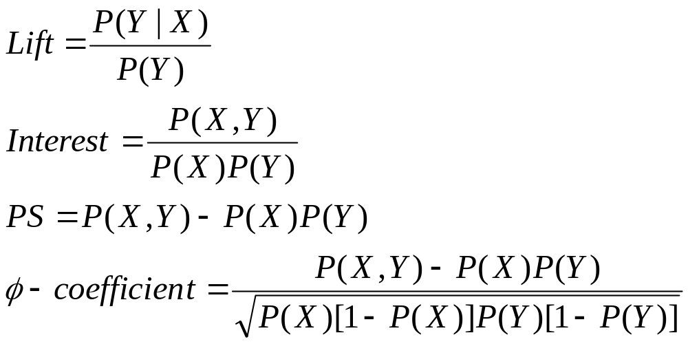
Statistical-based Measures
Measures that take into account statistical dependence

Slide 60
Example: Lift/Interest
 | Coffee | Coffee
Tea | 15 | 5 | 20
Tea | 75 | 5 | 80
 | 90 | 10 | 100
Association Rule: Tea → Coffee
Confidence= P(Coffee|Tea) = 0.75
but P(Coffee) = 0.9
Lift = 0.75/0.9= 0.8333 (< 1, therefore is negatively associated)

Slide 61
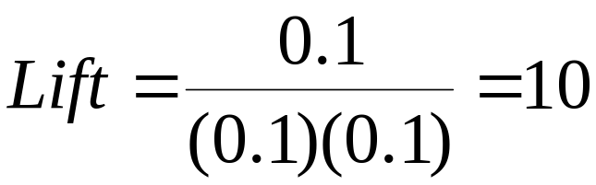
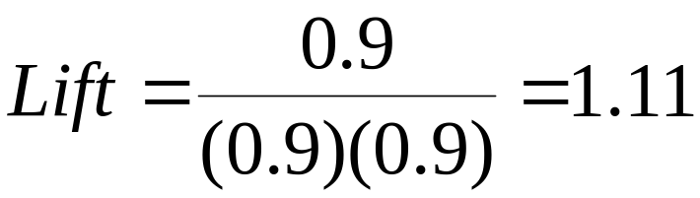
Drawback of Lift & Interest
 | Y | Y
X | 10 | 0 | 10
X | 0 | 90 | 90
 | 10 | 90 | 100
 | Y | Y
X | 90 | 0 | 90
X | 0 | 10 | 10
 | 90 | 10 | 100
Statistical independence:
If P(X,Y)=P(X)P(Y) => Lift = 1

Slide 62
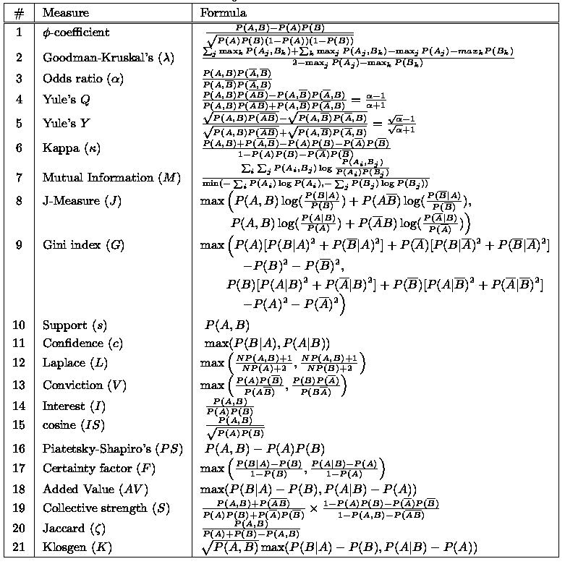
There are lots of measures proposed in the literature

Slide 63
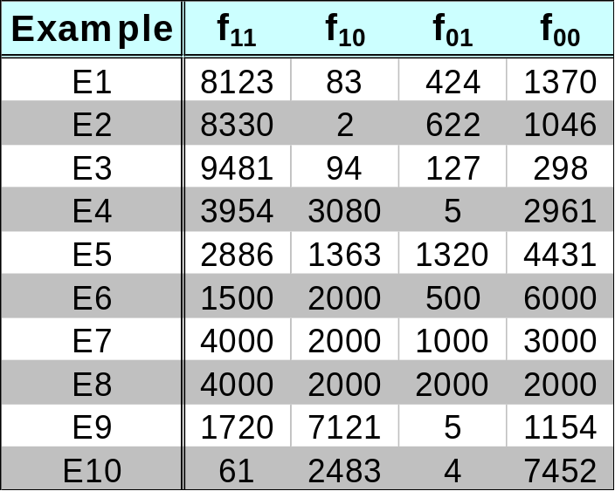
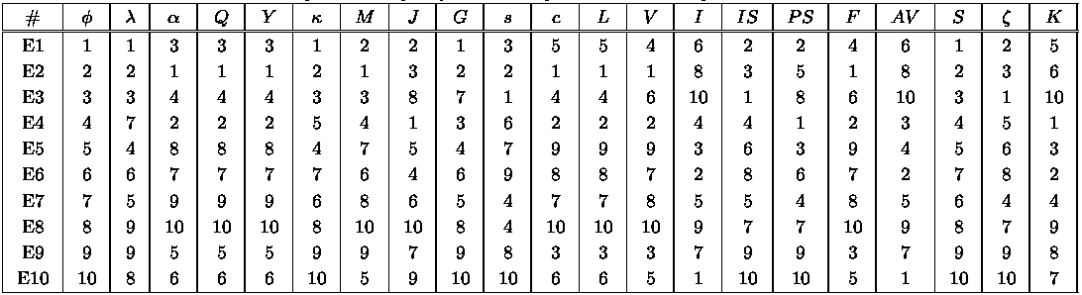
Comparing Different Measures
10 examples of contingency tables:
Rankings of contingency tables using various measures:

Slide 64
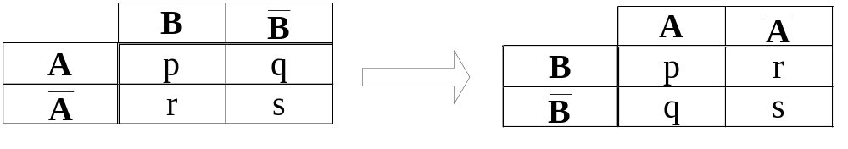
Property under Variable Permutation
Does M(A,B) = M(B,A)?
Symmetric measures:
  support, lift, collective strength, cosine, Jaccard, etc
Asymmetric measures:
  confidence, conviction, Laplace, J-measure, etc

Slide 65
Property under Row/Column Scaling
Grade-Gender Example (Mosteller, 1968):
 | Male | Female
High | 2 | 3 | 5
Low | 1 | 4 | 5
 | 3 | 7 | 10
 | Male | Female
High | 4 | 30 | 34
Low | 2 | 40 | 42
 | 6 | 70 | 76
2x
10x
Mosteller:
Underlying association should be independent of
the relative number of male and female students
in the samples

Slide 66
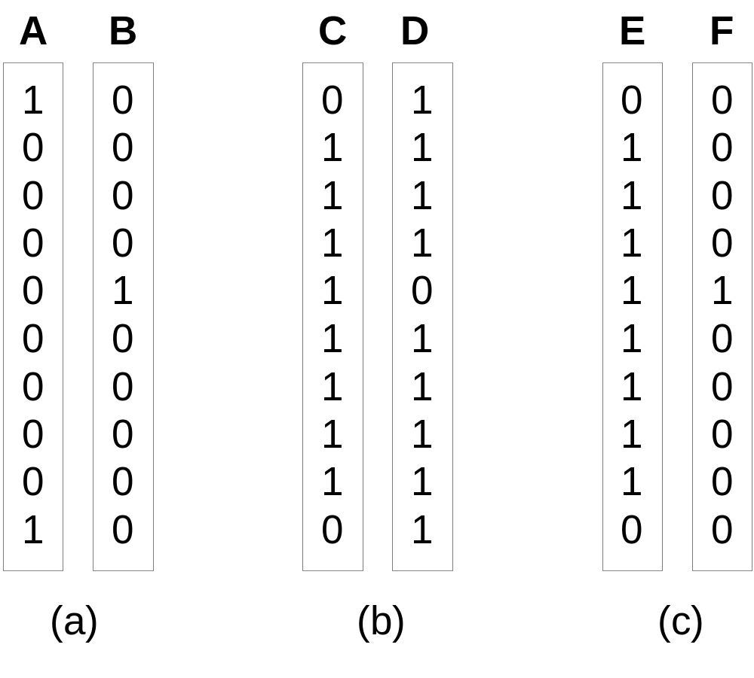
Property under Inversion Operation
Transaction 1
.
.
.
.
.
Transaction N

Slide 67
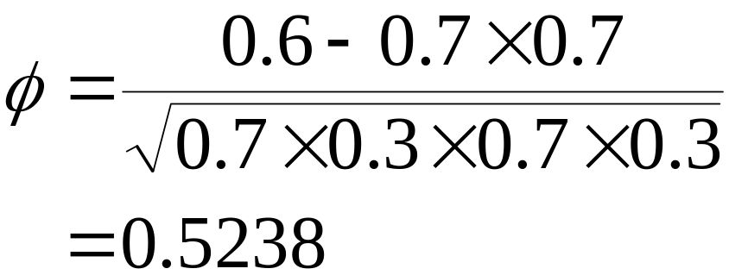
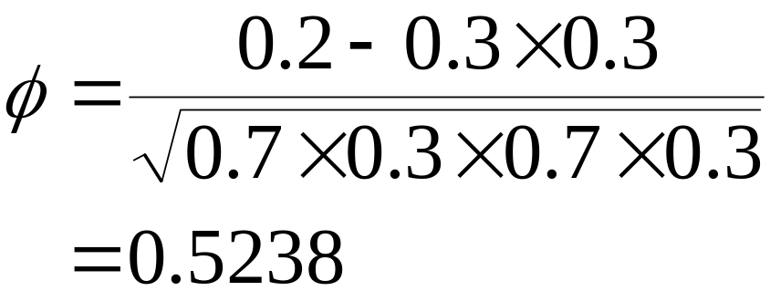
Example: φ-Coefficient
φ-coefficient is analogous to correlation coefficient for continuous variables
 | Y | Y
X | 60 | 10 | 70
X | 10 | 20 | 30
 | 70 | 30 | 100
 | Y | Y
X | 20 | 10 | 30
X | 10 | 60 | 70
 | 30 | 70 | 100
φ Coefficient is the same for both tables

Slide 68
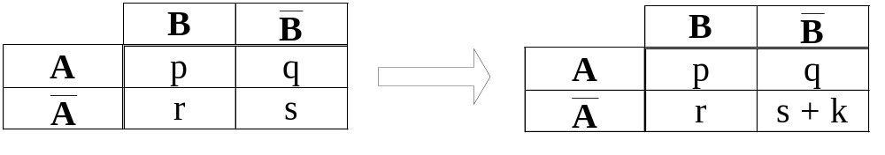
Property under Null Addition
Invariant measures:
  support, cosine, Jaccard, etc
Non-invariant measures:
  correlation, Gini, mutual information, odds ratio, etc

Slide 69
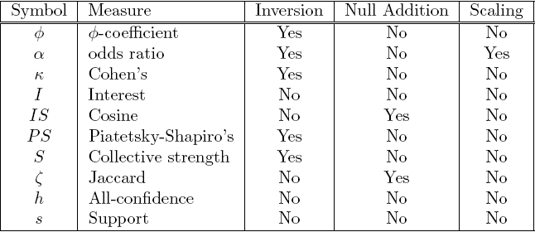
Different Measures have Different Properties

Slide 70
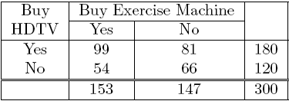
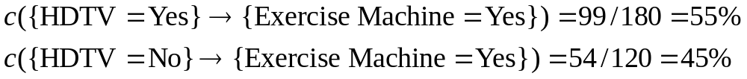
Simpson’s Paradox
=> Customers who buy HDTV are more likely to buy exercise machines

Slide 71
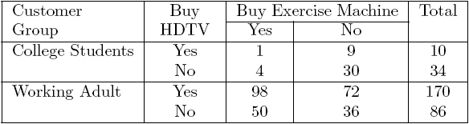
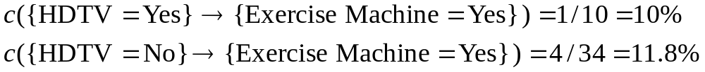
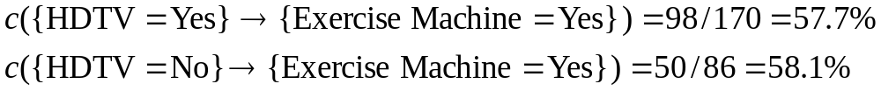
Simpson’s Paradox
College students:
Working adults:

Slide 72
Simpson’s Paradox
Observed relationship in data may be influenced by the presence of other confounding factors (hidden variables)
  Hidden variables may cause the observed relationship to disappear or reverse its direction!
Proper stratification is needed to avoid generating spurious patterns

