Slide 1
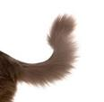
dog
tail
Created with a trial version of Syncfusion Essential Presentation

