Slide 1
Proyecto Modulo 1
Data Pipelines

Slide 2



Challenge 1
p_acquisition/m_career_info_acquisition.py
p_acquisition/m_job_data_acquisition.py
p_acquisition/m_country_data_acquisition.py
Librerías
pandas
sqlalchemy
Librerías
requests
Librerías
requests
beautifulsoup
raw_data_project_m1.db
http://api.dataatwork.org/v1/jobs/[job_id]
https://ec.europa.eu/eurostat/
main.py
Librerías
argparse
RESULTADO
Rural_Area | Quantity | Percentage | country_name | job_name
No | 12 | 0.21 | Germany | Database Consultant
No | 3 | 0.05 | Denmark | Oracle Database Administrator (Oracle DBA)
Yes | 1 | 0.02 | Slovakia | Database Security Administrator

Slide 3
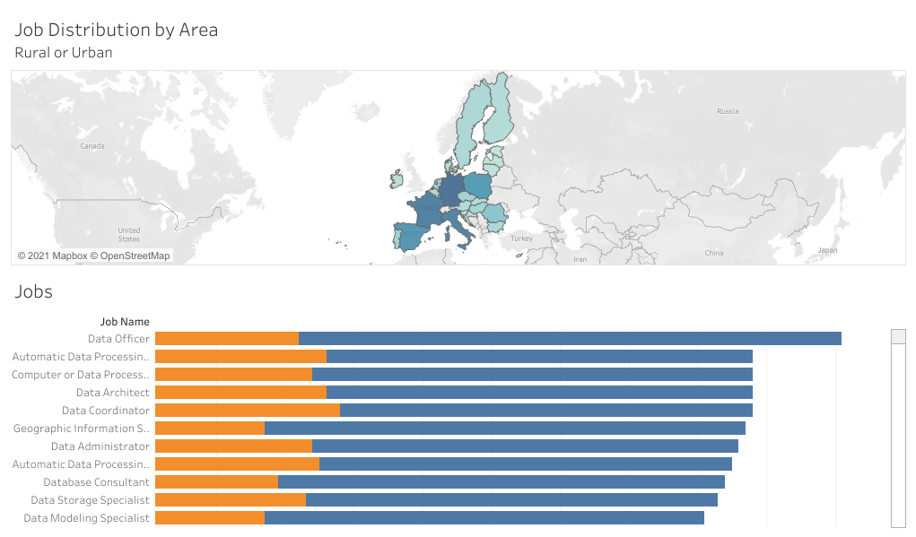
Challenge 1

Slide 4
Bonus 1
p_acquisition/m_career_info_acquisition.py
Tablas
poll_info
raw_data_project_m1.db
main.py
Librerías
argparse
RESULTADO
Vote Tendency | Number of Pro Arguments | Number of Cons Arguments
In Favor | 5625 | 5485
Against | 1438 | 2276
Not Vote | 423 | 507

Slide 5
Bonus 2
p_acquisition/m_career_info_acquisition.py
p_acquisition/m_job_data_acquisition.py
Tablas
career_info
country_info
Librerías
requests
raw_data_project_m1.db
main.py
Librerías
argparse
RESULTADO
Education Level | Top 1 job | Top 2 job | ...
N/A | Automatic Data Processing Planner | Data Scientist
high | Data Administrator | Data Officer
medium | Data Storage Specialist | Geographic Information Systems Data Specialist (GIS Data Specialist)

Slide 6
Ironhack Data Code Beauty Pageant
def get_clean_country_names(country_dict):
country_names = list(country_dict.values())
# remove non-aphabetic characters at the end of the string
country_names = list(map(lambda s: re.sub(r"[^\w]$", "", s), country_names))
# remove content surrounded by parenthesis and squared brackets
country_names = list(map(lambda s: re.sub(r"\s[\[\(].*", "", s), country_names))
return country_names
Limpiar nombres de países sacados de:
https://ec.europa.eu/eurostat/statistics-explained/index.php/Glossary:Country_codes
Usando regex, lambdas y map.

Slide 7
Fin

