Slide 1
Modern Application Automation with Chef
Prague, 2018
Christian Johannsen, Solutions Architect EMEA

Slide 3
Modern application design
How we define a modern application
It's isolated from external dependencies.
It's immutable once built, with that immutable artifact that is agnostic to its operating environment.
Its deployment artifacts can be rebuilt from source with the same outcome every time.
It provides external entities with a clear API for runtime configurability that exposes all of its configurable elements.
Its packaging and deployment mechanisms are easy to use and not tied to any particular language or execution environment.
It supports multiple deployment patterns using the same package.

Slide 4

Monolithic vs. Microservices
Modern software design principles
UI
UI
Data Access Layer
Business Logic

Slide 5
Application Deployment
Modern software design principles
Software deployment is all of the activities that make a software system available for use.
Modern Software deployment cycles
Release, Installation, Deactivation, Unistallation, Update etc.
Microservice architectures lead to new velocity necessity
Small changes and bugfixes are worth to be shipped into production
Lower risk with small changes, high automation rate to allow many changes per day/week
Code will be stored in central repository systems
Code will be tested and compiled automatically
Deployment artifact is build and delivered

Slide 6
Applications and Automation
Modern software design principles
Two different automation methods in configuration management theory:
Central, obligation-based approach
assume that an application is "dumb,"
has no capacity for self-governance,
must be managed by an orchestrator, which dictates how it should behave,
we try to set up preconditions for an application
Decentralized, promise-based approach
assume that each component is an autonomous agent
agent publishes its intentions
model is based on cooperation between independent entities
Reliable systems while underlying architecture might be unreliable

Slide 7
Cloud Native Operations with Habitat

Slide 8
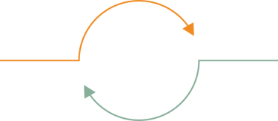




Shifting to Cloud Native Architectures
Demands a shift to cloud native operations models
Infrastructure
centric
operations
Application
centric
operations
Cloud
Microservices
Containers
UNIT OF VALUE is server
UNIT OF WORK is configuration
UNIT OF VALUE is app
UNIT OF WORK is deployment

Slide 9

Defining Habitat
Delivering essential tools and services for cloud native operations
Application automation that enables modern application teams to build, deploy, and manage any application in any environment - from traditional to cloud native architectures.

Slide 10
Habitat design point
The right implementation philosophy for cloud native operations
Implementing 12 Factor app patterns
Decoupling the app from operating system dependencies.
Decoupled build and run dependencies and explicitly declaration of those dependencies.
Separating concerns of ‘build’ from ‘deploy’ to provide improved DevOps collaboration.
Providing declarative deployment capabilities.
DevOps for modern app teams
Provides freedom of choice for language, services, and infrastructure.
Provides common process across teams regardless of cloud, container platform, OS, VM platform.
Delays infrastructure choice closer to deployment through correct separation of concerns.
Common management paradigm regardless of architectural choice.

Slide 11
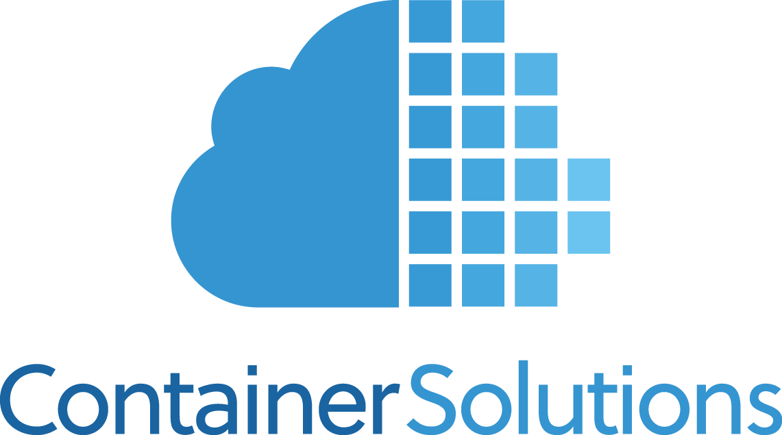
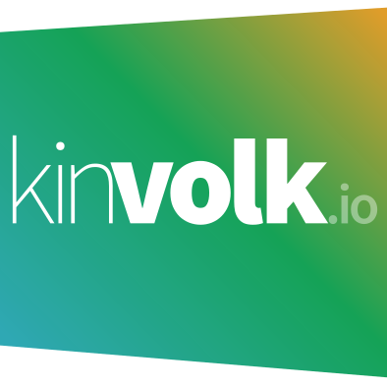



Growing Product and Customer Momentum
Core engineering combined with open-source, customer, and partner contrib
2016
2017
2017
2016
2017
2017
2017
Jun
Dec
May
Jun
Aug
Oct
Oct
Rolling Deploys Released
BOSH Integration
Kubernetes Operator Preview
CF Integration
Habitat released
Enterprise Plans & Scaffolding
Builder released
Customer Design Partners
Engineering Partners
12
Deep design engagements with enterprise customers moving Habitat to production.
20
Community Momentum
Weekly release cadence
2 external core maintainers, >70 external contributors
>1400 Slack members
Enterprise customers in the next set of design engagements.

Slide 12





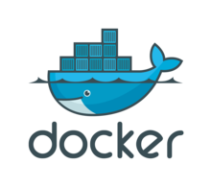

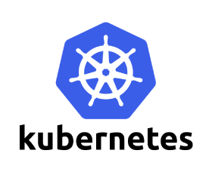
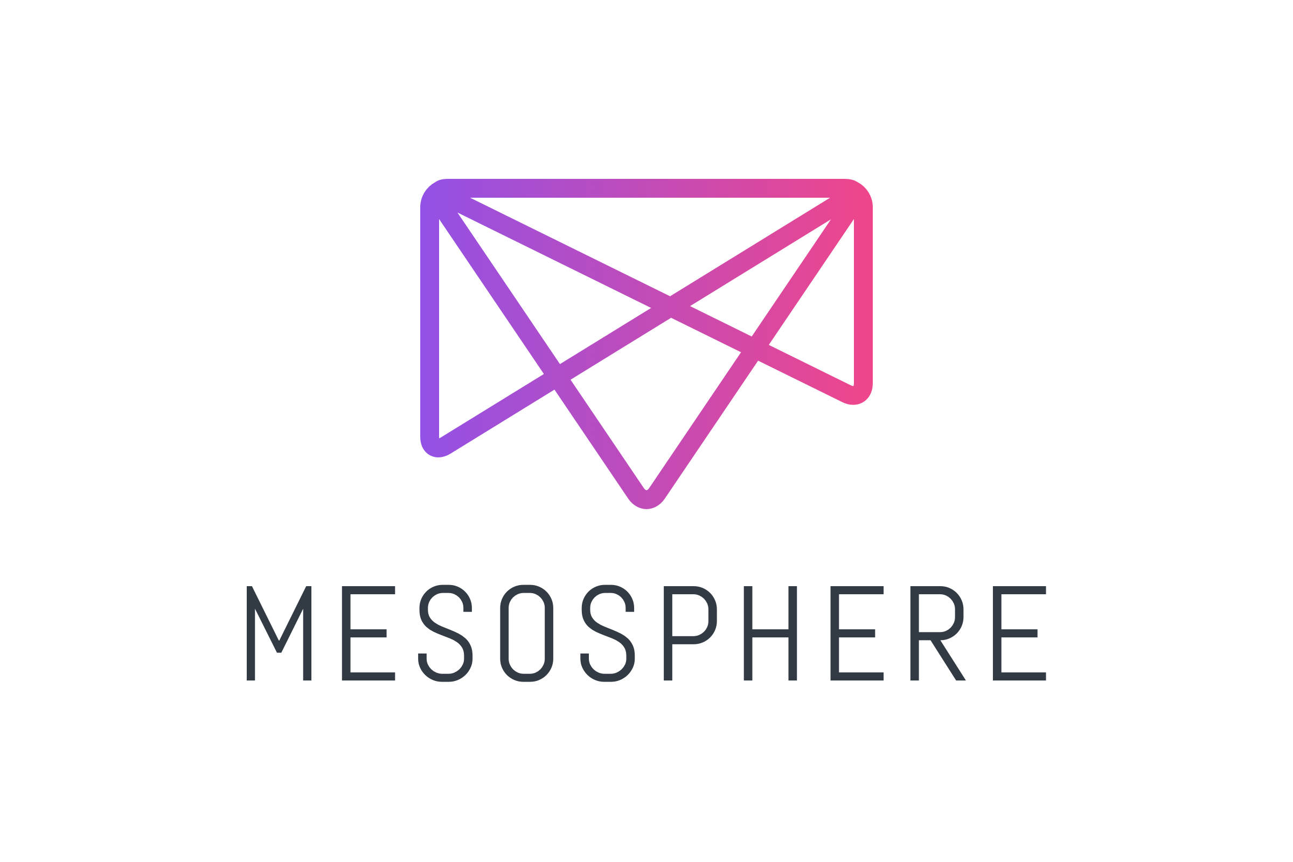


Cloud Native Operations with Habitat
BUILD
DEPLOY
MANAGE
PUBLIC DEPOT
Habitat Supervisor
PRIVATE DEPOT
Habitat Supervisor
Habitat Builder

Slide 13
Essentials of Habitat
BUILD
DEPLOY
MANAGE
Better application packaging
Consistent process for packaging all apps across all architectures.
Simple process for key languages: Node.js, Ruby, Go, etc.
Works with current SCM/CI/CD workflows.
Target any format and runtime
Build artifact is separate from deployment artifact, offering flexibility and deferred decision making.
All knowledge of app dependencies are included in the deployment artifact.
Assists ‘lift and shift’, or ‘lift and modernize’ strategies in mixed portfolios.
Automation for applications
Consistent management capabilities in any runtime environment (clustering topology support, auto-configuration, auto-update).
Build specifically for distributed, stateful application topologies - real use cases.
BUILD
DEPLOY
SUPERVISE

Slide 14
Build with habitat

Slide 15
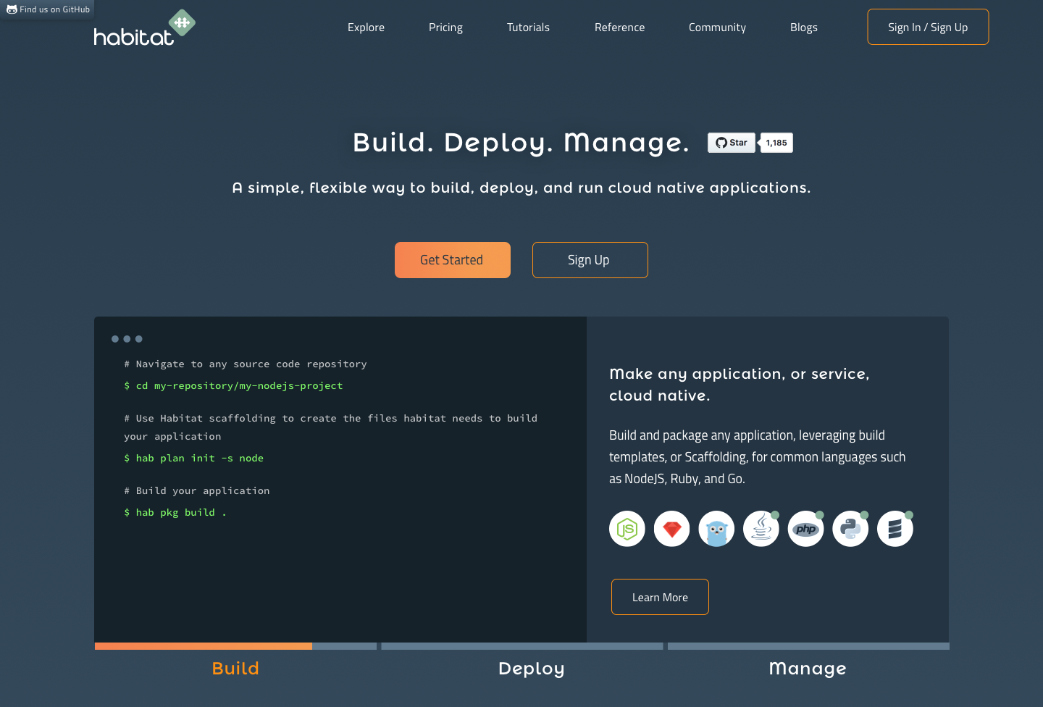
Introducing Habitat Builder
The fastest path from code to cloud native
Modern application teams can connect to source code, then package and build applications along with their dependencies and configuration. They can then deploy those applications in any format and runtime, and manage the application lifecycle at runtime in any cloud native architecture.
Habitat Builder Features
SaaS-based build service
GitHub SCM and authentication integration
Automated builds
Automated dependency rebuilds
Public and private origins
Release Channels for Continuous Delivery
Container publishing to Docker Hub
Scaffolding for Node.js, Ruby, more coming
> 500 packages for common applications and libraries
Notes:
Use press release

Slide 16
Introducing Habitat Builder
The fastest path from code to cloud native
Modern application teams can connect to source code, then package and build applications along with their dependencies and configuration. They can then deploy those applications in any format and runtime, and manage the application lifecycle at runtime in any cloud native architecture.
Habitat Builder Features
SaaS-based build service
GitHub SCM and authentication integration
Automated builds
Automated dependency rebuilds
Public and private origins
Release Channels for Continuous Delivery
Container publishing to Docker Hub
Scaffolding for Node.js, Ruby, more coming
> 500 packages for common applications and libraries
Notes:
Use press release

Slide 17
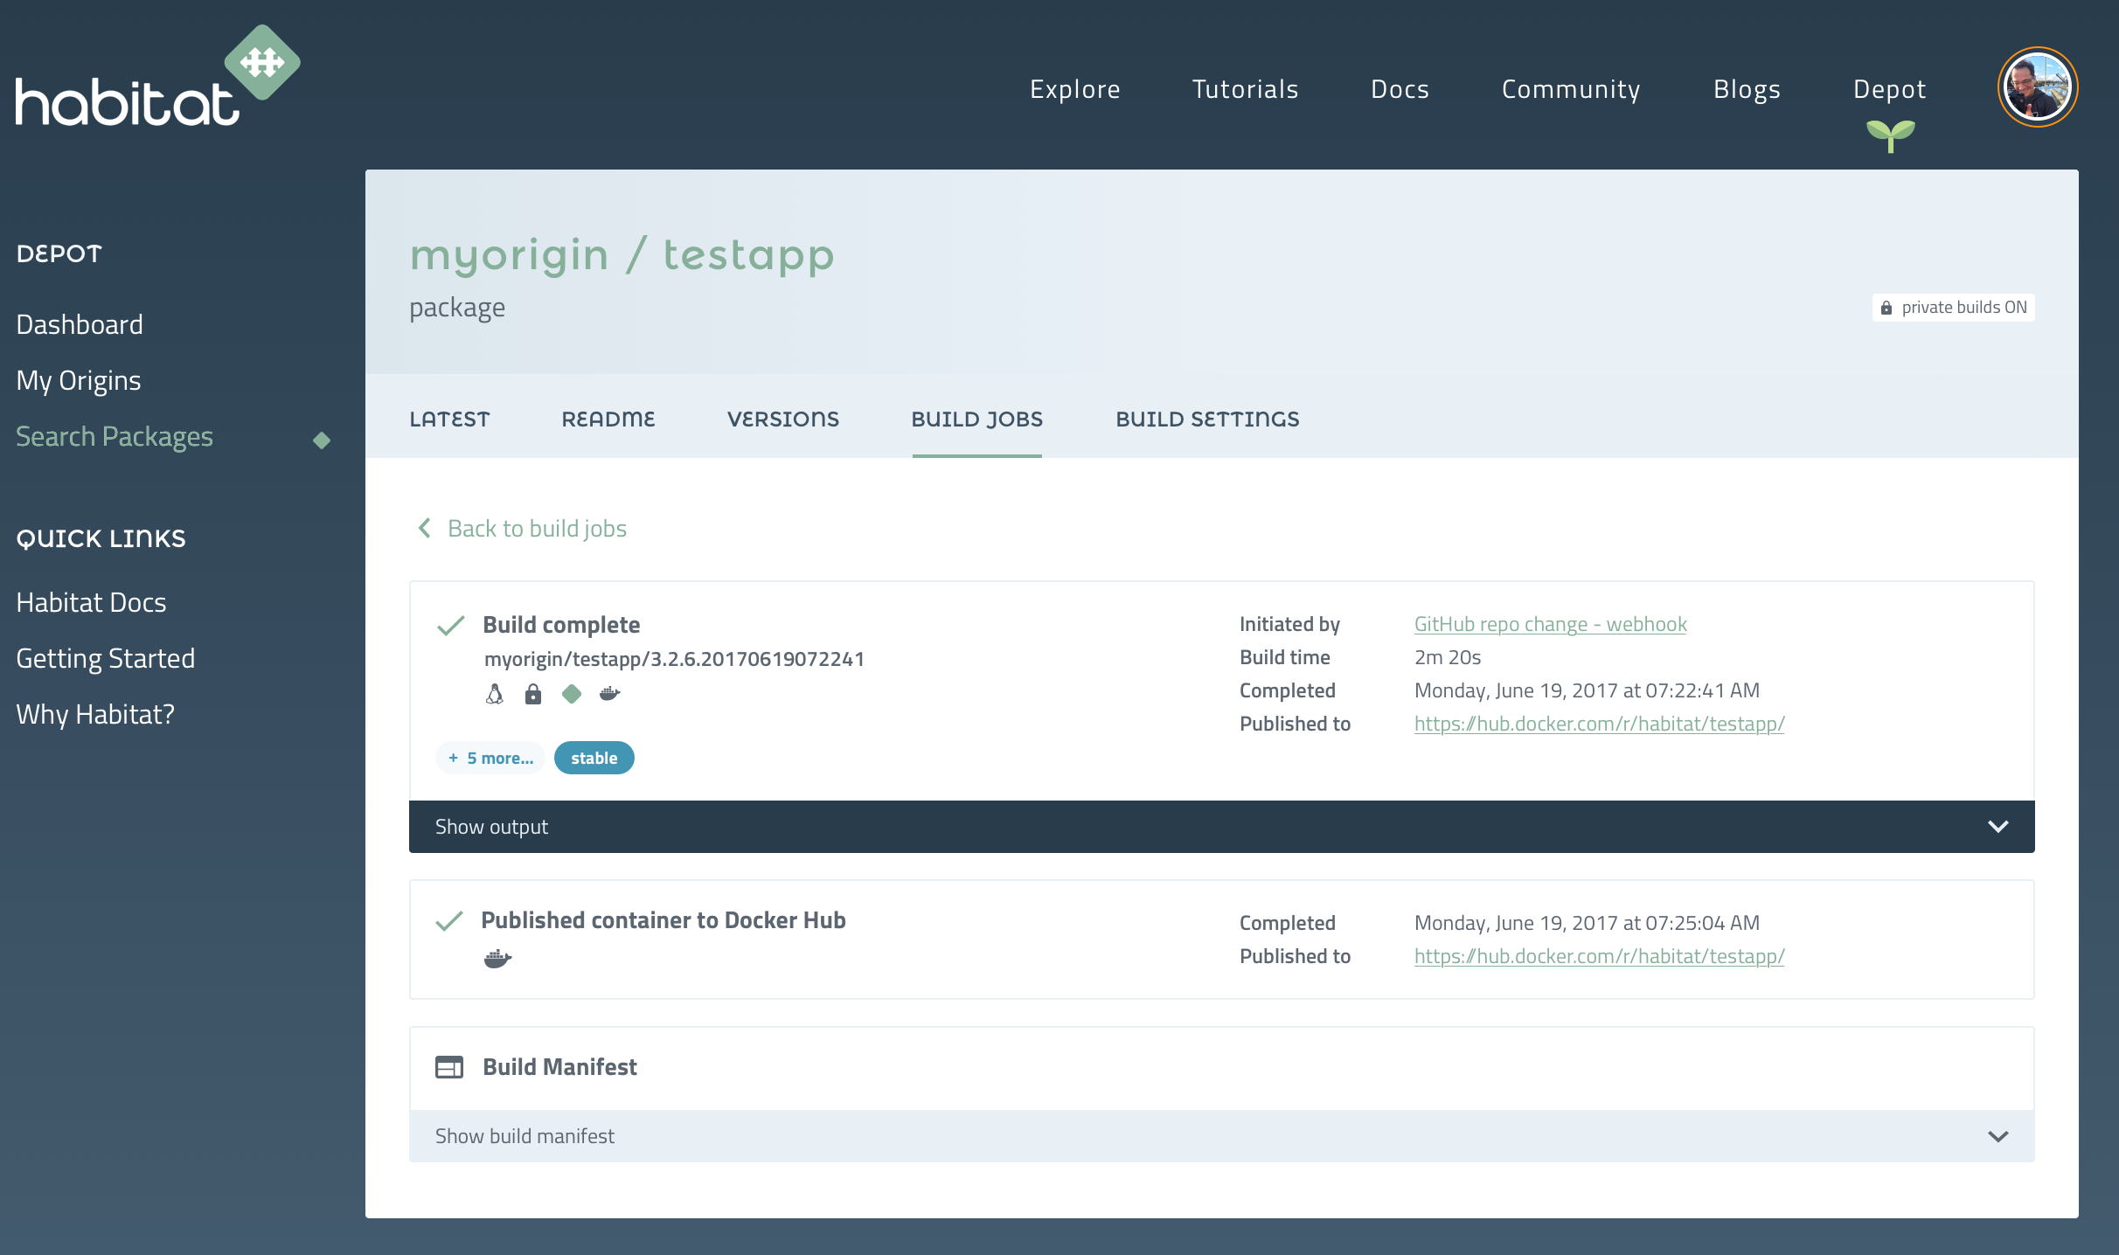
Habitat Builder Demo
Five simple steps to building and deploying your application code.
Getting Started With Habitat Builder
Authenticate with Github
Create a Habitat Builder origin
Connect Docker Hub registry
Create a Habitat package from a GitHub repo
Habitat Builder packages your application and exports a container image to Docker Hub

Slide 18
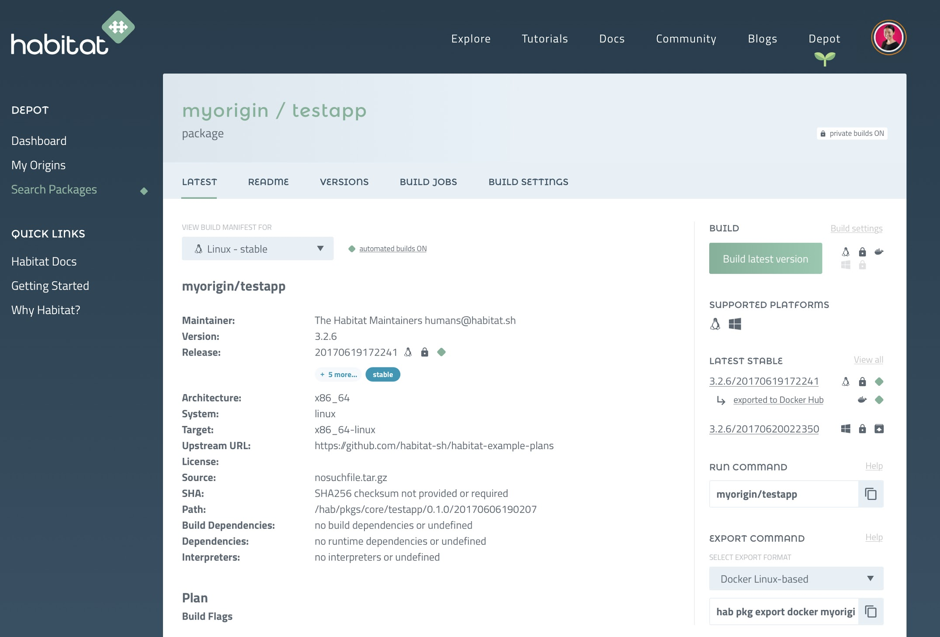
Happy Devs, Happy Ops, Habitat
For Developers:
GitHub integration
Automatic builds on commit
Explicit dependency declarations
Stable & unstable release channels
For Operations:
Immutable build artifacts
Automated container builds
Application exports to Docker, rkt, Mesos, Cloud Foundry, Kubernetes, and TAR
Release channels for CD workflow

Slide 19

Building with Habitat
Habitat provides a cloud native build and packaging system
HABITAT BUILDER
PUBLIC DEPOT
PRIVATE DEPOT
USER
PLAN
Developer adds a plan.sh to define the build phases of their software.
Scaffolding for common languages can be used to provide reasonable defaults.
Developer explicitly declares dependencies, required backing services, and what services/ports are exposed.
Runtime lifecycle hooks can be defined for the application (start, reconfigure, etc).
Templated configuration files can be included.
Habitat Builder watches a GitHub repository for changes, when code is merged a build is performed based on the repo’s plan.sh.
Build artifact includes runtime lifecycle hooks, configuration, and application binaries or code.
Build artifact metadata includes dependent services, exposed services/ports, and required dependencies.
Artifacts are stored in a Habitat Builder depot.

Slide 20
Building with Habitat
Habitat provides a cloud native build and packaging system.
Initialize a plan with the Node.js Scaffolding
$ hab plan init -s node
Build the Habitat package
$ hab pkg build .
$ cat habitat/plan.sh
pkg_name=hello-node
pkg_origin=mehzer
pkg_version="0.1.0"
pkg_scaffolding=core/scaffolding-node
Habitat builds a immutable, signed artifact that can be deployed to the infrastructure of choice.
Packages are built using the Habitat Studio which is a clean room ensuring that all dependencies are explicitly declared and linked to the resulting package.
This artifact is used in deployment to target the desired environment.
Habitat will initialize a source code directory with a skeleton Habitat plan using the scaffolding specified.

Slide 21
Deploying with Habitat
Habitat packages can be deployed to a variety of infrastructure platforms
HABITAT BUILDER
BARE METAL
SUPERVISOR
ARTIFACT
SERVICE
PUBLIC DEPOT
VM
SUPERVISOR
SERVICE
AMI
SUPERVISOR
PRIVATE DEPOT
DEPLOYABLE ARTIFACT
SERVICE
CONTAINERS
SUPERVISOR
SERVICE
Habitat can export Habitat artifacts in a variety of formats: Docker, rkt, CloudFoundry, Mesos, and TAR
Habitat Builder can automatically build Docker container images & publish them to Docker Hub.
Exported Habitat artifacts contain all dependencies required to run the application, runtime lifecycle hooks, application configuration, & the Habitat Supervisor to create a complete Deployable Artifact.
Deployable Artifacts can be run on your infrastructure of choice.
The Habitat Supervisor can also start any application artifact published in the Builder depot, downloading the artifact and required dependencies, skipping the process of creating a deployable artifact.

Slide 22
Deploying with Habitat
Habitat packages can be deployed to a variety of infrastructure platforms.
Target Docker
$ hab pkg export docker myorg/myapp
Create a container image that can be deployed to a variety of schedulers such as Kubernetes or Docker Swarm.
Target Kubernetes
apiVersion: habitat.sh/v1
kind: ServiceGroup
metadata:
name: exampleapp
spec:
image: kinvolk/nodejs-hab
count: 1
habitat:
topology: standalone
group: nodejs
config: user-toml-secret
Use the Habitat Kubernetes Operator for seamless integration with k8s clusters.
Target Cloud Foundry
$ hab pkg export cf myorg/myapp
Deploy an application to Cloud Foundry, and have the lifecycle managed by Cloud Foundry.

Slide 23
Managing with Habitat
The Habitat Supervisor runs applications in a cloud native manner.
Supervisor Service Groups
The Habitat Supervisor is responsible for managing the runtime lifecycle, configuration updates, clustering topologies, and artifact updates.
Each application instance (VM, Container, Bare Metal, Cloud) runs a Habitat Supervisor. Habitat Supervisors can peer with other Supervisors to form a Service Groups.
Habitat Supervisors exchange configuration information through this Service Group.
Habitat Supervisors generate application configuration based on the Service Group, environment variables, and default values.
New Supervisors that join the Service Group, and will automatically receive the application’s running config.
SUPERVISOR
SERVICE
SUPERVISOR
SUPERVISOR
SERVICE
SERVICE
SUPERVISOR
SUPERVISOR
SERVICE
SERVICE
SUPERVISOR
SERVICE

Slide 24
Managing with Habitat
Habitat supports multiple application clustering topologies
Application Clustering Topologies
Habitat Supervisor Service Groups can self-organize into an application clustering topology such as Leader/Follower or stand alone.
In Leader/Follower mode, Habitat Supervisors perform an election to determine which instance will be the Leader.
Habitat Supervisors generate application configuration based on the election results & start the application.
New Supervisors that join the Service Group will automatically join as a follower.
If a Leader is removed from a Service Group, a new election will be performed, and Supervisors will again self-organize.
LEADER/FOLLOWER
LEADER
FOLLOWER
FOLLOWER
FOLLOWER
STANDALONE
PEER
PEER
PEER
PEER

Slide 25
Managing with Habitat
Habitat applications can automatically update as new artifacts are published.
Update strategies
Habitat Supervisors can watch the Habitat Builder depot for newly published artifacts and deploy them via a “Rolling Deploy” or “All at Once”.
The Habitat Supervisor will automatically download new artifacts and dependencies.
If Supervisors are configured for a Rolling Deploy, Supervisors will perform an election to determine which Supervisor will update first. If successful, subsequent Supervisors will update themselves.
If Supervisors are configured for a “All at Once” update, all Supervisors in the Service Group will update & restart their applications. This is useful for lower environments.
ARTIFACT
DEPOT
SUPERVISOR
SERVICE
ALL AT ONCE
ROLLING DEPLOY

Slide 26
Managing with Habitat
Application stacks can be composed via Service Group Bindings.
Service Group Binding
Habitat Supervisor Service Groups can communicate with other Service Groups to share configuration through Service Group Binding.
Required backing services defined in the Habitat build artifact can be provided via Service Group Binding.
Full application stacks can be easily composed through Service Group Bindings.
SUPERVISOR
SUPERVISOR
SERVICE
SERVICE
SUPERVISOR
SUPERVISOR
SUPERVISOR
SUPERVISOR
SERVICE
SERVICE
SERVICE
SERVICE
SUPERVISOR
SUPERVISOR
SUPERVISOR
SUPERVISOR
SERVICE
SERVICE
SERVICE
SERVICE
SUPERVISOR
SUPERVISOR
SERVICE
SERVICE

Slide 27
Managing with Habitat
A RESTful API allows external services to integrate with Habitat Supervisors.
RESTful API
EXTERNAL SERVICES
Habitat Supervisors provide a RESTful API to query information about running services.
This includes version information about application artifacts and dependencies, running configuration of an application, health of the application, and the health of the Service Group.
SUPERVISOR
SERVICE
SUPERVISOR
SUPERVISOR
SERVICE
SERVICE
SUPERVISOR
SUPERVISOR
SERVICE
SERVICE
SUPERVISOR
SERVICE

Slide 28
Habitat extensibility
Integrations and features to enable flexibility and choice
Integrations: new source code providers, and new target repositories.
Exporters: new formats, runtimes and runtime platforms.
Scaffolding and Plans: popular languages, applications, frameworks, and build plans.
Topologies: new clustering topologies for distributed app management.
Update Strategies: supporting current app deployment best practices.
Open Source Project
https://github.com/habitat-sh

