Slide 1


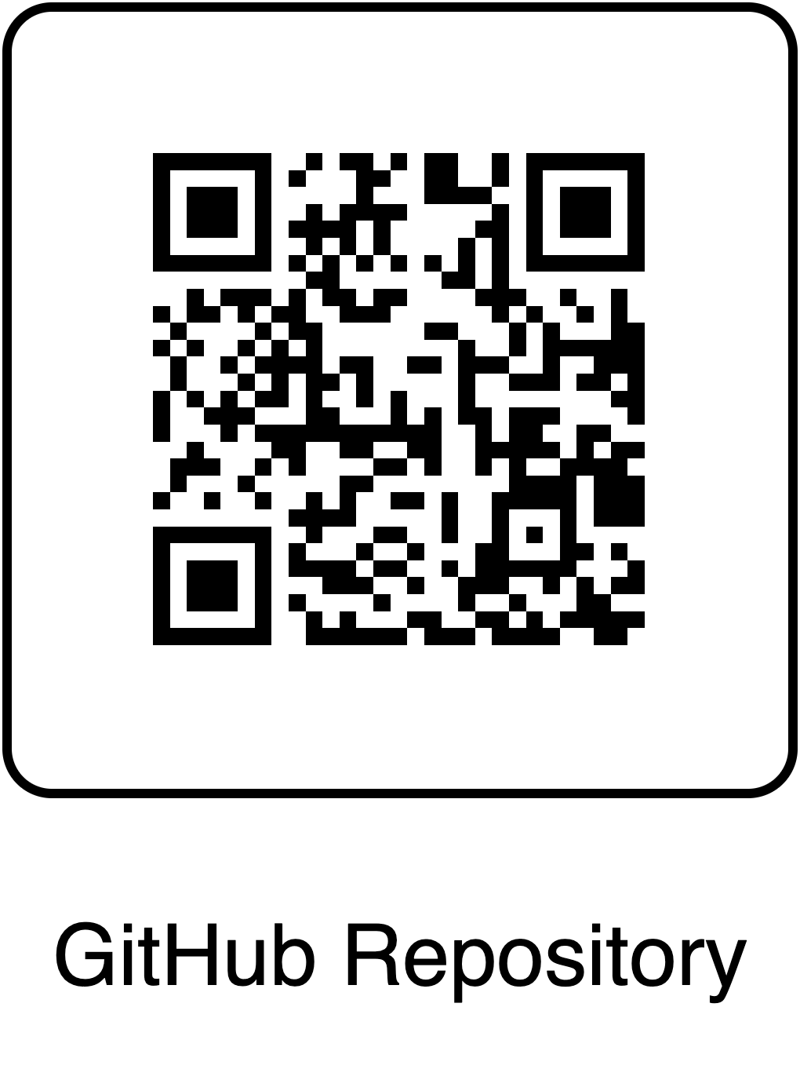
AI Voice Agent for IT Support
Rafael Olmedo*, Javier De La Rosa**, Paul Rad**
* Master of Applied Artificial Intelligence – Tecnológico de Monterrey
** School of Data Science – The University of Texas at San Antonio
Abstract
AI Agent Diagram
Conclusions
This project presents a real-time voice interaction system enabling natural conversation between users and an AI agent over Twilio. User speech is transcribed by Deepgram and processed by the AI, which generates responses that are converted to speech and played back via Twilio. This hands-free, interactive approach enables seamless AI-driven conversations for customer support, data collection, and other voice-enabled applications.
Deepgram (TTS)
Deepgram (STT)
This project demonstrates that integrating modern communication tools, speech recognition, and conversational AI technologies enables natural, real-time voice interactions between users and AI agents.
The system provides an effective platform for customer support, automated data collection, and other voice-enabled applications, reducing manual effort and streamlining workflows.
Future work could further enhance accuracy, reduce latency, and introduce more advanced dialogue management or personalized experiences.
FormAgent (gpt-4o)
State:
Is user’s identity verified
List of answered questions
Current question for user to answer
Next question to ask user
Introduction
Sets user identity verified to true if verification succeeds
Conversational AI is rapidly transforming the way organizations interact with users, offering new levels of accessibility and efficiency. Traditional text-based chatbots have evolved into advanced voice-driven systems, enabling more natural and intuitive exchanges. This project explores the development of a real-time voice interaction system that leverages Twilio for telephony integration, Deepgram for accurate speech-to-text and text-to-speech transcriptions, and advanced AI models for generating dynamic responses. By seamlessly combining these technologies, the system supports interactive, voice-based conversations tailored for customer support, automated data collection, and a variety of hands-free applications. This work demonstrates the potential of modern voice AI to streamline workflows, enhance user experiences, and open new opportunities for intelligent automation across industries.
Adds current question to answered questions
Sets current question to next question
Sets next question to the following question
Verify Identity Tool:
Gets the full name and birth date from the user and verifies whether they match with the database information.
References
Form Service
(Jotform API)
Twilio Documentation, TwiML, Media Streams, https://www.twilio.com/docs
Deepgram Documentation, Speech-to-Text and Text-to-Speech, https://developers.deepgram.com/home
Autogen Documentation, https://microsoft.github.io/autogen/stable//index.html
Jotform, Developer API, https://api.jotform.com/docs/
Add Question Tool:
Receives the answer to the current question and updates the State.
Creates a form submission using answered questions from the State
Submit Form Tool:
Submits form to a form service called Jotform.
Figure 2: FormAgent Overview.
Acknowledgements
Method
Results
We would like to thank everyone who contributed to the development and support of this project. We are also grateful to our colleagues and mentors for their feedback and encouragement throughout this work.
The user’s voice is received via Twilio, transcribed to text by Deepgram (STT), processed by the AI agent, converted back to speech by Deepgram (TTS), and played to the user through Twilio. The host server acts as the orchestrator, managing the communication between all components.
Hi
Hi! I hope you're having a great day. I’ll be happy to help you with the IT Service Ticket Form. To get things started, could you please provide me with your first name, last name, and birth date? Once we have that, we'll move right along with the rest of the form.
Sure, Peter Jones, December 10, 1978
User
Great, thanks for that information, Peter! Now let’s move on to the next part. Could you please provide your email address?
Host Server
(FastAPI)
+
Ngrok
peter@gmail.com
Got it. Now, please describe the problem you are experiencing.
Twilio API
(Outbound)
Twilio API
(Inbound)
I forgot the password of my service account
Deepgram
API (TTS)
Deepgram API (STT)
Got it. Now, please provide a subject for your problem. This will help us categorize and prioritize your request.
Need to restart my password
Your request has been submitted successfully. The IT team will look into your server access permission issue shortly.
FormAgent
(AutoGen)
Thanks, goodbye.
Figure 1: High-level diagram of the AI voice agent system.
Figure 3: Conversation sequence between a human and the FormAgent.

