Slide 1

TP4 - Textures
Computer Graphics
MIEIC
Concepts and Practice
Teresa Matos
19-20 March 2020

Slide 2
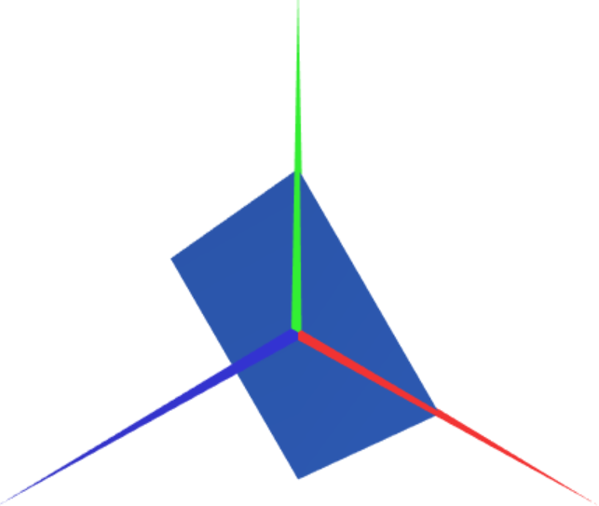
Previous lessons
We have learnt how to create geometries using vertices and indices
this.vertices = {
xA,yA,zA,
xB,yB,zB,
xC,yC,zC,
xD,yD,zD
}
this.indices = {
0, 1, 2,
0, 2, 3
}
D
A
C
B

Slide 3
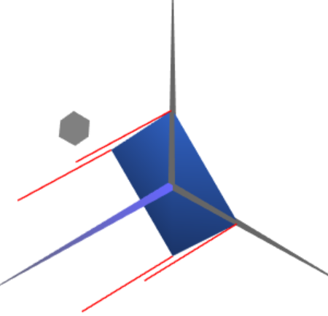
Previous lessons
We defined normals for more realistic lighting of the geometries
this.vertices = {...}
this.indices = {...}
this.normals = {
nAx,nAy,nAz,
nBx,nBy,nBz,
nCx,nCy,nCz,
nDx,nDy,nDz
}
D
A
C
B

Slide 4
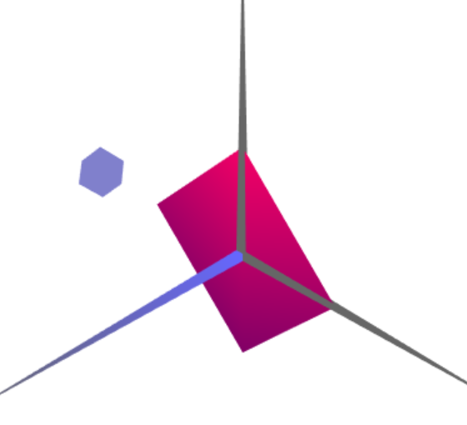
Previous lessons
We applied materials to change the appearance and color of the geometries
init(){
...
this.material = new CGFappearance(scene)
}
display(){
...
this.material.apply()
this.object.display()
}

Slide 5
Application of textures
Another fundamental part of computer graphics - textures

Slide 6
Application of textures in WebGL
In WebGL, images can be loaded to be used as textures for the geometries.
The process of mapping a texture to a geometry involves:
Define the texture coordinates for the geometry
Load an image into a texture
Apply texture before drawing geometry

Slide 7
1 Texture coordinates
Textures use normalized (u,v) coordinates
A pair of (u,v) coordinates represents an image pixel (texel)
(1,1)
(0,0)
(0,0)
(1,1)
OpenGL UV coordinates
WebGL UV coordinates

Slide 8
1 Texture coordinates in WebGL/WebCGF
For each vertex of a geometry, a pair of texture coordinates is defined
In object space, texture coordinates are named (s,t)
The texture coordinates are defined in a texCoords array
this.vertices = {
xA, yA, zA,
xB, yB, zB,
xC, yC, zC,
xD, yD, zD
}
this.texCoords = {
sA, tA,
sB, tB,
sC, tC,
sD, tD
}

Slide 9
1 Texture coordinates - Example
Basic example: Mapping a square texture to a square object
this.vertices = {...}
this.texCoords = {
0, 1,
0, 0,
1, 0,
1, 1
}
A
D
(1,1)
(0,0)
B
C

Slide 10
1 Texture coordinates - Example
Question: What happens when texture coordinates are out of [0-1] range?
this.vertices = {...}
this.texCoords = {
0, 2,
0, 0,
1, 0,
1, 2
}
A
D
?
(1,1)
(0,0)
B
C

Slide 11
1 Texture coordinates - Wrap Mode
Defines how texture is sampled for coordinates out of [0-1] range
By default, wrap mode is ‘REPEAT’
this.vertices = {...}
this.texCoords = {
0, 2,
0, 0,
1, 0,
1, 2
}
2
A
D
1
B
C
1
2

Slide 12
1 Texture coordinates - Wrap Mode
Wrap mode is applied to each axis separately
The other wrap modes are ‘MIRRORED_REPEAT’ and ‘CLAMP_TO_EDGE’
S = 1
Out-of-range coordinates (S > 1) have color of S = 1
‘MIRRORED_REPEAT’
Texture is mirrored in S axis
‘CLAMP_TO_EDGE’
Out-of-range coordinates copy margin values

Slide 13
2 Load image to texture with WebCGF
The WebCGF library has a class for textures - CGFtexture
new CGFtexture(scene, url)
Textures may be associated to materials
material.setTexture(CGFtexture)
Images may also be loaded directly to materials
CGFappearance.loadTexture(url)

Slide 14
3 Apply texture before drawing object
Textures may be applied in two different ways:
Indirectly, associating it to a material
material.setTexture(texture)
…
material.apply()
object.display()
The CGFappearance class also provides a function to define wrap mode
setTextureWrap(wrapS, wrapT)

Slide 15
3 Apply texture before drawing object
Textures may be applied in two different ways:
Directly, by binding it to the WebGL context
texture.bind()
object.display()
This requires the use of WebGL functions to define wrap mode
gl.texParameter[fi](target, pname, param)
Documentation for texParameter function [link]

Slide 16
Additional texture parameters
Other texture parameters may be defined with texParameter() function
Texture filtering mode can be changed to adapt to current requirements
Example: Small texture and a large object
1+ pixel covers 1 texel (magnification)
Linear filtering blends colors of 4 closest texels
Nearest filtering uses color of closest texel
‘LINEAR’
‘NEAREST’

Slide 17
Documentation and guides
CGFtexture documentation
https://paginas.fe.up.pt/~ruirodrig/pub/sw/webcgf/docs/#!/api/CGFtexture
CGFappearance documentation
https://paginas.fe.up.pt/~ruirodrig/pub/sw/webcgf/docs/#!/api/CGFappearance
WebGL texture parameter function
https://developer.mozilla.org/en-US/docs/Web/API/WebGLRenderingContext/texParameter
WebGL textures tutorial
https://webglfundamentals.org/webgl/lessons/webgl-3d-textures.html
Texture wrap mode demonstrator
https://webglfundamentals.org/webgl/webgl-3d-textures-repeat-clamp.html

