Slide 1
Fingerprint Indexing Based on Minutia Cylinder-Code
Ricardo Fontão
Orientadores:
- Ana Rebelo
- Eduardo Meca Castro
31 de julho de 2020
Notes:
Sub-Capa

Slide 2
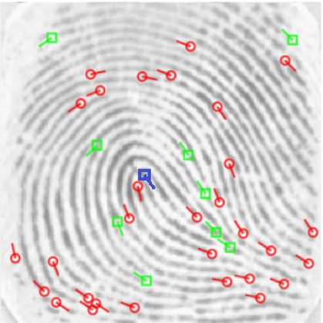
Introduction/motivation
A fingerprint is composed by ridges and valleys which form specific locations, called minutiae (features), which can be used to determine the uniqueness of a person.
In an automated fingerprint identification system (AFIS) the matching process of fingerprints is done against a database of known and unknown prints (1-N).

Slide 3
Objectives
Develop a system capable of doing 1-N fingerprint indexing based on the Compact Binary Minutia Cylinder Code (CBMCC)

Slide 4
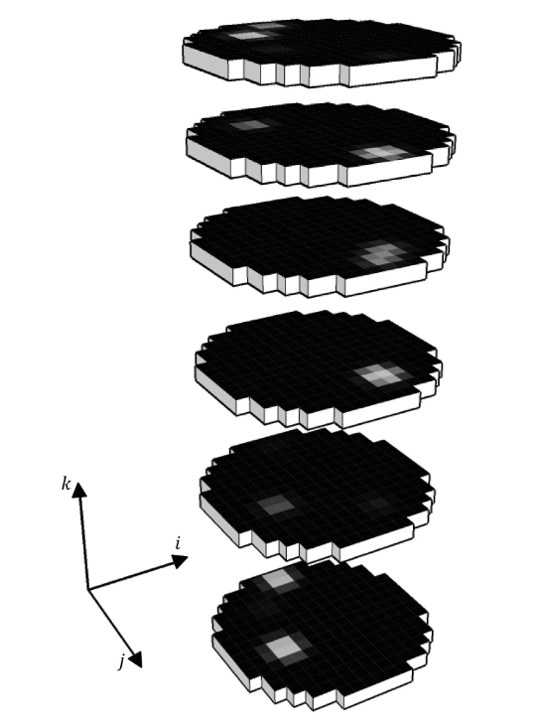
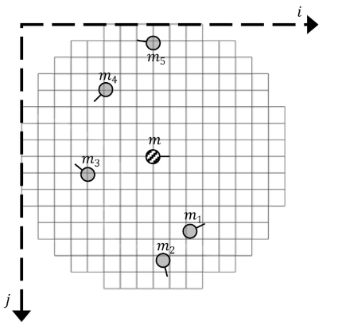
Minutia Cylinder Code (MCC)
Vetor binário
01100...1001

Slide 5
Compact Binary Minutia Cylinder Code (CBMCC)
Use of learning method do reduce MCC length
Aims to decrease the amount of 0s in MCC
It was partially implemented but was slow (using GSL – GNU Scientific Library)
The work was developed with a provided MCC implementation instead

Slide 6
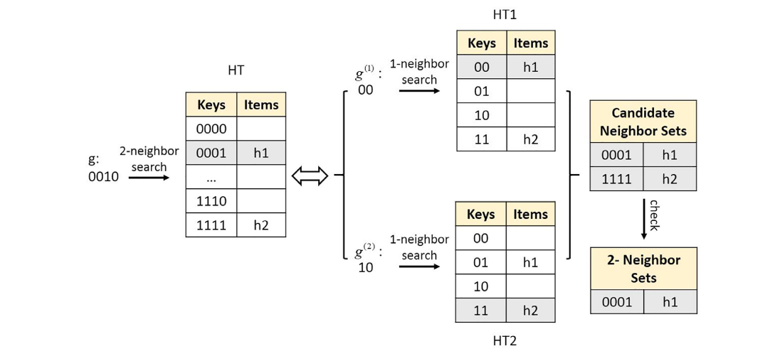
Multi Index Hashing (MIH)
11 buckets examined
Hamming Distance – Number of positions where the bits are different. Example: 0010 and 0001 have a hamming distance of 2
6 buckets examined

Slide 7
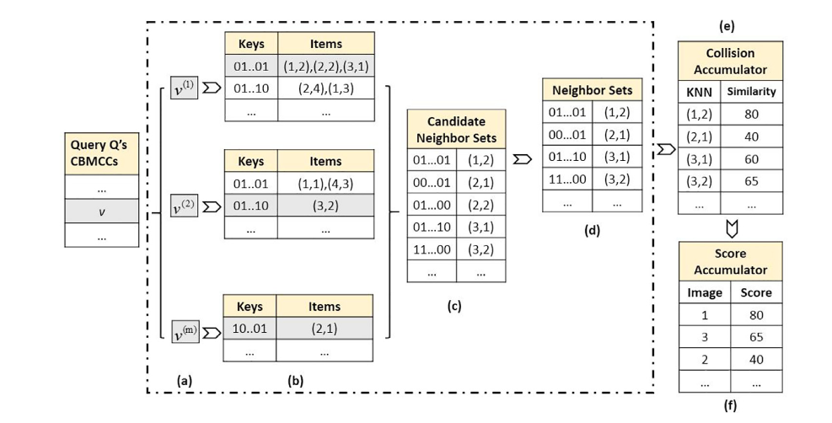
Multi Index Hashing (MIH)

Slide 8
Results obtained
Results obtained in the following conditions:
  Ryzen 5 3600X @ 3.8GHz
  16GB RAM
  GCC 9.3.0 on Ubuntu 20.04(WSL2) with O3 flag
State-of-the-art (Neurotechnology): Claimed 200,000 fingerprints per second (unknown conditions)

Slide 9
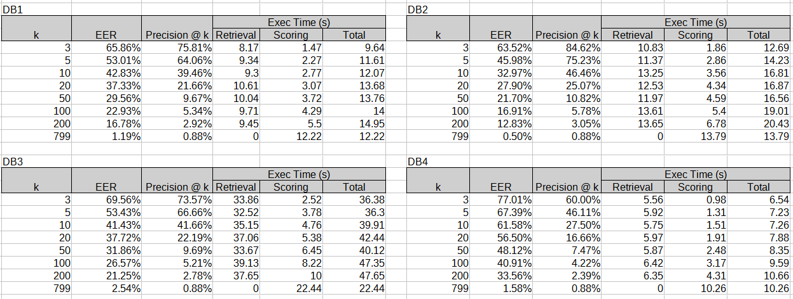
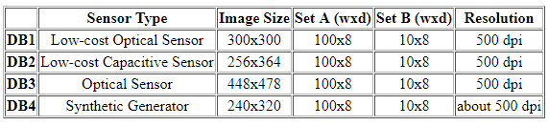
Obtained Results (FVC2000)

Slide 10
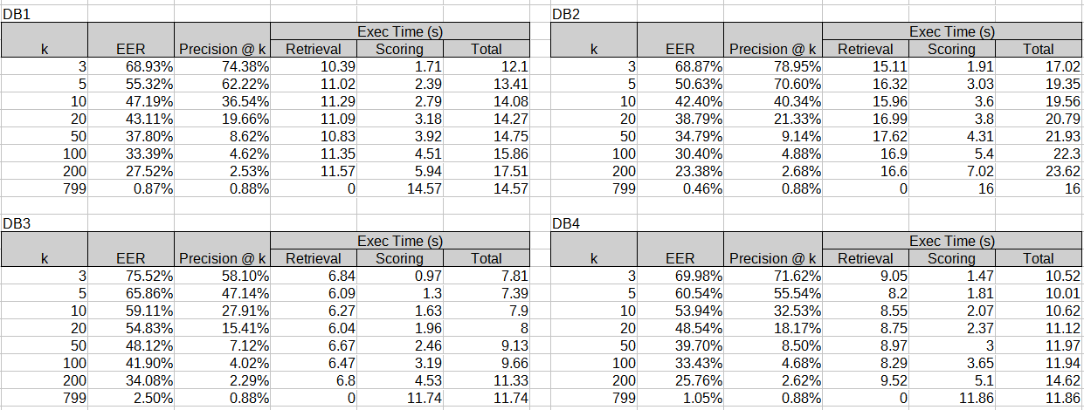
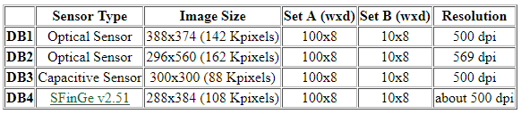
Obtained Results (FVC2002)

Slide 11
Future work
Reimplement CBMCC with a different library
Overall program optimization
Possible multithreading
Tests in bigger databases

