Slide 1
Questions 11-05-2020

Slide 2
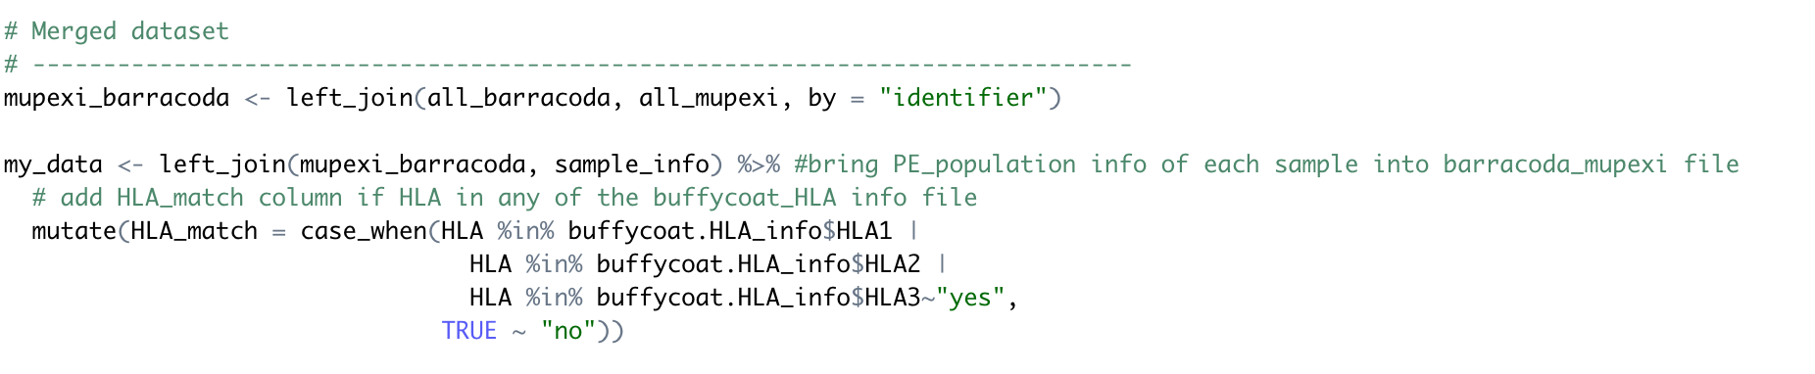
Estimated frequency ..

Slide 3
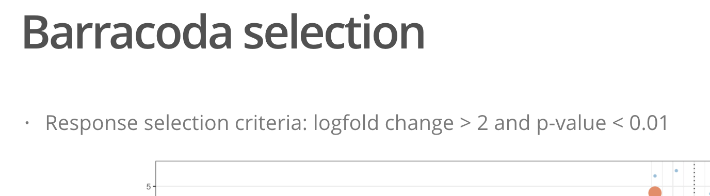
Remove space ioslide

Slide 4
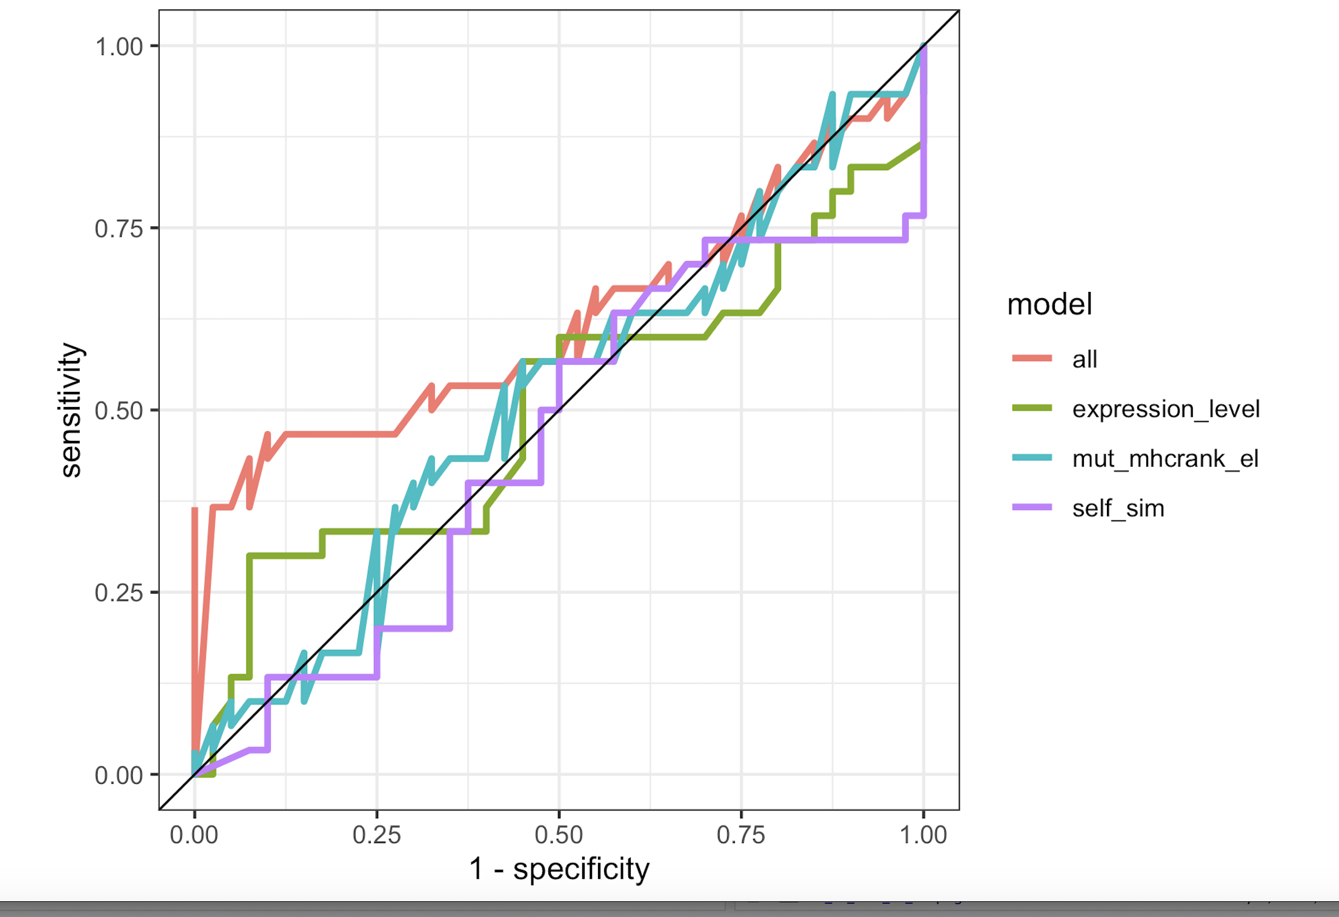
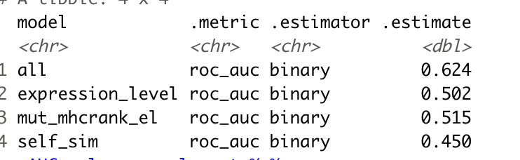
ROC curves - down sampling negative

Slide 5
modelling
Leave one out
Error_LogReg_merge = rep(NA, times=N)
for(k in 1:N){
print(paste('Leave one out number: ', k, '/', N, sep=''));
# Extract the training and test set
X_train <- X_selected[-k,]
y_train <- y[-k]
X_test <- X_selected[k,]
y_test <- y[k]
(fmla <- as.formula(paste("y_train ~ ", paste(attributeNames, collapse= "+"))))
# Fit logistic regression model to predict the response
model = glm(fmla,family=binomial(link="logit"), data=X_train)
# model = lm(fmla, data=X_train)
p = predict(model, newdata=X_test,type="response")
Error_LogReg_merge[k] = (round(p,0)==y_test)
}

