Slide 1
Revealing the success behind South Korea approach to COVID-19
Group 10

Slide 2
Introduction
South Korea during COVID-19

Slide 3
Materials and methods
Brief description of the dataset
The dataset Data Science for COVID-19, with the followin structure, was retreived from Kaggle. # image from file
Packages used
Tidyverse ——– plotly igraph viridis rgdal maptools gpclib
Table: Packages used.

Slide 4
Results
summary(cars)
## speed dist ## Min. : 4.0 Min. : 2.00 ## 1st Qu.:12.0 1st Qu.: 26.00 ## Median :15.0 Median : 36.00 ## Mean :15.4 Mean : 42.98 ## 3rd Qu.:19.0 3rd Qu.: 56.00 ## Max. :25.0 Max. :120.00

Slide 5
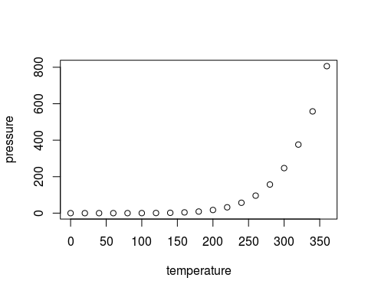
Slide with Plot

