Slide 1

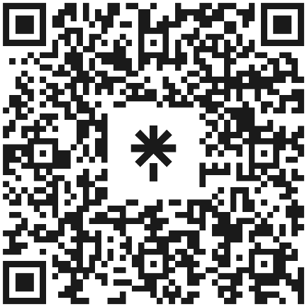
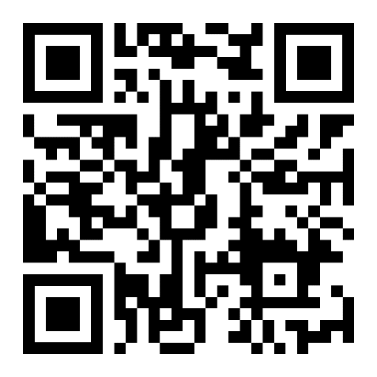
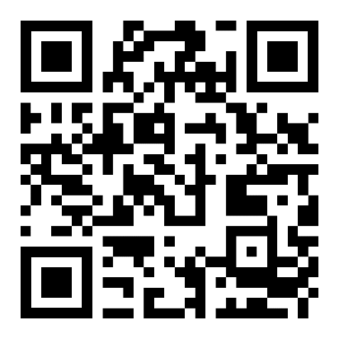

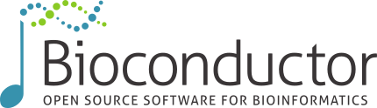
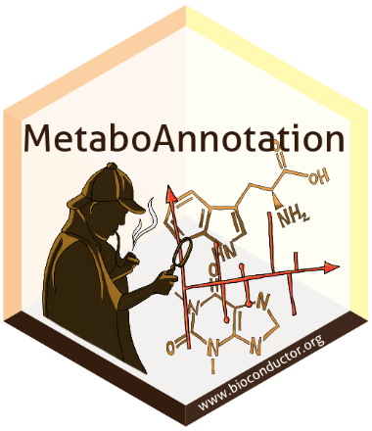

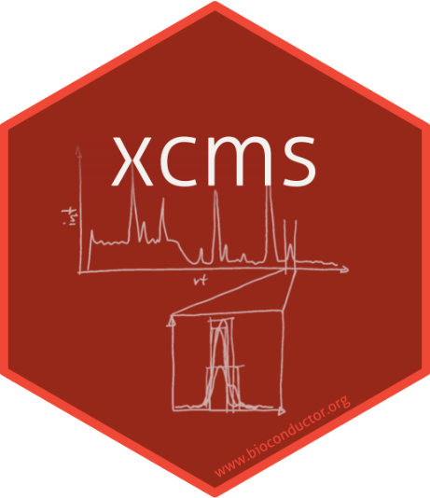
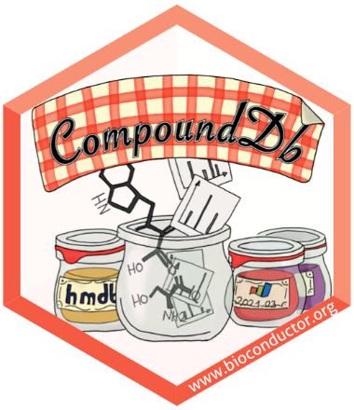
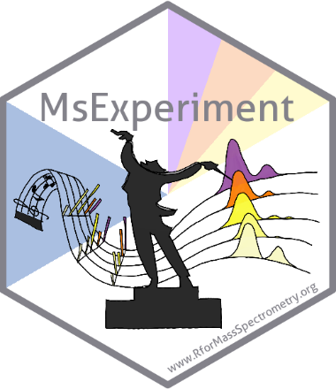

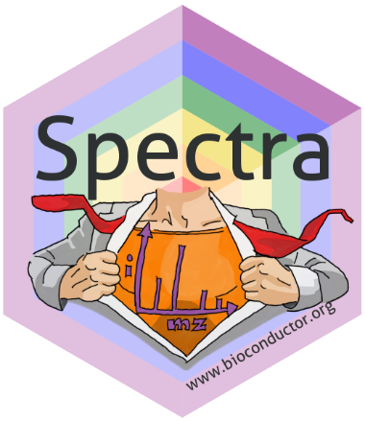


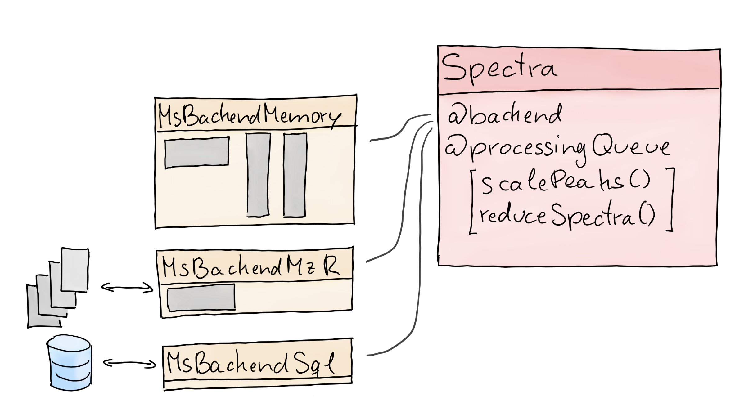
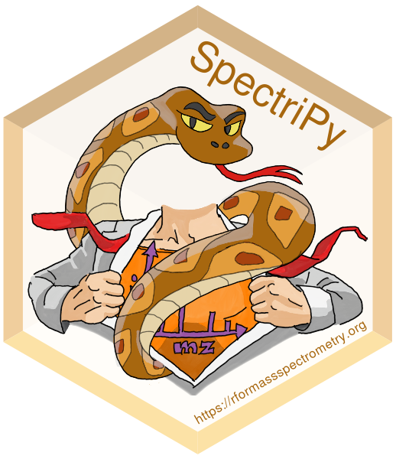





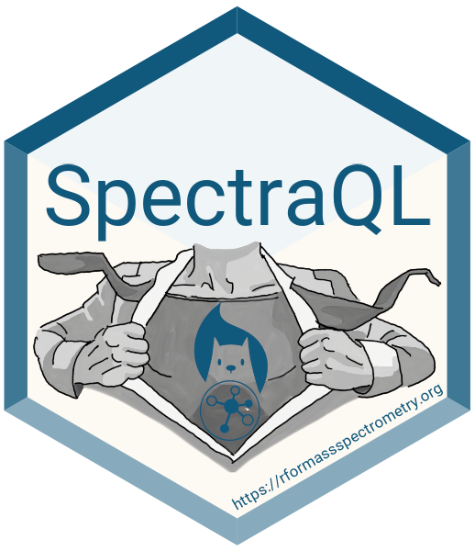
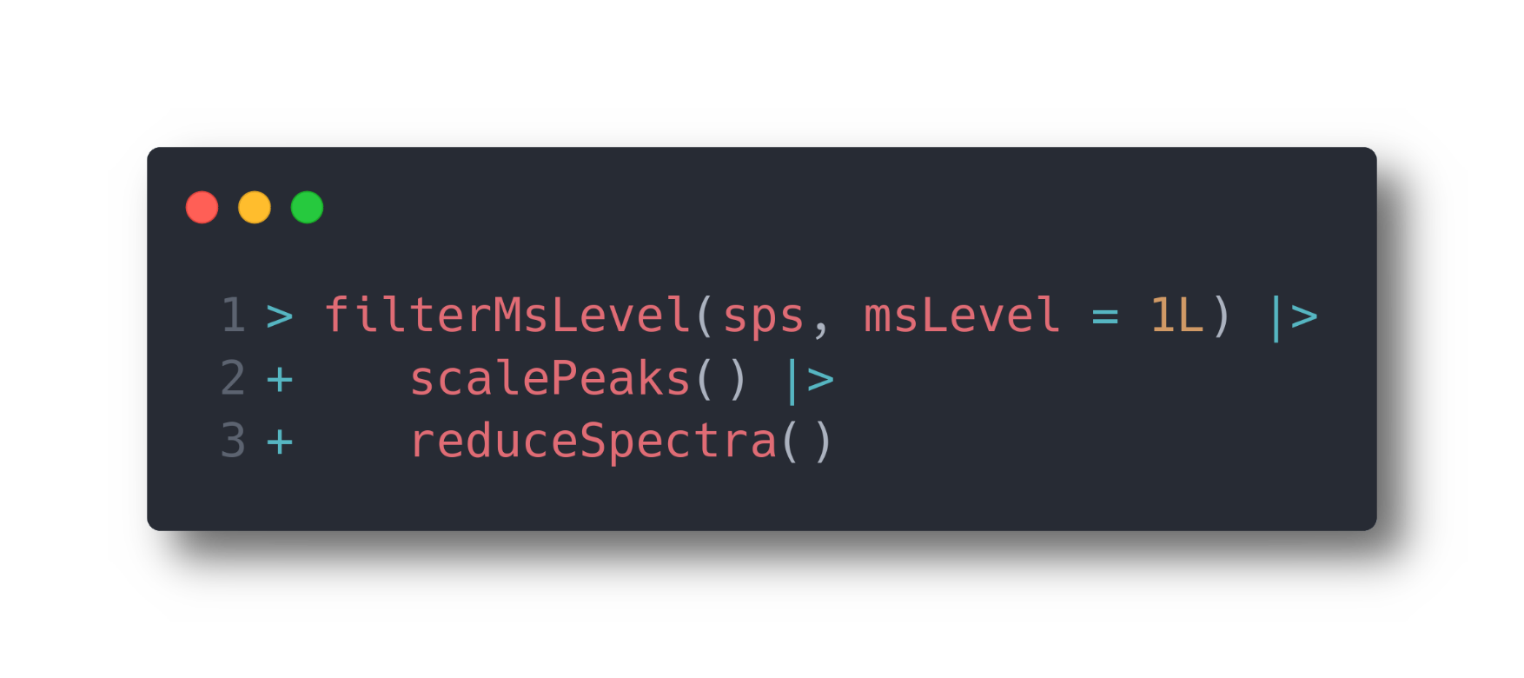

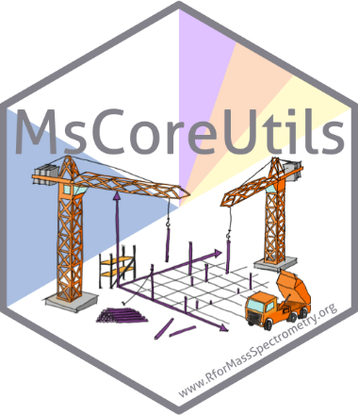
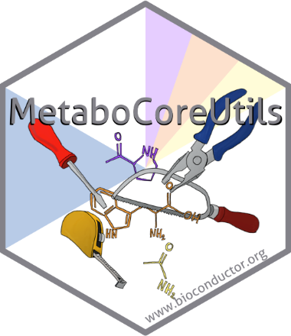
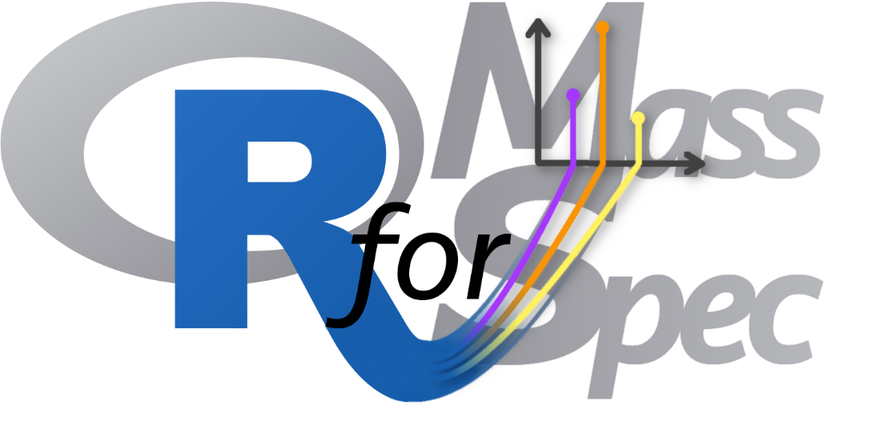


An Open Software Development-based Ecosystem of Packages for Metabolomics Data Analysis
Johannes Rainer¹, Philippine Louail¹, Andrea Vicini², Roger Gine³, Josep M Badia^{3,4} , Michele Stravs^{5,6}, Mar Garcia-Aloy⁷, Carolin Huber⁸, Liesa Salzer⁹, Jan Stanstrup¹⁰, Nir Shahaf¹¹, Christian Panse^{12,13}, Thomas Naake¹⁴, William Kumler¹⁵, Pablo Vangeenderhuysen¹⁶, Carl Brunius¹⁷, Helge Hecht¹⁸, Steffen Neumann¹⁹, Michael Witting²⁰, Sebastian Gibb²¹, Laurent Gatto²
¹Institute for Biomedicine, Eurac Research, Italy. ²Computational Biology and Bioinformatics, de Duve Institute, UCLouvain, Belgium. ³Department of Electronic Engineering & IISPV, Universitat Rovira i Virgili, Spain. ⁴CIBERDERM, Instituto de Salud Carlos III, Spain. ⁵Department of Environmental Chemistry, Switzerland. ⁶Institute of Molecular Systems Biology, ETH Zurich, Switzerland. ⁷Metabolomics Unit, Research and Innovation Centre, Fondazione Edmund Mach, Italy. ⁸Department of Effect Directed Analysis, Helmholtz Center for Environmental Research, Germany. ⁹Research Unit Analytical BioGeoChemistry, Helmholtz Munich, Germany. ¹⁰Department of Nutrition, Exercise and Sports, University of Copenhagen, Denmark. ¹¹Department of Plant and Environmental Sciences, Weizmann Institute of Science, Israel. ¹²Functional Genomics Center Zurich, University of Zurich/ETH Zurich, Switzerland. ¹³Swiss Institute of Bioinformatics, Switzerland. ¹⁴Genome Biology Unit, EMBL, Germany. ¹⁵Ingals Lab, School of Oceanography, University of Washington, USA. ¹⁶Laboratory of Integrative Metabolomics, Department of Translational Physiology, Infectiology and Public Health, Faculty of Veterinary Medicine, Ghent University, Belgium. ¹⁷Department of Life Sciences, Chalmers University of Technology, Sweden. ¹⁸RECETOX, Faculty of Science, Masaryk University, Czech Republic. ¹⁹Computational Plant Biochemistry, MetaCom, Leibniz Institute of Plant Biochemistry, Germany. ²⁰Metabolomics and Proteomics Core, Helmholtz Munich, Germany. ²¹Anesthesiology and Intensive Care Medicine, University Hospital Greifswald, Germany.
In a nutshell
Get in touch/contribute
Poster on Zenodo
… to see it in action
Powerful and flexible infrastructure for efficient analysis of large-scale MS data
Open collaborative development of software for MS data analysis:
Well documented and thoroughly tested
Long-term support and maintenance
Modular package ecosystem to allow creation of custom analysis workflows
Tightly integrated into
Annotation
[2]
Compounding
LC-MS(/MS) preprocessing
Group adducts
Group isotopes
MS1 and MS2-based annotation
Fragment spectra matching
Quality assessment
Chromatographic peak detection
Alignment
Correspondence
Reference libraries
In-house databases through CompoundDb
MassBank through Bioconductor’s AnnotationHub
Import GNPS or others from MGF, MSP files.
MsQuality
[1]
Data I/O and representation
Integration with external tools
Support for additional MS data file formats
Different data representations :
Optimized for performance
Optimized for large scale data
Design and usage
MsBackendTimsTof
[4]
Integrate/use mstchms-based similarity scores for fragment spectra
Query MS data using the MassQL query language in R.
MsBackend
RawFileReader
MS data handling, processing, filtering, aggregating, comparing, visualizing…
[3]
[5]
Core low-level functions
Spectra similarity scores
Peak alignment
Handling chemical formulas
Isotope peak prediction
Adduct/exact mass calculations
etc
Outlook
Continue integration of R/Bioconductor packages and external software
Emphasis on seamless integration to improve user experience
Open for contributions from the community -> reach out via github issue or email
References
[1] MsQuality – an interoperable open-source package for the calculation of standardized quality metrics of mass spectrometry data. Naake T et al. Bioinformatics 2023. https://doi.org/10.1093/bioinformatics/btad618
[2] A Modular and Expandable Ecosystem for Metabolomics Data Annotation in R. Rainer J et al. Metabolites 2022. https://doi.org/10.3390/metabo12020173
[3] The rawrr R Package: Direct Access to Orbitrap Data and Beyond. Kockmann T et al. Journal of Proteome Research 2021. https://doi.org/10.1021/acs.jproteome.0c00866
[4] matchms – processing and similarity evaluation of mass spectrometry data. Huber F et al. JOSS 2020. https://doi.org/10.21105/joss.02411
[5] A Universal Language for Finding Mass Spectrometry Data Patterns. Jarmusch AK et al. bioRxiv 2022. https://doi.org/10.1101/2022.08.06.503000
@jorainer@fosstodon.org
https://zenodo.org/doi/10.5281/zenodo.7936786

