Slide 1
Portland Public Schools Math Proficiency Report

Slide 2
Introduction
This is a report on math proficiency results in Portland Public Schools (PPS). The PPS mission statement is as follows:
We provide rigorous, high-quality academic learning experiences that are inclusive and joyful. We disrupt racial inequities to create vibrant environments for every student to demonstrate excellence.¹
Hello hello hello!
Portland Public Schools

Slide 3
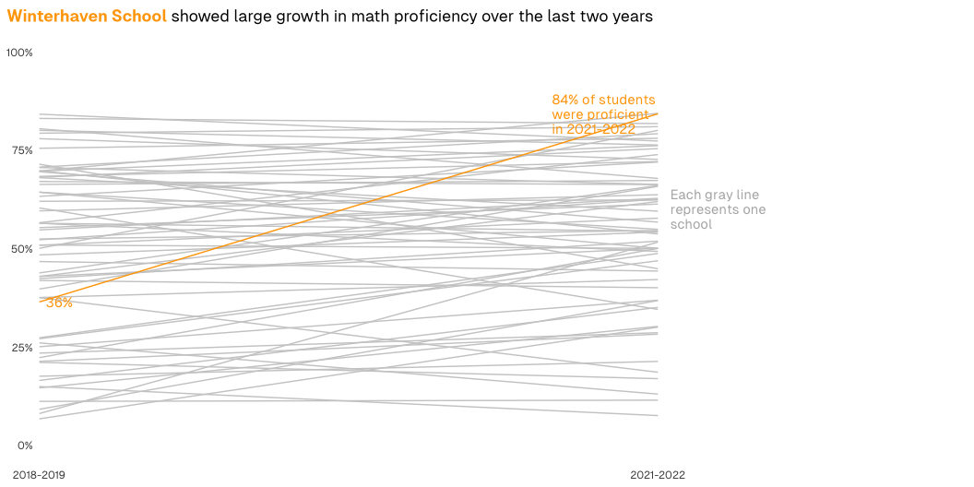
Plot
Chart showing growth in math proficiency for PPS schools from 2018-2019 to 2021-2022

Slide 4
Table
School | 2018-2019 | 2021-2022
Abernethy Elementary School | 71% | 79%
Ainsworth Elementary School | 80% | 68%
Alameda Elementary School | 83% | 82%
Arleta Elementary School | 42% | 52%
Astor Elementary School | 60% | 64%
Atkinson Elementary School | 51% | 58%
Beach Elementary School | 57% | 74%
Beverly Cleary School | 68% | 75%
Boise-Eliot Elementary School | 18% | 21%
Bridger Elementary School | 60% | 34%
Bridlemile Elementary School | 68% | 72%
Buckman Elementary School | 56% | 49%
Capitol Hill Elementary School | 66% | 67%
Cesar Chavez K-8 School | 26% | 13%
Chapman Elementary School | 70% | 54%
Chief Joseph Elementary School | 51% | 50%
Creative Science School | 38% | 42%
Creston Elementary School | 55% | 61%
Duniway Elementary School | 71% | 66%
Emerson School | 52% | 62%
Faubion Elementary School | 21% | 17%
Forest Park Elementary School | 70% | 84%
Glencoe Elementary School | 70% | 57%
Grout Elementary School | 48% | 54%
Harrison Park School | 16% | 35%
Hayhurst Elementary School | 67% | 66%
Irvington Elementary School | 64% | 50%
James John Elementary School | 42% | 40%
Kairos PDX | 8% | 52%
Kelly Elementary School | 23% | 29%
Laurelhurst Elementary School | 68% | 59%
Le Monde French Immersion Public Charter School | 84% | 77%
Lee Elementary School | 22% | 50%
Lent Elementary School | 11% | 11%
Lewis Elementary School | 55% | 63%
Llewellyn Elementary School | 79% | 81%
Maplewood Elementary School | 44% | 66%
Markham Elementary School | 71% | 45%
Martin Luther King Jr. School | 9% | 37%
Marysville Elementary School | 25% | 37%
Metropolitan Learning Center | 43% | 62%
Opal School of the Portland Children's Museum | 29% | NA
Peninsula Elementary School | 27% | 49%
Portland Arthur Academy Charter School | 43% | 50%
Portland Village School | 56% | 54%
Richmond Elementary School | 78% | 73%
Rieke Elementary School | 75% | 78%
Rigler Elementary School | 7% | 30%
Rosa Parks Elementary School | 15% | 8%
Rose City Park | 63% | 72%
Sabin Elementary School | 62% | 62%
Scott Elementary School | 27% | 47%
Sitton Elementary School | 15% | 30%
Skyline Elementary School | 50% | 80%
Stephenson Elementary School | 80% | 76%
Sunnyside Environmental School | 40% | 66%
Trillium | 29% | NA
Vernon Elementary School | 52% | 55%
Vestal Elementary School | 64% | 55%
Whitman Elementary School | 38% | 19%
Winterhaven School | 36% | 84%
Woodlawn Elementary School | 47% | 44%
Woodmere Elementary School | 21% | 28%
Woodstock Elementary School | 70% | 76%
The following table shows math proficiency in 2018-2019 and 2021-2022 for all PPS schools. If you want to see Winterhaven School, you can use the search bar to find it.

Slide 5
Notes
1. https://www.pps.net/about/portland-public-schools-information/overview

