Slide 1
There is variability in no-shows
AHEC data storytelling challenge
Story 1 Attendance summary
Review attendance data and identify opportunities. 6,000 simulated appointments.
Notes:
Source: synthetic_appointments.csv. Entirely simulated training data. One row is one original scheduled appointment. No-show rate uses all scheduled appointments, including cancellations. These observational comparisons do not establish causal effects.
6,000 simulated appointments across four specialties and one fictional calendar year. Student draft.

Slide 2
Data and considerations
6,000 appointments. Some considerations for the review.
The file includes one row for each originally scheduled appointment across four specialties and twelve months. Patients fall into four age bands. Appointments can end as completed visits, no-shows, early cancellations, or late cancellations. The no-show rate uses all originally scheduled appointments as the denominator, including canceled appointments. A no-show count describes volume and depends on how many appointments a group has. Age groups can have different mixes of specialties. Specialty services may have different attendance rates, booking lead times, and reminder assignments.
Comparing age groups across all specialties can therefore produce a different pattern from comparing them within the same specialty. Comparing groups within one specialty still leaves other differences unmeasured. These records contain no information on transport, prior attendance, patient preferences, or the reason for a missed visit. All records are synthetic examples for this class. An observed age difference supports further investigation, but it cannot establish that age causes patients to miss appointments or justify a punitive age-based policy.
Notes:
Source: synthetic_appointments.csv. Entirely simulated training data. One row is one original scheduled appointment. No-show rate uses all scheduled appointments, including cancellations. These observational comparisons do not establish causal effects.

Slide 3
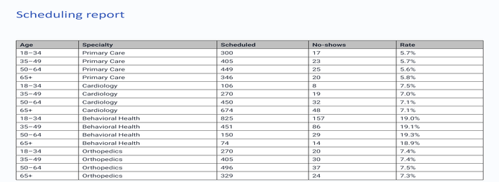
Dashboard image
Report export
Screenshot from an internal scheduling summary. Full detail is available in the CSV.
Notes:
Source: synthetic_appointments.csv. Entirely simulated training data. One row is one original scheduled appointment. No-show rate uses all scheduled appointments, including cancellations. These observational comparisons do not establish causal effects.

Slide 4
Other volume information
Monthly workload
Month | Scheduled
January | 422
February | 422
March | 483
April | 483
May | 483
June | 481
July | 418
August | 478
September | 658
October | 657
November | 538
December | 477
January through December appointment volume.
Notes:
Source: synthetic_appointments.csv. Entirely simulated training data. One row is one original scheduled appointment. No-show rate uses all scheduled appointments, including cancellations. These observational comparisons do not establish causal effects.

Slide 5
Age results
No-shows by age group. Younger people are more likely to no-show (probably because old people are more conscientious about their health).
Age | Scheduled | Rate
18–34 | 1,501 | 13.5%
35–49 | 1,531 | 10.3%
50–64 | 1,545 | 8.0%
65+ | 1,423 | 7.4%
Notes:
Source: synthetic_appointments.csv. Entirely simulated training data. One row is one original scheduled appointment. No-show rate uses all scheduled appointments, including cancellations. These observational comparisons do not establish causal effects.
18–34: 202/1501 = 13.5%
35–49: 158/1531 = 10.3%
50–64: 123/1545 = 8.0%
65+: 106/1423 = 7.4%

Slide 6
Specialty information
Some specialty details
This is the percentage distribution of specialties for each age category.
Notes:
Source: synthetic_appointments.csv. Entirely simulated training data. One row is one original scheduled appointment. No-show rate uses all scheduled appointments, including cancellations. These observational comparisons do not establish causal effects.
18–34, Primary Care: 300, 20.0%
35–49, Primary Care: 405, 26.5%
50–64, Primary Care: 449, 29.1%
65+, Primary Care: 346, 24.3%
18–34, Cardiology: 106, 7.1%
35–49, Cardiology: 270, 17.6%
50–64, Cardiology: 450, 29.1%
65+, Cardiology: 674, 47.4%
18–34, Behavioral Health: 825, 55.0%
35–49, Behavioral Health: 451, 29.5%
50–64, Behavioral Health: 150, 9.7%
65+, Behavioral Health: 74, 5.2%
18–34, Orthopedics: 270, 18.0%
35–49, Orthopedics: 405, 26.5%
50–64, Orthopedics: 496, 32.1%
65+, Orthopedics: 329, 23.1%

Slide 7
More results
Multiple group comparison
No-show percentages by specialty and age.
Notes:
Source: synthetic_appointments.csv. Entirely simulated training data. One row is one original scheduled appointment. No-show rate uses all scheduled appointments, including cancellations. These observational comparisons do not establish causal effects.
Primary Care, 18–34: 17/300 = 5.7%
Primary Care, 35–49: 23/405 = 5.7%
Primary Care, 50–64: 25/449 = 5.6%
Primary Care, 65+: 20/346 = 5.8%
Cardiology, 18–34: 8/106 = 7.5%
Cardiology, 35–49: 19/270 = 7.0%
Cardiology, 50–64: 32/450 = 7.1%
Cardiology, 65+: 48/674 = 7.1%
Behavioral Health, 18–34: 157/825 = 19.0%
Behavioral Health, 35–49: 86/451 = 19.1%
Behavioral Health, 50–64: 29/150 = 19.3%
Behavioral Health, 65+: 14/74 = 18.9%
Orthopedics, 18–34: 20/270 = 7.4%
Orthopedics, 35–49: 30/405 = 7.4%
Orthopedics, 50–64: 37/496 = 7.5%
Orthopedics, 65+: 24/329 = 7.3%

Slide 8
Summary and next steps
There are differences across groups. Specialty mix varies. Actions to help younger people make their appointments may reduce their no-shows.
Notes:
Source: synthetic_appointments.csv. Entirely simulated training data. One row is one original scheduled appointment. No-show rate uses all scheduled appointments, including cancellations. These observational comparisons do not establish causal effects.

