Slide 1
Reminder methods have different results
AHEC data storytelling challenge
Story 2 Attendance summary
Review attendance data and identify opportunities. 6,000 simulated appointments.
Notes:
Source: synthetic_appointments.csv. Entirely simulated training data. One row is one original scheduled appointment. No-show rate uses all scheduled appointments, including cancellations. These observational comparisons do not establish causal effects.
6,000 simulated appointments across four specialties and one fictional calendar year. Student draft.

Slide 2
Process details
6,000 appointments. Some considerations for the review.
The scheduling team records one reminder method for each appointment: phone call, text, AI outreach, or email. AI outreach represents a fictional automated conversational reminder process. Method assignment differs across appointments. In this simulation, scheduling rules assign AI outreach more often to appointments booked far in advance. The method groups therefore do not begin with the same distribution of booking lead times. Booking lead time is the number of days from scheduling to the appointment. The analysis uses the same four lead-time bands throughout.
The no-show rate uses all originally scheduled appointments, including cancellations, as the denominator. Pooled method rates combine short and long lead times. Comparing methods within the same lead-time band makes that factor more comparable but still leaves specialty, age, delivery, contact preferences, and other differences to consider. The file does not record whether patients received or read a message. Any method comparison describes an association in synthetic records and cannot establish the effect of replacing one reminder method with another.
Notes:
Source: synthetic_appointments.csv. Entirely simulated training data. One row is one original scheduled appointment. No-show rate uses all scheduled appointments, including cancellations. These observational comparisons do not establish causal effects.

Slide 3
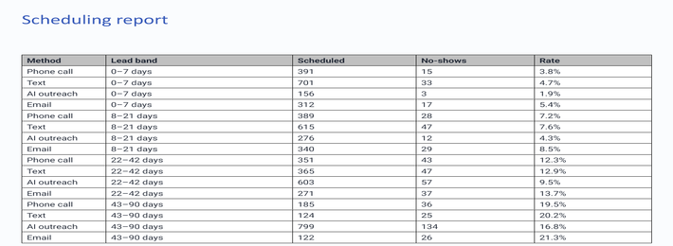
Outreach report
Report export
Screenshot from an internal scheduling summary. Full detail is available in the CSV.
Notes:
Source: synthetic_appointments.csv. Entirely simulated training data. One row is one original scheduled appointment. No-show rate uses all scheduled appointments, including cancellations. These observational comparisons do not establish causal effects.

Slide 4
Other volume information
Monthly workload
Month | Scheduled
January | 422
February | 422
March | 483
April | 483
May | 483
June | 481
July | 418
August | 478
September | 658
October | 657
November | 538
December | 477
January through December appointment volume. These numbers may be useful for another discussion.
Notes:
Source: synthetic_appointments.csv. Entirely simulated training data. One row is one original scheduled appointment. No-show rate uses all scheduled appointments, including cancellations. These observational comparisons do not establish causal effects.

Slide 5
Reminder performance
Method statistics
Methods have different percentages.
Notes:
Source: synthetic_appointments.csv. Entirely simulated training data. One row is one original scheduled appointment. No-show rate uses all scheduled appointments, including cancellations. These observational comparisons do not establish causal effects.
Phone call: 122/1316 = 9.3%
Text: 152/1805 = 8.4%
AI outreach: 206/1834 = 11.2%
Email: 109/1045 = 10.4%

Slide 6
Appointment distribution
Booking categories
The distribution of days varies by method.
Notes:
Source: synthetic_appointments.csv. Entirely simulated training data. One row is one original scheduled appointment. No-show rate uses all scheduled appointments, including cancellations. These observational comparisons do not establish causal effects.
Phone call, 0–7 days: n=391, 29.7%
Text, 0–7 days: n=701, 38.8%
AI outreach, 0–7 days: n=156, 8.5%
Email, 0–7 days: n=312, 29.9%
Phone call, 8–21 days: n=389, 29.6%
Text, 8–21 days: n=615, 34.1%
AI outreach, 8–21 days: n=276, 15.0%
Email, 8–21 days: n=340, 32.5%
Phone call, 22–42 days: n=351, 26.7%
Text, 22–42 days: n=365, 20.2%
AI outreach, 22–42 days: n=603, 32.9%
Email, 22–42 days: n=271, 25.9%
Phone call, 43–90 days: n=185, 14.1%
Text, 43–90 days: n=124, 6.9%
AI outreach, 43–90 days: n=799, 43.6%
Email, 43–90 days: n=122, 11.7%

Slide 7
Additional comparisons
Further data
Results in categories are shown in the chart.
Notes:
Source: synthetic_appointments.csv. Entirely simulated training data. One row is one original scheduled appointment. No-show rate uses all scheduled appointments, including cancellations. These observational comparisons do not establish causal effects.
Phone call, 0–7 days: 15/391 = 3.8%
Text, 0–7 days: 33/701 = 4.7%
AI outreach, 0–7 days: 3/156 = 1.9%
Email, 0–7 days: 17/312 = 5.4%
Phone call, 8–21 days: 28/389 = 7.2%
Text, 8–21 days: 47/615 = 7.6%
AI outreach, 8–21 days: 12/276 = 4.3%
Email, 8–21 days: 29/340 = 8.5%
Phone call, 22–42 days: 43/351 = 12.3%
Text, 22–42 days: 47/365 = 12.9%
AI outreach, 22–42 days: 57/603 = 9.5%
Email, 22–42 days: 37/271 = 13.7%
Phone call, 43–90 days: 36/185 = 19.5%
Text, 43–90 days: 25/124 = 20.2%
AI outreach, 43–90 days: 134/799 = 16.8%
Email, 43–90 days: 26/122 = 21.3%

Slide 8
Summary and next steps
Methods differ. Lead times differ. Consider additional review.
Notes:
Source: synthetic_appointments.csv. Entirely simulated training data. One row is one original scheduled appointment. No-show rate uses all scheduled appointments, including cancellations. These observational comparisons do not establish causal effects.

