Slide 1
Booking patterns and appointment outcomes
AHEC data storytelling challenge
Story 3 Attendance summary
Review attendance data and identify opportunities. 6,000 simulated appointments.
Notes:
Source: synthetic_appointments.csv. Entirely simulated training data. One row is one original scheduled appointment. No-show rate uses all scheduled appointments, including cancellations. These observational comparisons do not establish causal effects.
6,000 simulated appointments across four specialties and one fictional calendar year. Student draft.

Slide 2
Definitions and operational background
6,000 appointments. Some considerations for the review.
Each row represents an originally scheduled appointment slot. The file records a completed visit, a no-show, an early cancellation, or a late cancellation. Early means at least 24 hours before the scheduled visit and late means less than 24 hours. Canceled slots may refill. The replacement appointment does not create a second row in this file. For this review, an unrecovered slot is a no-show or a canceled slot recorded as not refilled. The denominator for the unrecovered-slot rate is all originally scheduled slots.
The denominator for refill rate is canceled slots only. These measures count appointments and cannot quantify clinician hours or financial losses. Specialties have different typical lead times, patient mixes, and refill patterns. Pooled lead-time comparisons may partly reflect those differences. An early cancellation that refills should not count as unrecovered capacity. These synthetic records can identify a service for closer review, but they cannot establish that shortening booking lead time would reduce losses or that a particular recovery process caused a higher refill rate.
Notes:
Source: synthetic_appointments.csv. Entirely simulated training data. One row is one original scheduled appointment. No-show rate uses all scheduled appointments, including cancellations. These observational comparisons do not establish causal effects.

Slide 3
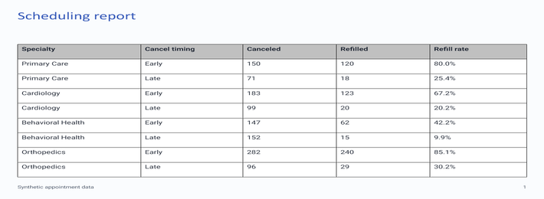
Capacity report
Report export
Screenshot from an internal scheduling summary. Full detail is available in the CSV.
Notes:
Source: synthetic_appointments.csv. Entirely simulated training data. One row is one original scheduled appointment. No-show rate uses all scheduled appointments, including cancellations. These observational comparisons do not establish causal effects.

Slide 4
Other volume information
Monthly workload
Month | Scheduled
January | 422
February | 422
March | 483
April | 483
May | 483
June | 481
July | 418
August | 478
September | 658
October | 657
November | 538
December | 477
January through December appointment volume. These numbers may be useful for another discussion.
Notes:
Source: synthetic_appointments.csv. Entirely simulated training data. One row is one original scheduled appointment. No-show rate uses all scheduled appointments, including cancellations. These observational comparisons do not establish causal effects.

Slide 5
Lead-time results
Booking intervals
Rates are shown for several lead-time bands.
Notes:
Source: synthetic_appointments.csv. Entirely simulated training data. One row is one original scheduled appointment. No-show rate uses all scheduled appointments, including cancellations. These observational comparisons do not establish causal effects.
Unrecovered = no-show or cancellation not refilled. Denominator: all scheduled appointments. 0–7 days: 160/1560
8–21 days: 251/1620
22–42 days: 349/1590
43–90 days: 382/1230

Slide 6
Specialty comparisons
A more detailed comparison
The chart gives additional outcomes by service and lead-time band.
Notes:
Source: synthetic_appointments.csv. Entirely simulated training data. One row is one original scheduled appointment. No-show rate uses all scheduled appointments, including cancellations. These observational comparisons do not establish causal effects.
Unrecovered = no-show or cancellation not refilled. Primary Care, 0–7 days: 66/750 = 8.8%
Primary Care, 8–21 days: 57/495 = 11.5%
Primary Care, 22–42 days: 26/180 = 14.4%
Primary Care, 43–90 days: 19/75 = 25.3%
Cardiology, 0–7 days: 24/270 = 8.9%
Cardiology, 8–21 days: 59/405 = 14.6%
Cardiology, 22–42 days: 95/525 = 18.1%
Cardiology, 43–90 days: 68/300 = 22.7%
Behavioral Health, 0–7 days: 30/120 = 25.0%
Behavioral Health, 8–21 days: 75/270 = 27.8%
Behavioral Health, 22–42 days: 160/480 = 33.3%
Behavioral Health, 43–90 days: 243/630 = 38.6%
Orthopedics, 0–7 days: 40/420 = 9.5%
Orthopedics, 8–21 days: 60/450 = 13.3%
Orthopedics, 22–42 days: 68/405 = 16.8%
Orthopedics, 43–90 days: 52/225 = 23.1%

Slide 7
Outcome breakdown
Several outcomes
Multiple appointment outcomes are included.
Notes:
Source: synthetic_appointments.csv. Entirely simulated training data. One row is one original scheduled appointment. No-show rate uses all scheduled appointments, including cancellations. These observational comparisons do not establish causal effects.
Unrecovered = no-show or cancellation not refilled. Primary Care: no-shows 85, early-unfilled 30, late-unfilled 53, total 168/1500 = 11.2%
Cardiology: no-shows 107, early-unfilled 60, late-unfilled 79, total 246/1500 = 16.4%
Behavioral Health: no-shows 286, early-unfilled 85, late-unfilled 137, total 508/1500 = 33.9%
Orthopedics: no-shows 111, early-unfilled 42, late-unfilled 67, total 220/1500 = 14.7%

Slide 8
Summary and next steps
Lead time varies. Outcomes vary. Canceled slots sometimes refill.
Notes:
Source: synthetic_appointments.csv. Entirely simulated training data. One row is one original scheduled appointment. No-show rate uses all scheduled appointments, including cancellations. These observational comparisons do not establish causal effects.

