Slide 1

CVR COLLEGE OF ENGINEERING
Department of CSE
B.Tech CSBS II Year II Semester
RFI Project Review-1, Feb. 2025

Slide 2
Project Title:- Table Turnover (Restaurants & Cafes)
24B81A3242 - B Rithesh
24B81A3249– L Sidharth
24B81A3259 – P Venkat Manas
Under the guidance of
Dr Prasad
Associate Professor

Slide 3
Introduction
The restaurant and café industry is highly competitive today. For any restaurant to succeed, customer satisfaction and smooth operations are very important.
One of the biggest challenges restaurants face is managing table turnover. Table turnover means how effectively tables are assigned to customers, used during dining, cleaned after use, and then made ready for the next customers.
If table management is not handled properly, it can create several problems such as:
Increased waiting time for customers
Tables remaining unused even during busy hours
Loss of potential revenue
Reduced customer satisfaction
Poor coordination among staff
Many small and medium-sized restaurants still manage their tables manually, without using any proper system. This manual approach often leads to mistakes, delays, and overall inefficiency in operations.

Slide 4
Problem definition
Many restaurants and cafés face problems in using their tables efficiently because they do not have a proper system to track table usage. They often lack a structured way to monitor whether a table is occupied, how many seats it has, whether it needs cleaning, or if the payment process is completed.
Because of this, several issues arise such as:
Tables not being used effectively
Too much crowd during peak hours
Delays in serving customers who are waiting
No real-time information to help managers make quick decisions
Therefore, there is a strong need for a smart and organized system that can manage tables dynamically and improve overall table turnover efficiency.

Slide 5
Existing work/method and challenges
Existing Work / Current Methods
In many small and medium-sized restaurants, table management is handled using traditional or semi-manual methods instead of automated systems.
Restaurants often rely on direct communication between staff members to update table status such as occupied or available.
Some use paper-based registers, whiteboards, or basic POS systems that only manage billing and do not track real-time table status.
Disadvantages of Existing Methods
Manual tracking increases the chances of human error and miscommunication.
There is no real-time monitoring of table occupancy, cleaning status, or seating capacity.
During peak hours, inefficient coordination leads to longer waiting times and underutilized tables, resulting in revenue loss.
Points to Overcome the Disadvantages (Proposed Solution)
Implement a smart system that tracks table status dynamically (Occupied, Cleaning, Ready, Available).
Provide real-time updates and centralized monitoring to improve staff coordination.
Store and analyze table usage data to optimize seating capacity, reduce waiting time, and increase overall efficiency.

Slide 6
Literature Review or Related works
Ref [1]: discusses the implementation of restaurant management systems that automate billing and order processing. The study highlights the importance of digital solutions in reducing manual workload and improving service efficiency.
Ref [2]: focuses on smart resource allocation techniques in the hospitality industry. The research emphasizes optimizing table usage and minimizing waiting time through structured data monitoring.
Ref [3]: presents an IoT-based system for real-time monitoring of table occupancy. The proposed system uses sensors to detect whether a table is occupied or free, improving operational visibility. However, it lacks integrated analytics for decision-making.
Ref [4]: explains the use of data analytics in predicting customer flow and peak hours in restaurants. The system helps managers prepare staff and resources in advance but does not fully automate table lifecycle management.
Ref [5]: studies workflow automation in small and medium-sized restaurants. The paper identifies the challenges of manual communication between staff and suggests centralized dashboards for better coordination.

Slide 7
Proposed Method and Modules
Monte Carlo-Based Smart Table Turnover Optimization System
The proposed system uses the Monte Carlo simulation method to model uncertainty in restaurant operations such as customer arrival time, dining duration, and table cleaning time. By performing multiple random simulations, the system predicts waiting time, table utilization, and peak-hour congestion. This helps optimize table turnover and improve operational efficiency.
Our system consists of 6 modules:
User Authentication Module – Handles login and controls user access.
Restaurant Owner Access Module – Provides special access to the restaurant owner to view reports, monitor performance, and manage system settings.
Table Configuration Module – Stores the number of tables and their seating capacity.
Table Lifecycle Management Module – Tracks the status of each table (Occupied, Cleaning, Ready, Available).
Monte Carlo Simulation Module – Simulates customer arrival and dining time to predict waiting time and table utilization.
Analytics and Reporting Module – Displays performance data such as utilization rate and average waiting time.

Slide 8
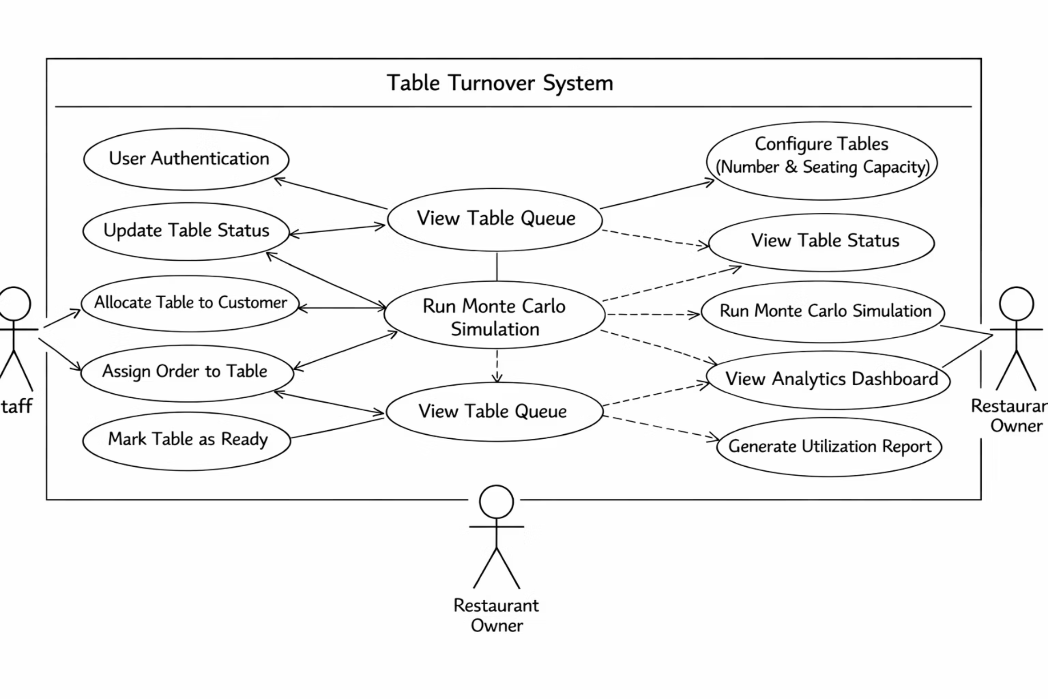
Architecture diagram

Slide 9
Functional & Non-functional Requirements
Functional
Non-functional:
User Authentication
Performance
The system should allow users to log in securely, differentiate between Staff and Restaurant Owner access.
The system should respond quickly to status updates. Simulation results should be generated within acceptable time limits.
Table Configuration
Usability
The system should allow the owner to configure the number of tables, store seating capacity for each table.
The system interface should be simple and user-friendly. The dashboard should be easy to understand for non-technical users.
Table Status Management
Reliability
The system should update table status (Occupied, Cleaning, Ready, Available), allow staff to allocate tables to customers, should allow staff to mark tables as ready after cleaning.
The system should accurately update table status without errors. The system should handle peak-hour data without crashing.
Order Assignment
Security
The system should allow staff to assign orders to specific tables.
Only authorized users should access the system. Login credentials should be protected.
Monte Carlo Simulation
Scalability
The system should simulate random customer arrivals and dining duration, estimate expected waiting time, calculate table utilization rate.
The system should support increasing number of tables. The system should handle high customer traffic scenarios.
Analytics & Reporting
Maintainability
The system should display peak hour analysis, generate utilization reports, provide real-time dashboard insights for the owner.
The system should be easy to update and modify.
Code structure should allow future enhancements.

Slide 10
Hardware & Software Requirements
Hardware
Software Requirements
No specific hardware requirements beyond a standard modern computer.
Operating System: Windows / macOS
Frontend: HTML, CSS, JavaScript
Backend : Python (FastAPI)
Browser: Google Chrome or any modern browser
Database: PostGRE

