Slide 1
canvaShare
Ryan Frappier
Austin Frandsen
Travis Banks

Slide 2

What is it?
A virtual whiteboard. The application provides various tools for drawing and communicating.

Slide 3
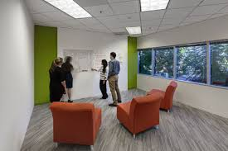
What is its goal?
The goal of canvaShare is to emulate in-person collaboration on a white board with software

Slide 4



Tools and Libraries
Libraries
SDL2
SDL2_gfx
SDL_net version 2.0

Slide 5
Features
Shape tools
Circle, Rectangle, Triangle
Free draw tools
Paintbrush, pencil
Eraser tool
Textbox tool
Undo & Redo
Export
Multiple page support
Local File-based login system
Custom GUI

