Slide 1
Working with the new AEM Assets View

Slide 2

Introductions!
- Name
- Role
- Where are you?

Slide 3
Legal and Confidentiality Information
© 2025 Adobe, Inc. All rights reserved.
Every effort was made to ensure that the information in this document was complete and accurate at the time of publication. However, information is subject to change and Adobe cannot assume responsibility for any errors or omissions. Changes or corrections to the information contained in this document may be incorporated in future issues.
This copyrighted document along with other materials for this course may not be recorded, reproduced, duplicated, reverse engineered, or adapted.
Training is intended only for those individuals who have registered and paid for it; training access URLs, user names and passwords, or access of any kind may not be shared.
This document and other materials for this course are Adobe confidential and proprietary information which must be retained in confidence by the recipient.
Notes:
(Before we dive in, please note the important legal information presented here. Don’t need to read through everything andyoou will get a copy of the presentation with this, however there are some points to call out
The content we'll cover is intended only for those enrolled in this training - so you!
Please do not record, reproduce, or share this material, including any URLs or account information.
Adobe makes every effort to provide accurate and up-to-date content, but always refer to the latest official documentation for any updates - Assets View is moving fast and it is very difficult for everyone - us included, to keep up.
Let's ensure we respect these guidelines throughout the course.

Slide 4
This Course –What you’ll Learn
Understand the different Assets user interfaces
Use the Assets View UI
Understand metadata use and configuration in Assets View and its role in search
Use Assets View productivity tools
Create dynamic images with Dynamic Media Templates
Notes:
CLICK
Understand the different Assets user interfaces
CLICK
Use the Assets View UI
CLICK
Understand metadata is Assets View and its role in search
CLICK
Use Assets View productivity tools and insights
CLICK
Use Dynamic Media Templates

Slide 5

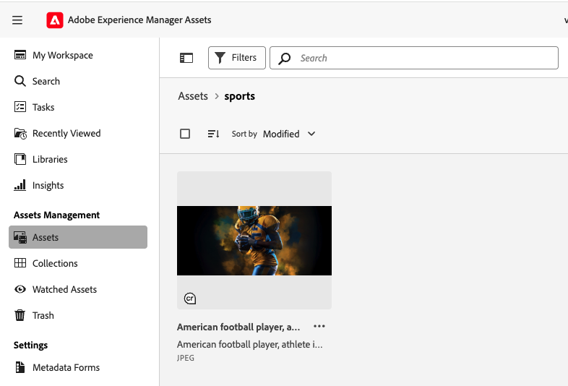
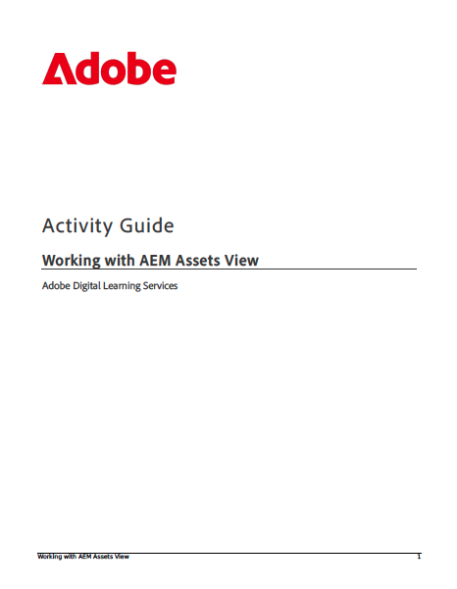

… and how you’ll learn it
Slides Demo Hands-on
Notes:
The course is roughly half teaching and half hands-on exercises
In each section, I’ll use slides to explain functions and features, then we’ll do a hands-on exercise to try these out in practice. Explain
Questions slides

Slide 6
Course Agenda
Module | Name
Intro | A flight over the assets landscape
1 | UI Foundations
2 | Metadata and Search
3 | Productivity Features
4 | Dynamic Media Templates
 | Takeaways and Questions

Slide 7
A flight over the Assets landscape
Notes:
We’ll start by looking at the primary interfaces for managing Assets in Experience Manager, and their naming: we have Assets Essentials, Assets View and Admin View.

Slide 8
The Assets View / Assets Essentials UI
Experience Manager Assets - Assets View
Experience Manager Assets Essentials
Notes:
These two products — Adobe Experience Manager Assets, where one interface is called Assets View, and Adobe Experience Manager Assets Essentials — are particularly confusing, so I’ll start by clarifying what they are and what the difference is.
Both are Adobe digital asset management products, and they use the same modern, cloud-based user interface, which you can see on this slide. From a user interface perspective, they look identical.
As a result, it’s easy to assume that the two are the same product — but that is not the case.
The key point is that the user interface is the same, but the underlying system it connects to is different.
In one case, the UI is accessing a full AEM Assets backend.
In the other, it’s accessing an AEM Assets Essentials backend — and these are very different in terms of scope and capabilities.
If both are available within an organisation, and I as a user have access to both, then when I open the Assets UI, I choose which system or repository I want to work in — Assets Essentials or full AEM Assets.
The next two slides explain that difference. And here, it’s important to think about the context and scope of the solution, not what the user interface looks like.

Slide 9
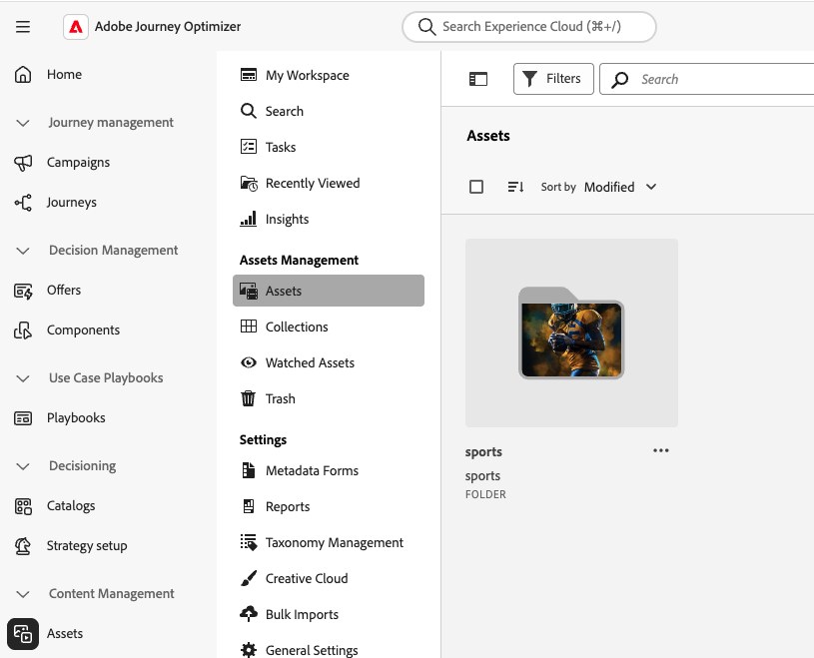
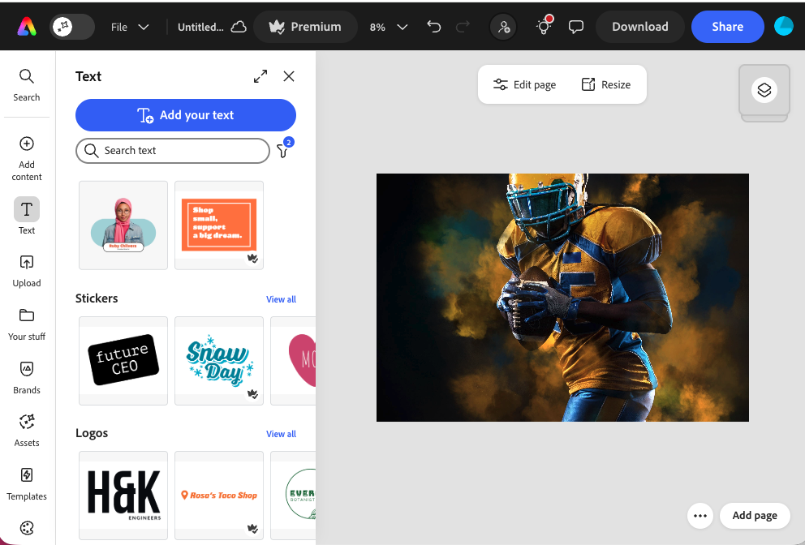
Assets Essentials - a Lightweight DAM for the Adobe Ecosystem
Assets Essentials
Journey Optimiser
Express
Notes:
Let’s first look at Assets Essentials - it’s a lightweight DAM for Adobe solutions.
What you’re seeing in the middle of this slide is a screenshot of the Assets Essentials UI.
As I mentioned this looks identical to Assets View in full AEM Assets.
Where Assets Essentials differs is not the UI — it’s the sophistication and flexibility of the underlying assets system, and the context it lives in.
Assets Essentials is typically used as a central asset service for Adobe solutions, for example the slide shows a section of the Assets UI used in Express on the lower left of the slide, and, on the lower right, the full Assets Essentials UI embedded in Journey Optimiser. Here it could be used for managing assets for marketing campaigns.
Assets can be stored in Assets Essentials and then consumed by other Adobe tools where no significant management process is needed, just a simple asset manager.
In this kind of setup, the DAM, Assets Essentials, supports just these Adobe tools, rather than acting as the centre of a large enterprise asset management architecture.

Slide 10
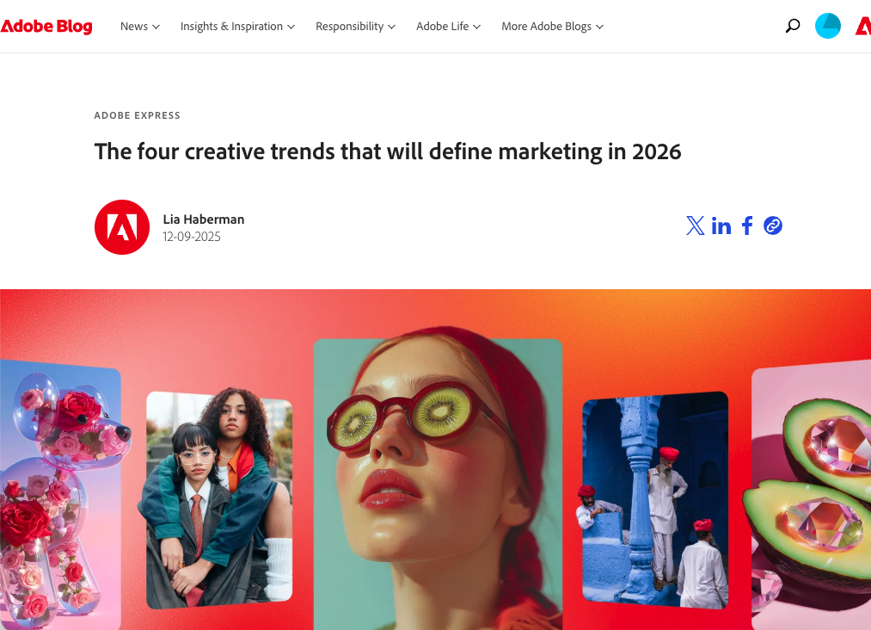
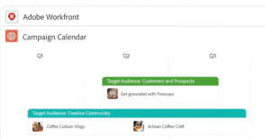
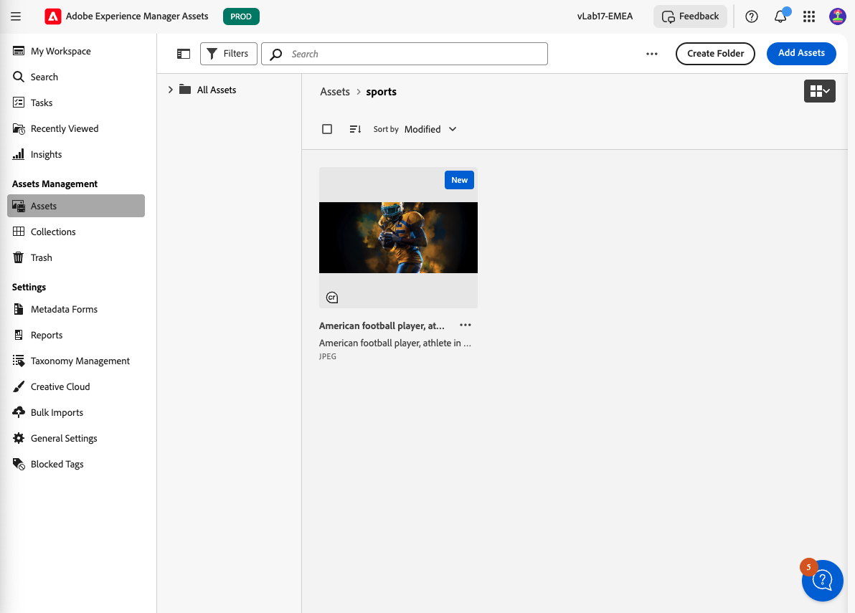
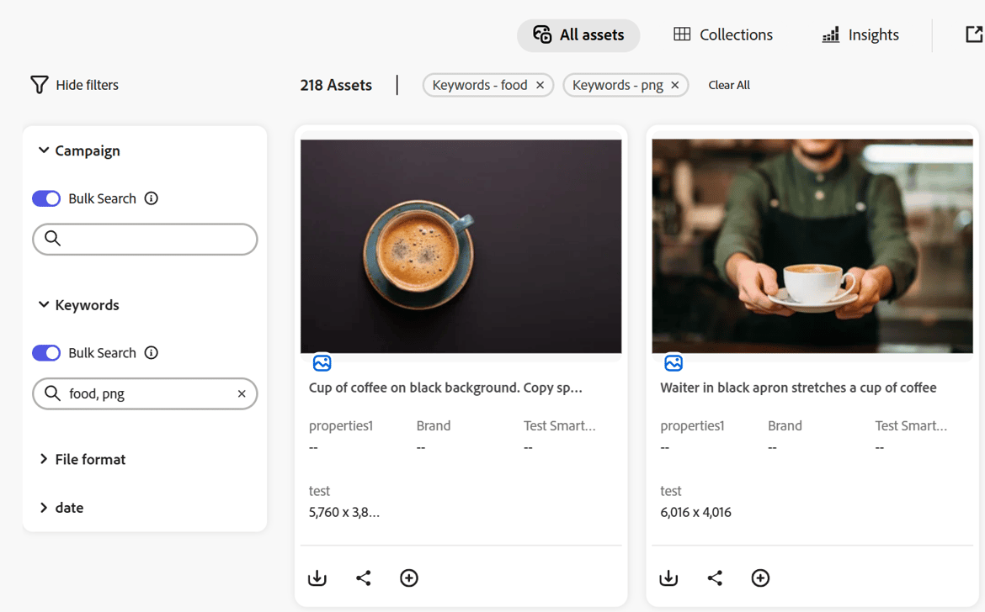
Assets (Assets View and Admin View) - Enterprise DAM
Workfront
Dynamic Media
Customisation
Asset consumer systems
API
Asset sources
ContentHub
Advanced processing
Notes:
Now let’s look at what a full AEM Assets system does. And here the same user interface is used to access a much more sophisticated underlying system.
This slide is deliberately busy — and that’s the point.
In full Adobe Experience Manager Assets, the DAM is not just supporting one tool or one team.
It sits at the centre of a complex enterprise ecosystem.
TALK THROUGH
This is where you see capabilities that simply don’t exist in Assets Essentials:
advanced processing, Dynamic Media, deep customization, enterprise APIs, and complex integrations.
To complicate matters further, the Assets View UI is actually not sufficient to manage all of this yet and we do still need the traditional AEM Touch UI to manage this complexity, under the name Admin View.
Assets View for everyday work, Admin View for configuration.
___ Now, one important practical warning — and this confuses a lot of people, including me until I worked on this course.
A lot of documentation that is labelled Assets Essentials is actually 100% valid for Assets View in full AEM Assets — because the UI and user flows are the same.
Occasionally, the reverse is also true.
You might read Assets View documentation and realise it applies perfectly to Assets Essentials as well.
So when you read the docs, it’s important to ask:
Is this describing the UI, or is it describing the product context behind the UI? This overlap in documentation also applied to the training today. We are working with a full AEM Assets system, but most of what we do today will also be relevant to Assets Essentials.

Slide 11
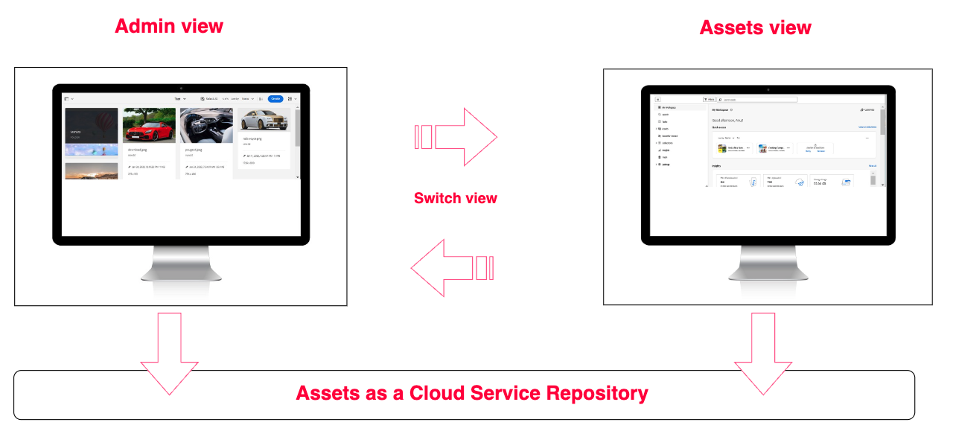
The two UIs of full AEM Assets - Admin View and Assets View
Notes:
As I mentioned, Assets View cannot yet fully manage an enterprise DAM, so full AEM Assets. We still need the touch UI so you effectively have two user experiences.
They are shown here
Admin View on the left is the old Touch UI, now used for administration and control: schemas, workflow models, deep permissions, bulk operations, reporting and governance.
Assets View on the right is designed for speed and usability: find, preview, download, share, light edits, collections, insights — the daily “asset work”.
The key point is that are not two separate assets systems. They’re two views on the same underlying DAM repository.
If you upload an asset in Assets View, you’ll see it in Admin View. If you configure something in Admin View, it affects what users experience in Assets View — although sometimes in different ways.
To decide which to use you can ask yourself “Am I doing work, or am I configuring the system?”. That won’t always work, particularly in heavily customised systems, but it’s a good guide.
A last point on the slide - switch view. We use this function to move between the two views. You will see this in action in the exercises.

Slide 12



Quick Facts – Assets View
More modern, responsive UI
Shared between environments (select repository from available environments)
AEMaaCS only
Fewer configuration and customization options than Admin View.
Notes:
A few quick facts about Assets View
CLICK It was introduced in 2024, so it’s modern and responsive — it’s designed to feel like a contemporary web app, not a classic admin console.
CLICK
It’s also shared across environments. In practice, that means you can select repositories from available environments — useful Ito those in roles that touch dev, stage, and prod, or your organisation uses both AEM Assets and AEM Assets Essentials, as I described earlier.
CLICK
It’s Cloud Service only — so if someone is on AMS or on-prem, Assets View won’t be there in the same way.
CLICK
And: it’s currently less configurable than Admin View. That’s a trade-off: fewer deep customisations, but a more consistent and user-friendly experience.
So the message is: Assets View is where day-to-day work becomes faster — but deep admin power is still in Admin View.

Slide 13
Questions?
Image by Ran Zheng
Notes:
TALK
Any final questions?

Slide 14
Module 1
UI Foundations
Notes:
We’re moving into UI foundations. I’ll keep this tight — we’ll run through the basics of the UI, then you’ll learn most by getting hands-on

Slide 15

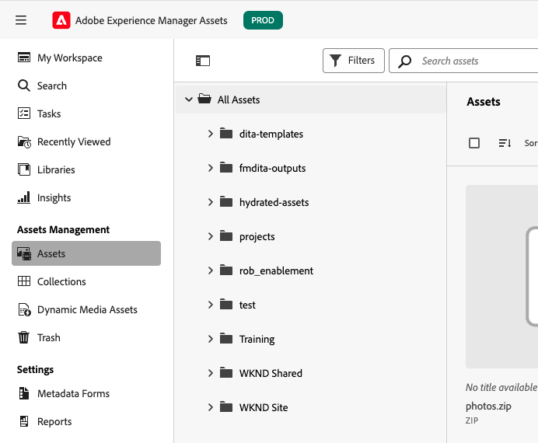
Use Assets View when…
Work in a marketer-friendly interface
Quickly find, annotate, download, collect, and share assets
Leverage workspace insights, pinning, and notifications
Use smart crop and DM renditions (for configured assets)
Using new Dynamic Media templates
Notes:
Use Assets View when
- you want a marketer-friendly interface that makes collaboration, searching, and gaining insights simple.
- you need to quickly find, annotate, download, collect, and share assets—without extra steps.
- Take advantage of workspace insights, pinning, and notification features to stay organized and informed.
- And if your asset workflow includes smart crop or Dynamic Media previews, you’ll find these built right in and easily accessible.
- Using the new editor for dynamic media templates - don’t worry if you haven’t heard of these - we will see them in the course

Slide 16
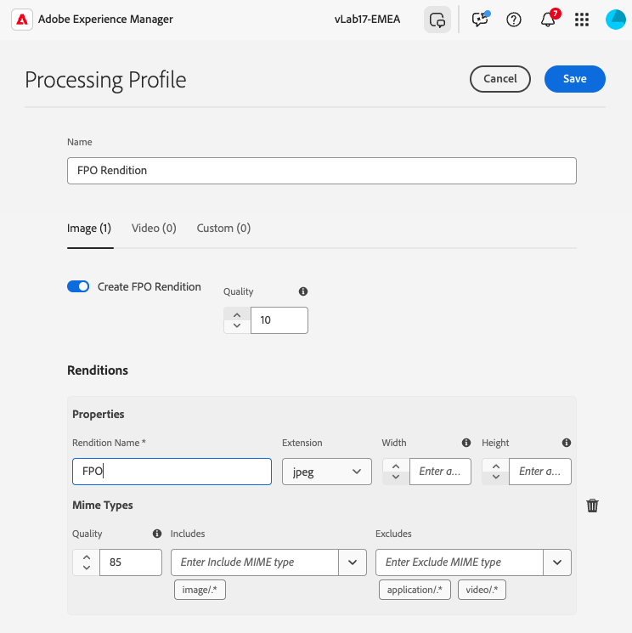
Use Admin View when….
Configuring advanced DAM settings
Performing bulk operations like metadata import/export
Building or controlling custom workflows and workflow models
Generating comprehensive asset and system reports
Notes:
Let’s look at when you’ll need to rely on Admin View.
CLICK
If you’re configuring advanced digital asset management settings—like Dynamic Media processing, complex metadata schemas, or handling complex processing profiles and custom renditions—Admin View is required.
CLICK
It’s your go-to for bulk operations, such as importing and exporting large sets of metadata, or…..
CLICK
For building and maintaining custom workflows, or for complex workflow models that support your business automation, Admin View offers the necessary tools and flexibility.
CLICK
And when you need to generate comprehensive reports on asset activities or system status, these capabilities are part of Admin View.
__________
In short, whenever your work calls for deep administrative control, technical configuration, or advanced integration, Admin View remains essential—even as Assets View takes on a more central role for day-to-day tasks.

Slide 17
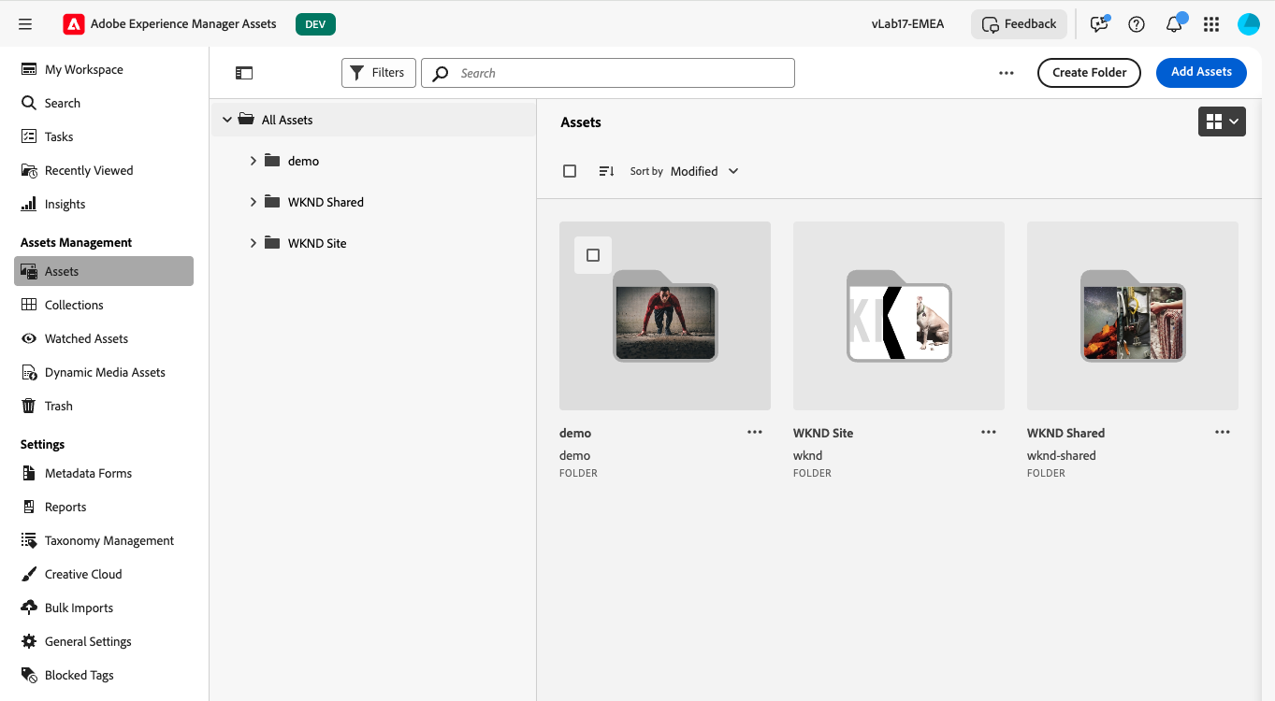
Assets View UI Intro
Notes:
Talk through.
Note: Toggles (menu, view, content tree) AI Assistant notifications Switch View

Slide 18
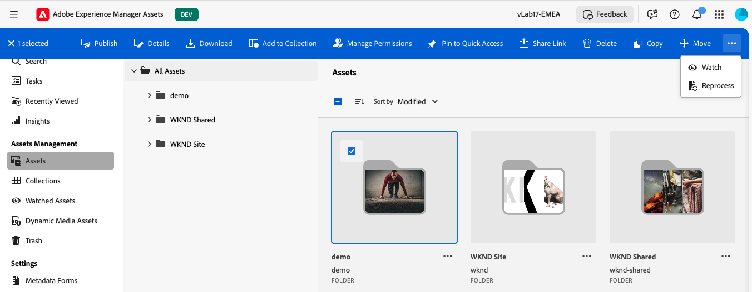
Assets View UI Intro 2

Slide 19
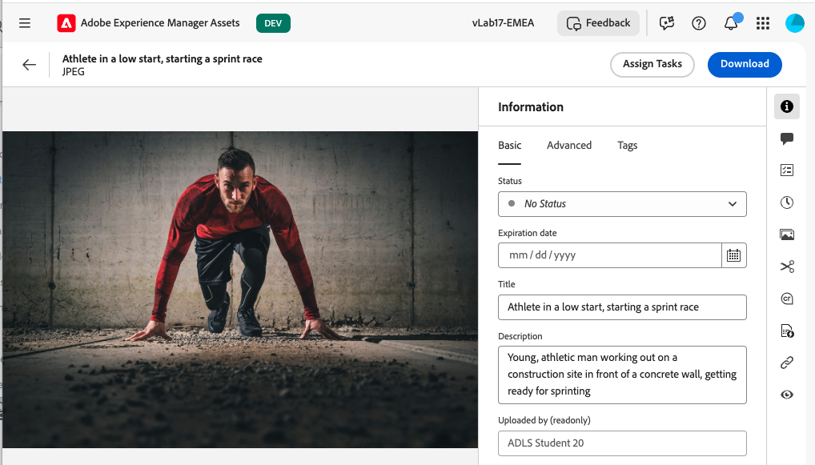
Assets View UI Intro - Details

Slide 20
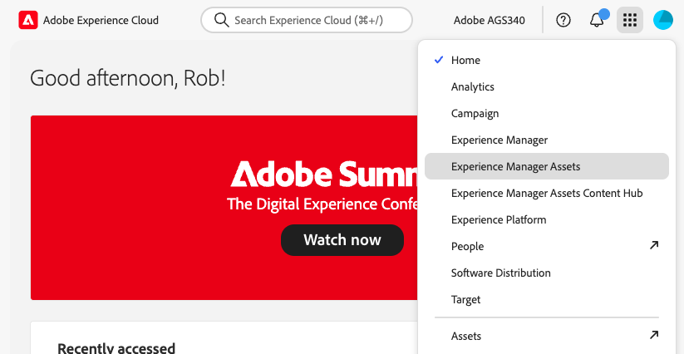
Navigate to Assets View
-> Asset View
Legacy - don’t use

Slide 21
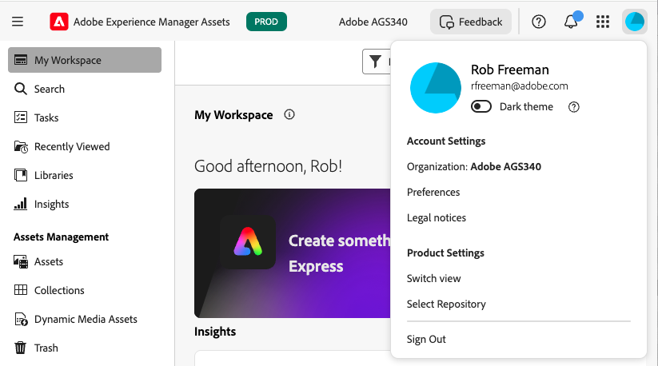
Switch between Admin and Assets View
To Admin View (and back)
Dev/stage/prod/preview

Slide 22
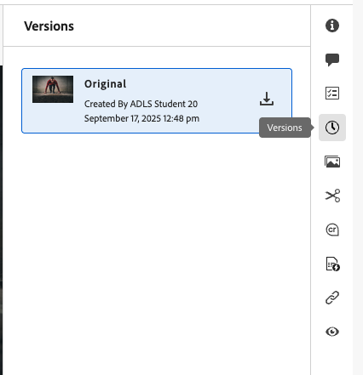
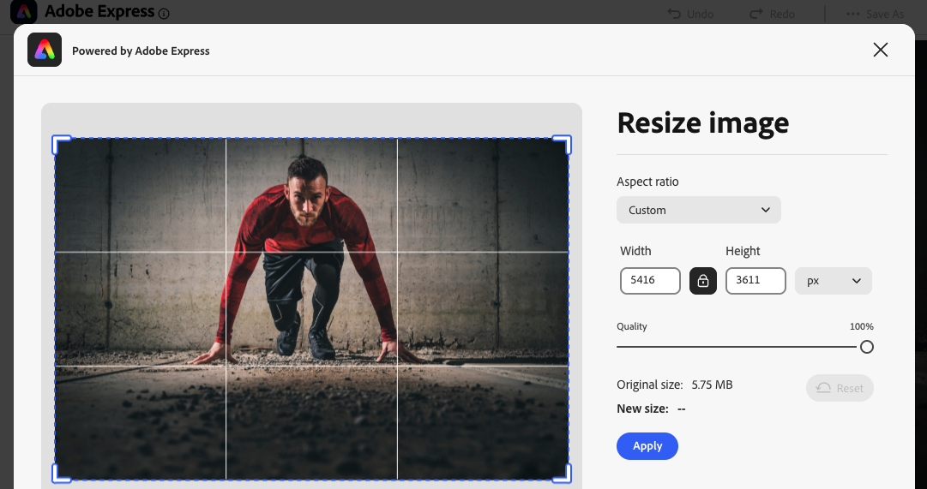
Activity 1.1 – The Fundamentals
Login
Navigate to Assets View
Create folder
Upload
Edit and save version
Revert
Switch View stop at bottom of page 8!

Slide 23
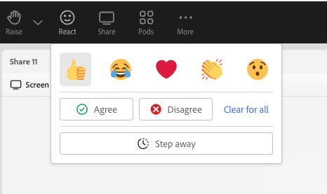
I am working!
“I am doing the exercise”

Slide 24
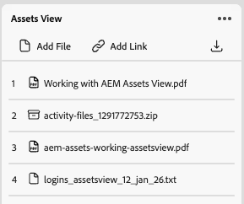
Getting started
Activity guide
Activity files (test images)
Your login details
Open experience.adobe.com and login with student login from files
Check you are in VLab17-emea
Don’t add a secondary email address or phone number (if asked)
Navigate to Experience Manager Assets

Slide 25
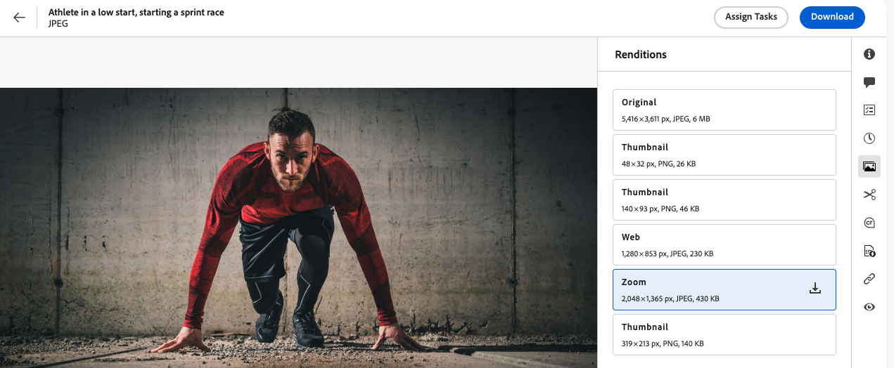
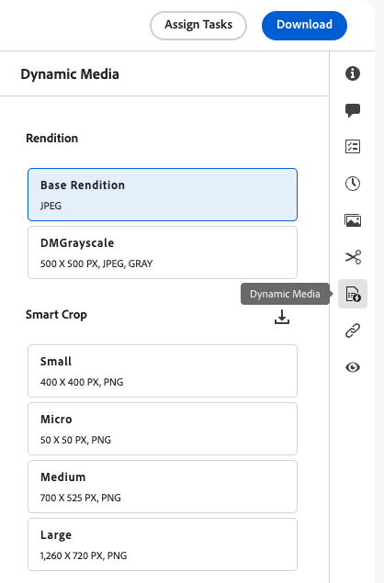
Renditions - Static, Dynamic and Smart Crops
Notes:
Renditions are one of those topics that seem simple… until you have to explain them to someone else.
A practical way to think about renditions is: “different usable versions of the same asset.” The available renditions are the same in both Admin View and Assets View.
(Click) we access the first type of renditions - static renditions, via the asset details panel as shown
Static renditions are produced during image processing. They’re predictable, file-like and stored in the assets repository
(Click) Dynamic Renditions are accessed in the same way, but via their own icon, only visible if Dynamic Media is available
These are generated on the fly based on URL parameters. The asset remains the same, but delivery adapts it. These renditions are not stored in the repository.
(click)
And smart crops are a specific kind of “intelligent delivery”: rather than manually cropping for every placement, the system generates crops based on key subject framing. —-
Why this matters: in enterprise environments, renditions are a major lever for scale. Instead of making 10 variants manually, you manage one asset and deliver many variants properly.

Slide 26
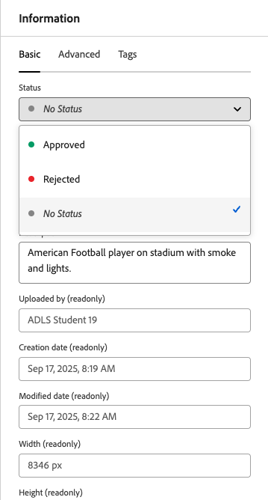
Approval and Publishing
Publishing activates assets for AEM Publish and (Scene7) Dynamic Media
Approval is enforced only for Content Hub & Dynamic Media Open API delivery (new delivery channels)
Publish = visibility, copy to publish instance / DM Approve = governance for new delivery channels
Notes:
This slide is about avoiding a common misunderstanding: “publish” and “approve” are not the same thing.
Click
Publishing is about pushing assets available to delivery targets — normally AEM Publish and Dynamic Media servers, although AEM’s publish mechanism can be extended to include other destinations. It’s about distribution.
Click
Approval is more about governance — particularly for newer delivery channels and controlled distribution. An approval action doesn’t copy the asset anywhere but instead mark is as ready for use.
Click
The way I’d summarise it is:
Publish is “send the image to a another, public system”
Approve is “it’s ready to be used in governed channels.”
While approval is a new concept in Assets, and immediately visible in asset details, but we can also approve in Admin View, but it’s somewhat hidden compared.

Slide 27
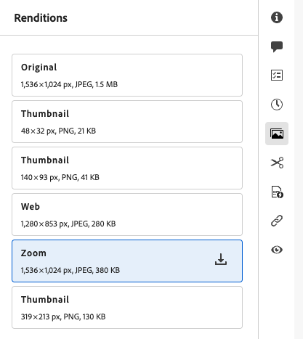
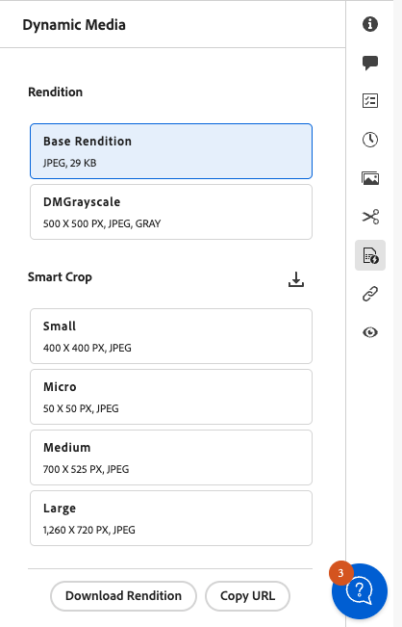
Activity 1.2 – Renditions, Publish, Delete
View static renditions
View dynamic renditions and smart crops
Publish
Review published renditions
Delete and restore
Stop at end of page 14

Slide 28
User Interface Foundations - Questions?
Image by Ran Zheng
Notes:
TALK
Any final questions?

Slide 29
Module 2
Metadata and Search
Notes:
Next we move to metadata and search
If you come from traditional folder-first DAM habits, there is a shift in mindset here.

Slide 30
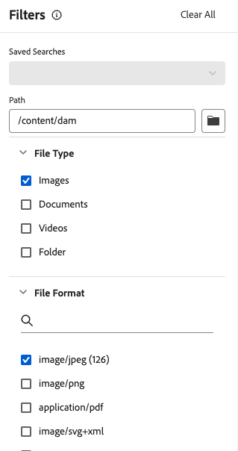
Search first: Metadata instead of Folder structure
Search bar and filters always visible
Metadata drives all results
Folder navigation is secondary
AI and Smart Tags need metadata
Scales with fast asset discovery
Find by describing, not by remembering locations
Notes:
In Assets View, search and metadata filtering are the primary ways to discover assets.
Instead of relying on complicated folder structures, users start by entering keywords or applying filters — so search enabled by metadata is front and center in every workflow.
CLICK
The search bar and filters are therefore always visible—it’s the main way users interact with assets.
CLICK
Asset metadata like titles, tags, dates, and usage rights drive the results, ensuring you get what you need quickly.
CLICK
Browsing folders is still possible, but it’s secondary; the interface encourages searching instead of clicking through folders.
CLICK
Features like Smart Tags and AI-powered visual search work best when assets have rich metadata.
CLICK
A meta-data first approach is scalable. Using a folder structure to organize assets has practical limits in organizing large number of assets.
CLICK
You don’t need to remember where a file lives—just describe what you need, and let the metadata guide you.
Summary:
Assets View is “search-first” because search isn’t just powerful—it’s the main method of finding, organizing, and working with assets. Metadata is the foundation, and search is the entryway.

Slide 31
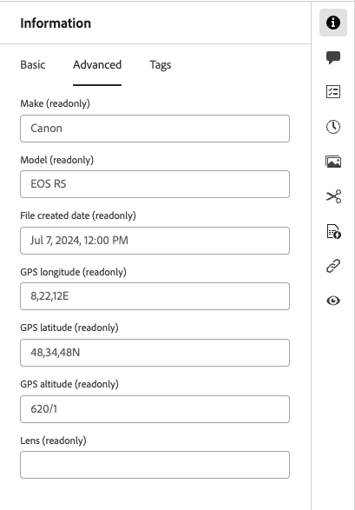
Exercise 2.1: Access Metadata
View metadata
Compare with local metadata view Stop at end of page 16!

Slide 32
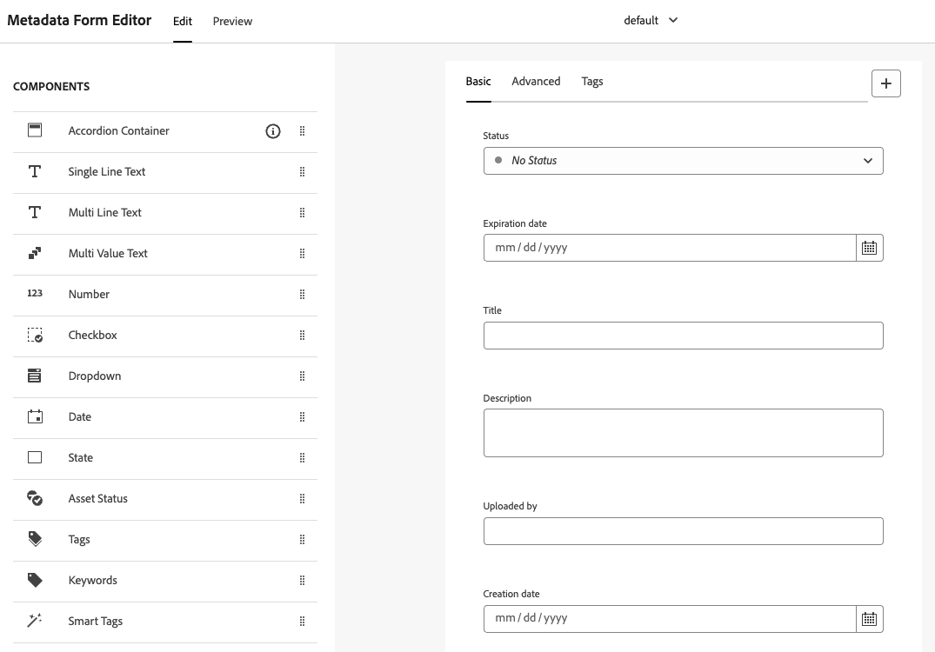
Assets View: Metadata Forms
Controls fields on Asset Details page
Assign by MIME type or folder
Limited layout & validation options
Notes:
Metadata forms are where many people get confused, so let’s make it simple.
In the last exercise you saw a subset of the metadata that was available on your test image. This is because a Metadata Form was used to filter what you saw to a sensible, relevant set of metadata.
In Assets View, metadata forms control what fields users see on the asset details page.
They are easy to set up in a visual editor, and they’re often “good enough” for business users.
But here’s the key principle: forms are UI configuration, not “the definition of metadata”.
The underlying metadata exists in the repository regardless of which fields you choose to display.
Forms can be assigned by MIME type or by folder. That’s actually quite powerful: you can tailor the user experience to the asset type or to the business area without changing the underlying asset model.
Also note the trade-off: Assets View forms have limited layout and validation compared to deep schema customisation in Admin View — again by design, to keep it simpler.

Slide 33
MIME Type - Examples
File type (common name) | type/subtype
JPEG image | image/jpeg
PNG image | image/png
SVG image | image/svg+xml
PDF document | application/pdf
Word document (DOCX) | application/vnd.openxmlformats-officedocument.wordprocessingml.document
PowerPoint (PPTX) | application/vnd.openxmlformats-officedocument.presentationml.presentation
ZIP archive | application/zip
MP4 video | video/mp4
Notes:
MIME types sound technical, but they’re basically just “file type identifiers” that systems agree on.
Here we see a list of different types for some of the files we can manage in Assets. Note the highlighted image and application - these are the types, and the sublimes are often similar to the file extension, so image/jpeg for example.
Take a moment to look through the list and understand types and subtypes.
The practical relevance here is: MIME type is what Assets View can use to decide which metadata form to apply.
So images might show one set of fields, PDFs another, videos another.
That’s why people sometimes say, “Why do I see different metadata fields and tabs?” — it’s often because the UI is using different forms per type.
We don’t need to memorise the MIME type strings. We just need to understand the mechanism.

Slide 34
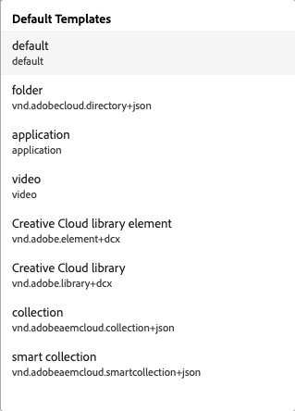
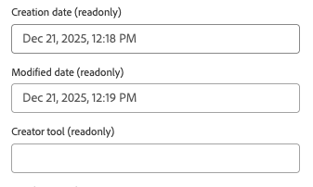
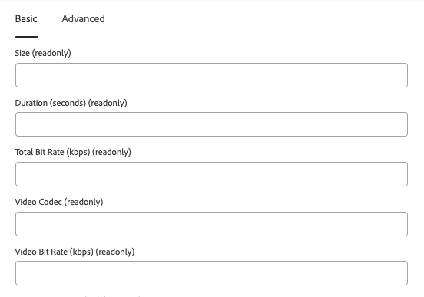
Adobe-provided Forms (used as templates)
Example MIME Type
Available forms
Example form contents
image/png
application/pdf
video/mp4
Notes:
Adobe provides starter forms for common types — think of these as templates, not as “the one true form.”
These starter form types are shown in the column in the middle of the slide - the available forms.
Two examples are shown for the forms for the types application and video - you can see why different metadata is needed by looking at the two screenshots of the form fields.
In a real project, the best practice is usually: start with Adobe’s default, then make small, intentional changes based on your business needs.
The risk is trying to expose everything — that creates metadata fatigue. Users stop filling fields because the UI feels like a tax form.
The goal is: expose the fields that actually help discovery, governance, and reuse. Hide the noise.

Slide 35
Exercise 2.2: Apply Metadata Forms
Create a custom form to include access to photoshop:city
Apply form to our folders
Understand effect on MIME types
Challenge: Mixed MIME types and Metadata Forms Stop at the end of page 19!

Slide 36
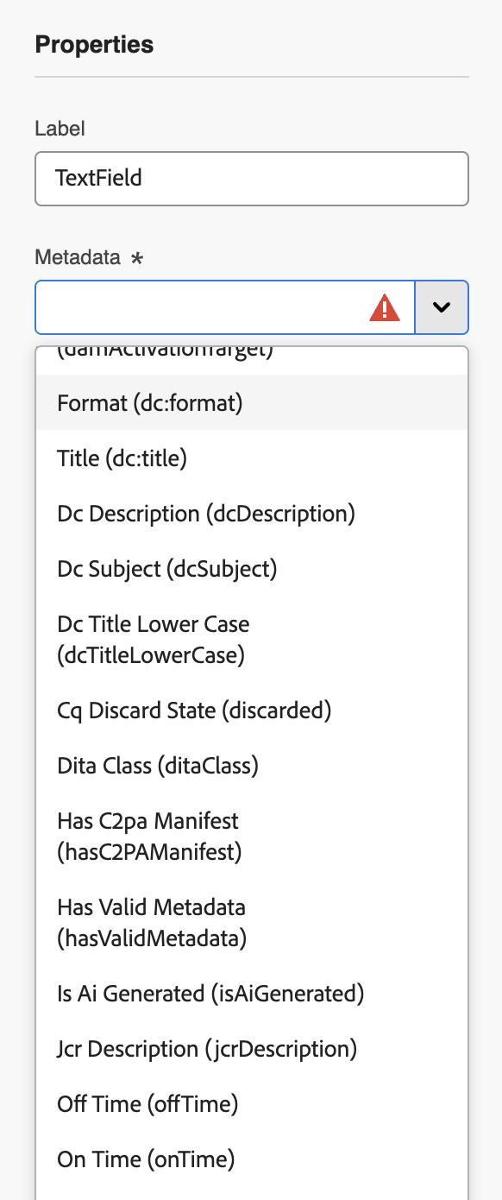
Search Capabilities – Assets View
Assets View search supports powerful features such as fuzzy search, boolean search, proximity, wild card, and suggestions.
Assets View supports contextual search: natural language input;
E.g., “images of mountains uploaded in the last month”
Assets View uses AI for ranking results
Aim: search by description, not file structure
Notes:
Assets View provides a rich set of search capabilities for everyday users.
click Beyond simple keyword lookups, it supports fuzzy search, Boolean logic, proximity queries, and wildcards. This means that typos, variations in spelling, and more complex combinations of terms can still return meaningful results. Suggestions also help guide users toward common or likely matches as they type.
click
A newer capability in Assets View is contextual search, where natural language input is translated into filters and search criteria automatically.
Click
For instance, a query such as “images of mountains uploaded in the last month” will create the appropriate search filters without the user needing to build a structured query.
Click Assets View AI to rank results Click
Most importantly the underlying aim of the AI involvement and the highly visible search field - we’ll see in a moment - search by description is encouraged, and file system structure is secondary

Slide 37
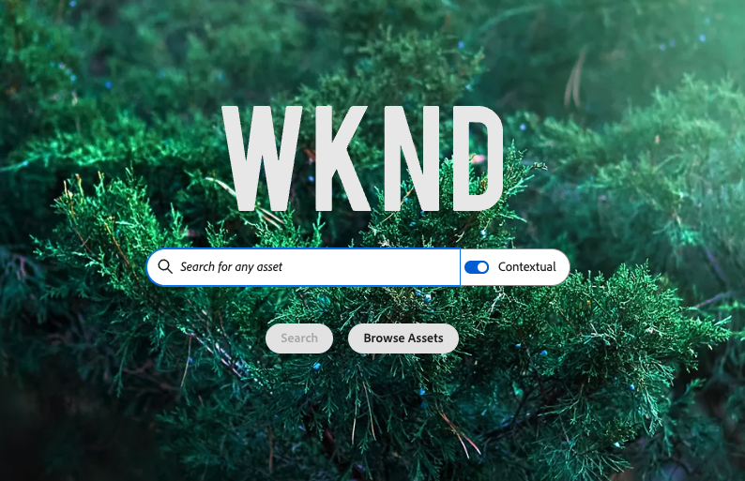
UI - Contextual Search
Notes:
Contextual search is worth showing because it changes how non-technical users behave.
DESCRIBE SCREENSHOT
Instead of building filters manually, users type a natural phrase — and the system converts it into filters.
The “aha moment” is when people realise: “I can search like I speak.”
But there’s an important expectation setting: it’s not magic. Results are still driven by metadata and what the system can infer.
So if your metadata is weak, contextual search will feel inconsistent.
Note that at present you are using the contextual search to create filters for you. This is not a way of asking an AI to consider the actual image assets, but only their filterable metadata. So a search for something like “a mountain in the middle with a lake at the bottom” might product mountains and lakes, but the relative position won’t work unless that phrase is part of the description

Slide 38
Exercise 2.3: Explore Search Features
Access search settings
Understand search filter configuration
Test drive contextual search
Challenge: Where is a result stored?

Slide 39
Metadata and Search Summary
Assets View uses Metadata Forms to configure the metadata in the information panel
Forms are UI filters, not definitions of data stores
Same metadata exists in the repository regardless of UI (Assets View / Admin View)
Assets View promotes metadata / search first
Find by description!
Notes:
Let’s lock the principles in before we move on.
Assets View uses metadata forms to control what appears in the details UI.
Forms are not data model definitions — they’re display filters.
The same underlying metadata exists regardless of whether you view it in Assets View or Admin View.
Assets View pushes you toward metadata-first working: search and filters first, folders second.
That’s the future-proof operating model, especially as the repository grows and teams change.
So the takeaway is simple:
if you want fast discovery and reuse, invest in metadata and teach people to search by description.

Slide 40
Metadata and Search Questions?
Image by Ran Zheng
Notes:
TALK
Any final questions?

Slide 41
Module 3
Productivity Features
Notes:
Next: productivity features.
This is the part where Assets View feels like a modern work app — not just a DAM interface.

Slide 42
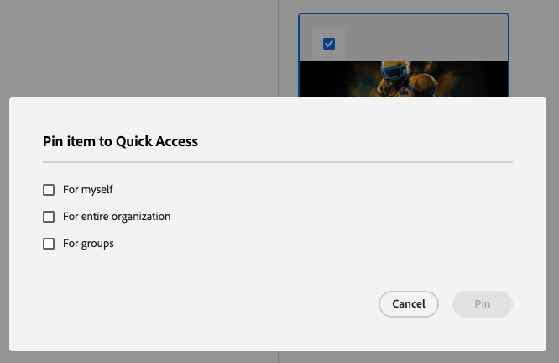
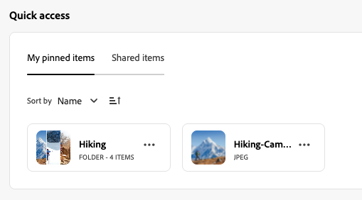
Quick Access
Pin / unpin Assets, Folders, Collections
Pin for:
you
your organisation (admin / power user)
groups (admin / power user)
“Shared” not related to “Share Link”
Notes:
Quick Access is basically your “working set.”
You can pin assets, folders, and collections so they’re always one click away.
DESCRIBE SCREENSHOTS
Two things to clarify:
First, you can pin for yourself, and admins can pin for groups or the whole org — so it can also be used as lightweight “recommended places to work.”
Second, “Shared” here is not the same as “share a link.” It’s more like “visible to others in the organisation” depending on how it’s configured.
The real value is speed: people stop navigating the same folder paths every day.

Slide 43
Exercise 3.1: Quick Access
Add folders and assets to Quick Access
Up to end of page 24

Slide 44
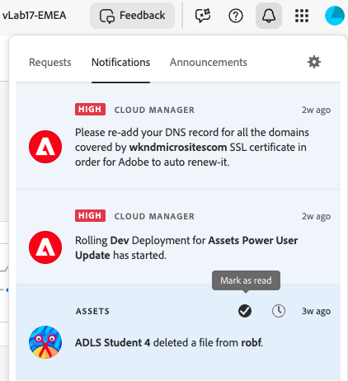
Notifications
Access notifications
Integrated with Experience Cloud notifications
Configurable:
In-app, email, integrations
Popup
Priorities
“Watch” to add Assets View notifications
Preferences
Product
Notes:
Notifications are integrated with Experience Cloud notifications, so they feel consistent across Adobe products.
The screenshot therefore shows the Experience Cloud notifications panel. You can see that a notification from Assets is mixed with, in this case, notifications about AEM technical issues from the Cloud Manager tool.
The main concept in Assets View is “watching” items — you watch an asset or folder, and then you get notified about relevant changes.
And because notifications can route to in-app, email, or integrations, it’s flexible — but we’ll keep configuration simple today. Let’s see that in action in an exercise

Slide 45
Exercise 3.2: Notifications
Watch items
Configure notifications

Slide 46
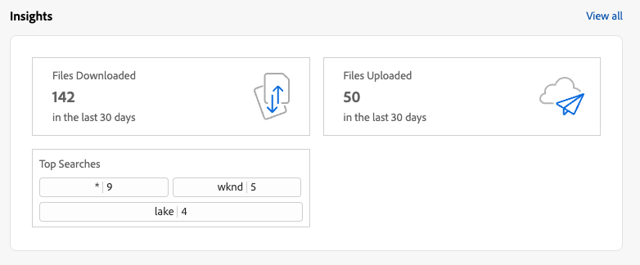
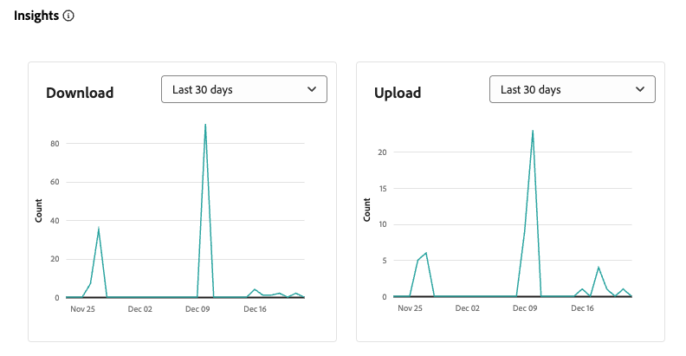
Insights
Simple analytics: Downloads, Uploads, Asset counts, Searches
Product scoped, i.e. no combined reporting of Asset interactions in Content Hub or other distribution channels.
No inclusion of activity via integrations, e.g. Edge Delivery Service assets integration
Notes:
Insights are lightweight analytics inside Assets View.
CLICK
Think of it as “operational visibility”: downloads, uploads, asset counts, and searches — enough to understand usage patterns without running a full reporting project.
Two key points
Insights are product-scoped — they don’t automatically unify interactions across Content Hub or external channels.
They don’t include everything that might happen through deep integrations.
So: useful for day-to-day understanding, not a replacement for enterprise BI.

Slide 47
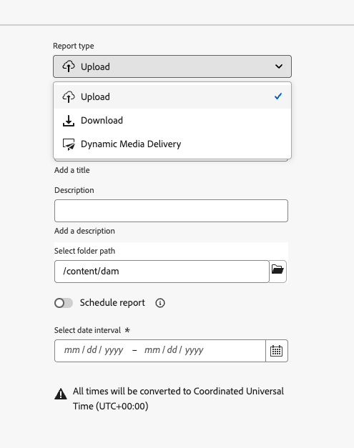
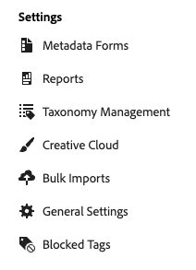

Reports
Three report types. Upload / download as expected
Dynamic Media shows any assets request using a Dynamic Media URL
Notes:
Reports are more “exportable” than insights.
You’ll usually use them when someone asks for a list, an audit, or a usage summary.
The Dynamic Media angle is important: Dynamic Media reporting can surface asset requests via DM URLs, which is often exactly what teams want when they’re trying to understand delivery usage.
Lets keep expectations realistic. Reports here are limited basic tools at present — not a full reporting platform.

Slide 48
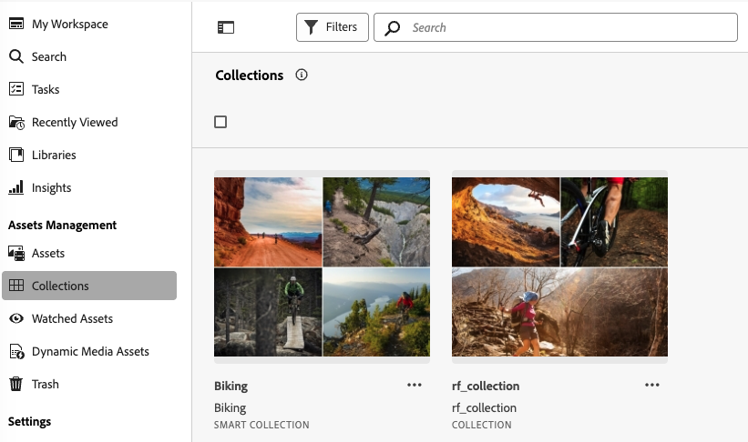
Collections
Virtual folders
Access control:
Public (visible to all)
Private (access controlled)
Type:
Manual
Smart
Same as Admin View collections
Types
Notes:
Collections are virtual folders — and they’re one of the best ways to work in a metadata-first model.
Instead of creating more and more folder structures, you create a collection that represents a purpose: “Campaign X”, “Approved hero images”, “Partner pack”, whatever.
Click
Collections can be public or private,. Private collections have a permissions dialog where you can grant access to the collection.
Click
There are two type - manual and smart. You select and manually add folders and assets to Manual Collections. Smart collections we’ll come to in the next slide
Click
The collections are essentially the same as in the Admin View and they do show in both interfaces
The important point is: collections reduce the pressure to create “perfect folder structures” — because they let you group assets in multiple ways without moving them.

Slide 49
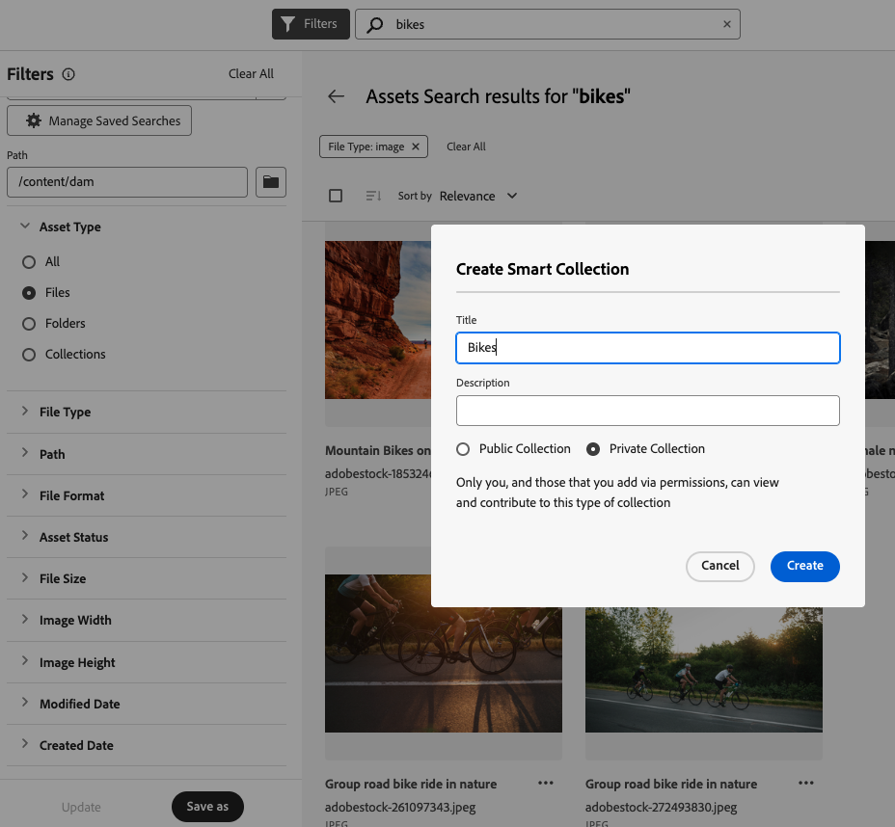

Smart Collections
Search then…
smart collection
Automatic addition of new assets
Public or private
Notes:
Smart collections are where collections get really powerful.
You run a search, then save it as a smart collection — and it stays up to date automatically.
DESCRIBE SCREENSHOT
So instead of manually maintaining a list, the system maintains it for you based on criteria like tags, metadata fields, dates, or other filters.
The trick is: keep the rules understandable.
Smart collections that only one person understands become fragile.
Smart collections that match business language become durable.

Slide 50
Exercise 3.3: Insights
Watch items
Configure notifications
Exercise 3.4: Collections
Create a static collect and add asset and folder
Investigate collection permissions
Challenge: create a Smart Collection and use Smart Tags.

Slide 51
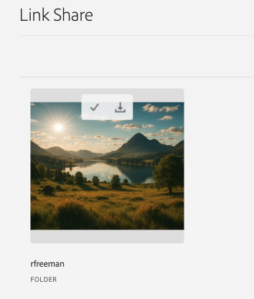
Link Share
Allow anonymous access to Assets and Folders
Time limited
Multi-select possible
Download directly or via Download Inbox
Notes:
Link Share is a very practical feature: it gives time-limited anonymous access to assets or folders.
This is often used for external sharing: agencies, partners, internal stakeholders without direct access.
The key controls are:
time limitation
multi-select
and download methods (direct or via download inbox, a mechanism to allow processing of multiple assets, followed by download)
In enterprise contexts, link sharing needs governance — because it’s very easy to overshare if teams treat it casually. So we’ll understand the feature.

Slide 52
Exercise 3.5 Link Share
Understand Link Share functionality

Slide 53
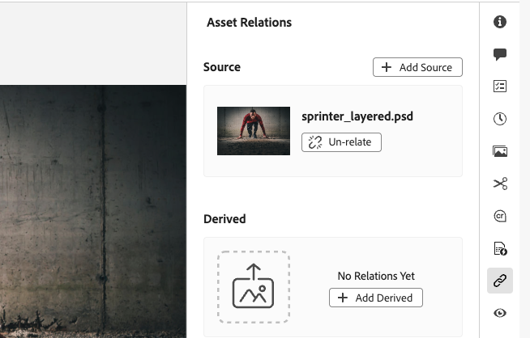
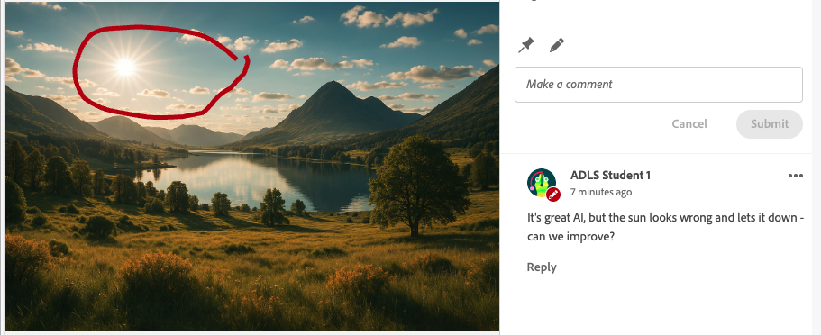
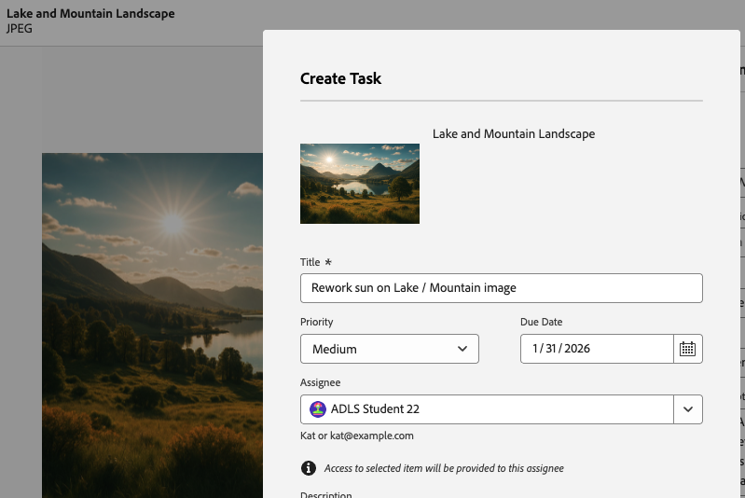
What else?
Annotations
Tasks
Relations
Creative Cloud integration and libraries
Notes:
This slide is basically: “there are more collaboration features, but we’re not covering them today.”
CLICK
Annotations can be useful, especially for lightweight collaborative work.
EXPLAIN SCREENSHOT
CLICK
Tasks allow you to assign a job to another user, so enabling simple project workflows.
The screenshot shows the creating of a task for Student 22 - reworking the sun to address the complaint that we saw in the annotations.
In a sophisticated enterprise DAM this is unlikely to be widely used, but for lightweight work in Assets Essentials, it may be useful.
CLICK
Relations are straightforward in Assets View and work the same way as in Admin View. They are a mechanism for associating one asset with another. A common example is the linking of an image to it’s source, as we see in the screenshot - the sprinter image has a relationship with the PSD source file.
CLICK
And finally, Creative Cloud integrations and Libraries are valuable and allow us to multiple Adobe Asset sources and solutions, but we’re leaving them out purely due to time. If you need that area, the right approach is: read the documentation and treat it as a separate enablement topic.

Slide 54
Productivity Features - Questions?
Image by Ran Zheng
Notes:
TALK
Any final questions?

Slide 55
Module 4
Dynamic Media Templates

Slide 56
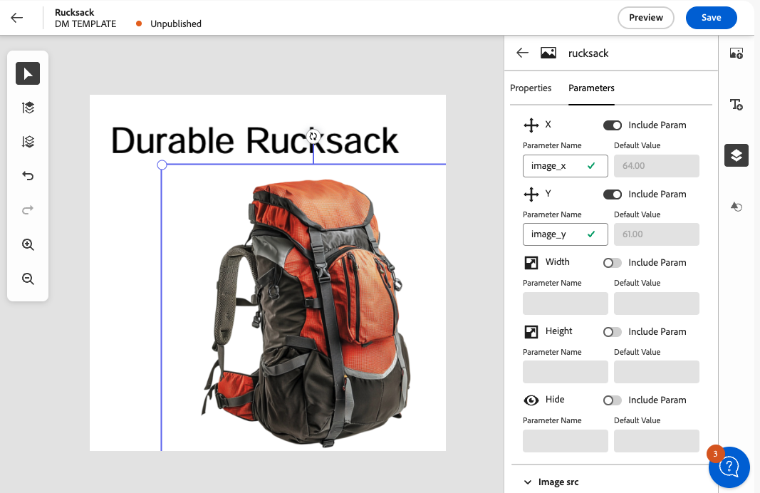
Dynamic Media Templates
Enable brand-consistent asset variations at scale
Templates link artwork with dynamic text, colors, or imagery
Users generate on-brand renditions without creative tools
Parameters controlled in AEM (no file editing required)
Streamlined for campaigns, regionalization, personalization
Notes:
We will though cover something that is a great feature of Assets and fun to experiment with - a bit more visual and exciting! Dynamic Media Templates are a capability that has been available in Dynamic Media for some years but it is made accessible and much easier to use in Assets View.
Templates allow organizations to scale creative output while maintaining brand consistency. A designer creates a master template once, linking certain elements—like text fields, colors, or image slots—to dynamic parameters.
Business users can then open the template in Assets View and generate their own on-brand variations. For example, a marketer can swap in new product shots, update a headline, or localize text for a region, all without touching Photoshop or Illustrator.
Because parameters are controlled in AEM, users can only edit what the designer intended. Fonts, layouts, and brand rules stay locked, so the output remains consistent while still supporting personalization and localization.
This dramatically reduces turnaround time for campaigns and ensures every asset variation stays on brand—at scale.
We won't go deeper in to templates today, and the takeaway for power users is just that the new feature is available in Assets View.

Slide 57
Exercise 4.1 Dynamic Media Templates
Get creative!

Slide 58
Dynamic Media Templates - Questions?
Image by Ran Zheng
Notes:
TALK
Any final questions?

Slide 59
Conclusion

Slide 60

The Future
“Assets View” is the future “Assets”
Customers recommended to adopt Assets View for future-proofing
New features likely to be only available in Assets View.
Admin View still supported and no sunset
Notes:
So where is this strange mix of admin and assets view going? Well…
Click
The future of assets is in Assets View, with ContentHub as the asset distribution portal.
Click
Where possible Adobe encourages customers to adopt Assets View for future-proofing.
Click
New features and innovations — such as natural language search, and the sophisticated _Dynamic Media Template_ editor — are launching exclusively in Assets View. Also admin and configuration features will be added to Assets View as we move towards feature parity. Click
Despite that, for the time being Admin View (Touch UI) is still essential and continues to be supported. There is no end of life date.

Slide 61
Key Course Takeaways
Assets View:
Is evolving rapidly
promotes metadata/search-first design, including AI search features
focuses on usability, speed, productivity and convenience for non-administrative tasks
Accesses the same underlying AEM repository as Admin view
is generally less customisable than Admin View
has the same UI as Assets Essentials, but is part of a full Enterprise DAM system
Notes:
Assets View:
CLICK
Is evolving rapidly
CLICK
promotes metadata/search-first design, including AI search features
CLICK
focuses on usability, speed, productivity and convenience for non-administrative tasks
CLICK
Accesses the same underlying AEM repository as Admin view
CLICK
is generally less customisable than Admin View
CLICK
has the same UI as Assets Essentials, but is part of a full Enterprise DAM system

Slide 62
Questions?
Image by Ran Zheng
Notes:
TALK
Any final questions?

Slide 63
Closer Slide

